Slide 1
SUSTAINABILITY GLOSSARY
A helpful reference for terms and phrases

Slide 2


General

Slide 3


GENERAL
SUSTAINABILITY
Everything that we need for our survival and well-being depends, either directly or indirectly, on our natural environment. To pursue sustainability is to create and maintain the conditions under which humans and nature can exist in productive harmony to support present and future generations.
PLANETARY BOUNDARIES
Environmental limits (e.g., the Earth’s limits) within which humanity can safely operate, now and for generations to come. Planetary boundaries guide a ‘safe operating space’ for humanity on planet Earth.
VALUE CHAIN
The complete set of a business’s activities in the creation of a product or service.
ESG
ESG stands for environmental, social, and governance and is a term primarily used by the investor and finance community.
SCIENCE-BASED TARGETS
Science-based targets show organizations how much and how quickly they need to reduce their greenhouse gas (GHG) emissions to prevent the worst effects of climate change. According to the Science Based Targets initiative (SBTi), emissions targets are “considered science-based if they are in line with what the latest climate science deems necessary to meet the goals of the Paris Agreement – limiting global warming to well-below 2°C above pre-industrial levels and pursuing efforts to limit warming to 1.5°C.”
CLIMATE CHANGE
Climate change is a long-term change in the average weather patterns that have come to define Earth’s local, regional and global climates.
CLIMATE CHANGE RESILIENCE
Reducing vulnerabilities to the impacts of climate change by incorporating climate risk into our business continuity plans.
HUMAN RIGHTS
Human rights are rights inherent to all human beings, regardless of race, sex, nationality, ethnicity, language, religion, or any other status. Human rights include the right to life and liberty, freedom from slavery and torture, freedom of opinion and expression, the right to work and education, and many more.
GLOBAL WARMING
The warming of the planet's overall temperature generally attributed to the greenhouse gas effect caused by increased levels of carbon dioxide, chlorofluorocarbons, and other pollutants.

Slide 4

Carbon & Energy

Slide 5
CARBON & ENERGY
GREENHOUSE GASES (GHG)
Gases in the Earth’s atmosphere that trap heat and make the planet warmer.
NET ZERO EMISSIONS
Achieving a balance between the greenhouse gasses put into the atmosphere and those taken out, or an elimination of emissions altogether. Net-zero emissions will be achieved when all greenhouse gas (GHG) emissions released by humans are counterbalanced by removing GHGs from the atmosphere in a process known as carbon removal. Human-caused emissions (such as those from fossil-fuelled transport and heating homes) should be reduced to as close to zero as possible. Any remaining GHGs should then be balanced with an equivalent amount of carbon removal. Reaching net-zero emissions is akin to achieving “climate neutrality.”
SCOPE 1
Emissions generated by direct operations, such as from our company-owned fleet or manufacturing facilities.
SCOPE 2
Emissions generated from the energy purchased for direct operations, such as any non-renewable electricity purchased from a utility company.
ENERGY EFFICIENCY
Energy efficiency is the use of less energy to perform the same task or produce the same result.
SCOPE 3
Emissions generated as a result of activities from assets not owned or controlled by the reporting organization, but that the organization indirectly affects in its value chain.
RENEWABLE ENERGY VS. GREEN ENERGY VS. CLEAN ENERGY
Renewable fuels include liquid and gaseous fuels and electricity derived from renewable biomass energy sources biomass energy sources.
RENEWABLE ELECTRICITY
Renewable energy comes from sources that are constantly and naturally renewed, such as wind power and solar energy. Green energy is often used interchangeably but even though it is sourced from natural resources, it is not always renewable. Clean energy comes from sources that do not pollute the atmosphere (unlike fossil fuels).
CARBON FOOTPRINT
A carbon footprint is the total greenhouse gas (GHG) emissions caused directly and indirectly by an individual, organization, event or product.

Slide 6
CARBON & ENERGY
CLEAN ELECTRICITY
Emissions generated from the energy purchased for direct operations, such as any non-renewable electricity purchased from a utility company.
RENEWABLE FUEL
Commonly referred to as green electricity or green energy, clean electricity also refers to electrical power generated by renewable energy sources, such as geothermal, rain, solar, tidal, waste and wind.

Slide 7

Nature & Agriculture

Slide 8
NATURE AND AGRICULTURE
REGENERATIVE AGRICULTURAL / PRACTICES
Practices that focus on improving soil health and better water management, promoting biodiversity and improving livelihoods of farming communities. Regenerative practices help to restore natural ecosystems by rebuilding organic matter, restoring biodiversity and sequestering carbon below the soil surface, which reduces overall CO2 emissions and increases water holding capacity.
DEFORESTATION
Deforestation is the purposeful clearing of forested land. Throughout history and into modern times, forests have been razed to make space for agriculture and animal grazing, and to obtain wood for fuel, manufacturing, and construction. Deforestation has greatly altered landscapes around
the world.
BIODIVERSITY
Biodiversity is all the different kinds of life you’ll find in one area—the variety of animals, plants, fungi, and even microorganisms that make up our natural world. Each work together in ecosystems, like an intricate web, to maintain balance and support life. Biodiversity supports everything in nature that we need to survive: food, clean water, medicine, and shelter.
NATURE FRIENDLY FARMING
Nature friendly farming is an umbrella term to describe farming systems and practices that enhance and protect biodiversity and contribute to tackling climate change alongside food production.

Slide 9

Water

Slide 10
WATER
NET WATER POSITIVE
Replenishing back into the local watershed (which are land areas that channel rainfall to larger bodies of water) more than 100% of the water used at company-owned and third-party sites in high-water-risk areas.
WATERSHED HEALTH
Watershed health means the continued capacity of a surface and groundwater ecosystem to function as a vital living ecosystem that is resilient to drought, storm and other extreme weather events and that sustains all biological kingdoms; healthy watersheds provide public and private benefits including but not limited to improved water cycle and hydrology, water quality, drinking water security, recreation and tourism, stormwater management, flood mitigation, habitat resilience and environmentally sound control of invasive species, and lower crop risk.
WATER REPLENISHMENT
Replenishment activities seek to return water to ecosystems and communities so that the water used by industrial and agricultural operations is “balanced” or “offset.”
HIGH RISK AREA / BASIN / WATERSHED
A location likely to experience a water-related challenge, such as a flood or drought, that could have detrimental impact to our business.
WATER CONSERVATION
Water conservation is the practice of using water efficiently to reduce unnecessary water usage.
WATER EFFICIENCY
Water efficiency means using improved technologies and practices to deliver equal or better service with less water.

Slide 11
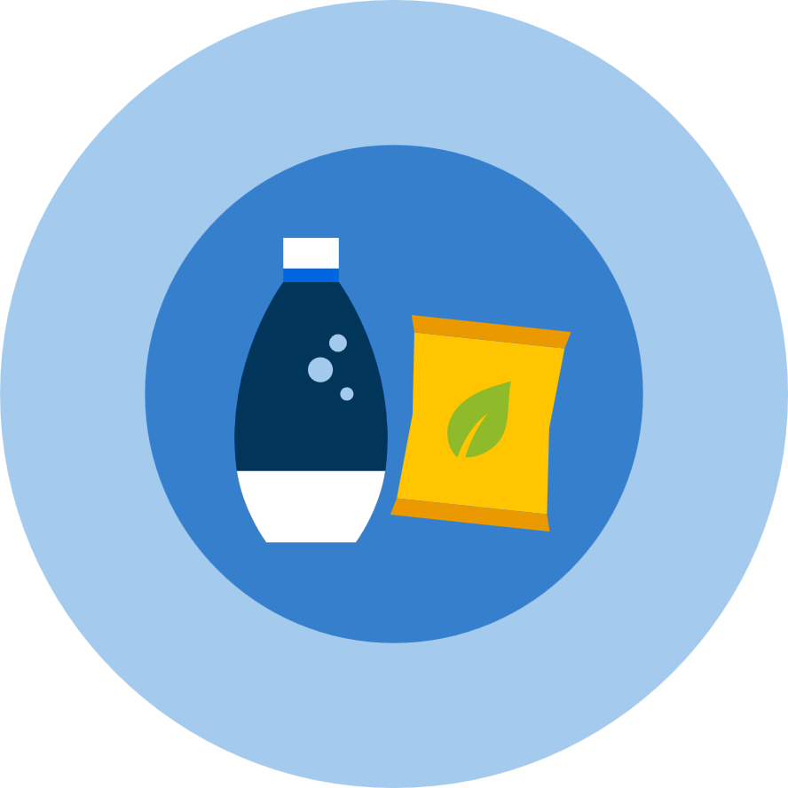
Packaging

Slide 12
PACKAGING
VIRGIN PLASTIC
New plastic material entering the supply chain for the first time, rather than made from recycled or alternative materials.
REUSABLE
Reusable packaging is packaging that allows either the business or the consumer to put the same type of purchased product back into the original packaging, is designed to be returnable and/or refillable, is free of chemicals of concern, and accomplishes a minimum number of reuses by being part of a system that enables reuse.
RECYCLABLE
The turning of materials that would otherwise become waste into materials that are processed and turned back into raw materials or products.
PET
Polyethylene terephthalate, also called PET, is the name of a type of clear, strong, lightweight and 100% recyclable plastic. Unlike other types of plastic, PET plastic is not single-use -- it is 100% recyclable, versatile, and made to be remade.
COMPOSTABLE
Compostable plastics are a subset of biodegradable plastics since composting is one specific environment where aerobic biodegradation occurs. To be considered compostable, plastic packaging must undergo rigorous testing and adhere to international standards.
rPET
Plastic recycled from post-consumer PET packaging (aka “recycled polyethylene terephthalate” or “rPET”).
BIO-BASED PLASTICS
Biobased plastics are produced from a renewable resource. Biobased plastics can be chemically identical to conventional plastics and some biobased plastics are biodegradable under specific EOL conditions. Examples of biobased plastics included BioPET, PLA and PHA.
BIODEGRADABLE
Biodegradable refers to the end of life (EOL) of the concerned material. Biodegradable plastics can be fossil-based or biobased. They can be broken down completely by microorganisms through either aerobic or anaerobic degradation to yield carbon dioxide and water, or carbon dioxide, water, and methane, respectively, within a specified time and environment.
PRODUCT LIFE CYCLE ENVIRONMENTAL IMPACT/ LIFECYCLE ANALYSIS (LCA)
A way of calculating the environmental impact of a product across the full lifetime of that product.

Slide 13
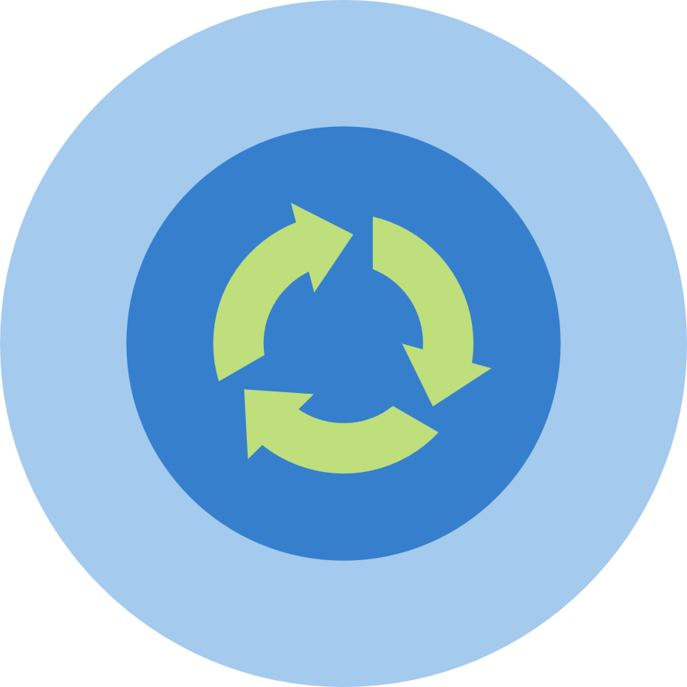
Waste & Circularity

Slide 14
WASTE & CIRCULARITY
CIRCULAR ECONOMY
A system that puts back what it takes from the pool of global raw materials, keeping resources in use, for example recycling PET plastic bottles into rPET and using that material to make new bottles, reducing the need for virgin materials.
MATERIAL RECOVERY FACILITY (MRF)
A facility where source-separated recyclables are either stored until large enough volumes are collected to be shipped to a buyer or processor, or they are processed to meet the specifications of recycling markets.

