Slide 1
Module 1: Introduction to pep+

Slide 2
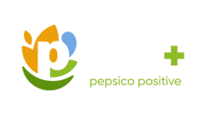
contents
1 Introduction
2 Sustainability at PepsiCo
3 Introducing pep+
Module 1
4 Spotlight on Carbon and Climate
5 Why is this important to you?
6 Where to find more information

Slide 3


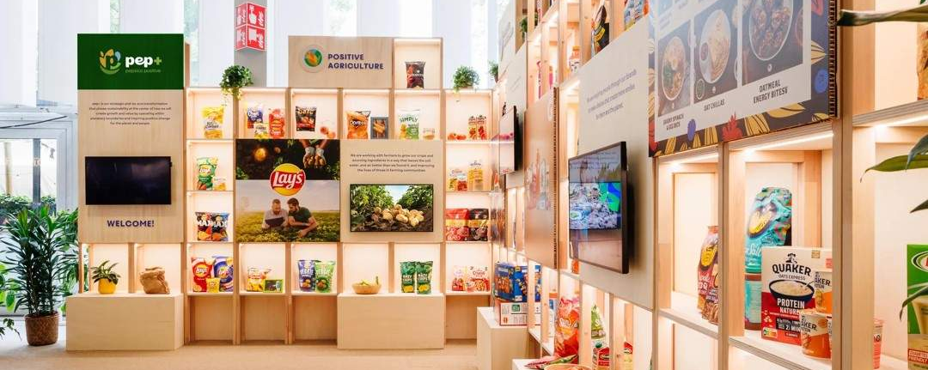
Introduction
WELCOME!
This training aims to help you understand PepsiCo’s sustainability priorities, so you can help serve our customers better and be a valued partner.
Sustainability is an increasingly important topic for many businesses. Customer priorities and consumer demand are evolving. As part of the PepsiCo sales team, you have an opportunity to engage with our customers on sustainability topics that may be relevant to their business goals, supporting shared progress where it makes sense.
Through four self-driven learning modules, you'll learn how to have conversations around sustainability, and the key topics that may be of interest to our customers. We'll cover:
Why is sustainability important to PepsiCo and our customers?
What actions is PepsiCo taking to engage with the topics of most interest to our customers?
How can sustainability unlock more customer opportunities and help PepsiCo be a valued partner?

Slide 4
OVERVIEW OF MODULES
Module 1
An introduction to PepsiCo’s sustainability agenda
Module 2
Sourcing and ingredients
Module 3
Packaging
Module 4
Recycling and circular solutions
Learn about pep+ and why sustainability matters to PepsiCo and our customers, alongside some of the actions we’re taking.
(around 12 minutes)
Explore PepsiCo’s product innovations that address consumer trends and climate and water impacts.
(around 8 minutes)
Find out about PepsiCo's sustainable packaging efforts to balance environmental sustainability, food safety regulations, and consumer preferences.
(around 10 minutes).
Understand PepsiCo's efforts to contribute to more circular and sustainable systems.
(around 10 minutes).

Slide 5

We get it – sustainability can be a daunting topic.
This first module will give you the lowdown on:
There’s a lot to learn, and some of it can get technical, but don’t worry, we’re not expecting you to be an expert. This course is designed to give you a solid understanding of the most important concepts so you can confidently start sustainability conversations with your customers.
Why sustainability is important for PepsiCo: Understand why it really matters to our customers and consumers.
Understanding pep+: Get to know PepsiCo Positive (pep+), our end-to-end transformation strategy.
Our actions on sustainability: Explore the journey we are on to transform how PepsiCo grows, makes, moves, sells and packages products.
Creating shared value: Explore how sustainability can be an area of mutual interest for PepsiCo, our customers, and the communities we serve.

