Slide 1








RESOURCE :
PEP+ WATER GOALS & RESOURCES
ADDITIONAL RESOURCES:
FOR QUESTIONS OR
MORE INFORMATION:
PEPSICO SUSTAINABILITY
PepsiCo’s hub for strategy, goals, and progress on our PepsiCo Positive journey.
SHANNA PARRA
shanna.parra@pepsico.com
ESG TOPICS A-Z
This online resource explores the sustainability topics that matter to our business key stakeholders, from A-Z.
CATHERINE WALTON
catherine.walton@pepsico.com
LATEST ENVIRONMENTAL, SOCIAL AND GOVERNANCE (ESG)
REPORT
Access PepsiCo’s ESG metrics and reports, which are updated on a rolling basis.
NICOLE POPOWSKI
nicole.popowski@pepsico.com

Slide 2
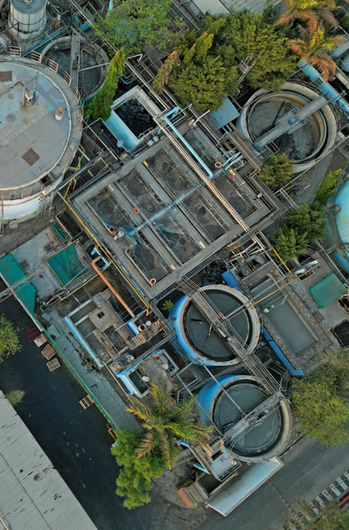




For a full list of pep+
goals, click here
Positive VALUE
CHAIN: WATER
ESG Topics A-Z
2030 Operational
Water-Use Efficiency
Reach average water-use efficiency ratios
of 1.4 liters/liter of production in beverages sites and 1.7 liters/kilogram of production
in convenient foods sites for 100% of high
water-risk PepsiCo and franchise bottler manufacturing facilities by 2030*
2025 Replenishment
Achieve 100% water replenishment
at company-owned facilities
designated in high water-risk
areas by 2025*
*World Resource Institute’s Aqueduct water stress assessment tool is used to reconfirm
high water-risk areas every three years. We continue to measure progress against our original 2025 goal and our extended 2030 goal. In 2022, an updated water risk assessment identified additional company-owned high water-risk facilities, which are in-scope for calculating progress against our 2030 goal only. The reported replenishment volumes
for company-owned facilities are currently being capped at 100% per location. Once
we achieve 100% for each company-owned location, we will start to then report progress
of more than 100% replenishment. We do not currently capture data from third-party manufacturers and are evaluating how to obtain and include information from our
top third-party manufacturers in future calculations
*Contract manufacturers and co-packers are excluded. Our progress toward this goal relies in part on water-use efficiency at high water-risk franchise bottler manufacturing facilities. We are working to integrate their data into future calculations
Watershed (AWS)
Adopt the Alliance for Water Stewardship (AWS) Standard in high water-risk manufacturing facilities by 2025
2030 Replenishment
Replenish back into the watershed
100% of the water we use in high
water-risk PepsiCo and franchise
bottler manufacturing facilities
by 2030*
Net Water Positive
Achieve net water positive by 2030
*Contract manufacturers and co-packers are excluded. Our progress toward this goal relies in part on replenishment associated with high water-risk franchise bottler manufacturing facilities. We are working to integrate their data into future calculations
2
Notes:
NET WATER POSITIVE VISION
Strive to be net water positive in company owned and franchise bottling high-water-risk manufacturing by improving water use efficiency and replenishing back into the local watershed
all of the water that we use.

