Slide 1








RESOURCE :
PEP+ STRATEGY & INSIGHTS
ADDITIONAL RESOURCES:
FOR QUESTIONS OR
MORE INFORMATION:
PEPSICO SUSTAINABILITY
PepsiCo’s hub for strategy, goals, and progress on our PepsiCo Positive journey.
SHANNA PARRA
shanna.parra@pepsico.com
ESG TOPICS A-Z
This online resource explores the sustainability topics that matter to our business key stakeholders, from A-Z.
CATHERINE WALTON
catherine.walton@pepsico.com
LATEST ENVIRONMENTAL, SOCIAL AND GOVERNANCE (ESG)
REPORT
Access PepsiCo’s ESG metrics and reports, which are updated on a rolling basis.
NICOLE POPOWSKI
nicole.popowski@pepsico.com

Slide 2

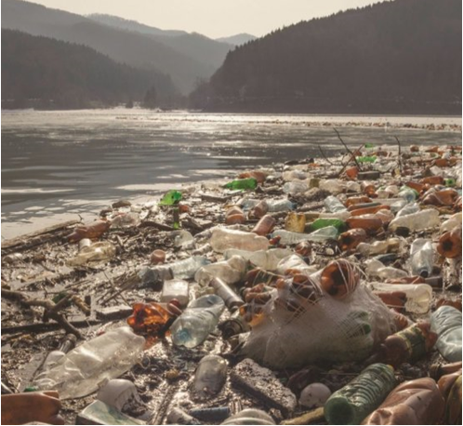

The world is facing unprecedented impacts of climate change —
threatening
our planet, our communities and
our livelihood
Notes:
Updated: 5/13/24
As many of you are aware, global climate change is threatening our planet, our communities and our livelihood ​
Sustainability is an increasingly important and relevant topic and we are seeing more and more evidence of its significance every day: Over the last couple years we’ve witnessed an increasing number of wildfires, droughts, flash floods and rising sea levels…[fires in California, floods in Texas, sea levels rising in Miami Beach, half of Pakistan currently under water]​
​
These are a result of decades of burning fossil fuels and destroying nature [forests being cut down], altering the delicate balance of gases in Earth’s atmosphere and destabilizing its heating and cooling systems and its weather patterns.​

Slide 3
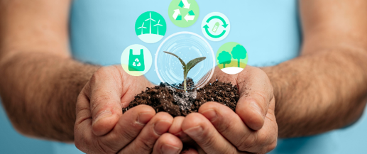


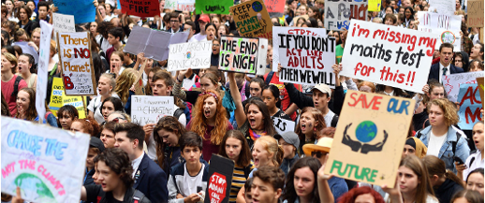


Consumers are expanding their expectations of sustainability
Peer advancement and innovation
THERE IS INCREASED DEMAND THAT BUSINESSES ACT MORE SUSTAINABLY
Regulatory pressure
and changes
Civil society/activist pressure
Investor scrutiny
Colleagues and team members
Notes:
And our customers are feeling the pressure to act more sustainably…​
​
In the U.S. 58% of consumers are willing to pay more for products that are better for the environment
There is increasing regulation across the world about transparency and disclosure on ESG topics
Since 2018 there has been 42% increase in sustainable investments and are considering more non-financial information
Corporates like PepsiCo which can tackle sustainability challenges, customers face a competitive environment where sustainability has become a differentiator
There is a healthy tension and pressure from activist groups on range of topics and effective public benchmarking of customers by organizations like Greenpeace’s supermarket plastic ranking
The workforce is also a key stakeholder and driver of change for many customers. Walkouts over key ESG issues (e.g., recent walk outs at amazon over pay and covid protection)
In addition inclusion in business audits becoming a reality. DEI audit is a large undertaking and a variety of perspectives will enrich and define the areas to focus on — from gender, sexuality, race, educational attainment, socioeconomic status, disability, age, and other areas relevant to your business. For example, the demographics from department to department can be vastly different. According to the U.S. Bureau of Labor Statistics’ 2020 data, women accounted for 66% of public relations professionals and 91% of public relations professionals were white. Departments will have different demographics based on their work, so including all the perspectives is critical

Slide 4

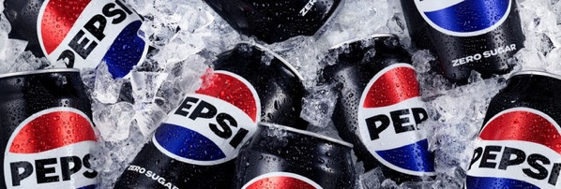

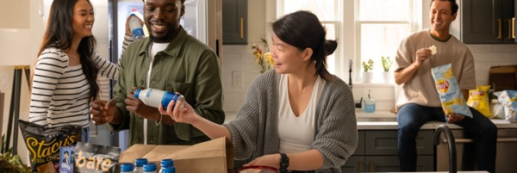



Consumer choices and
barriers in sustainability
Recyclable Packaging
38%
of Americans feel that 100% recyclable beverage packaging is the most eco-friendly packaging option — followed by refillable/reusable packaging.
But just 24%
of Americans will pay more for
100% recyclable beverage packaging.
Messaging on Pack
29%
of Americans find information directly on packaging the most useful to learn more about environmental issues.
~72%
of Americans pay attention
to information on beverage packaging/labels.
Barriers to Solve
More than 2/3
of Americans fail to buy sustainably due to affordability — and this continues to increase this year.
Thereafter 1 in 2
don’t feel like experts and thus
need more education to make adequately informed decisions
around sustainability.
Fielded June 2024, 6110 (n) total survey respondents (18+), 6618 (13+)
Notes:
Educate for customer dialog
When we engage in conversations with customers there are times when they want to understand how we are adding “value” or how we are helping them against their scope 3 goals. We are going to spend a few minutes to help you understand what they are and where we as a partner impact our customers sustainability goals.
GHG emissions have been classified into distinct scopes for corporate footprints, organized by level of ownership and control, to help with measurement and management.
Scope 1, 2, and 3 emissions are a way to categorize the different types of greenhouse gas (GHG) emissions a company creates.
The scopes are determined by where the emissions come from:
Scope 1
Direct emissions that a company generates while performing its business activities, such as emissions from fuel burned in buildings, vehicles, and equipment
Scope 2
Indirect emissions from purchased energy, such as electricity, steam, heat, and cooling
Scope 3
In this category go all the emissions associated, not with the company itself, but that the organization is indirectly responsible for, up and down its value chain. For example, from buying products from its suppliers, and from its products when customers use them. Emissions-wise, Scope 3 is nearly always the big one.

Slide 5
RETAIL
US market Sustainability insights
Sustainably-marketed products grew 2.3x faster
than conventionally marketed Consumer Packaged Goods between 2019 and 2024¹.
3 in 4 consumers engage with sustainability-related information
on beverage packaging and labels².
44% consumers say environmental impact of packaging is important to them
when making a purchasing decision³.
Notes:
Sources:
NYU Centre for Sustainable Business (2024) Sustainable Market Share Index. https://www.stern.nyu.edu/experience-stern/about/departments-centers-initiatives/centers-of-research/center-sustainable-business/research/csb-sustainable-market-share-index
Kantar (2024) Sustainability insights [‘72% Americans pay attention to information on beverage packaging/ labels’]
McKinsey (2025) Do US consumers care about sustainable packaging?. https://www.mckinsey.com/industries/packaging-and-paper/our-insights/do-us-consumers-care-about-sustainable-packaging-in-2025#/ [‘44% consumers say environmental impact of packaging is “extremely important” or “very important” to them when making a purchasing decision’]
Alternatives:
Trust remains an issue - 4 in 5 US consumers can't name a beverage brand that they believe shows genuine concern for the environment.
Source: Kantar (2024) Sustainability insights
24% US consumers will pay more for 100% recyclable beverage packaging.
Source: Kantar (2024) Sustainability insights

Slide 6
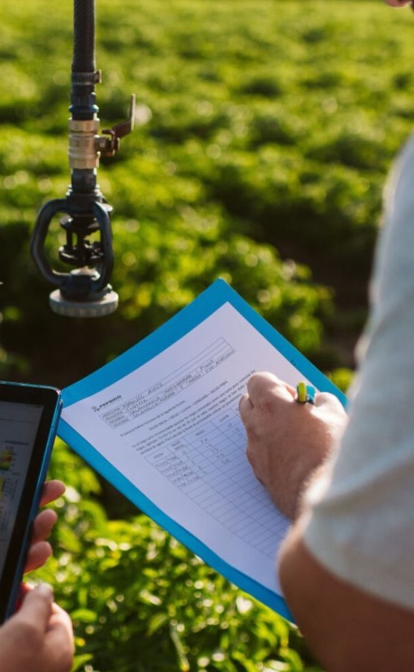

Food Service
US market sustainability insights
72% of adults are more likely to visit restaurants that use sustainable business practices¹.
81%
consumers cannot name a beverage brand they believe genuinely cares about the environment³.
Consumers are willing to pay 13% more for sustainable products².
Notes:
Sources:
National Restaurant Association (2023) State of the Industry report. https://cdn.ymaws.com/www.krha.org/resource/resmgr/nra_/2023-State-of-the-Restaurant.pdf
Bain (2025) What’s Still Stopping Consumers from Living Sustainably?. https://www.bain.com/insights/whats-still-stopping-consumers-from-living-sustainably-ceo-sustainability-guide-2025/
Kantar (2024) Sustainability insights
Alternatives:
1 in 3 consumers rank “plastic pollution” as one of their top three environmental concerns (globally).
Source: Mintel (2025) Global Outlook on Sustainability
2 in 3 US consumers believe that either brand owners or packaging producers should be held responsible for sustainability in packaging.
Source: McKinsey (2025) Do US consumers care about sustainable packaging?. https://www.mckinsey.com/industries/packaging-and-paper/our-insights/do-us-consumers-care-about-sustainable-packaging-in-2025#/

Slide 7
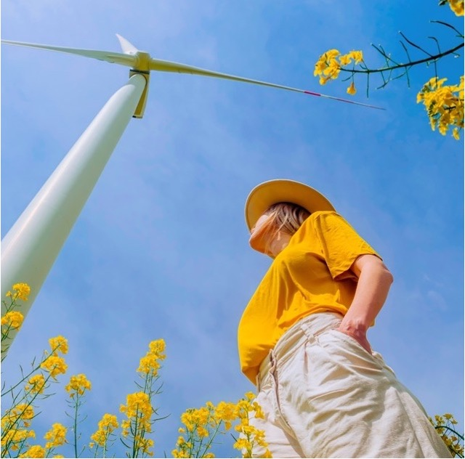
Colleges and universities
US market sustainability insights
Over 70% of younger consumers~ have chosen a product specifically because of its sustainable packaging¹.
1 in 4 Gen Zs research a company's environmental credentials before making a purchase².
18-29 year olds are twice as likely* to choose not to buy a product because of negative environmental impacts³.
Notes:
Sources:
[Global statistic] Statista (2024) Sustainable food packaging market - statistics & facts. https://www.statista.com/topics/12478/sustainable-food-packaging-market/
Deloitte (2025) Gen Z and Millennial Survey. https://www.deloitte.com/global/en/issues/work/genz-millennial-survey.html [26% Gen Zs have conducted research on a company's environmental impact or policies before buying a product or service from them].
Kantar (2024) Sustainability insights
Alternatives:
3 in 5 students say environmental credentials affect whether they attend a particular school.
Source: Princeton Review (2024) Hopes & Worries Survey Report. https://www.princetonreview.com/cms-content/2024-college-hopes-worries-survey-report.pdf [The majority (59%) of respondents chose answers indicating that information about a college's commitment to the environment would contribute to their decision to apply to or attend the school].
A quarter of higher education institutions have registered with STARS~ to track sustainability performance.
Source: 970 US higher education institutions have registered with STARS (Sustainability Tracking, Assessment & Rating System). https://reports.aashe.org/institutions/data-displays/dashboard/
Source: 3931 higher education institutions in US. https://www.statista.com/statistics/240833/higher-education-institutions-in-the-us-by-type/
US postgraduates worry more about global warming than the average consumer [71% respondents said they worried a great deal/ fair amount vs 61% average].
Source: Gallup (2024) https://news.gallup.com/poll/355427/americans-concerned-global-warming.aspx

Slide 8

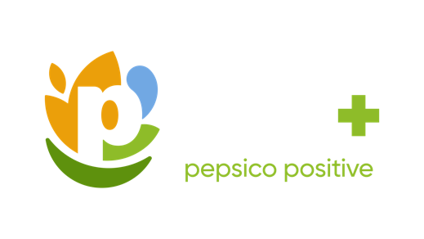





Pep+ has 3 interconnected pillars:
Guiding PepsiCo is our vision to
Be the Global Leader in Drinks and Convenient Foods by Winning with
pep+ (PepsiCo Positive).
pep+ is our strategic end-to-end transformation that places sustainability at the center of our business strategy, seeking to drive growth and build a stronger, more resilient future for PepsiCo and the communities where we operate.
Positive agriculture
We are working to source our crops and ingredients in ways that restore the earth and strengthen farming communities.
Positive
Value Chain
We are helping to build a circular and inclusive value chain.
Positive Choices
We are inspiring people through our brands to make choices that create more smiles for them and the planet.
8

Slide 9

For a full list of pep+
goals, click here
Pep+ key pillars
ESG Topics A-Z
We’re charting a new course to drive positive action for the planet and people.
POSITIVE AGRICULTURE
POSITIVE
VALUE CHAIN
POSITIVE CHOICES
Spread the adoption of regenerative agriculture, restorative, or protective practices across 10 MILLION ACRES of land supporting the growth of our key crops and ingredients by 2030*
*See PepsiCo’s Regenerative Agriculture Guidelines for additional information, including details on key crops and regeneration, restoration and protection criteria. Results represent reflect total acreage meeting these criteria within the annual reporting period
Achieve an average of 2% year-over-year reduction in our absolute tonnage of virgin plastics through 2030*
*Goal tracks primary plastic packaging in PepsiCo’s key packaging markets. This scope represents more than 80% of PepsiCo’s 2024 global plastic packaging footprint (by weight)
Adopt the Alliance for Water Stewardship
(AWS) Standard in high water-risk manufacturing facilities by 2025
Achieve NET ZERO emissions by 2050
or sooner*
*Refer to our Climate Transition Plan for more information
Use 40% or greater recycled content in
our plastic packaging by 2035 or sooner*
*Goal tracks primary plastic packaging in PepsiCo’s key packaging markets. This scope represents more than 80% of PepsiCo’s 2024 global plastic packaging footprint (by weight)
REDUCE SODIUM
≥ 75% of convenient foods portfolio volume will not exceed 1.3 milligrams
of sodium per Calorie by 2025*
*Our global results are based on our Top 23 convenient foods markets
REDUCE SATURATED FATS
≥ 75% of convenient foods portfolio volume will not exceed 1.1 grams of saturated fat per 100 Calories by 2025*
*Our global results are based on our Top 23 convenient foods markets
REDUCE ADDED SUGARS
≥ 67% of beverage portfolio volume will have ≤100 Calories from added sugars per 12oz. Serving by 2025*
*Our global results are based on our Top 26 beverage markets
Sustainably source 90% OF OUR KEY INGREDIENTS and progress volumes
(10% or less) that face systemic barriers towards being sustainably sourced in accordance with our guidelines, by 2030*
*Sustainably sourced refers to in-scope ingredient volumes that meet the established criteria outlined in PepsiCo’s Sustainable Sourcing Guidelines. Sustainable Sourcing practices can help manage risks, but challenges like deforestation or social issues can persist in some regions

Slide 10

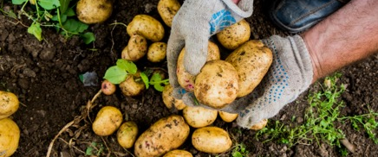
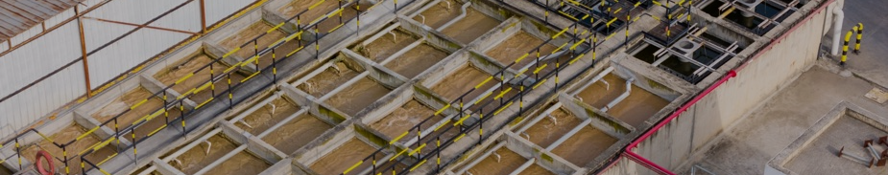
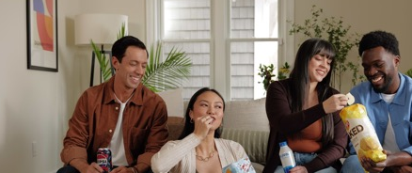
2024 Highlights—Global Results
For a full list of pep+
goals, click here
ESG Topics A-Z
POSITIVE AGRICULTURE
POSITIVE
VALUE CHAIN
POSITIVE CHOICES
>3.5MM
acres used regenerative agriculture,​ restorative or protective practices in 2024¹​
~80%
compressed natural gas for our North American foods fleet was renewable in 2024³
18%
reduction in Scope
1 and 2 emissions (verses 2022 baseline)⁵
75%
Replenished ~75%
of the water we use in
our company-owned manufacturing facilities in high-risk watersheds in 2024⁷
~66%
of our key ingredients
are sustainably sourced
in accordance with our
guidelines in 2024²
>185K
Measurable improvements in more than 185,000 livelihoods since 2021^{2​}
89%
of company-owned operations using 100% renewable electricity⁴
12%
reduction in Scope 3 emissions (verses 2022 baseline)⁶
5%
reduction in our absolute tonnage of virgin plastics between 2023 and 2024 in key packaging markets⁸
~77%
of our convenient
foods portfolio volume⁶ already meets our
2025 goal⁶
1. Refined goal announced on May 22, 2025. 2024 performance calculated retroactively. For more information, see Calculation Methodology
2. This goal captures the number of livelihoods reached through an outcome-focused evaluation measuring improvements in economic prosperity and farmer and farm worker security. Metric counts the cumulative people impacted since 2021
3. 100% renewable electricity includes energy attribute certificates.
4. Former ambition became a pep+ goal in 2025. 2024 performance calculated retroactively. For more information, see Calculation Methodology
5. Refined goal (including 2022 baseline) announced on May 22, 2025. Past performance against the baseline calculated retroactively. For more information, see Calculation Methodology.
6. Refined goal (including 2022 baseline) announced on May 22, 2025. Past performance against the baseline calculated retroactively. For more information, see Calculation Methodology
7. Redefined 2030 goal announced on May 22, 2025. 2024 performance calculated retroactively. We continue to measure progress against our original 2025 goal and our extended 2030 goal. In addition to internal site-specific data, World Resource Institute’s Aqueduct water stress assessment tool is used to reconfirm high water-risk areas every three years. In 2022, an updated water risk assessment identified additional company-owned high water risk facilities, which are in-scope for calculating progress against our 2030 goal only. Reported performance does not include data from franchise bottler manufacturing facilities but work is underway to obtain it for inclusion in future years. For more information, see Calculation Methodology
8. Refined goal announced on May 22, 2025. 2024 performance calculated retroactively. For more information, see Calculation Methodology
2. Refined goal announced on May 22, 2025. 2024 performance calculated retroactively. For more information, see Calculation Methodology
6. As of 2024, Top 26 beverage markets represented 78% of our global beverages volume and Top 23 convenient foods markets represented 86% of our global convenient foods volume. Results reflect the exclusion of Be & Cheery portfolio

Slide 11
Solutions to drive value with customers
The following five areas have been identified as the best value creation opportunities for PepsiCo and its top customers.
Energy
Agriculture
Recycling
Packaging
Water**
pep+ Renew
Why?
Accelerate their renewable energy transition and achieve climate targets on schedule.
How?
Support in reducing emissions
Equip with educational materials to understand opportunities
Sow+
Why?
Build supply chain resilience and progress against Scope 3 carbon reduction commitments.
How?
Reduce ag footprint and Scope 3 emissions
Provide learnings based on PepsiCo’s experience as leader in regen ag
Recycling programs
Why?
Hit recycling targets or position as leaders and innovators in the circular economy.
How?
Increase recycling rates and support customer waste goals
Simplify the sorting process
Sustainable packaging portfolio
Why?
Stay ahead on packaging innovation and lead in sustainable packaging solutions.
How?
Increase the sustainability of packaging portfolio
Support plastic reduction goals
Net Water Positive programs
Why?
Meet water stewardship goals and implement effective water strategies across operations.
How?
Provide expertise in becoming Net Water Positive
Collaborate on replenishment initiatives
Existing Partners for Tomorrow Programming
*Exploratory

