Slide 1








RESOURCE :
PEP+ PEOPLE GOALS
ADDITIONAL RESOURCES:
FOR QUESTIONS OR
MORE INFORMATION:
PEPSICO SUSTAINABILITY
PepsiCo’s hub for strategy, goals, and progress on our PepsiCo Positive journey.
SHANNA PARRA
shanna.parra@pepsico.com
ESG TOPICS A-Z
This online resource explores the sustainability topics that matter to our business key stakeholders, from A-Z.
CATHERINE WALTON
catherine.walton@pepsico.com
LATEST ENVIRONMENTAL, SOCIAL AND GOVERNANCE (ESG)
REPORT
Access PepsiCo’s ESG metrics and reports, which are updated on a rolling basis.
NICOLE POPOWSKI
nicole.popowski@pepsico.com

Slide 2
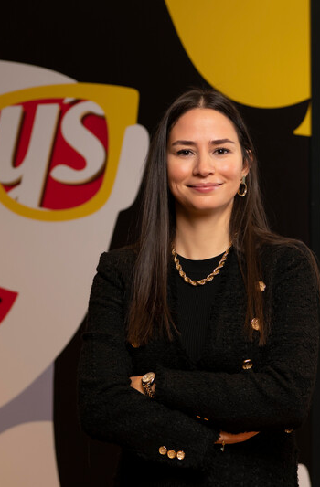



For a full list of pep+
goals, click here
Positive VALUE
CHAIN: PEOPLE
ESG Topics A-Z
Volunteer Growth
Empower our associates with the
resources and time needed to build
and cultivate prosperity in our communities
Supplier Code of Conduct
Extend the principles of our Supplier Code
of Conduct to all of our franchisees and joint ventures by 2025
Food Security
Partner with communities to advance food security and make nutritious food accessible to 50 million people*
Pay Equity
Achieve and sustain pay equity for our global professional population by maintaining a comprehensive global pay equity review process*
*After controlling for legitimate drivers of pay such as job level, geographic location, and performance ratings; based on base compensation
*Results represent the cumulative sum of people reached with nutritious meals per annual reporting period through programs funded by the PepsiCo Foundation, as well as through commercial efforts that are intended to provide nutritious meals. Initial target setting for this metric did not include Pioneer Foods, which delivered accessibility to more than 20 million people in each reported year. The target will be reassessed in the future to fully account for both commercial and charitable efforts. See Calculation methodology in our ESG Topics A-Z for further explanation of how we calculate this goal
Safe Water Access
Reach 100 million people with safe water
access by 2030*
Injury-free Work Environment
Continue to strive for an injury-free
work environment*
*Metric counts the cumulative number of people provided with access to safe water since 2010
Job Growth
Increase the employability of our people through increased access to degrees, skill development and new roles, providing meaningful growth opportunities to everyone at every stage
Human Rights
Promote fair and safe working conditions
by advancing respect for human rights
2
Notes:
MEANINGFUL JOBS AND OPPORTUNITIES
Provide meaningful jobs and growth opportunities for our people and empower them to enhance their well-being and make a positive impact at work, at home and in their local communities.
INCLUSION FOR GROWTH
Our company has a deep history of
building an inclusive and respectful workplace culture. PepsiCo has always
been a company that thrives on bringing together the best talent, empowering people to grow, and delivering innovative products that meet the needs of our consumers. This legacy inspires the way we work today.

