Slide 1




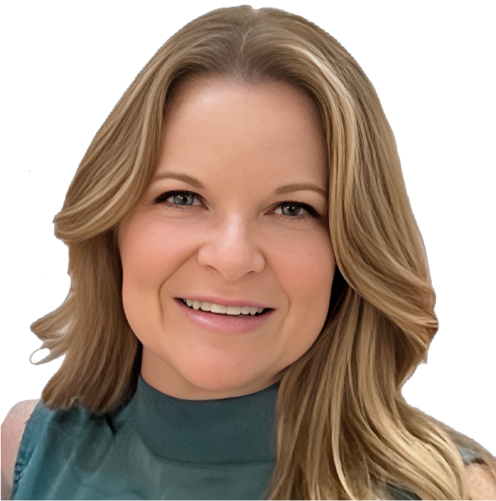



RESOURCE :
PEP+ PACKAGING AND RECYCLING GOALS & RESOURCES
ADDITIONAL RESOURCES:
FOR QUESTIONS OR
MORE INFORMATION:
PEPSICO SUSTAINABILITY
PepsiCo’s hub for strategy, goals, and progress on our PepsiCo Positive journey.
SHANNA PARRA
shanna.parra@pepsico.com
ESG TOPICS A-Z
This online resource explores the sustainability topics that matter to our business key stakeholders, from A-Z.
CATHERINE WALTON
catherine.walton@pepsico.com
LATEST ENVIRONMENTAL, SOCIAL AND GOVERNANCE (ESG)
REPORT
Access PepsiCo’s ESG metrics and reports, which are updated on a rolling basis.
NICOLE POPOWSKI
nicole.popowski@pepsico.com

Slide 2
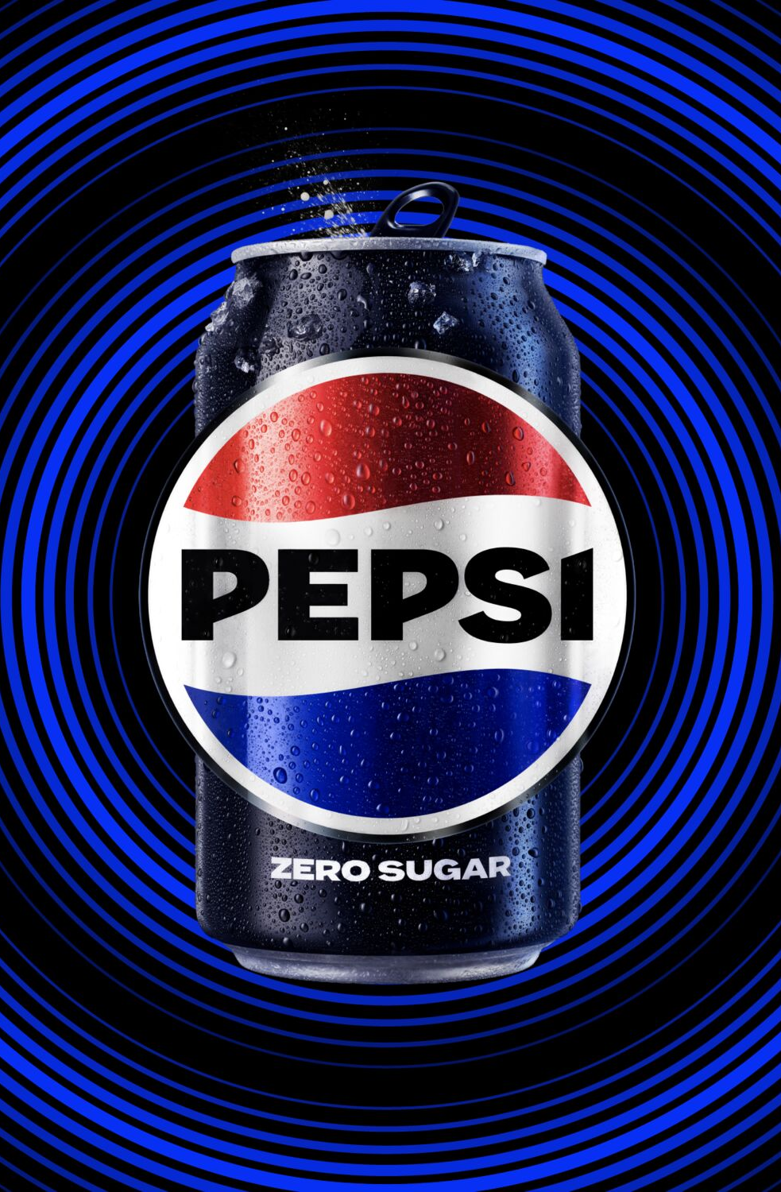




For a full list of pep+
goals, click here
Positive VALUE
CHAIN: PACKAGING
ESG Topics A-Z
FOR OUR PRIMARY PLASTIC PACKAGING IN KEY PACKAGING MARKETS, OUR GOALS ARE:
Recycled Content
Use 40% or greater recycled
content in our plastic packaging
by 2035 or sooner*
Virgin Plastic Reduction (Tonnage)
Achieve an average of 2% year-over-year reduction in our absolute tonnage of virgin plastics through 2030*
*Goal tracks primary plastic packaging in PepsiCo’s key packaging markets. This scope represents more than 80% of PepsiCo’s 2024 global plastic packaging footprint (by weight)
Innovative Packaging Materials
Develop and support innovation,
in collaboration with our partners
and external organizations, of new
packaging material technologies
and solutions
*Goal tracks primary plastic packaging in PepsiCo’s key packaging markets. This scope represents more than 80% of PepsiCo’s 2024 global plastic packaging footprint (by weight)
RCBR/RRC
Achieve 97% or greater reusable, recyclable, or compostable (RRC)
packaging by design by 2030 in
our primary and secondary
packaging in our key
packaging markets*
Recycling Rates
Invest to increase recycling rates
in our key packaging markets*
*Goal tracks primary and secondary packaging in PepsiCo’s key packaging markets. This scope represents more than 85% of PepsiCo’s 2024 global packaging footprint (by weight). Reusable packaging must also be designed to be recyclable or compostable
*Goal relates to primary and secondary packaging in PepsiCo’s key packaging markets. This scope represents more than 85% of PepsiCo’s 2024 global packaging footprint (by weight)
2
Notes:
SUSTAINABLE PACKAGING
Scaling new business models that minimize single-use packaging.
Reducing our absolute tonnage
of virgin plastic derived from
non-renewable sources.

Slide 3

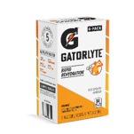

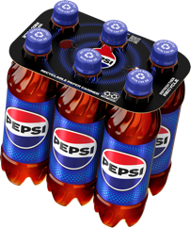

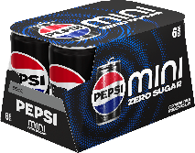
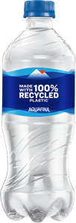

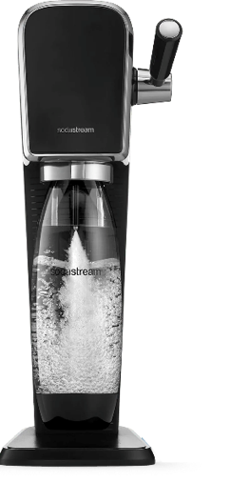

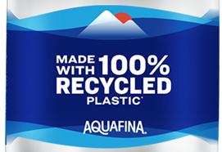
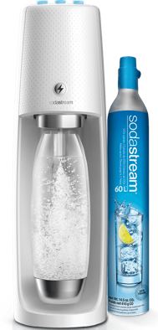
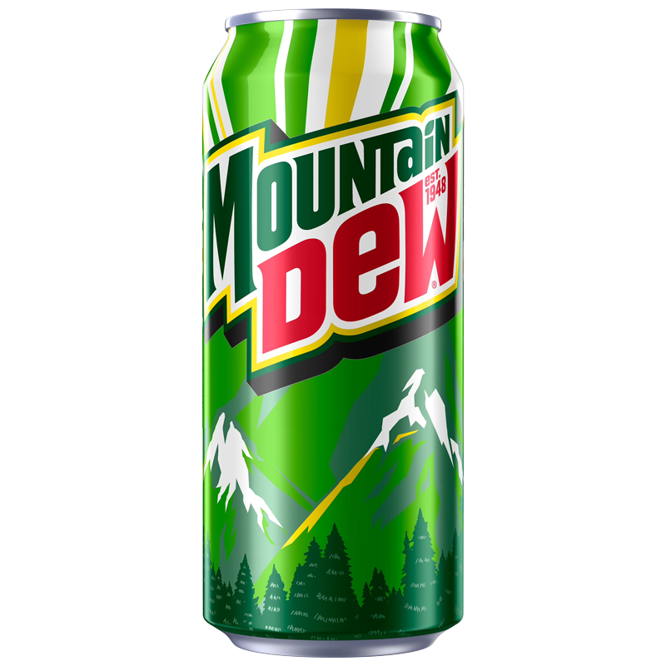
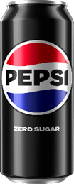




Use in customer meeting. Do not leave behind
THREE KEY LEVERS WILL HELP US
ACHIEVE OUR PACKAGING GOALS
Removal of Virgin Plastic
Increase Recycled
Content & Messaging
Alternative Formats
confidential and proprietary

Slide 4
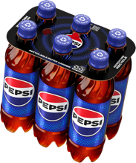



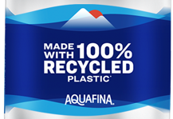
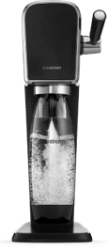




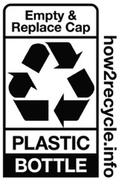




Key Packaging for
positive impact
Plastic Ring Removal
Plastic-free Portfolio
Recycled Content
Recycling Communication
SodaStream
Alternative Formats
confidential and proprietary
Notes:
PepsiCo bevs NA has ambitious goals to achieve our vision of a world where packaging never becomes waste, reducing virgin (fossil fuel) plastic by 50% by 2030 and increasing % of all bev servings delivered thru reusable models to 20% by 2030:
1. Removing plastic across NA. Announced removal of plastic rings around our multipack bevs, switching to paperboard. 100% RECYCLABLE BY 2025
2. Expanding plastic-free portfolio:
Major brands available in plastic-free vessels like aluminum cans (all CSDs, Brisk tea, Starbucks energy, Rockstar energy) & aluminum bottles (Aquafina) w commercial activities designed to shift mix toward plastic-free products
Expand avail. of major brands in aluminum cans in 2024 including Propel & Aquafina; further expansion to LifeWTR, GTQ, and G-Zero for 2025
R&D & commercialization programs underway w major aluminum can manufacturers to expand resealable options for major brands starting next 12 months
3. Accelerating incorporation of recycled plastic (rPET) across NA, prioritizing SS
4. Roll out graphic changes to communicate messaging reminders for consumers to R
5. Actively growing alternative formats – SodaStream + powders and tablets
6. Work to increase reusable formats and vessels

Slide 5
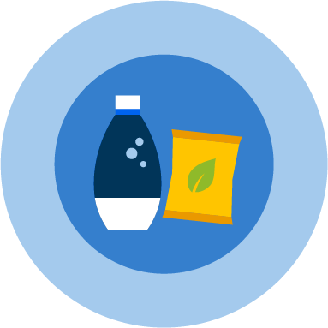



OUR SUSTAINABLE PACKAGING
VISION – KEY MARKETS
Reduce
Reuse
Reinvent
Achieve an average of 2%
Use
40%
ACHIEVE
97%
year-over-year reduction
in our absolute tonnage of virgin plastic through 2030¹
or greater recycled content in our plastic packaging
by 2035 or sooner¹
or greater reusable, recyclable or compostable (RRC)2 packaging by design by 2030 in our primary and secondary packaging in our key packaging markets
1 Goal tracks primary plastic packaging in PepsiCo’s key packaging markets. This scope represents more than 80% of PepsiCo’s 2024 global plastic packaging footprint (by weight)
2 Goal tracks primary and secondary packaging in PepsiCo’s key packaging markets. This scope represents more than 85% of PepsiCo’s 2024 global packaging footprint (by weight). Reusable packaging must also be designed to be recyclable or compostable

Slide 6






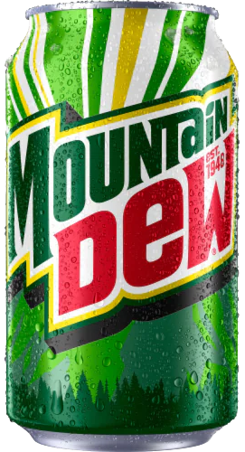
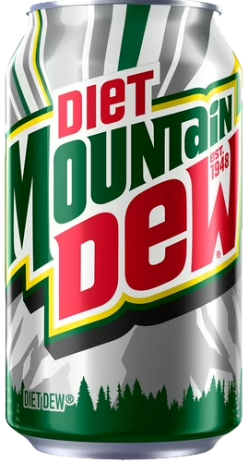
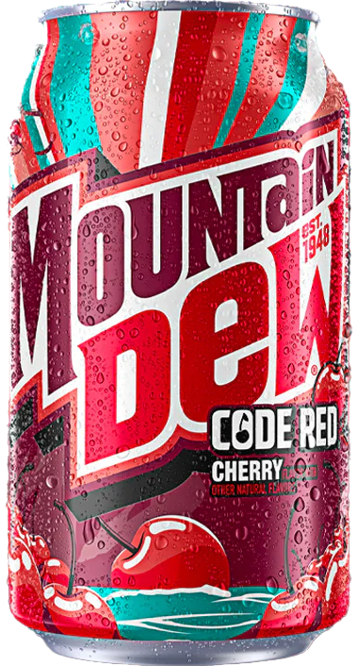



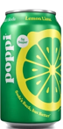






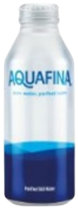







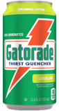
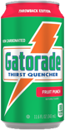
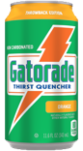





Use in customer meeting. Do not leave behind
*Update and confirm assortment with marketing in your area*
PLASTIC FREE PORTFOLIO
Available now
CSDs
WEST ONLY
Primarily Lodging
Primarily
Healthcare
Sports
Energy
Water
Tea
Coffee
Juice
Notes:
Call out that it’s reactive page. Provide this page only if customer asks.

Slide 7






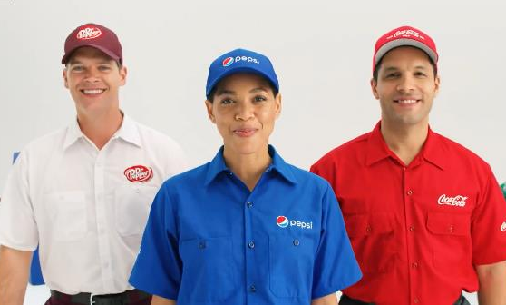


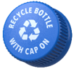
Customer Programs
Infrastructure Investment
We are working to improve recycling rates across the usa
Industry Partnership

Slide 8
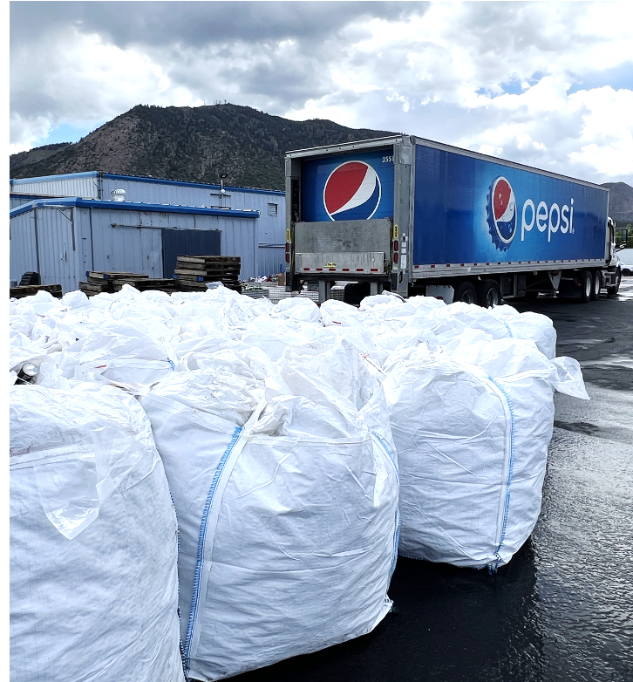


CIRQU
PROGRAM UPDATE 2026
PLEASE NOTE THAT THE CIRQU PROGRAM HAS BEEN PUT ON-HOLD AND IS BEING RE-EVALUATED FOR 2027
IN PARTNERSHIP WITH
confidential and proprietary
Supersacks full of recycled material collected through CIRQU

Slide 9
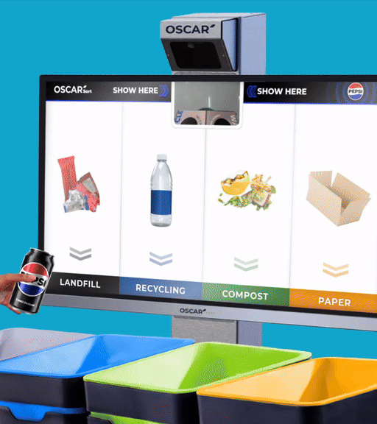

MEET OSCAR SORT!
The smart recycling sorting solution
Oscar Sort is an AI trash sorting assistant that will guide customers to sort items into the correct streams in a fun and engaging way. Using advanced AI vision detection, Oscar Sort is designed to seamlessly integrate with your facility.
confidential and proprietary
Notes:
See Oscar in Action
Oscar Sort, an artificial intelligence fun/entertaining waste-sorting system to aid consumer error on which bin to use
Zero touch – zero waste
Automatically identifies recyclables from waste, by using AI tech to understand the item that a person is trying to dispose of
Instruct users on which waste bin to use

Slide 10




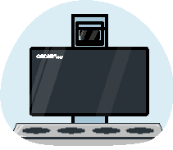
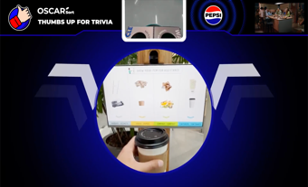
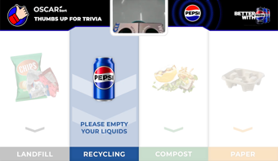
The Oscar experience
1. OSCAR IS IDLE
Consumer may view mix of Third-Party Ad Content (aligning with your exclusions) and your own static or video messaging
2. APPROACH
Oscar introduces itself and instructs how to show an item
3. SORT
Oscar then instructs how to sort the item in the correct bin
4. FEEDBACK/
REWARD
Oscar responds
with real time good job/bad job feedback.
Strategic PEP reward campaigns possible across multiple Oscars during
a specified time.
5. TRIVIA
Intuitive AI may choose to display
a quiz or trivia to engage users with environmental or climate literacy content.
Notes:
THE OSCAR EXPERIENCE
OSCAR IS IDLE: During this time, you have the option to show custom static or video content (~30%). Intuitive AI will also be able to display their curated ad content that aligns with any exclusions that you have (~70%). Custom content can be updated on a monthly basis.
APPROACH: Here, Oscar introduces itself instructs how to show an item. This is a co-branded Pepsi & customer interface, which continues throughout the rest of the experience.
SORT: Oscar then instructs how to sort the item in the correct bin. The items shown as examples of each waste stream can be customized according to the specific waste streams you have on site.
FEEDBACK/REWARD: Oscar then responds with real time good job/bad job feedback. [INTERNAL NOTE: Customization not available here] It may also be possible to participate in a PepsiCo-led rewards campaign across multiple Oscars during a specified period, one time per year for a month.
TRIVIA: At this stage, at the end of the sorting process, Intuitive AI may choose to display a quiz or trivia to engage users with environmental or climate literacy content.
FUNDING
This Oscar Experience is based on an investment of $2,000/year per Oscar Sort for software subscription services (starting in Y2 of placement). Funding can be covered by marketing or sustainability budgets.
Year 1 is fully funded by the PBNA Sustainability team.
At the end of the first year, there are three options to proceed:
Customer can choose to keep their Oscars onsite with current co-branded UX ($2,000 per Oscar for the following year should be transferred to PBNA Sustainability team)
Customer can choose to keep their Oscars onsite for $365 per year, but without any co-branding (customer and PepsiCo), custom content, or waste analytics. Oscar simply keeps nudging consumers to sort their waste.
Customer can choose to have the Oscars removed. Before 1 year from placement, there is no charge. After Y1, PBNA sustainability charges $1,000 (to marketing/sustainability funding) to decommission each Oscar Sort.

Slide 11
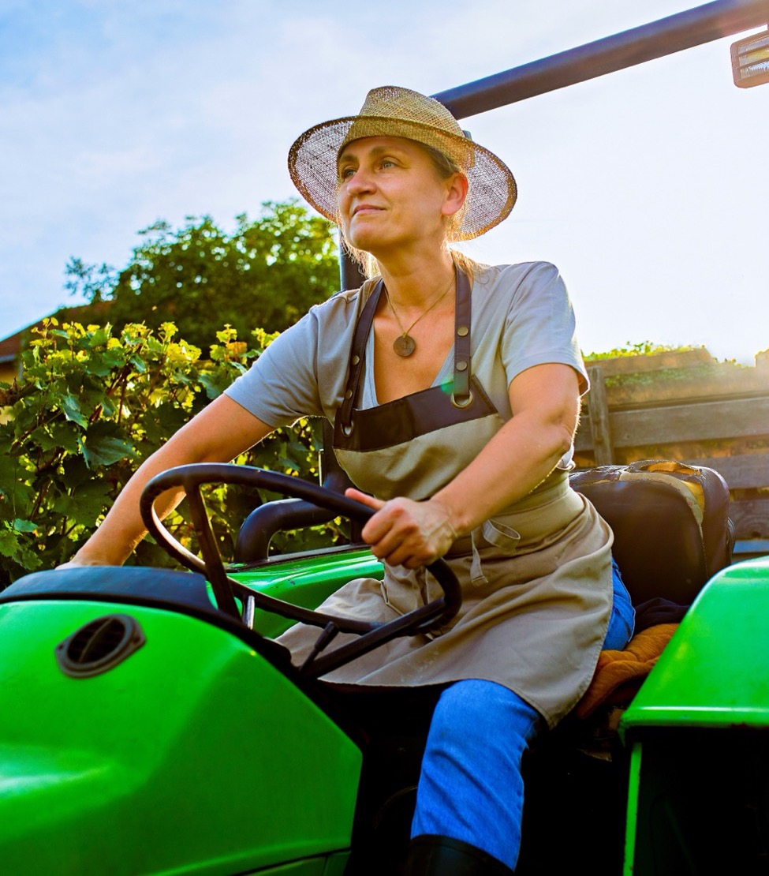
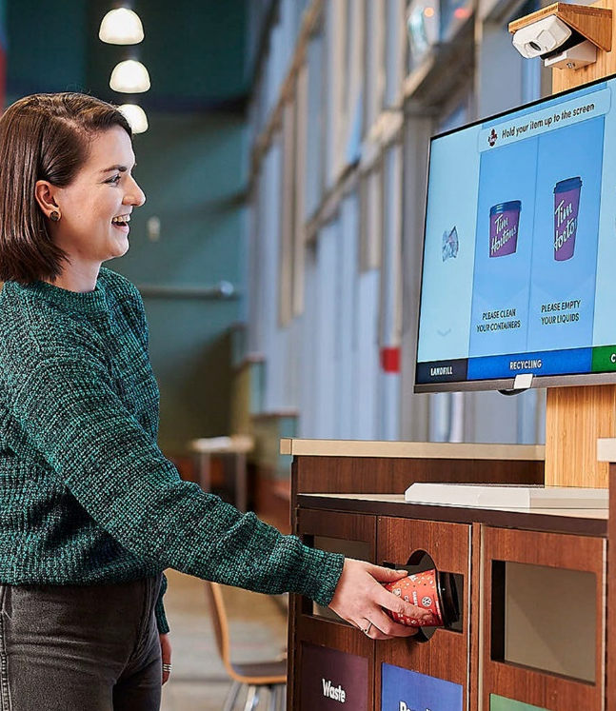




Features & Benefits
Oscar Sort makes recycling decisions easier and fun
SUSTAINABILITY
Oscar is a proven way to increase the amount of correct decisions made at the bin. Items ending up in the correct bin is the first and most important step on the journey to a true circular economy
GAMIFY RECYCLING
Oscar transforms the dull task of disposing trash into a memorable experience by engaging
with customers in a fun, and educational way directly at
the moment of disposal.
REPORTING
Waste analytics provides granular insights into the behaviors of customers. What is being sorted and when is it being sorted correctly. Equivalent to a waste audit, up to 4 days/year.
ADAPTS SEAMLESSLY
Oscar retrofits to existing bin style
in place. Oscar also is customized to align with the waste regulations per location
11
Notes:
Feature/benefits of participating as a partner

Slide 12
OSCAR SORT FAQs
Where Should I have my Oscars?
High traffic, public spaces, high consumption onsite – Indoors
Cannot deploy in outdoor settings. Covered outdoor areas may apply, further details needed to provide deployment approval
Network/Data Connection
Operates on a cellular connection, network/WiFi not required– Detailed technical specifications available here.
Power
Standard 120V power outlet
Privacy
Oscar adheres to the strictest privacy standards globally including the global gold standard–GDPR
What does the installation look like?
2-4 hours for setup per unit
Power on-site need to be confirmed before scheduling installation
If applicable, drilling on site to be done by facility personnel
Lead time: 1-3 weeks from site details verification, Q2 2024 onwards
What Local Support will I have?
Installation is done by Intuitive approved partners
Each site is assigned a local partner for installation
Onboarding, Tech Support & Training
Each site to be assigned with their Intuitive Account Manager for Customer Success and on-going support

Slide 13
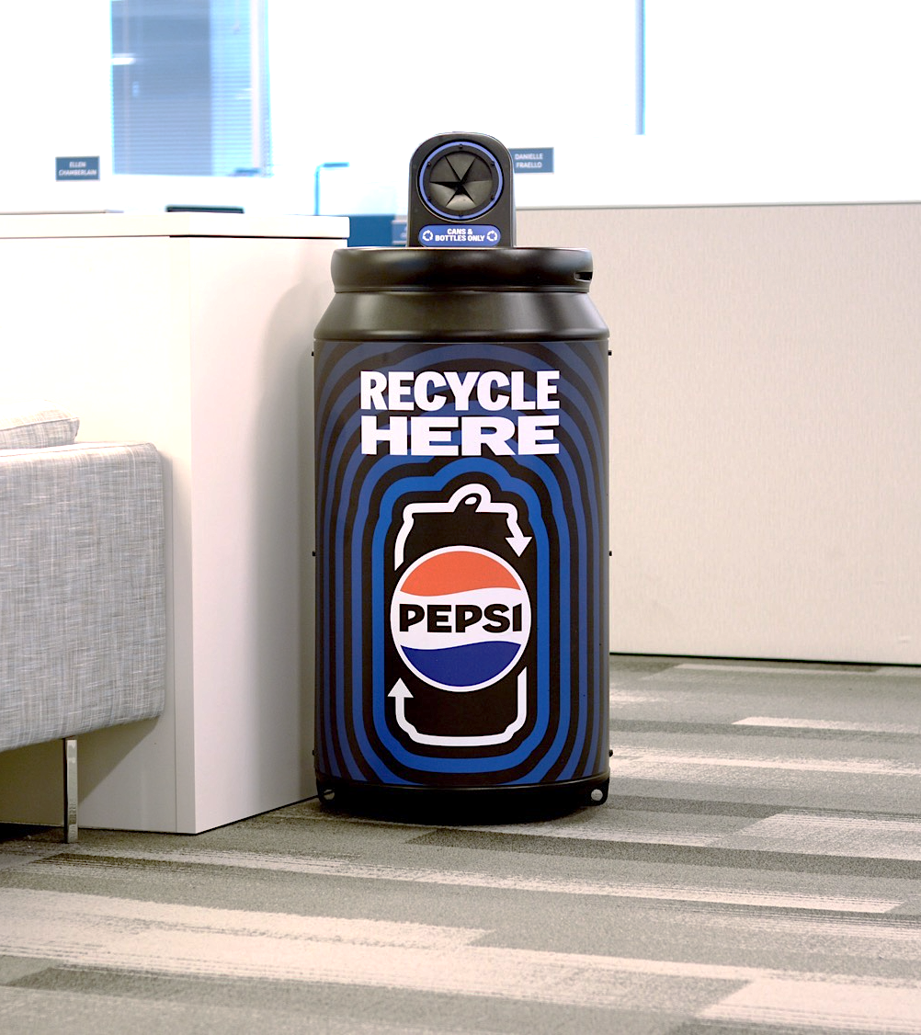
RECYCLING BINS
Recycling matters.
Consumers want to make the responsible decision to recycle after consuming our products, and we’re happy to provide recycling bins for plastic bottles and aluminum cans.
Together, let’s increase consumer access to recycling.
confidential and proprietary

Slide 14
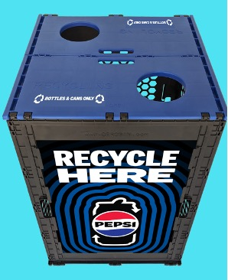
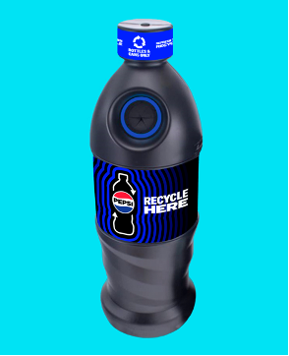
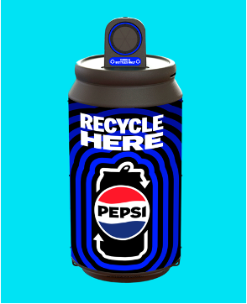
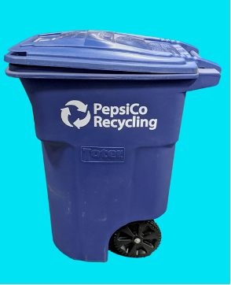

Pepsico offers recycling bins to suit customer needs
DURABLE, REUSABLE EVENT RECYCLING BINS
Available upon request for special events
BOTTLE COLLECTION BINS
Indoor or
Outdoor Use
Made of
100% recycled material
Recycling bins are optimized for beverage container recycling with round disposal holes and come with labeling for various waste streams such as:
Bottles Only
Cans Only
Bottles & Cans Only
Customization for some bins
may be available upon request.
CAN COLLECTION BINS
Indoor or
Outdoor Use
Made of
100% recycled material
96 GALLON TOTER
Best for
Outdoor Use
Made of
100% recycled material
14

Slide 15
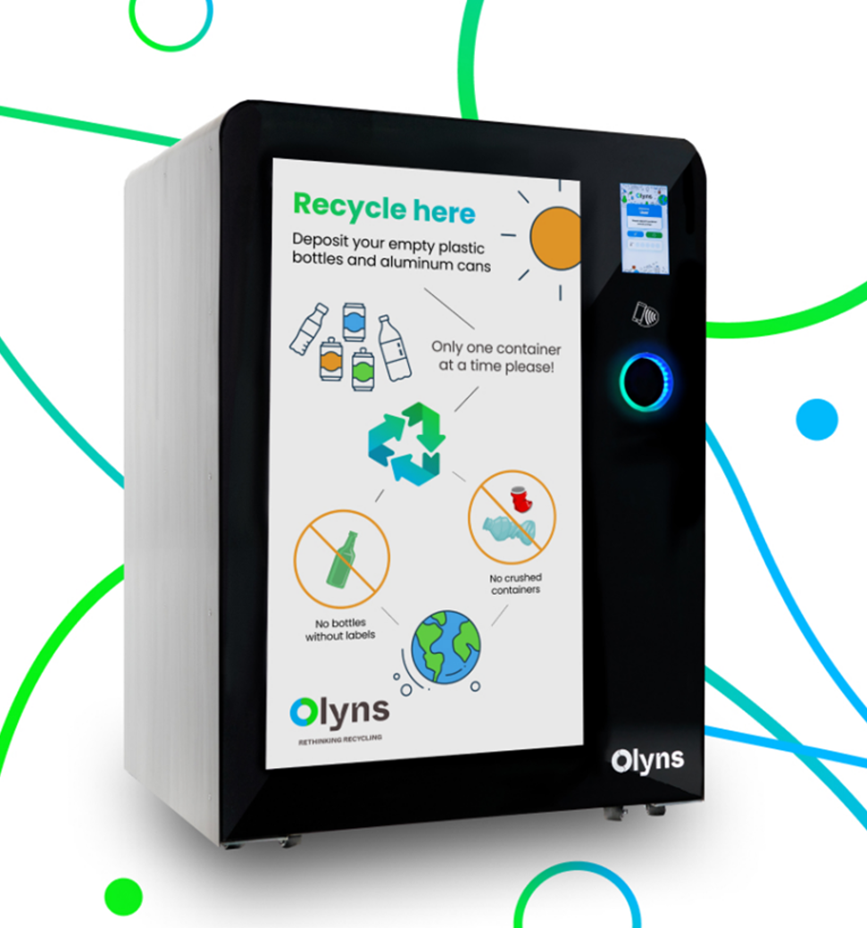




OLYNS REVERSE VENDING SOLUTION
Olyns cubes are AI-powered reverse vending machines for beverage container recycling. PepsiCo is investing in Olyns to drive circularity and provide an advanced recycling solution for consumers.
INNOVATIVE RECYCLING SOLUTION
TURNKEY COLLECTION
ADVERTISING CAPABILITIES
CONSUMER DATA & ANALYTICS
confidential and proprietary
Notes:
How makes a difference/or is a solution in pep+ agenda

Slide 16
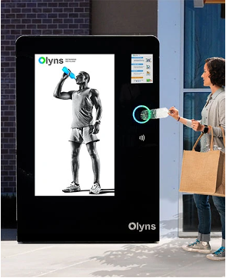
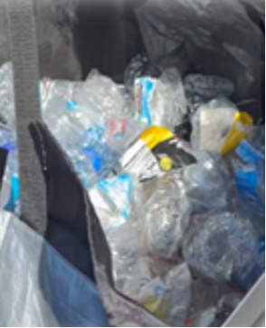
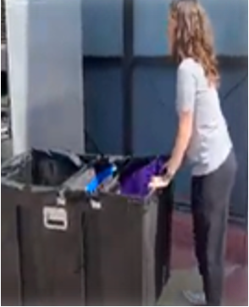
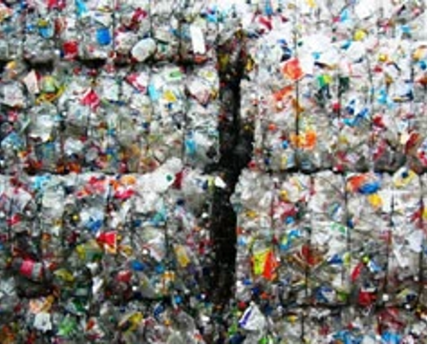
OLYNS: How it works
1. COLLECT MATERIAL
Eye-catching display calls on consumers to deposit empty bottles and cans via mobile app.
2. COMPACT & SORT
Bottles and cans are sorted and compacted inside the cube – capacity > 2,000 containers.
PILOT DETAILS
PepsiCo is partnering with Olyns to with expand the network in the state of Texas.
LOCATION: Austin, TX
REQUIREMENTS: High foot traffic
(~70K impressions/month required)
CHANNELS: Example venues include colleges & universities, stadiums, and transit hubs
TIMELINE: H2 2025 for placement
3. PICK UP
Retail or Foodservice Host does not need to touch. App enlists “gig workers” to service machine before it fills up.
4. BALE
& SHIP
Extremely high-quality bales are generated and shipped to bottle-to-bottle rPET processors.
16

Slide 17
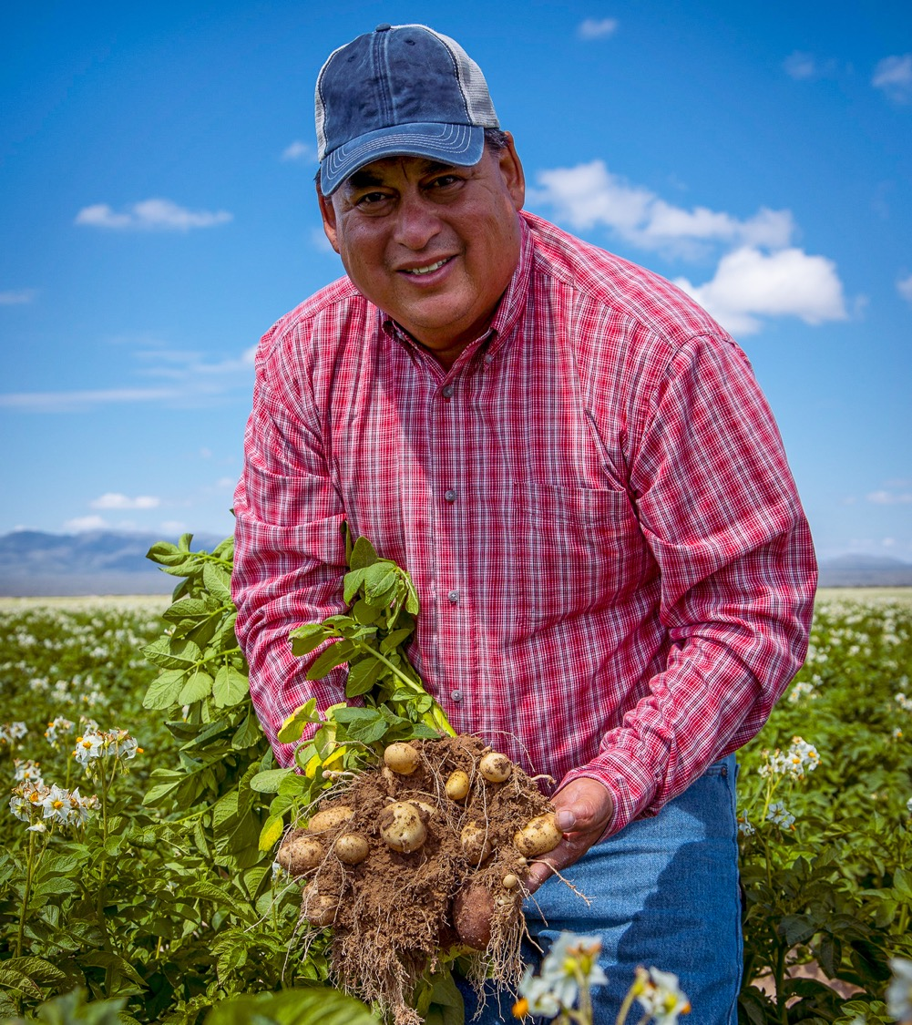
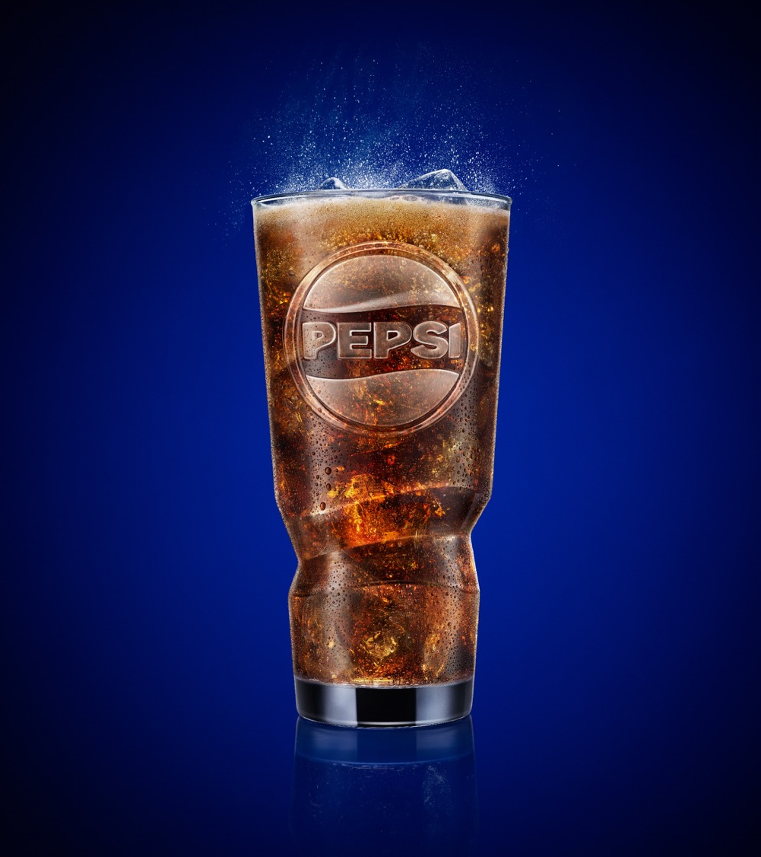
Sustainable fountain packaging portfolio
PepsiCo provides a suite of RECYCLABLE, REUSABLE, and COMPOSTABLE fountain packaging solutions.

Slide 18

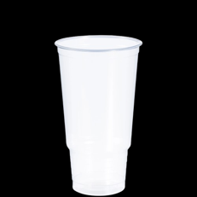
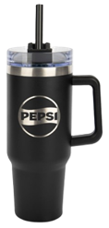
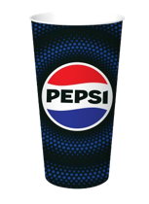
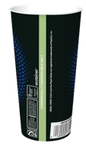
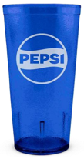


SUSTAINABLE FOUNTAIN PACKAGING PORTFOLIO
COMPOSTABLE
RECYCLABLE
REUSABLE
COMPOSTABLE CUPS
Commercially compostable
Sizes: 12, 16oz, 22oz, 32oz
PLASTIC CUPS
Recyclable plastic
Coming soon!
PERSONAL VESSELS
Personal cups for ‘bring-your-own-cup’ programs
Multiple styles
and sizes
Available on PepsiCo Premiums website
TRADITIONAL TUMBLERS
Dishwasher-safe tumblers
Sizes: 16oz, 20oz, 24oz plastic
Available on PepsiCo Partners website and PepsiCo Premiums website
EMBOSSED TUMBLERS
*NEW* updated design
Sizes: 20oz, 24oz plastic, 20oz glass
Available on PepsiCo Premiums website or through POS Direct
For more information on our sustainable
disposable cups, please visit the
PepsiCo Partners website
Notes:
Plan for end of life for any cups you purchase. Compostable cups should be commercially composted. The plastic cups are made of polypropylene plastic and can be recycled with many recycling partners.

Slide 19



Our reusable cup strategy has three key levers
Industry Partnerships
VALUE CHAIN-WIDE COLLABORATION
We participate in industry collaborations to identify and scale circular-solutions that can lead to systemic transformation.
Through the NextGen Consortium, we advance innovative projects with partners and our customers.
The Consortium is currently scoping a 2026 citywide multi-channel reusable cup pilot in California with opportunities to participate.
Turn-Key Solutions
SUSTAINABLE CUP SOLUTIONS
We offer easy-to-implement
solutions to help our restaurant
customers make sustainable choices
for fountain beverage cups.
Cups for Tomorrow includes cup options, plus FREE customer resources:
Cost savings calculator
Toolkit with step-by-step guidance for making the switch
Free downloadable signage
Customer Partnerships
PILOTS TO TEST
AND SCALE REUSE
We work with our customers on reuse pilot programs to:
Help our customers achieve their sustainability goals
Gather learnings that can help create better reuse programs & scale reuse systems
These pilots are focused on contained spaces and have included: Levi’s Stadium, Chase Field, and the Alaska Airlines Arena.
Participation details & contact info available on the Closed Loop Partners website.
For more information reach out to
your PepsiCo Account Manager!
Notes:
One pager

Slide 20
Our reusable cup strategy has three key levers
Industry Partnerships
VALUE CHAIN-WIDE COLLABORATION
We participate in industry consortium alongside our customers to identify and scale circular-solutions that can lead to systemic transformation
Turn-Key Solutions
SUSTAINABLE CUP
SOLUTIONS
We offer easy-to-implement solutions to help our customers make sustainable choices for fountain beverage cups
Customer Partnerships
CUSTOMER PARTNERSHIPS
TO TEST AND SCALE REUSE
We partner on reusable cup pilot programs with our customers to help them achieve their sustainability goals and gather learnings that can help scale reuse systems
1
2
3

Slide 21




1. INDUSTRY PARTNERSHIPS
PepsiCo participates in industry partnerships to identify and scale circular-solutions that can lead to systemic transformation.
Through the NextGen Consortium, we advance innovative fountain cup projects with our customers and partners. One recent example is the Petaluma Reusable Cup Project, a 3-month pilot of a city-scale reusable cup program with both local and national partners. This project helped avoid over 220,000 single-use cups.
The Consortium is currently scoping a 2026 citywide multi-channel reusable cup pilot in California with opportunities for our customers to join the initiative. Additional details and contact information available on the Closed Loop Partners website.

Slide 22

2. Turnkey solutions
REUSABLE TUMBLERS
Reusable tumblers for our restaurant
customers interested in transitioning
from single-use to reusable cups
ACTION PLAN
Step-by-step guide to switching to
reusables including staff training
materials and printable signage
SAVINGS MODEL FOR SMALL, MEDIUM, LARGE RESTAURANTS
Data from reuse non-profit Upstream showing the economic and environmental savings for restaurants switching to reusables
The Cups for Tomorrow website offers FREE resources that equip our restaurant partners with the tools they need to transition from disposable cups to reusable cups for on-site dining seamlessly.
22

Slide 23












3. Pepsico reusable cup pilot partnerships
CFG BANK ARENA
CHASE FIELD
ALASKA AIRLINES ARENA
OREGON CONVENTION CENTER
LEVI’S STADIUM
13,000+
SINGLE-USE
CUPS AVOIDED
Apr 2023-Jun 2023
Three-month full arena pilot for all beverages including CSD’s and alcoholic beverages
38,000+
SINGLE-USE
CUPS AVOIDED
Jul 2024-Sep 2025
12 oz. cups in Bar S
All You Can Eat Seats & 16 oz. cups in Estrella Jalisco Cantina
23,000+
SINGLE-USE
CUPS AVOIDED
Nov 2024-April 2025
20 oz. cups for Alaska Airlines Arena for Basketball, Volleyball, Gymnastics
14,000+
SINGLE-USE
CUPS AVOIDED
Permanent as of March 2025
Added 24 oz. cups for CSDs to the customer’s existing reuse tray program
32,000+
SINGLE-USE CUPS AVOIDED PER GAME (PROJECTED)
Aug 2025-Jan 2026
16 oz. cups for United and Graton Winner’s Clubs for all 10 games of
2025-2026 season
Notes:
THE OSCAR EXPERIENCE
OSCAR IS IDLE: During this time, you have the option to show custom static or video content (~30%). Intuitive AI will also be able to display their curated ad content that aligns with any exclusions that you have (~70%). Custom content can be updated on a monthly basis.
APPROACH: Here, Oscar introduces itself instructs how to show an item. This is a co-branded Pepsi & customer interface, which continues throughout the rest of the experience.
SORT: Oscar then instructs how to sort the item in the correct bin. The items shown as examples of each waste stream can be customized according to the specific waste streams you have on site.
FEEDBACK/REWARD: Oscar then responds with real time good job/bad job feedback. [INTERNAL NOTE: Customization not available here] It may also be possible to participate in a PepsiCo-led rewards campaign across multiple Oscars during a specified period, one time per year for a month.
TRIVIA: At this stage, at the end of the sorting process, Intuitive AI may choose to display a quiz or trivia to engage users with environmental or climate literacy content.
FUNDING
This Oscar Experience is based on an investment of $2,000/year per Oscar Sort for software subscription services (starting in Y2 of placement). Funding can be covered by marketing or sustainability budgets.
Year 1 is fully funded by the PBNA Sustainability team.
At the end of the first year, there are three options to proceed:
Customer can choose to keep their Oscars onsite with current co-branded UX ($2,000 per Oscar for the following year should be transferred to PBNA Sustainability team)
Customer can choose to keep their Oscars onsite for $365 per year, but without any co-branding (customer and PepsiCo), custom content, or waste analytics. Oscar simply keeps nudging consumers to sort their waste.
Customer can choose to have the Oscars removed. Before 1 year from placement, there is no charge. After Y1, PBNA sustainability charges $1,000 (to marketing/sustainability funding) to decommission each Oscar Sort.

