Slide 1








RESOURCE :
PEP+ CLIMATE AND ENERGY GOALS & RESOURCES
ADDITIONAL RESOURCES:
FOR QUESTIONS OR
MORE INFORMATION:
PEPSICO SUSTAINABILITY
PepsiCo’s hub for strategy, goals, and progress on our PepsiCo Positive journey.
SHANNA PARRA
shanna.parra@pepsico.com
ESG TOPICS A-Z
This online resource explores the sustainability topics that matter to our business key stakeholders, from A-Z.
CATHERINE WALTON
catherine.walton@pepsico.com
LATEST ENVIRONMENTAL, SOCIAL AND GOVERNANCE (ESG)
REPORT
Access PepsiCo’s ESG metrics and reports, which are updated on a rolling basis.
NICOLE POPOWSKI
nicole.popowski@pepsico.com

Slide 2


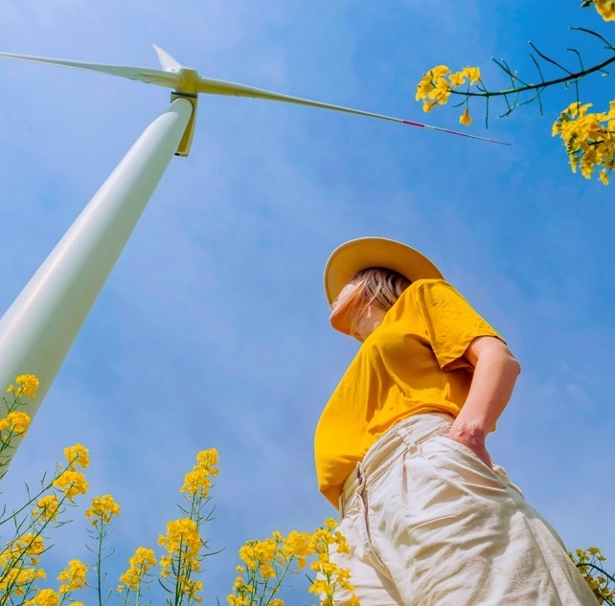


For a full list of pep+
goals, click here
Positive VALUE
CHAIN: CLIMATE
ESG Topics A-Z
Our Approach
We’re transforming our value chain to be more circular, inclusive, and innovative to benefit communities and the planet.
Scope 1 & 2 Emissions
Achieve a 50% reduction
in Scope 1 and 2 emissions
by 2030 (vs 2022 baseline)
Scope 3 E&I Emissions
Achieve a 42% reduction in
Scope 3 Energy and Industry
(E&I) by 2030 (vs 2022 baseline)*
Goal tracks Scope 1 and 2 emissions consistent with the Greenhouse Gas Protocol.
See Calculation Methodology for detail.
Scope 3 FLAG
Achieve a 30% reduction in Scope 3 Forest, Land and Agriculture (FLAG) emissions by 2030 (vs 2022 baseline)
*Goal tracks energy- and industry-related Scope 3 emissions consistent with the Greenhouse Gas Protocol's Scope 3 Standard and the Science Based Target Initiative’s Corporate Net-Zero Standard V1.2. See Calculation Methodology for details on how these emissions are calculated and categories included in scope of this goal.
Renewable Electricity
Achieve 100% renewable
electricity in company —
owned operations by 2030
Goal tracks Scope 3 emissions based on purchased goods emissions consistent with the Greenhouse Gas Protocol's draft Land Sector and Removals Guidance and Standard and the Science Based Target Initiative's Forest, Land and Agriculture (FLAG) Guidance. See Calculation Methodology for details on how these emissions are calculated and categories included in scope of this goal.
Net-Zero Ambition
Achieve net-zero emissions
by 2050 or sooner
Refer to our Climate Transition Plan for more information.
In working to achieve this goal, PepsiCo uses a diversified portfolio of solutions, including energy attribute certificates.
2
Notes:
NET ZERO EMISSIONS
Reduce GHG emissions in the near-term and strive for net zero emissions in the longer-term.

Slide 3
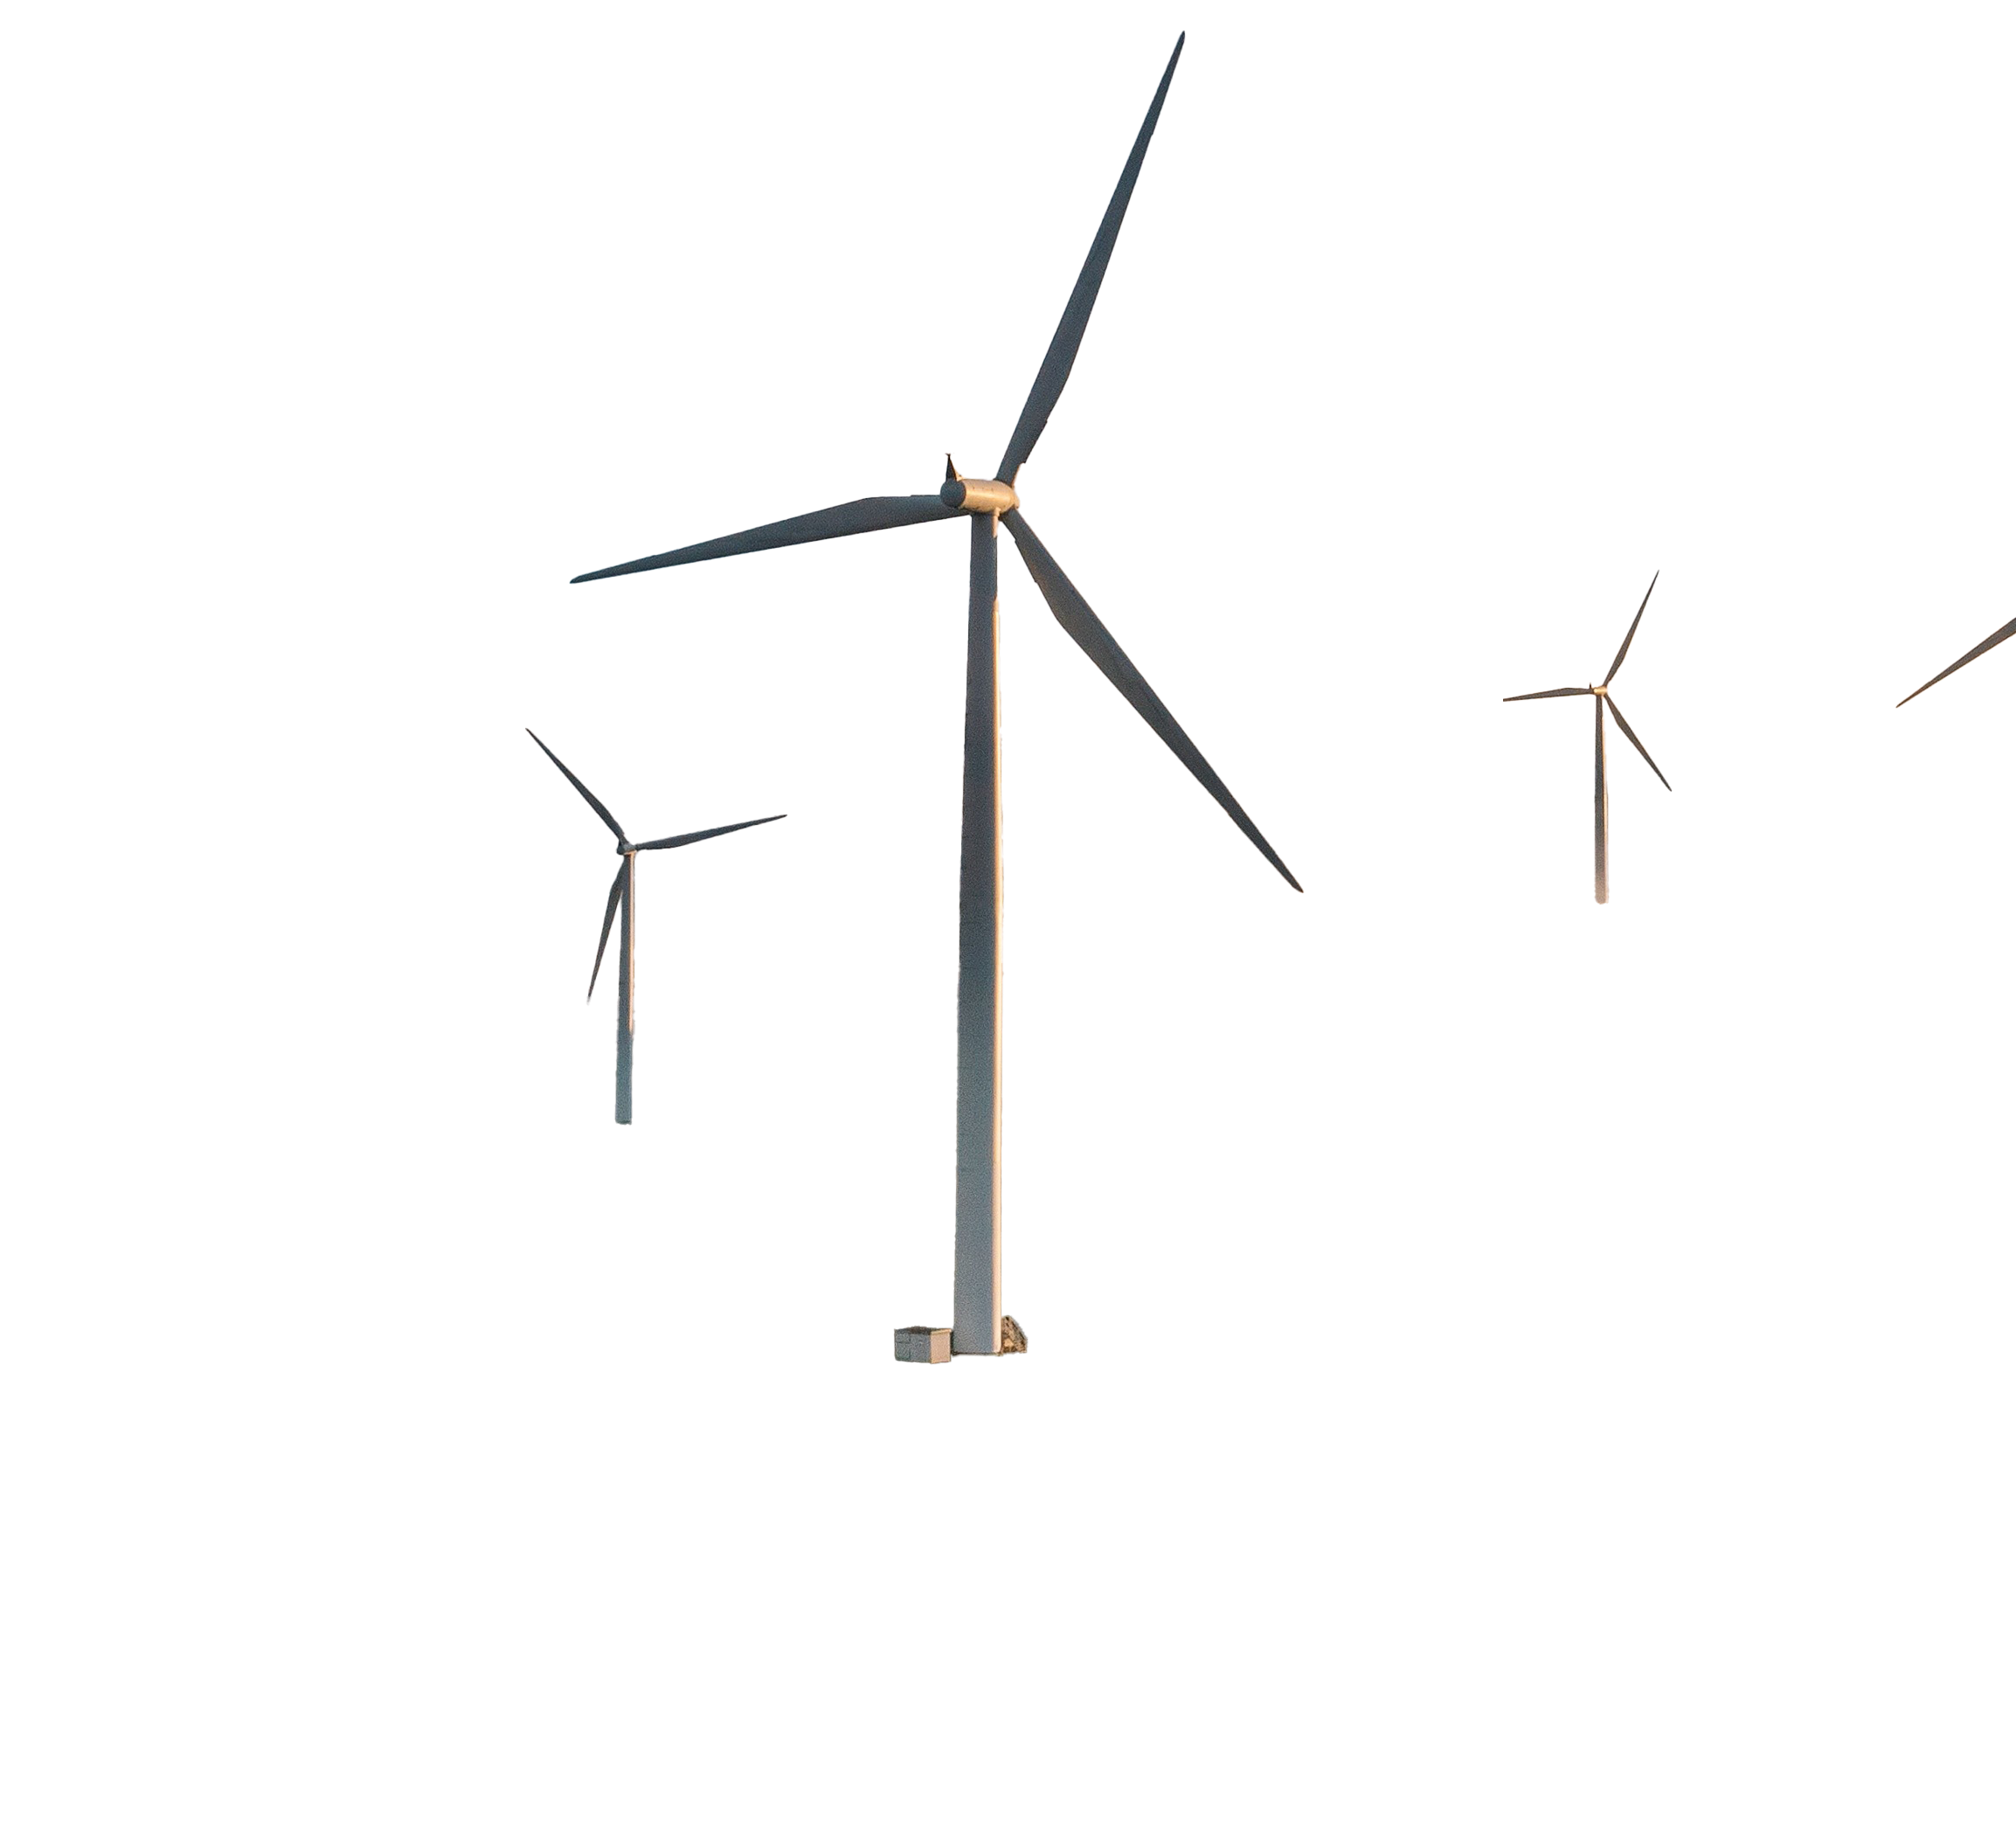
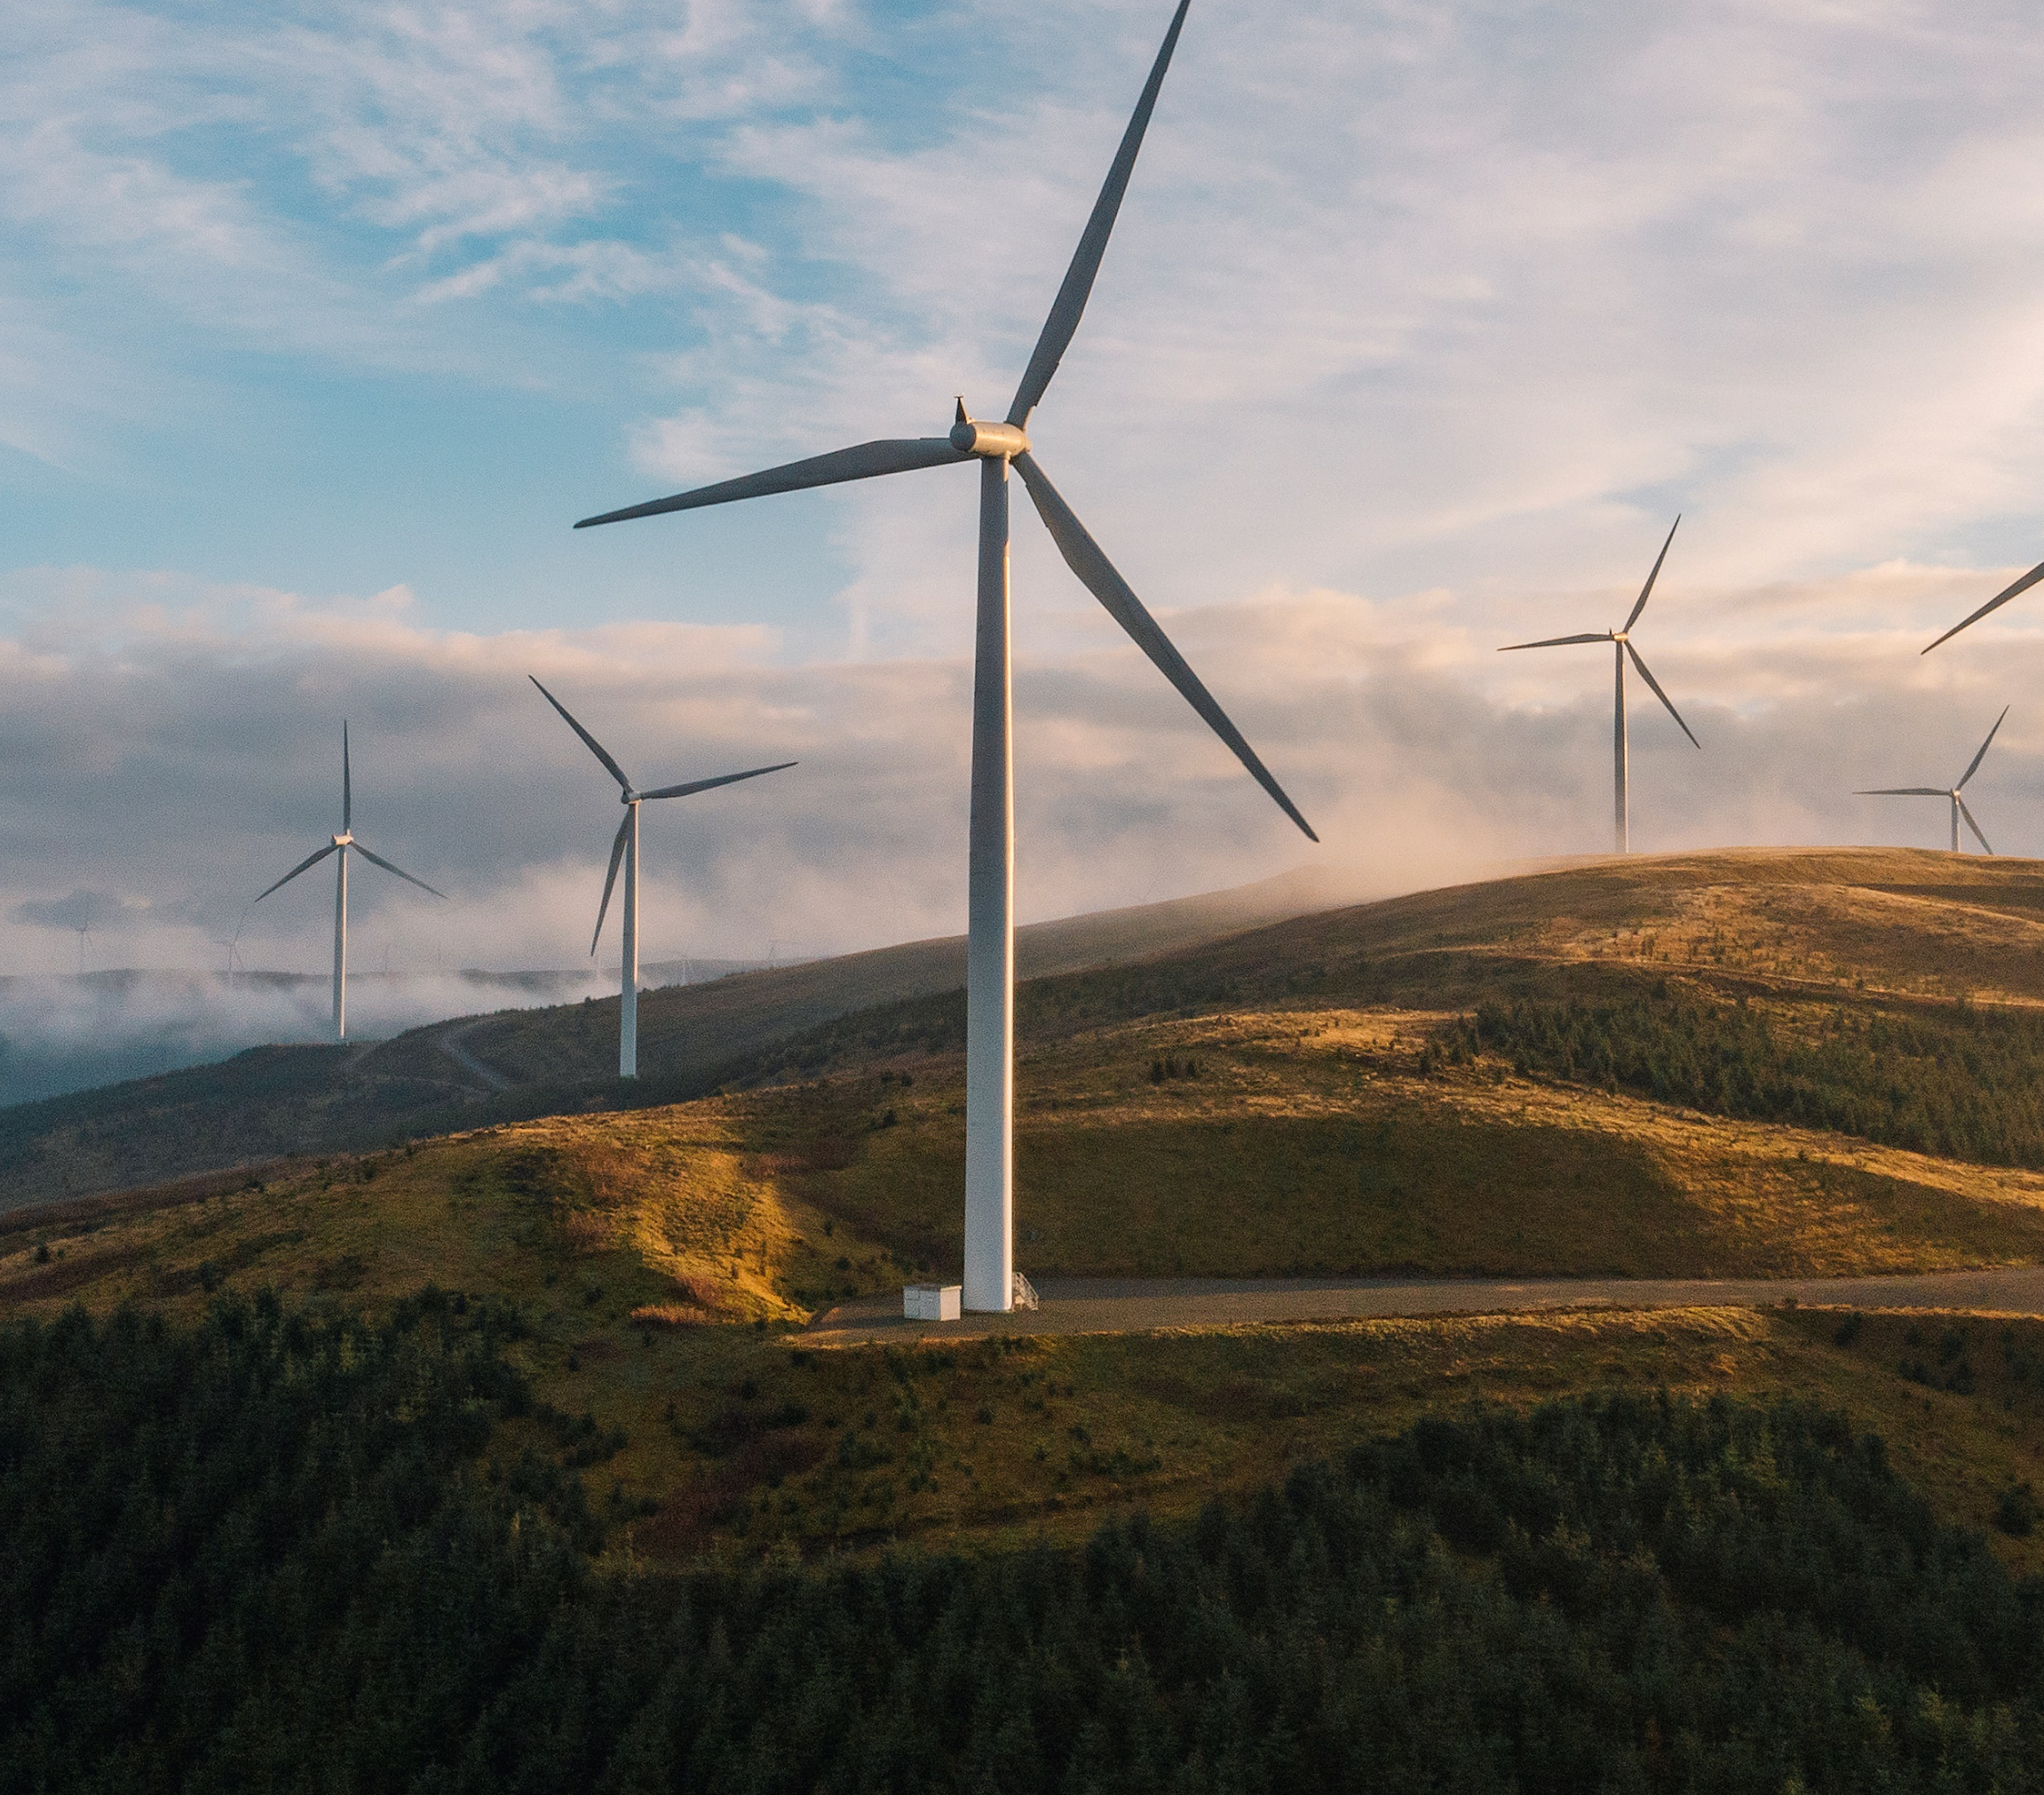

pep+
REnew
PepsiCo’s flagship program to advance renewable electricity education and adoption within it’s value chain

Slide 4
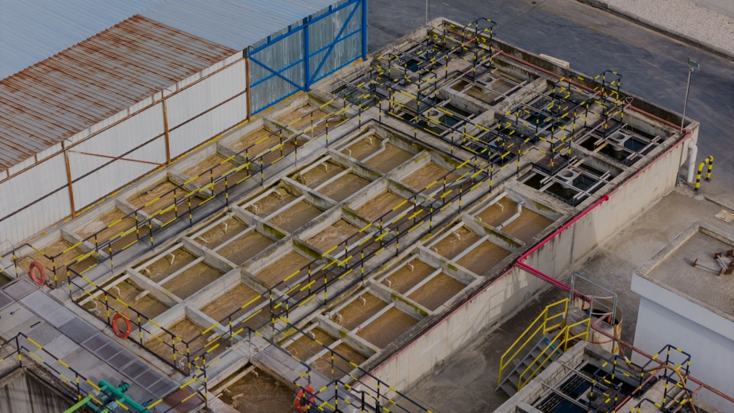

POSITIVE VALUE CHAIN
WHAT IS PEP+ REnew?
Partnership to adopt Renewable Energy
PepsiCo created pep+ REnew with Schneider Electric, an independent advisor on renewable energy purchasing. The goal is to help value chain partners adopt renewable electricity to reduce their carbon footprint.
WHO IS IT FOR?
NEXT STEPS
PepsiCo Value Chain Partners (VCPs) at all levels of climate maturity. From those just starting out to companies who have been making climate progress
for years.
1
Register for the program
It’s free
Learn about RE in a no-pressure space with support and resources
WHAT’S OFFERED?
2
Develop Renewable Energy Roadmap
Build cost into financial algorithms
Engage SE & Pep for execution support
Education for VCPs about their renewable
electricity choices
Renewable electricity purchasing opportunities
3
Join PPA Cohort or Purchase EACs
2nd N. America VPPA cohort is now forming
Immediate recognition of investment
Virtual Power Purchase Agreements (VPPA)
Energy Attribute Certificates
(EAC) (aka RECs)
REGISTER TODAY
https://hub.zeigo.com/peprenew

Slide 5

PepsiCo’s Flagship Renewable Electricity Program Pep+ REnew has been successfully Supporting Value Chain Re adoption since 2022
Program Objective : Accelerate RE Adoption within PepsiCo’s value chain through providing no cost RE education, advisory support and opportunities to cost down RE procurement through group purchasing.
>250
participating companies
4
Active regions
2
Completed PPA Cohorts
Suppliers
North America
North America
Contract Manufacturers
LATAM
Europe
Bottlers
Europe
(In progress) LATAM
APAC
(In progress) APAC
In 2026...
We are expanding the program into new markets (India) and expanding the scope of impact beyond PepsiCo’s Tier 1 suppliers, bottlers and contract manufacturers.

Slide 6


Who we are
partnering with
Depending on the global market, we tailor our pep+ REnew advisory partner to ensure our value chain is working with the leading expertise in market
SUPPORTING OUR VALUE
CHAIN TO TRANSACT IN
SUPPORTING OUR VALUE
CHAIN TO TRANSACT IN
North
America
LATAM
EMEA
India
APAC

Slide 7

pep+ REnew brings value to participants through creating opportunities for learning and collaboration
Opportunity
Benefits
Free Market-specific RE buying options & Information at your fingertips
Educational Videos and Market Briefs
Expert RE purchasing advisory support at the click of a button
Access to Advisory Support
Opportunity to unlock more favorable, long-term RE pricing and supply through Power Purchase Agreement Cohorts
Group Purchasing Opportunities

