Slide 1








RESOURCE :
PEP+ AGRICULTURE GOALS & RESOURCES
ADDITIONAL RESOURCES:
FOR QUESTIONS OR
MORE INFORMATION:
PEPSICO SUSTAINABILITY
PepsiCo’s hub for strategy, goals, and progress on our PepsiCo Positive journey.
SHANNA PARRA
shanna.parra@pepsico.com
ESG TOPICS A-Z
This online resource explores the sustainability topics that matter to our business key stakeholders, from A-Z.
CATHERINE WALTON
catherine.walton@pepsico.com
LATEST ENVIRONMENTAL, SOCIAL AND GOVERNANCE (ESG)
REPORT
Access PepsiCo’s ESG metrics and reports, which are updated on a rolling basis.
NICOLE POPOWSKI
nicole.popowski@pepsico.com

Slide 2
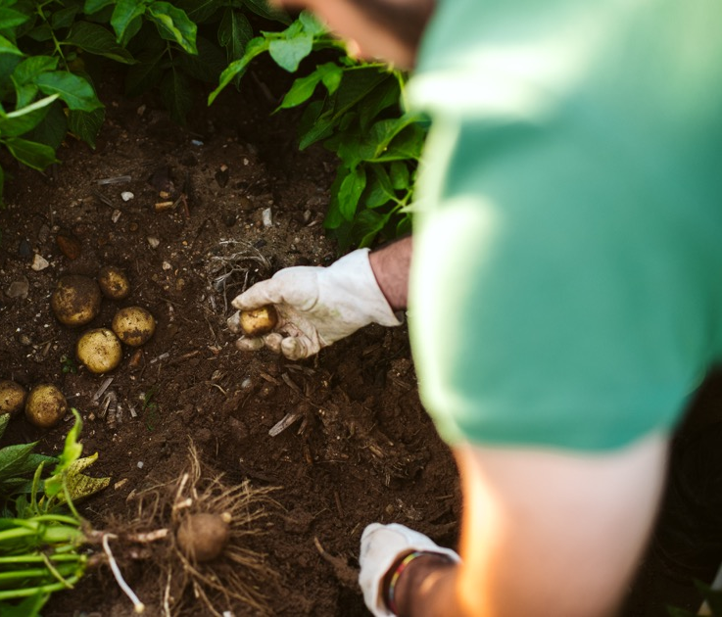



ESG Topics A-Z
For a full list of pep+
goals, click here
Positive agriculture
ESG Topics A-Z
Our Approach
We're collaborating to help transform the way the crops we source are grown, by supporting agricultural practices that aim to restore soil health, reduce water use and emissions and improve biodiversity — all while supporting farmers and farming communities.​
Regenerative Agriculture
Spread the adoption of regenerative agriculture, restorative, or protective practices across 10 Million acres of land by 2030* supporting the growth of our key crops and ingredients by ​
Sustainably Sourced Ingredients
Sustainably source 90% of our key ingredients and progress volumes (10% or less) that face systemic barriers towards being sustainably sourced in accordance with our guidelines, by 2030*​
*See PepsiCo’s Regenerative Agriculture Guidelines for additional information, including details on key crops and regeneration, restoration and protection criteria. Results represent the total acreage meeting these criteria as of the end of the reported year.​
*Sustainably sourced refers to in-scope ingredient volumes that meet the established criteria outlined in PepsiCo’s Sustainable Sourcing Guidelines. Sustainable Sourcing practices can help manage risks, but challenges like deforestation or social issues can persist in some regions​.
Deforestation and
Conversion-Free Sourcing
Continue to strive toward deforestation-free sourcing by 2025 and toward deforestation- and conversion-free sourcing by 2030 for high-risk commodities in our company-owned and -operated activities*​
Livelihoods
Improve the livelihoods of more than 250,000 people in our agriculture supply chain and supporting communities by 2030*​
*PepsiCo set this ambition in its Stewardship of Forests and Natural Ecosystems Policy. High-risk commodities include ingredients and materials at high risk of deforestation and conversion as defined in our Calculation Methodology. Systemic challenges continue to be an industry-wide barrier to reaching fully deforestation-free sourcing, but we continue striving toward this ambition and expect to reach more than 90% by the end of 2025​.
*This goal captures the number of livelihoods reached through an outcome-focused evaluation measuring improvements in economic prosperity and farmer and farm worker security. Metric counts the cumulative people impacted since 2021​.
2

