Slide 1








RESOURCE :
PEP+ U.S. RECYCLING GOALS & RESOURCES
ADDITIONAL RESOURCES:
FOR QUESTIONS OR
MORE INFORMATION:
PEPSICO SUSTAINABILITY
PepsiCo’s hub for strategy, goals, and progress on our PepsiCo Positive journey.
SHANNA PARRA
shanna.parra@pepsico.com
ESG TOPICS A-Z
This online resource explores the sustainability topics that matter to our business key stakeholders, from A-Z.
CATHERINE WALTON
catherine.walton@pepsico.com
LATEST ENVIRONMENTAL, SOCIAL AND GOVERNANCE (ESG)
REPORT
Access PepsiCo’s ESG metrics and reports, which are updated on a rolling basis.
NICOLE POPOWSKI
nicole.popowski@pepsico.com

Slide 2


TABLE OF CONTENTS
01
OUR STRATEGY TO IMPROVE CIRCULARITY
U.S. Recycling Toolkit
02
QUESTIONS TO ASK THE CUSTOMER
03
CUSTOMER PROGRAMS
CONFIDENTIAL

Slide 3

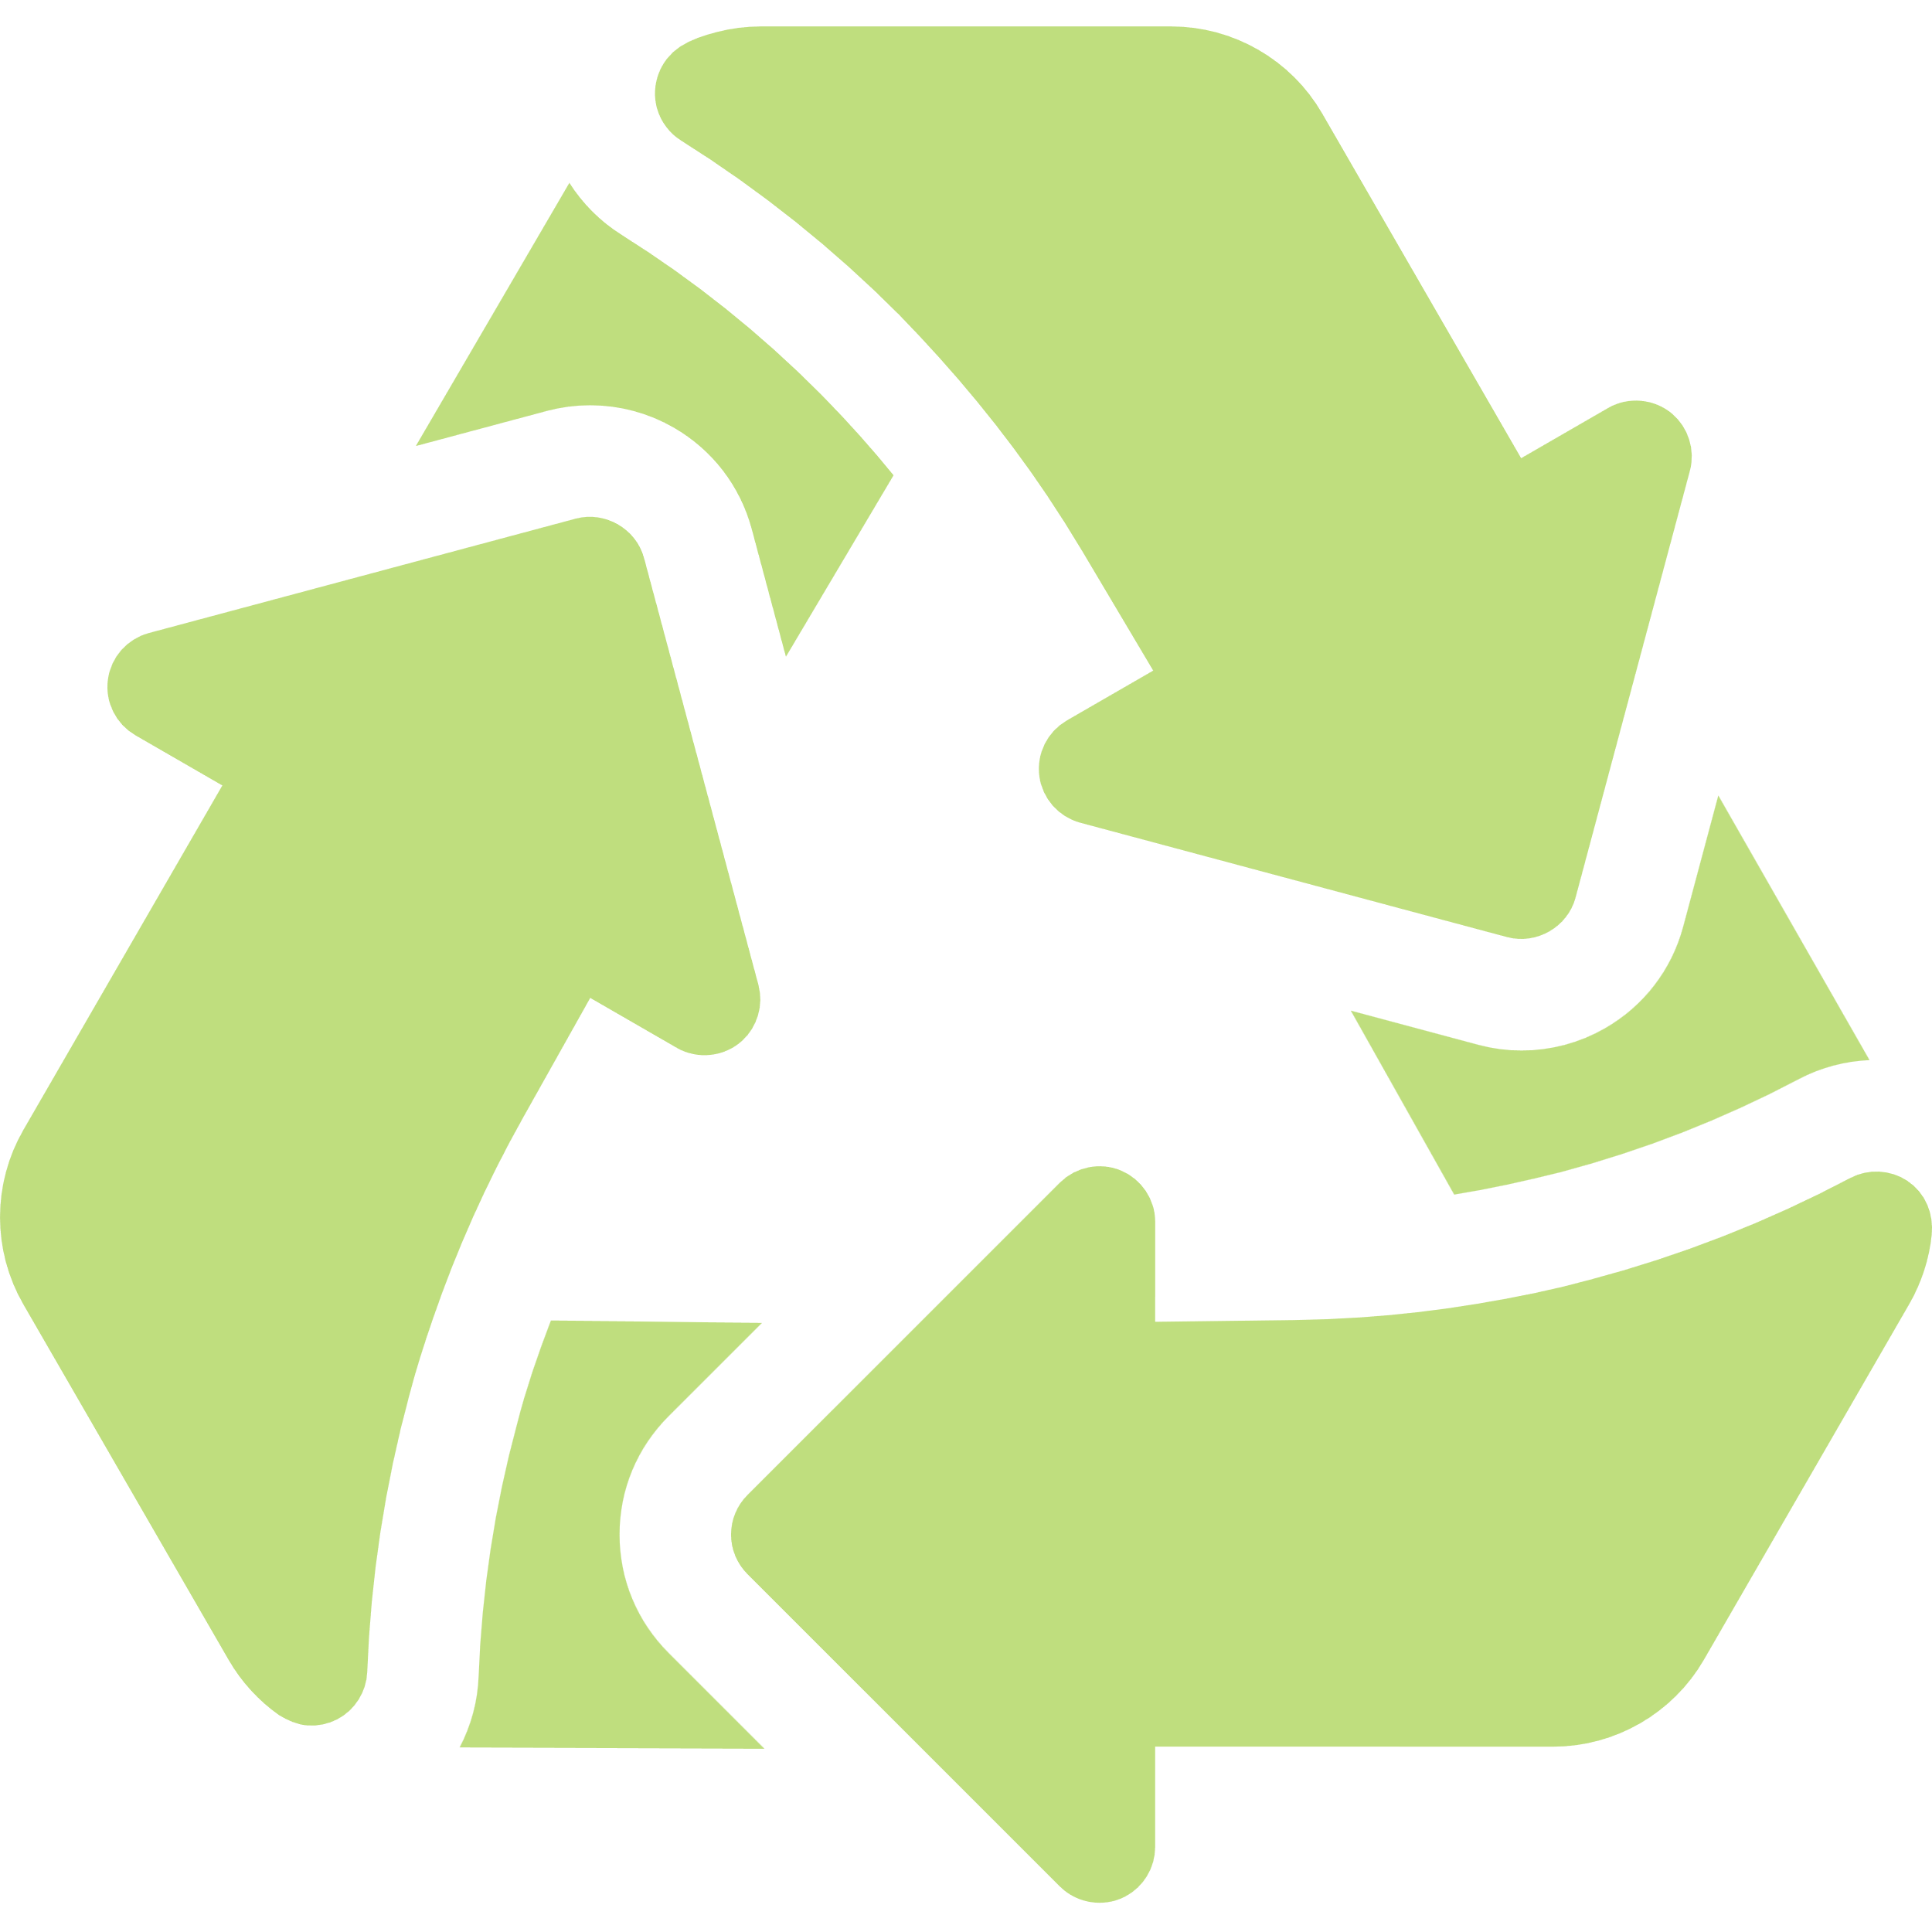

PepsiCo’s sustainable packaging vision is to help build a world where packaging never becomes waste.
INTERNAL ONLY
WE TAKE A THREE-PRONGED APPROACH TO REALIZING OUR VISION,
AND RECYCLING PLAYS A LARGE ROLE.
REDUCE
RECYCLE
REINVENT
Reducing the amount of virgin
plastic we use.
Supporting recycling and a circular economy for recycled materials.
Reinventing how we deliver products: Through exploring
low-packaging formats, reuse models and the use of alternative packaging materials
such as non-plastic and compostable solutions.

Slide 4
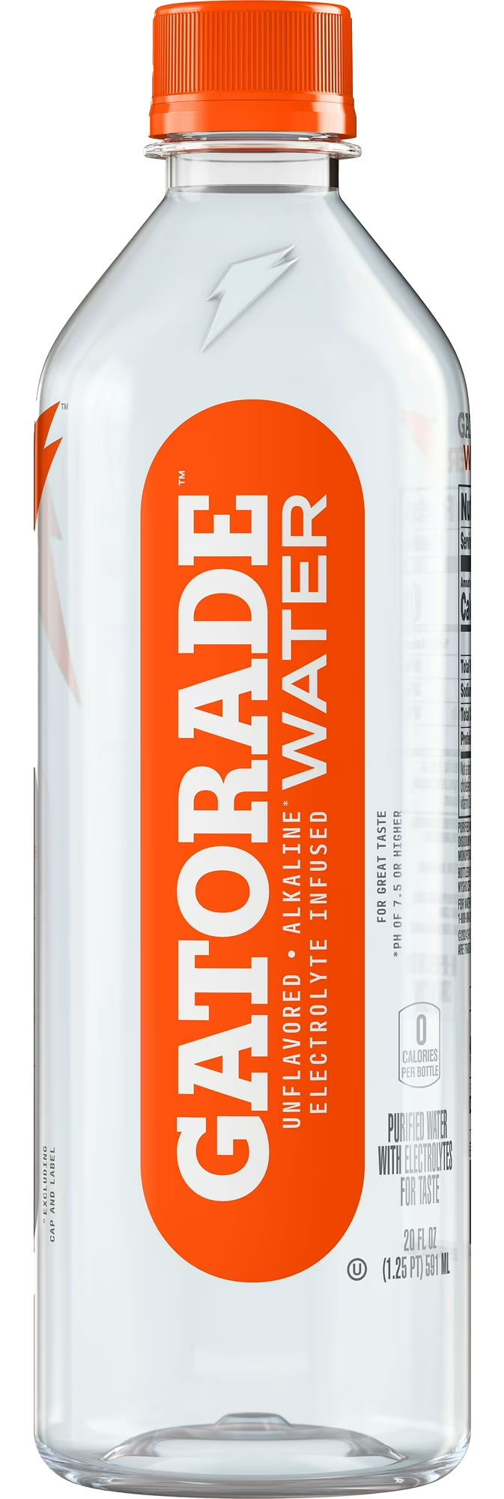
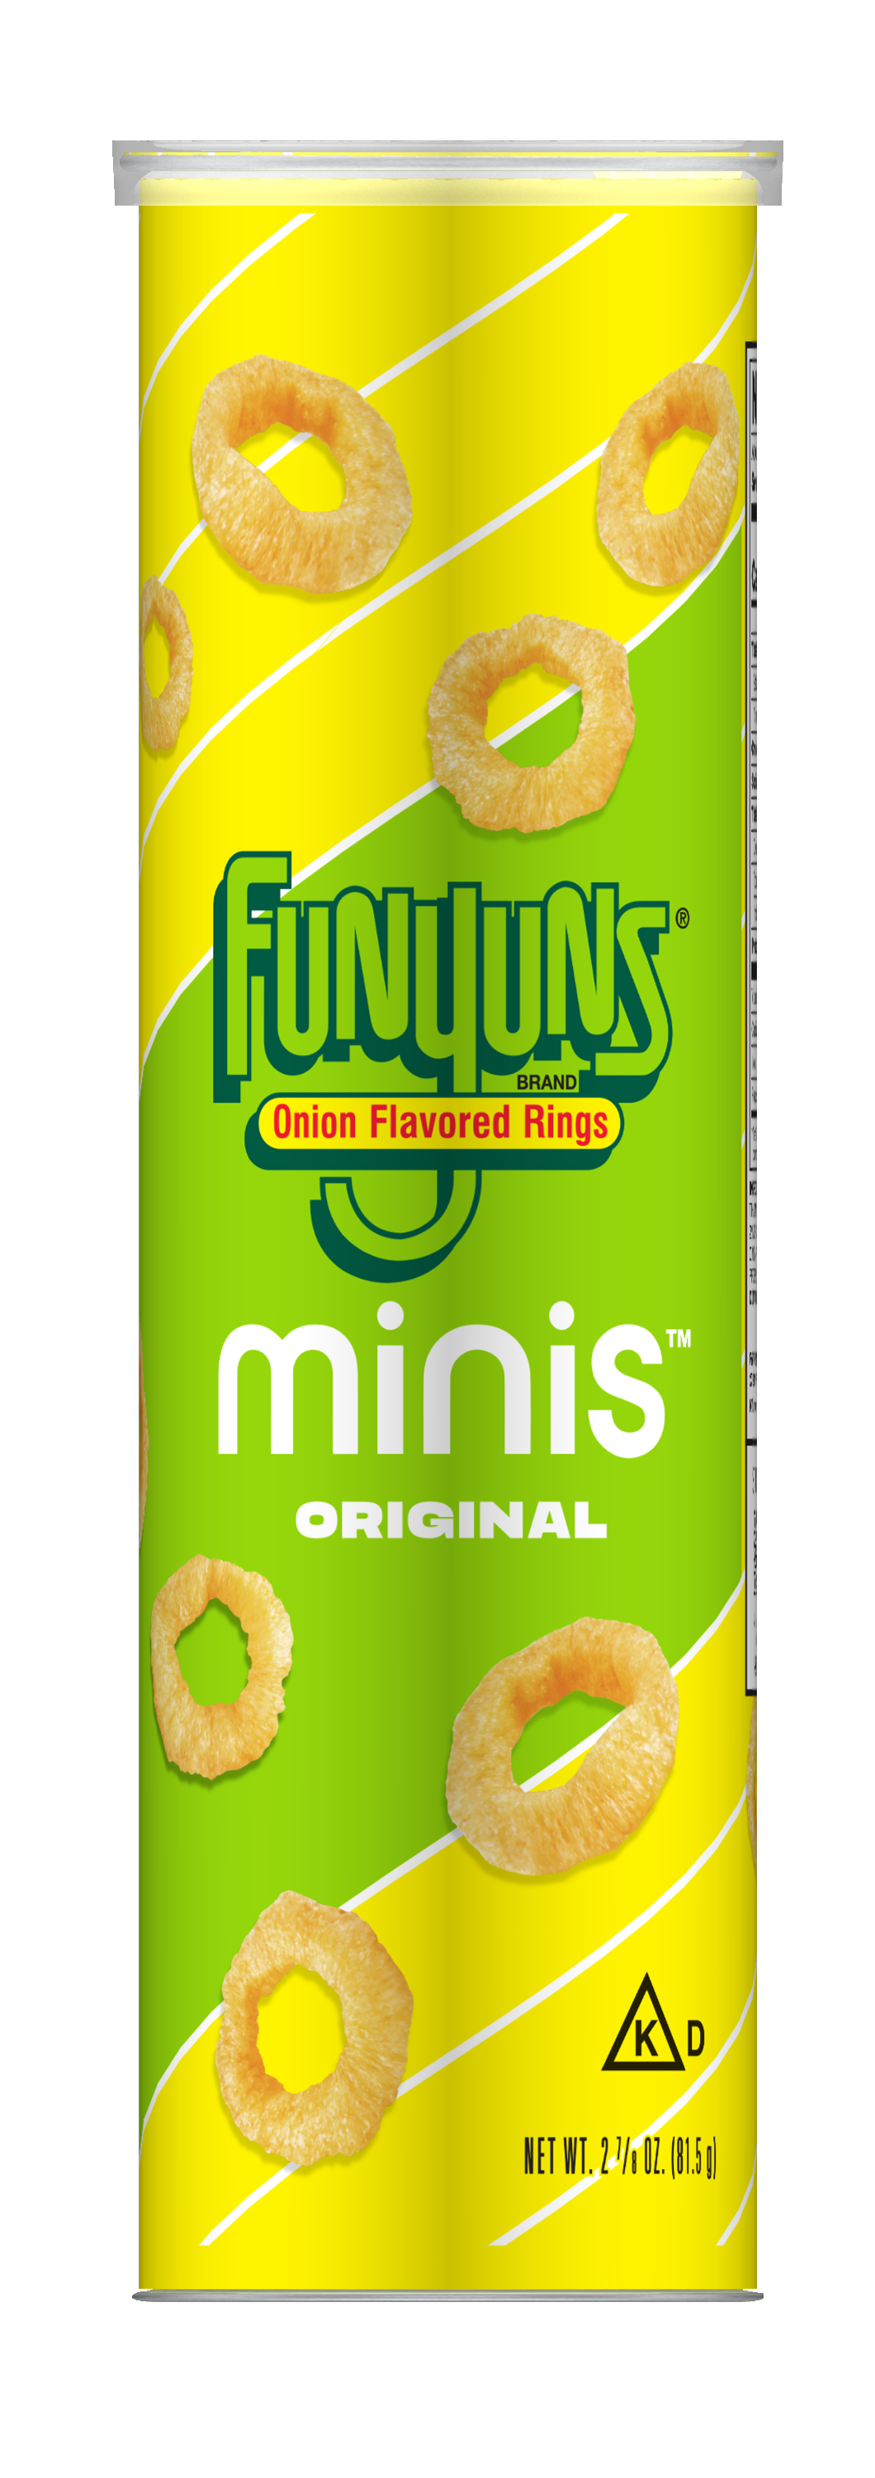

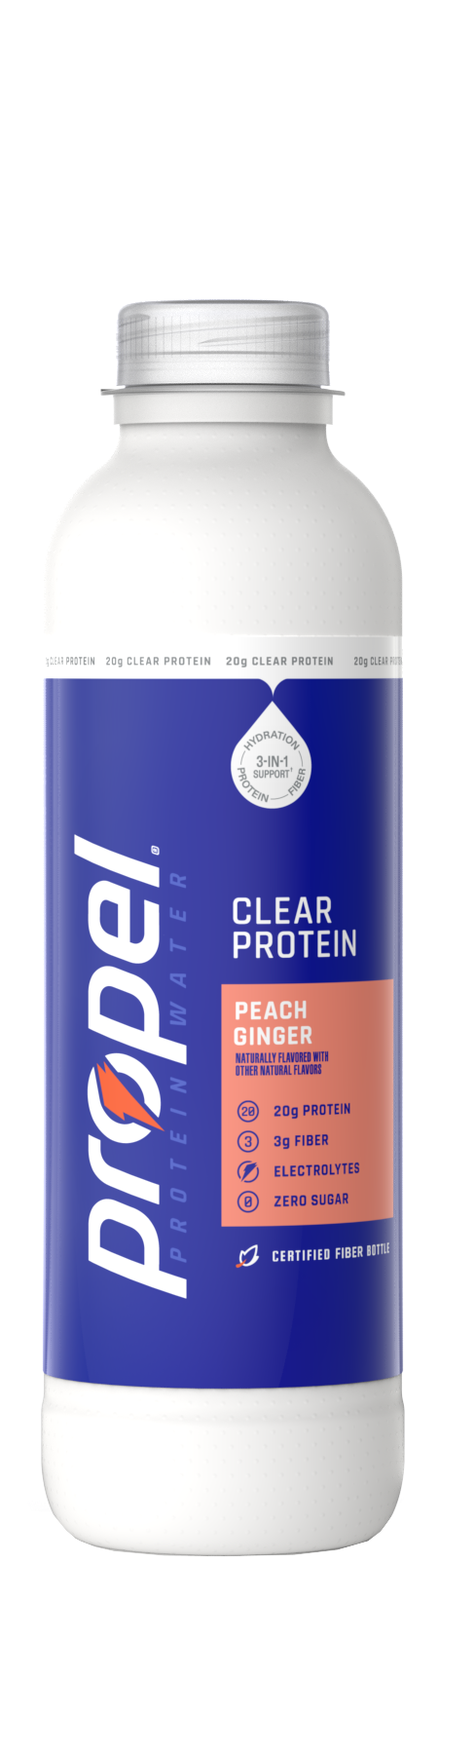
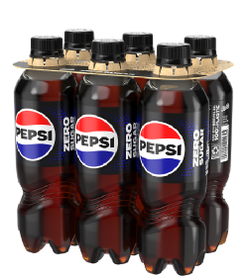
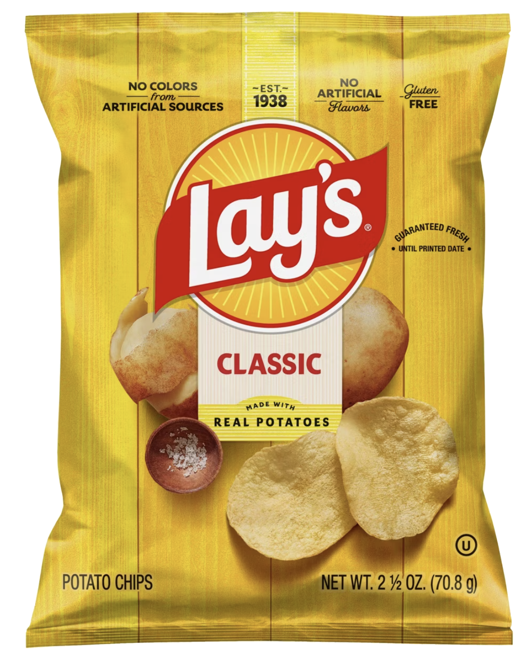

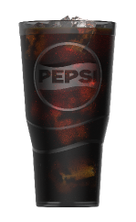
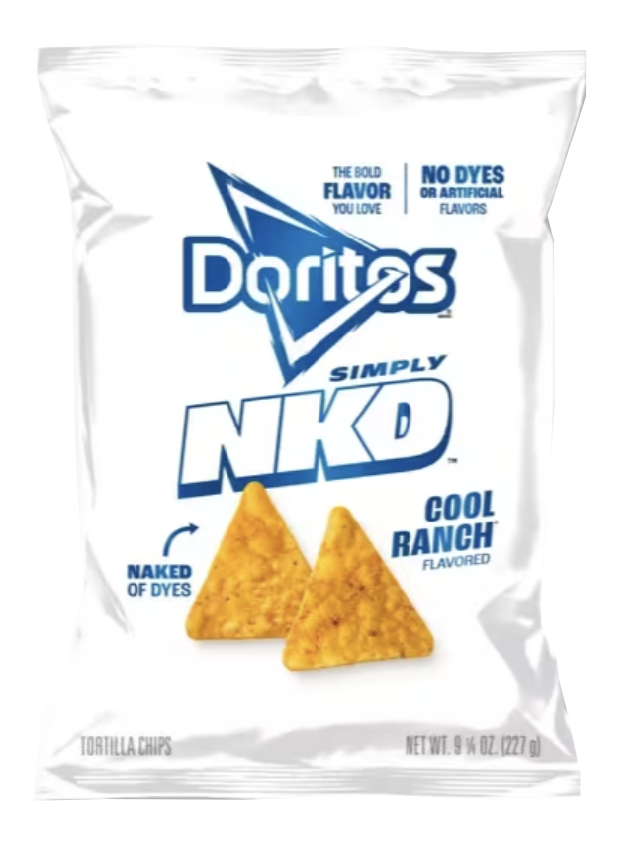
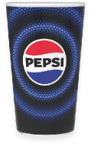
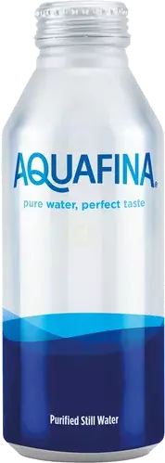
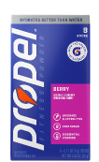

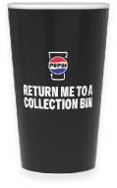

We have multiple PEP+ goals to help drive the future of more sustainable packaging
Improved US recycling system with consistent domestic supply of recycled material helps enable these goals
Achieve an average 2% YoY reduction in absolute tonnage of virgin plastic through 2030¹
40%+ recycled content by 2035 or sooner¹
97%+ RRC Compliance by design by 2030^{1,2}
PRIVILEGED & CONFIDENTIAL
PRIVILEGED & CONFIDENTIAL
4
Notes: 1. Goal tracks primary plastic packaging in PepsiCo’s key packaging markets. This scope represents more than 80% of PepsiCo’s 2024 global plastic packaging footprint (by weight). 2. Achieve 97% or greater reusable, recyclable, or compostable (RRC) packaging by design by 2030 in our primary and secondary packaging in our key packaging markets Reusable packaging must also be designed to be recyclable or compostable
4
Notes:
Opening
“This slide outlines our three PEP+ packaging goals. You may have seen these before, but they’re worth revisiting because they directly explain why recycling and packaging choices matter for our business.”
Goal 1: Reduce virgin plastic
“Our first goal is reducing virgin plastic. We’re targeting an average 2% year‑over‑year reduction in absolute tonnage through 2030. The encouraging news is that we’re tracking well, especially in North America.
On beverages, we’re lightweighting bottles and adding recycled material across more parts of the package, including closures. We’re also taking advantage of aluminum more, and I know we’re working on providing a plastic free portfolio for you. On the foods side, we’ve shifted from multi‑pack sacks to cubes, and our new compaction technology across the chips portfolio puts us on track to reduce virgin plastic by about 14 million pounds each year.
Goal 2: Increase recycled content
“Second, we’re working toward 40% or more recycled content in plastic packaging by 2035, or sooner. In the U.S., we’re already in a strong position today, with roughly a quarter to a third of our packaging as recycled content.”
Goal 3: Design for circularity
“And third, we’re designing all of our packaging to be reusable, recyclable, or compostable by 2030. Here in the US, we’re already almost meeting this goal”
Closing
What’s important to recognize is that these goals reinforce one another. Reducing virgin plastic, increasing recycled content, and designing for recycling all reinforce and help one another, and it’s why an improved US recycling system is an enabler for us. I did a little research and did see that UC Berkeley has a goal to go zero waste which I think is really amazing and would love to hear how that’s going.

Slide 5
INTERNAL ONLY
The U.S. has further to go in its collection and recycling journey…
THE SYSTEMIC CHALLENGES IN THIS RECYCLING JOURNEY ARE SIGNIFICANT AND COMPLEX.
Low collection and recycling rates
Inconsistent access to recycling infrastructure
Varying levels of engagement around recycling
Low quality of recycled material
Emerging EPR / DRS in place at state level
CONFIDENTIAL

Slide 6
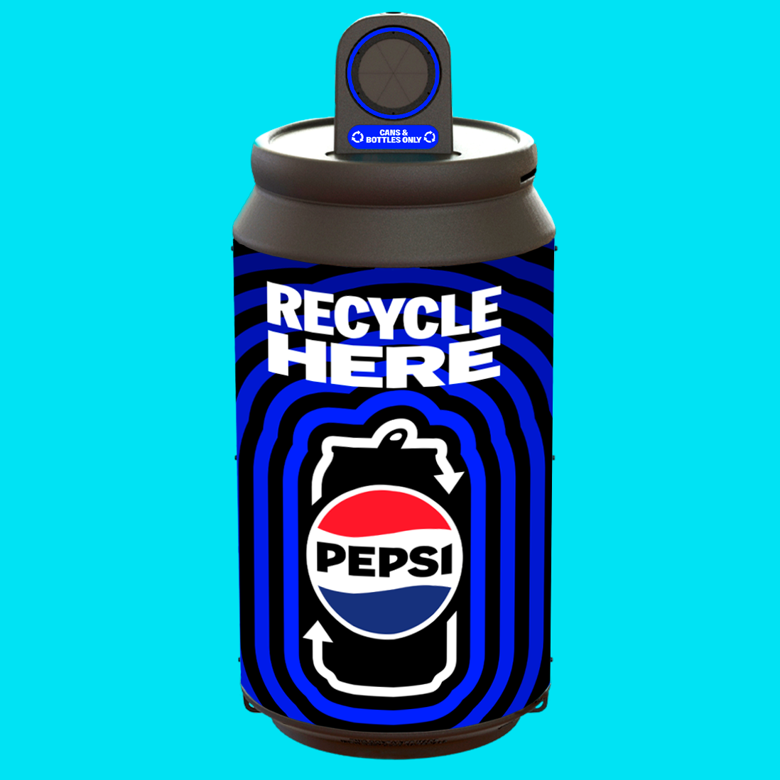






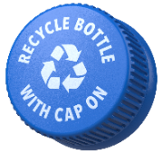


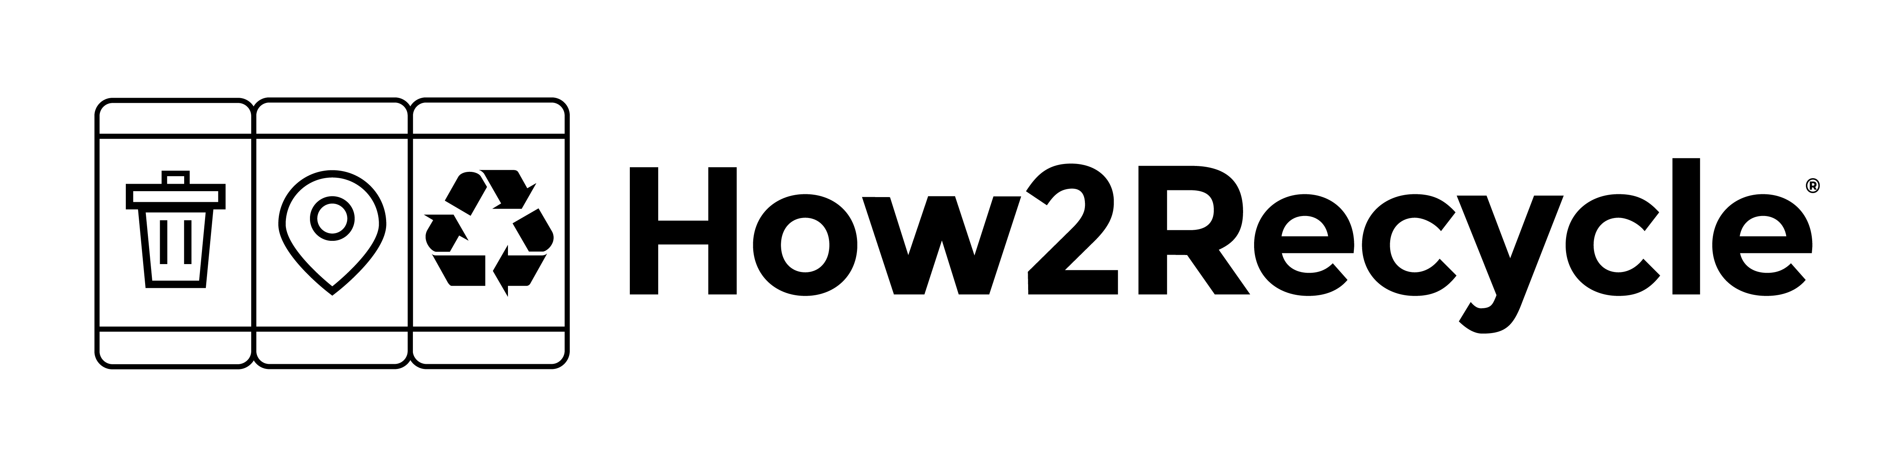
Customer Programs
Policy & Infrastructure Support
OUR U.S. STRATEGY
TO IMPROVE CIRCULARITY FOCUSES ON INVESTING
IN KEY AREAS
Industry Partnership
Supporting consumer education & stakeholder engagement
CONFIDENTIAL

Slide 7

Customer Programs
OUR U.S. STRATEGY
TO IMPROVE CIRCULARITY FOCUSES ON INVESTING
IN KEY AREAS
This Toolkit focuses on the Customer Programs available to our customers in the United States.
Informational purposes only
For customer pitch slides, please visit the Commercial Sustainability Toolkit
CONFIDENTIAL

Slide 8



INTERNAL ONLY
DO YOU RECYCLE AT YOUR LOCATION(S)?
If you think your customer can benefit from a recycling program, it’s important to ask them the following questions.
  IF YES
    What materials do you recycle?
    Do you have a recycling service provider?
    Do you sort recyclables, or is it a single stream system?
    What are the most pressing challenges you face with recycling?
    Do visitors actively participate?
  IF NO
    Have you considered setting up a recycling program before?
    What are the major barriers keeping you from recycling?
    Ex: Lack of local programming, don’t know how to start, lack of buy-in, etc.
CONFIDENTIAL
8

Slide 9
The answers will help us determine how we can support.
INTERNAL ONLY
EXAMPLE CUSTOMER RESPONSE | POTENTIAL PROGRAM RECOMMENDATIONS
Yes, we recycle – but we need more recycling bins across the location. | Recycling Bins, Recycling Bin Messaging & Placement Guide
Yes, we recycle – but we are looking to save money on hauling costs. | CIRQU
Yes, we recycle – and we sort our plastic from aluminum (not single stream) | CIRQU
Yes, we recycle – but we have a serious problem with contamination / need to boost overall engagement. | Oscar Sort, Recycling Bin Messaging & Placement Guide
Yes, we recycle – and we’d love to do some community outreach or spread the word about our sustainable initiatives. | CIRQU, Oscar Sort
Yes, we recycle – and we’d like to do something innovative together to amplify our program. | Oscar Sort
No, we don’t recycle (because it’s not available in my region, because it’s too expensive, etc.) but we want to get something started. | CIRQU, Recycling Bins, Recycling Bin Messaging & Placement Guide, Oscar Sort
CONFIDENTIAL
9
Notes:
Do you recycle at your location(s)?

Slide 10
CUSTOMER PROGRAMS

Slide 11


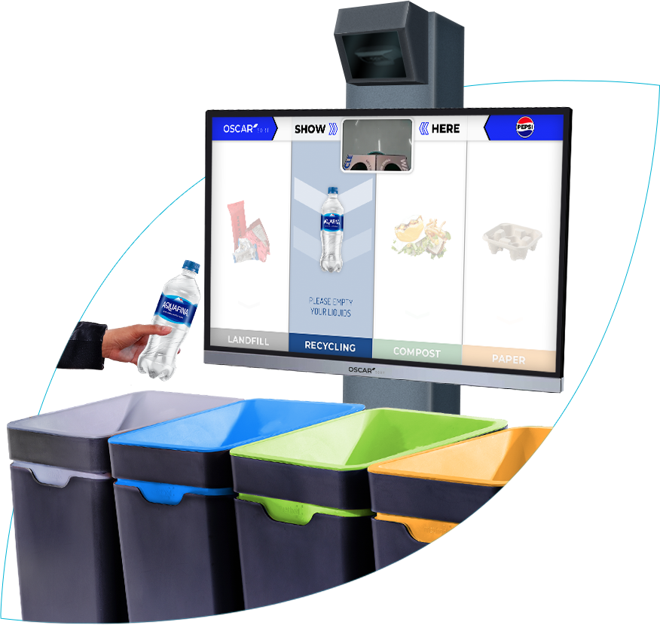


OSCAR SORT
Taking the guesswork out of recycling
INTERNAL ONLY
ABOUT
Oscar Sort is an AI trash sorting assistant that will guide customers to sort items into the correct streams in a fun and engaging way. Using advanced AI vision detection, Oscar Sort is designed to seamlessly integrate with our customers’ facilities.
CHANNELS
Partners with high traffic, onsite consumption of B&C, and high sales or collection volume that already have recycling service. Possible to pair with CIRQU in instances where there is no recycling service. Locations such as: C&U, event venues, arenas, stadiums, zoos, aquariums, parks, shopping malls, airports, etc.
KEY REQUIREMENTS
Recycling Service: Customer must have recycling service (to prevent recyclable materials from being trashed).
Power: Standard 120V outlet
Funding: Yearly funding requirement (see below)
See it in action!
COST
NA Sustainability funds the hardware, shipping, installation, and Y1 of software services. Starting in Y2, there is a yearly funding requirement of $2,000/year per Oscar Sort for recurring software services. Following Y1, decommissioning fee of $1,000 applies if Oscar needs to be removed. These funds can be embedded into beverage sales agreements.
HOW TO ACTIVATE
Contact the NA Sustainability Team to determine Oscar availability. Following participation confirmation, an onboarding call will introduce customer to Intuitive AI (Oscar Sort partner) and Intuitive AI will handle next steps (placement agreement, compiling ad restrictions, creative assets, shipping info, etc.)

Slide 12
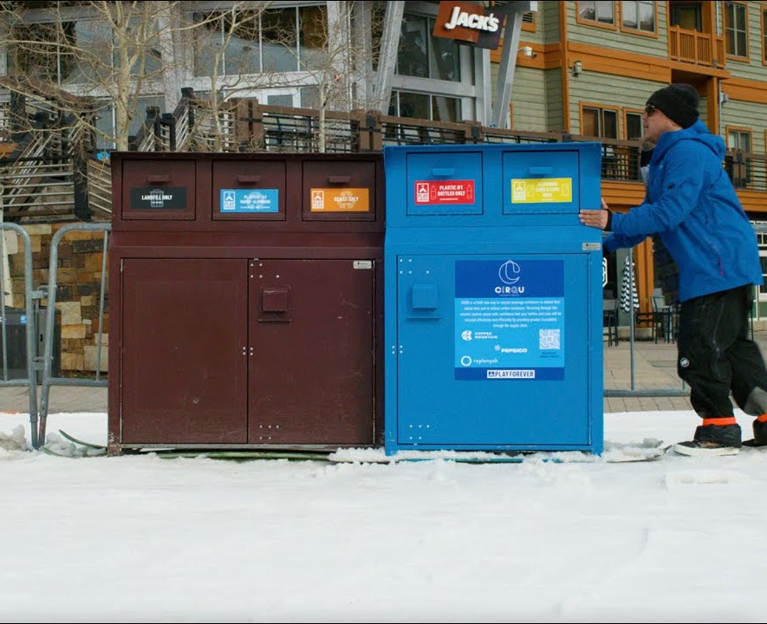
Note: New Customer Participation Currently On Hold
As the program undergoes enhancements, we will not be onboarding new locations outside of the Denver market in 2026. We appreciate your patience as we evaluate and implement new models designed to better serve our customers and maximize environmental impact. Customers interested in future participation are encouraged to register their interest using this link: PepsiCo CIRQU Program Interest Form – Fill out form
CIRQU
Linking our customers’ empties with our rPET supply chain to create circularity
INTERNAL ONLY
ABOUT
CIRQU is helping to drive a circular economy for aluminum and PET beverage containers. Our innovative solution, run in partnership with Replenysh, enables businesses to recover valuable materials, minimize waste, and contribute to packaging circularity. With our platform, customers can measure their impact, engage their stakeholders, and accelerate their sustainability journey.
CHANNELS
Partners with high traffic, onsite consumption of B&C, and high sales or collection volume that have no recycling service, want to save $ on service, or already have service but want to track impact and engage stakeholders. Locations such as: C&U, large resorts, office spaces, large event venues, arenas, or stadiums, zoos, aquariums,
or parks.
Note: New Customer Participation Currently On Hold
As the program undergoes enhancements, we will not be onboarding new locations outside of the Denver market in 2026. We appreciate your patience as we evaluate and implement new models designed to better serve our customers and maximize environmental impact. Customers interested in future participation are encouraged to register their interest using this link: PepsiCo CIRQU Program Interest Form – Fill out form
KEY REQUIREMENTS
Location & Volume: Customer must a) be in a current CIRQU market, or b) generate enough volume to justify opening a new market. We must collect enough aluminum to offset cost of transporting materials to a local Replenysh operator.
Storage: Unless local PBNA market can backhaul recycling (explored first for all new CIRQU markets) customer may require indoor storage space, or space to place a
20 ft. shipping container in a parking space.
Sorting: Customer must commit to sorting PET from aluminum.
See it in action!
COST
NA Sustainability sponsors CIRQU, making participation free for eligible customers. Customer sales teams may need to help with one time storage fees, or they may choose to help the customer purchase front of house recycling bins. See page 17 for CIRQU brand recycling bin options.
HOW TO ACTIVATE
Contact the NA Sustainability Team to determine customer eligibility.
Notes:
Change the picture to supersacks
Change out the video

Slide 13
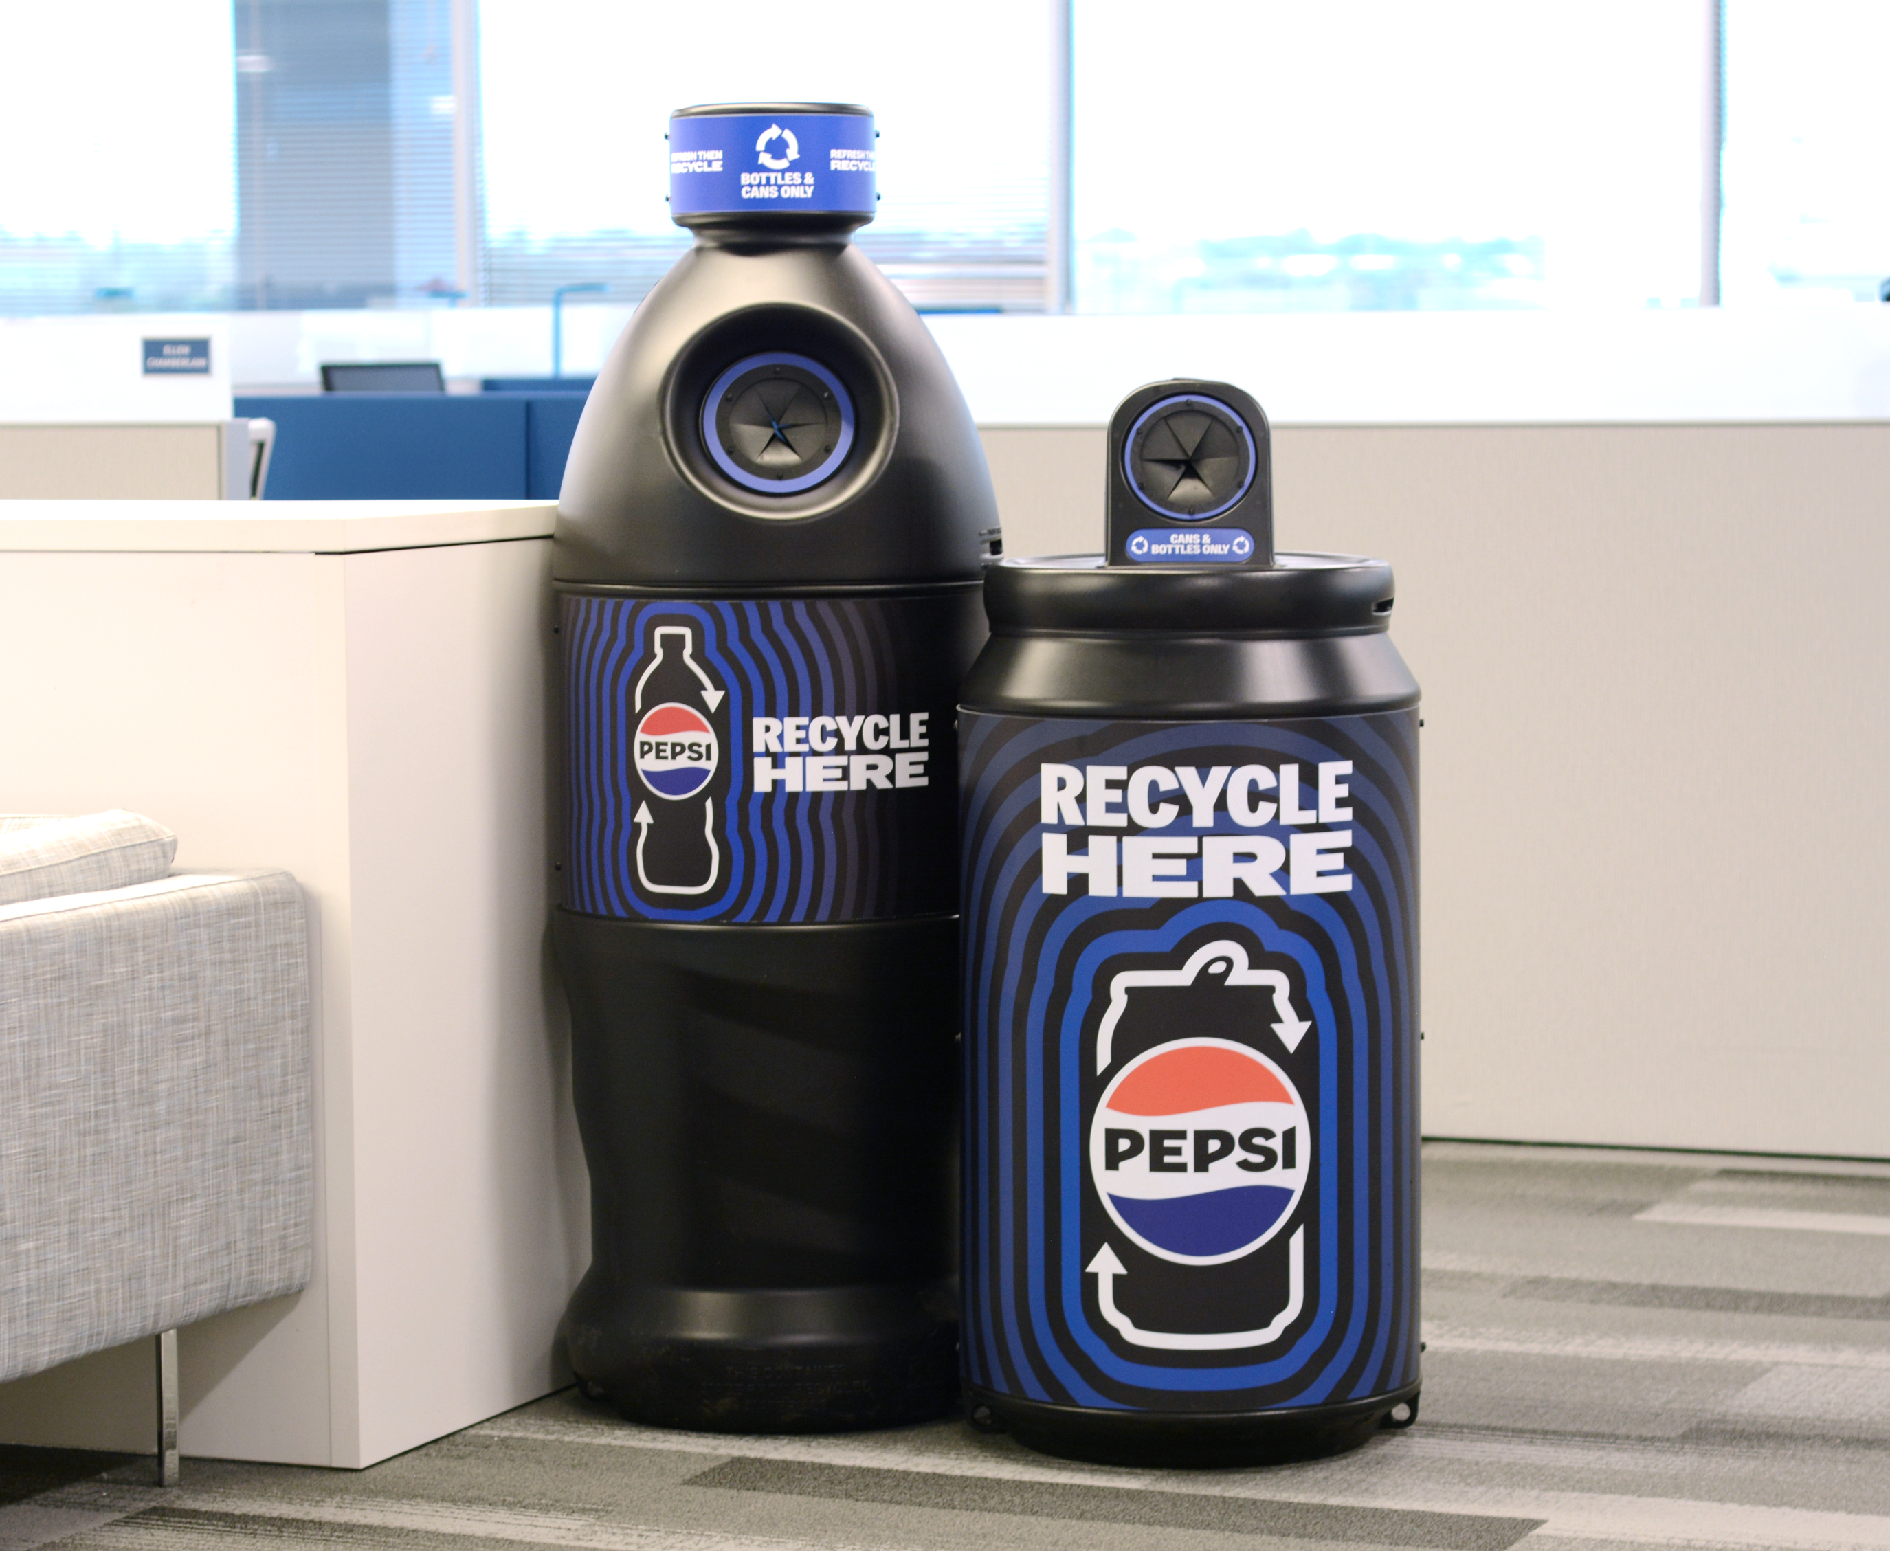
RECYCLING BINS
Providing our customers with optimal bins for recycling beverage packaging
INTERNAL ONLY
ABOUT
PBNA Sustainability understands the value in providing recycling bins for customers and have made Pepsi branded bins available for purchase on POS Direct and Shop PepsiCo Premiums. If your customer would like guidance on where to place their recycling bins for optimal public participation, please check out our guide (see page 19).
CHANNELS
Any customer that would like to collect bottles and cans for recycling at their location.
KEY REQUIREMENTS
Customer must have recycling service (to prevent recyclable materials from being trashed). If the customer does not have recycling service, explore offering CIRQU
(see page 18).
DETAILS
Bottle and can shaped bins can be purchased as single units or as a pack of 5. You can also select collection for bottles only, bottles & cans only, or cans only. Full details and pricing can be found on https://www.partnersfortomorrow.com/solutions/recycling-bins/
To order custom wraps, see the following page.
HOW TO PURCHASE
Bottle and can shaped bins are available on either of the two ordering portals:
POS Direct
PepsiCo Premiums (accessible to all PepsiCo associates with GPID/passcode)
Notes:
Feature/benefits of participating as a partner

Slide 14
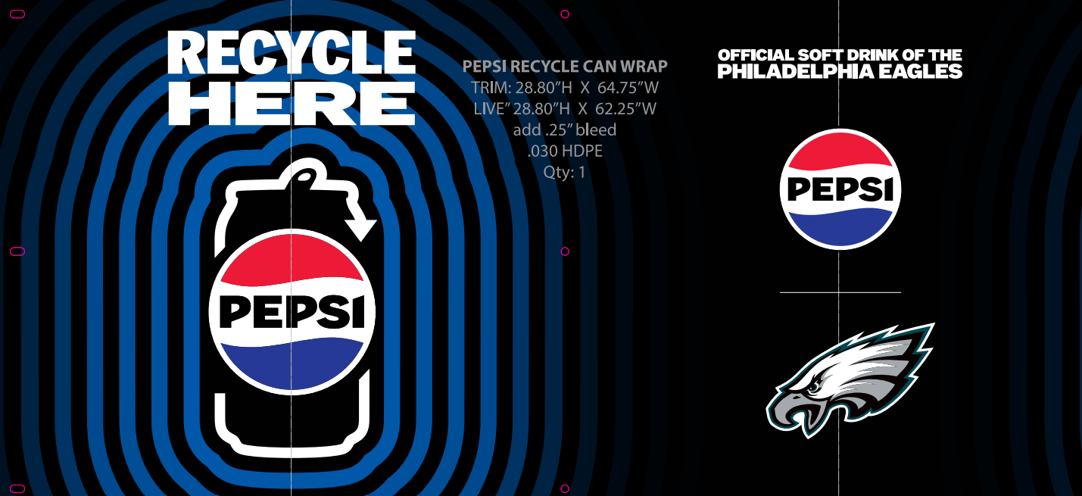
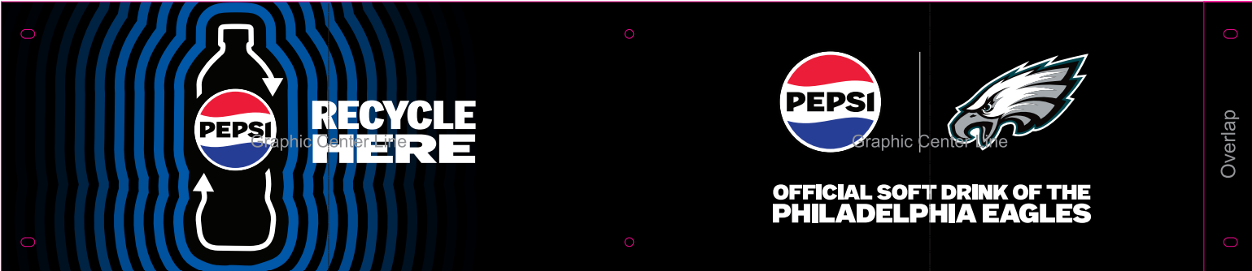
RECYCLING BIN CUSTOMIZATION – BOTTLE & CAN SHAPED BINS
INTERNAL ONLY
Example co-branded
can-shaped recycling bin wrap
ABOUT
Bottle and can shaped bins can be customized if you order directly from the vendor, PFI.
Important: Bin wraps must not divert from the style pictured to the right, as they have been carefully designed for optimal public participation in recycling (for example, we cannot create wraps without a clear CTA to recycle).
PRICING
TO ORDER
Bottle or can shaped bins with custom wraps: $96–$106 each
Can wraps only: $25/each
Bottle wraps only: $25/each
Contact Dawn at PFI: dbonin@PFIInstore.com
Example co-branded
bottle-shaped recycling bin wrap
TIMELINE
Orders can be shipped within 3–4 WEEKS from order date
PBNA
APPROVER
All custom wraps must be approved by Pam Madigan (pamela.madigan@pepsico.com)

Slide 15
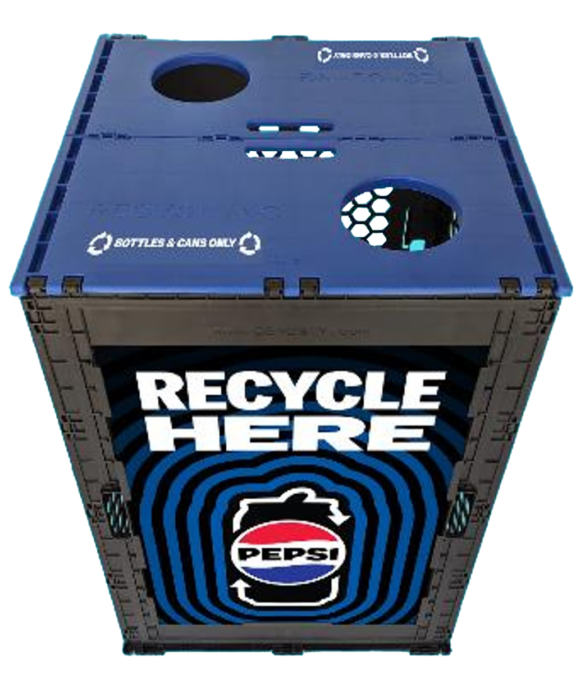
CEROBINS (EVENT RECYCLING BINS)
INTERNAL ONLY
ABOUT
Cero Bins are a sustainable, weather-proof, durable alternative to disposable bins, perfect for special events. These reusable bins can be easily folded and stored away, making them a hassle-free solution. For smaller events that need less than 48 bins, please reach out to your division marketing contact to utilize the division’s allotment of bins.
Above:
1 crate of
48 bins,
Ready for debut at Super Bowl LVIII
PRICING
TO ORDER
Shipping:
FREE when you request crates of 24
or 48 bins
Signage:
~$12-16
per bin
Cero Bin Event Request: Start with this form to request Cero Bins for your event.
Cero Bin Event Order Form: Use this form once availability has been confirmed and you are ready to order your bins.
Below: Evergreen signage accompanied with “Bottles & Cans Only” stickers
TIMELINE
Please request Cero Bins at least 30 DAYS in advance of your event.
PBNA
APPROVER
All custom signage (NOT one of the 3 standard designs) must be approved by Pam Madigan (pamela.madigan@pepsico.com)

Slide 16
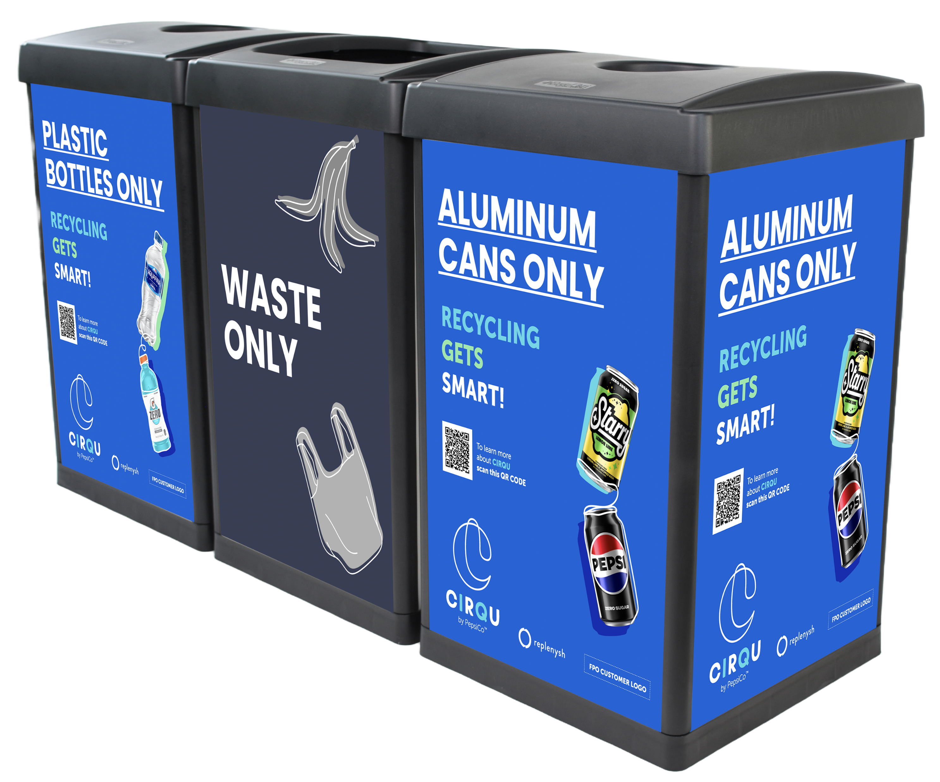
CIRQU RECYCLING BINS
INTERNAL ONLY
Note: Stickers will be added to the lids of the bins to note each waste stream.
ABOUT
CIRQU branded recycling bins can be ordered for customers that participate in PepsiCo’s CIRQU program. Each bin is 18” x 18” x 30” and weighs 25 lbs. Lids with circular openings are included for plastic bottle and aluminum can collection to reduce contamination. Includes bin connectors. Bins can be customized with the customer’s logo and unique impact QR code received from Replenysh.
PRICING
TO ORDER
2 Bin Stream $380.00
3 Bin Stream $570.00
4 Bin Stream $760.00 (can include 4th Other Recycling bin)
Note: Shipping is included within continguous US states; stickers included
Contact Victoria Jani (Victoria.Jani@pepsico.com) if you want to order.
TIMELINE
12 bins or less: ~1–2 WEEKS from order confirmation | Larger orders: ~4–6 WEEKS from order confirmation
Customization here
PBUS
APPROVER
All final designs must be approved by NA Sustainability (Victoria.Jani@pepsico.com)
Notes:
sales@ergocan.com
tnetterfield@ergocan.com

Slide 17
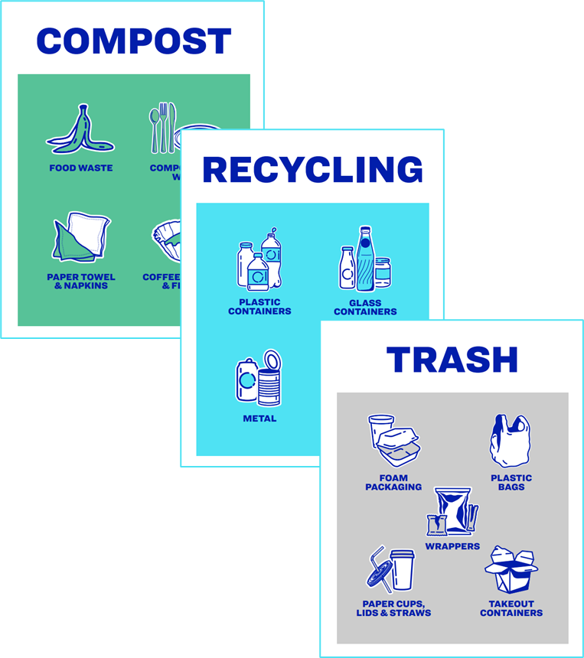
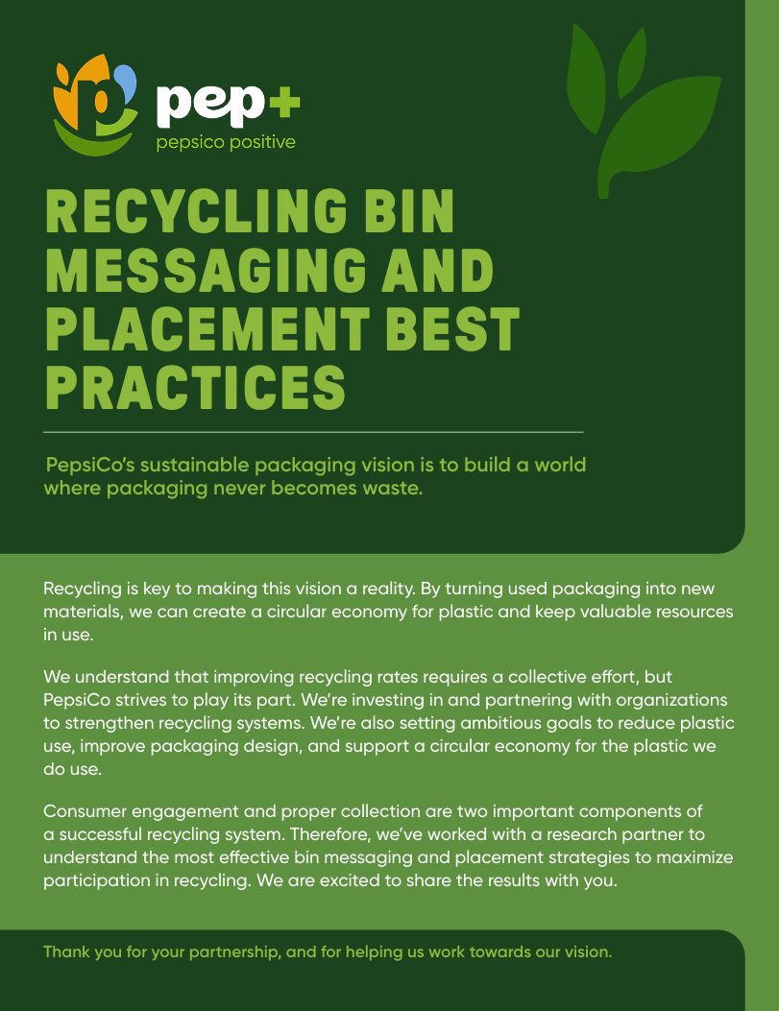
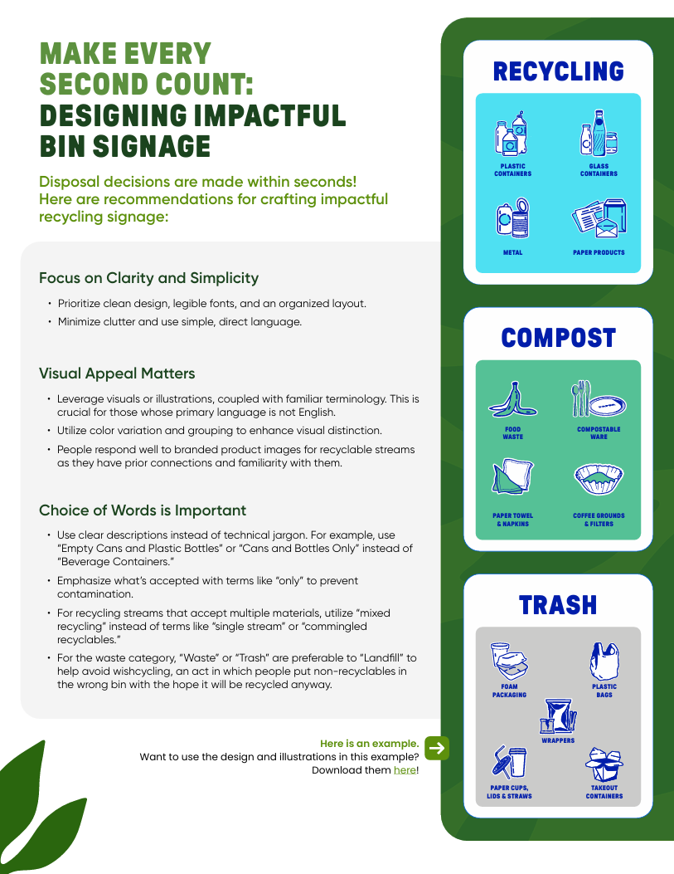

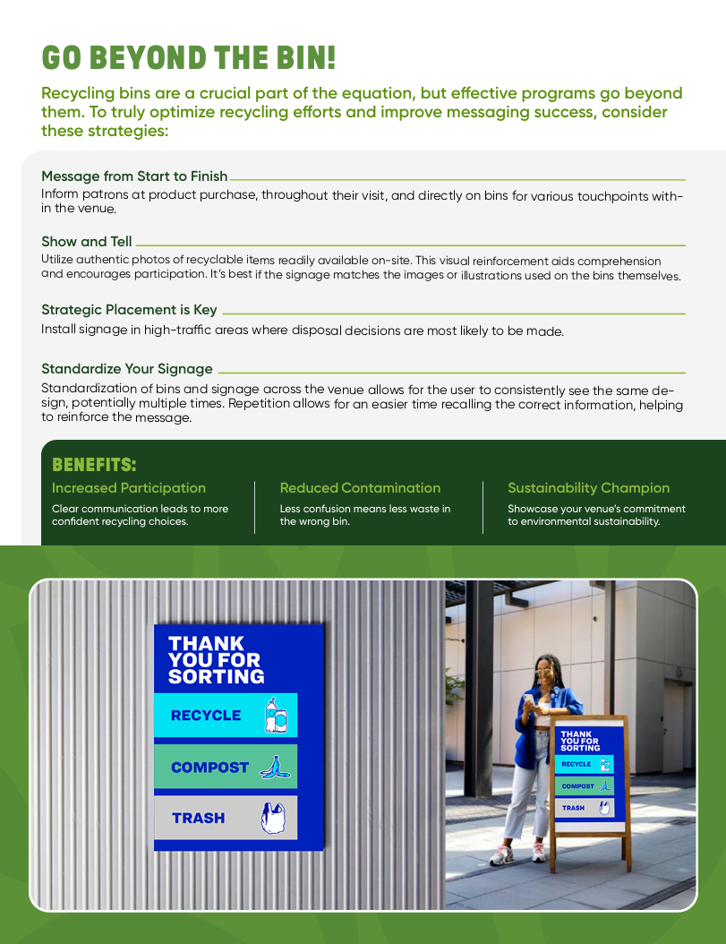
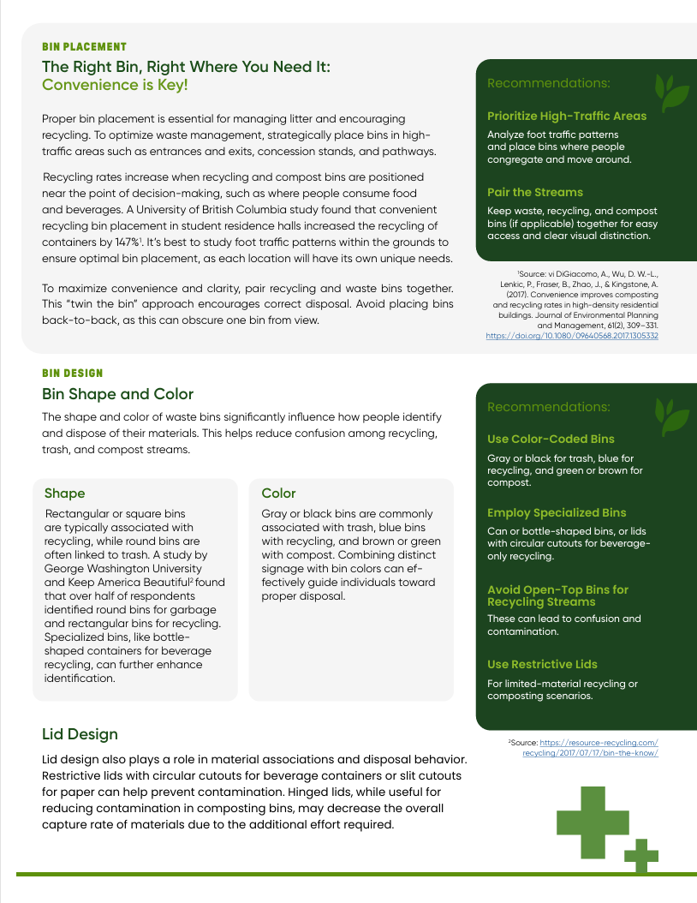
RECYCLING BIN MESSAGING AND PLACEMENT GUIDE
INTERNAL ONLY
ACCOMPANIED BY 45 FREE DOWNLOADABLE CUSTOM-MADE ICONS AND AN EDITABLE POSTER SERIES!
A comprehensive best practices document rooted in research
ABOUT
Our customers are often interested to know if PepsiCo has specific best practices related to placing and designing recycling bins.
To fill this need, we’ve partnered with a recycling research organization to gather information on the best bin placement, design, and messaging strategies for optimal public participation in recycling.
The external guide is available here, and will also be accessible by our customers on www.partnersfortomorrow.com
COMPREHENSIVE GUIDE FOR EFFECTIVE RECYCLING BIN MESSAGING AND PLACEMENT STRATEGIES.

Slide 18
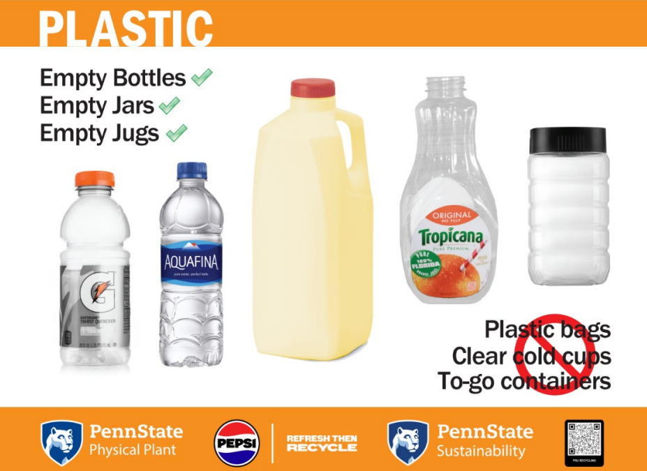
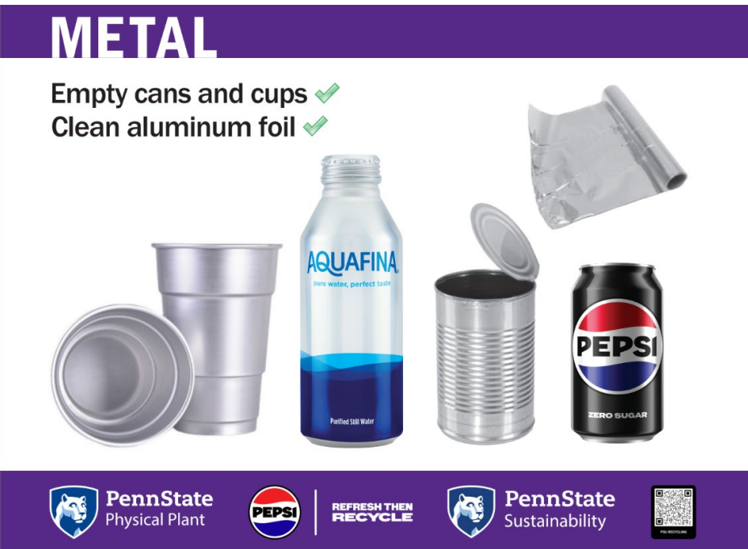
GUIDANCE FOR ADDING PEP BRANDING TO CUSTOMER SIGNAGE
INTERNAL ONLY
Oftentimes, customers that design their own waste and recycling signage may ask us to contribute by adding our logos or products that are available for sale at their location.
GENERAL GUIDELINES
NO pep+ branding
For branding, you may use the Pepsi and Refresh then Recycle lockup shown above, available for download here in all applicable formats. You MUST get written approval from North America Sustainability and Trademark Legal before using this logo.
NO PepsiCo products in LANDFILL/WASTE category (ex. Lay’s or Doritos chip bags, Rold Gold pretzel bags, etc.)
Use “snack packaging” instead of “chip bags” for Trash category, alongside unbranded/generic packaging.
Customers MUST have a backend recycling program. If the products do not actually get recycled, it is a reputational risk. If customer does not have a recycling program, please consult with the NA Sustainability Team.
Example: Penn State
Notes:
Show the lockup

