Slide 1








RESOURCE :
SUSTAINABLE SAMPLING EVENTS TOOLKIT
ADDITIONAL RESOURCES:
FOR QUESTIONS OR
MORE INFORMATION:
PEPSICO SUSTAINABILITY
PepsiCo’s hub for strategy, goals, and progress on our PepsiCo Positive journey.
SHANNA PARRA
shanna.parra@pepsico.com
ESG TOPICS A-Z
This online resource explores the sustainability topics that matter to our business key stakeholders, from A-Z.
CATHERINE WALTON
catherine.walton@pepsico.com
LATEST ENVIRONMENTAL, SOCIAL AND GOVERNANCE (ESG)
REPORT
Access PepsiCo’s ESG metrics and reports, which are updated on a rolling basis.
NICOLE POPOWSKI
nicole.popowski@pepsico.com

Slide 2





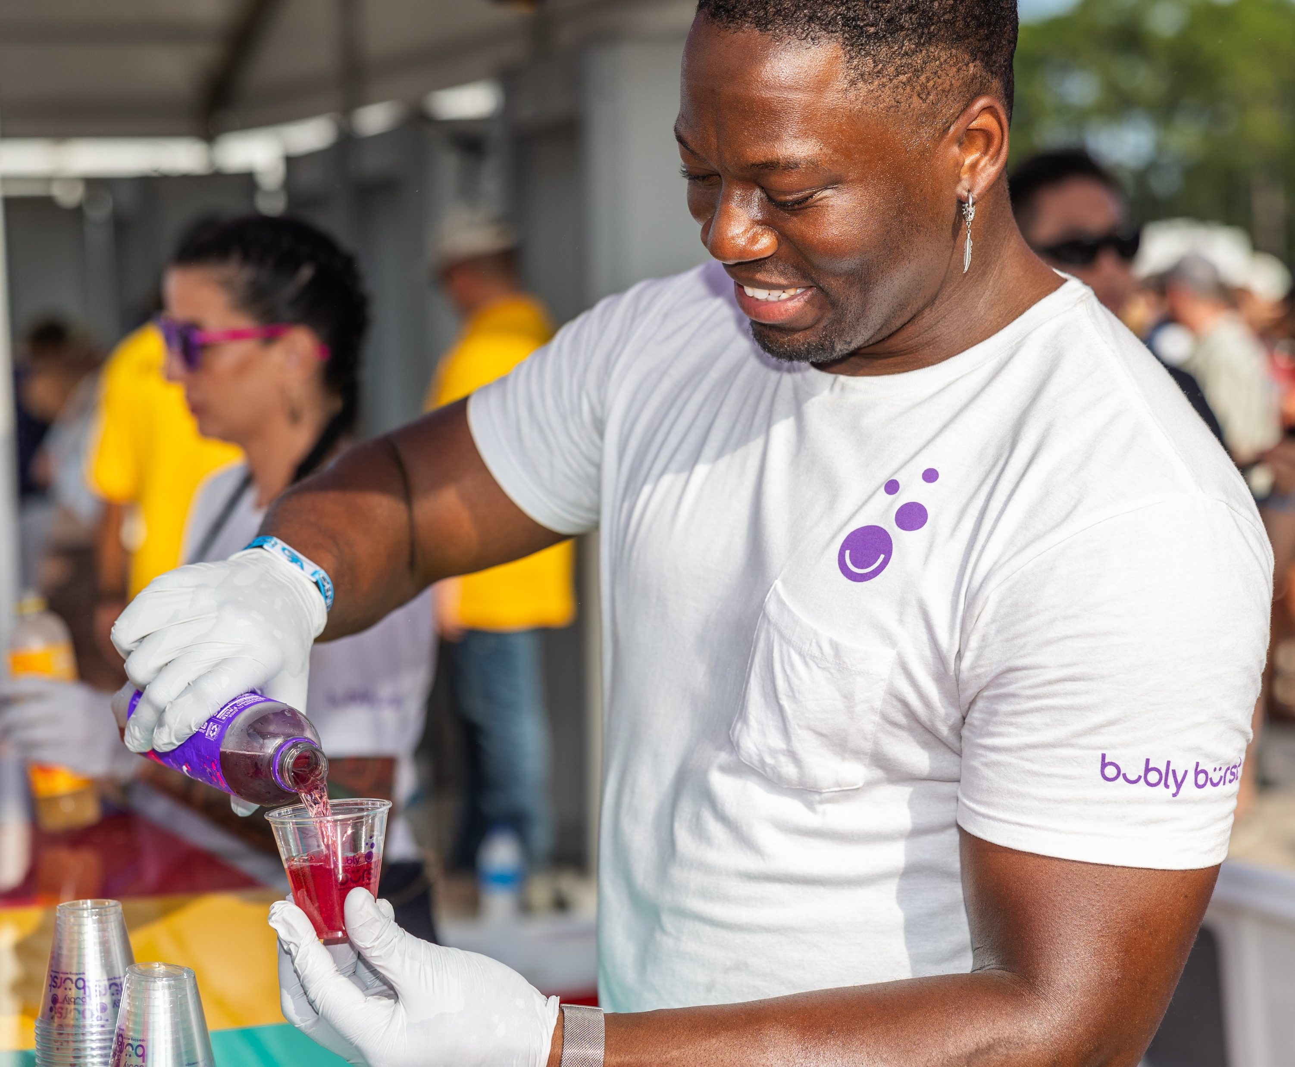
SUSTAINABLE SAMPLING EVENTS TOOLKIT
INTERNAL USE ONLY
OBJECTIVE
Ensure that bottles, cans, cups, plates,
and utensils that are used for sampling
are recycled, reused, or composted
OPPORTUNITY
Elevate and increase interest in pep+ initiatives by “Walking the Walk” at tradeshows and PepsiCo events
QUESTIONS?
REACH OUT FOR MORE INFORMATION
Shanna Parra
shanna.parra@pepsico.com
CONFIDENTIAL
Catherine Walton
catherine.walton@pepsico.com
2

Slide 3
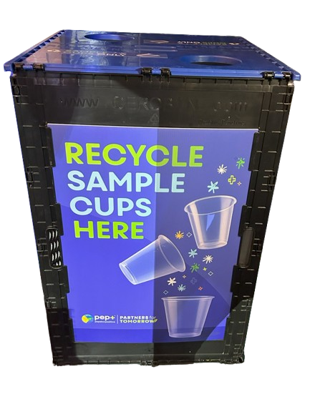
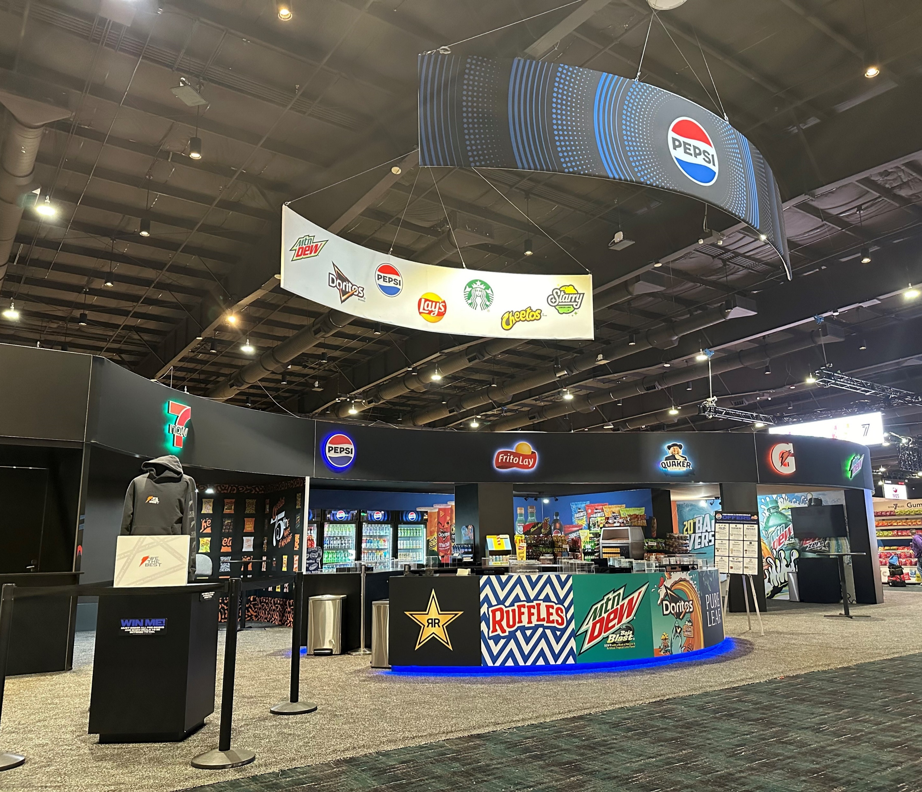
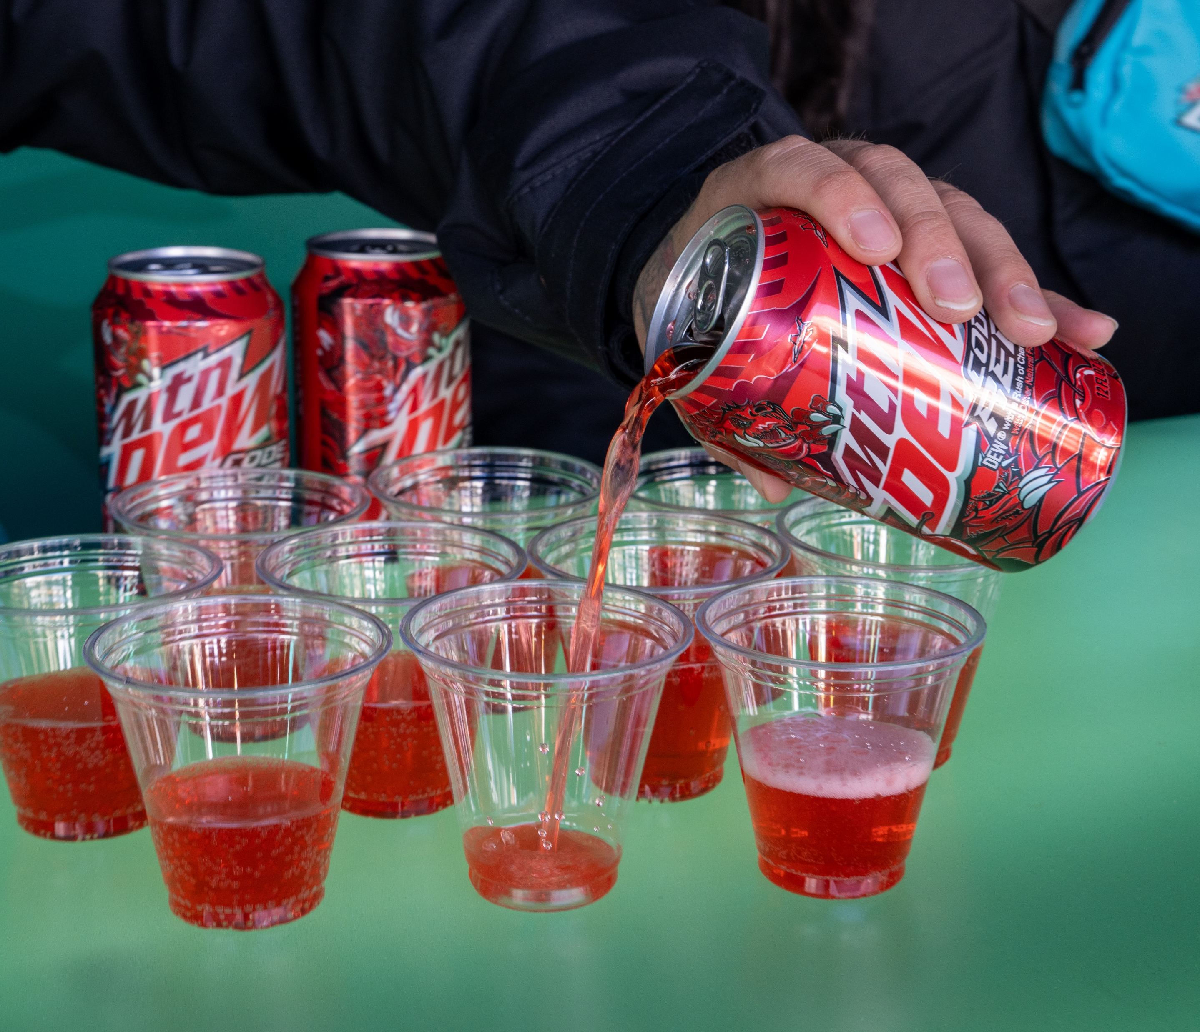
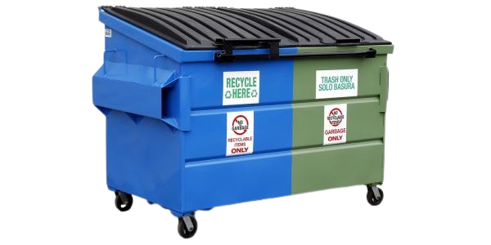
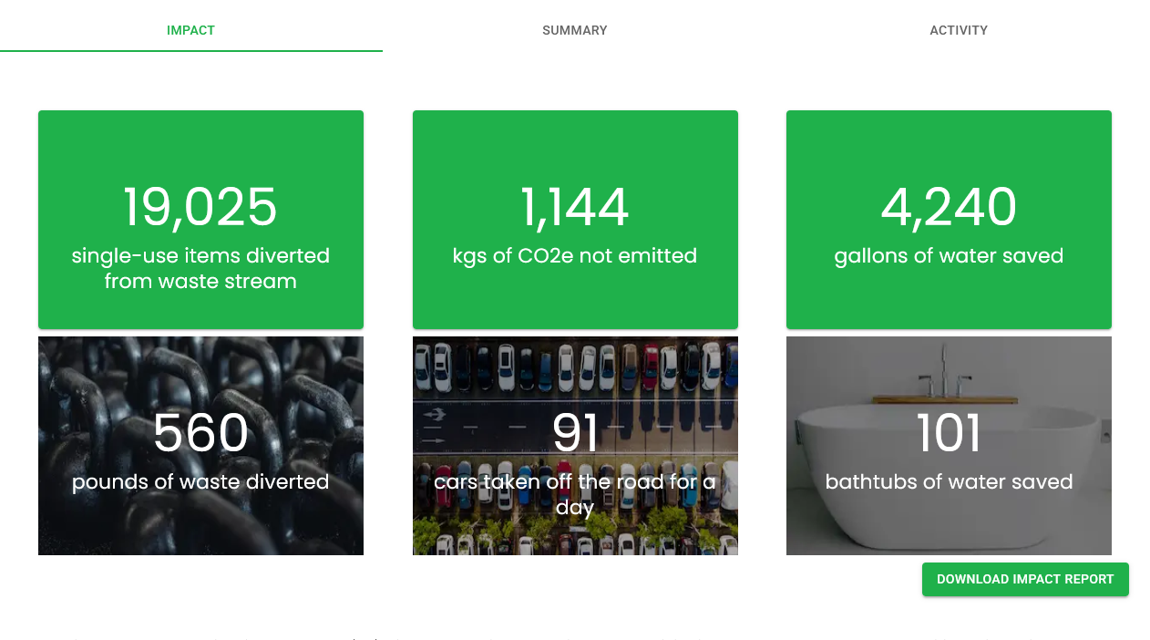
SUSTAINABLE SAMPLING GUIDELINES
EVENT
VENUE
SAMPLING MATERIALS
COLLECTION BINS
SORTATION
POST-EVENT DATA
Where possible include recycling & composting capacity into venue decision making
Chose recyclable, reusable, or compostable sampling cups & dishware based on venue capacity
Order Cero Bins & signage from Group O for collection bins for sampling using the request form (see slide )
Ensure venue or outside service will sort items into the proper Back of House recycling, compost, and waste bins for collection
Collect data from vendors on weight of items collected & data from internal team on # of items used
Working with an agency for sampling?
Make sure they understand their responsibility around properly disposing of sampling materials post-event and that they
have a plan in place for recycling and composting.

Slide 4

Ensure Bottles, Cans, cardboard, paper, cups and wood can be recycled following the event.
RECYCLING
Does the venue offer recycling?
What items can be recycled?
Do they sort or comingle recyclables?
Are there additional costs for recycling? If so, what are these costs?
PEPSICO – EVENT SCOUTING VENUE QUESTIONS
Reduce environmental impact by serving meals sustainably.
REUSE
Does the venue offer reusable dishware and cups for meals and breaks?
Is there an added cost for reusables?
Ensure sampling cups can be composted following the event.
COMPOSTING
Does the venue offer composting for food waste?
Does the venue offer composting for clear, PLA plastic cups? Paper trays?
Is there an additional cost for composting?
Ensure recyclables and compostables are sorted correctly and don’t end up in waste stream.
SORTATION
Does the venue have sortation services for trash and recycling to ensure they are handled properly?
Alternatively, are there outside services the venue work with to provide sortation?
Notes:
=

Slide 5
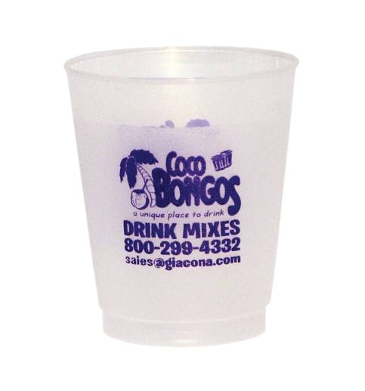
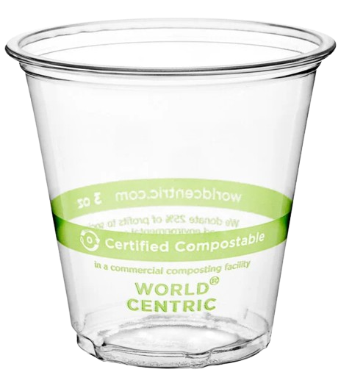
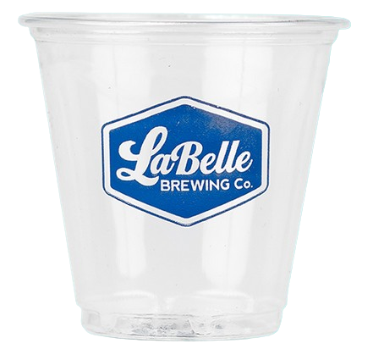
SAMPLING CUP OPTIONS FOR EVENTS
RECYCLABLE PET CUPS
COMPOSTABLE CUPS
REUSABLE PP CUPS
Blank 3 oz PET plastic cups recyclable cups
Custom-printed 3 oz PET plastic cups recyclable
*Pricing included in the links above
3 oz compostable PLA plastic cups
2 oz compostable PLA plastic cups
*Pricing included in the links above
Bold Reuse provides custom-printed reusable Polypropylene plastic cups for use at tradeshows and events
Fees for: Production, washing & storage
Make sure you have a plan to recycle or compost these cups! Please check local guidelines to ensure these cups will be recycled or composted properly.
CONFIDENTIAL

Slide 6
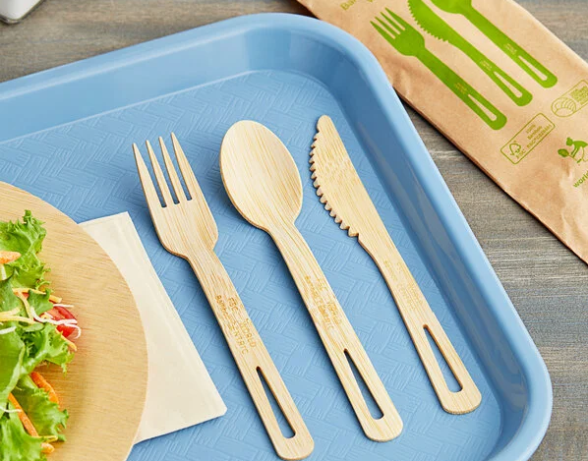

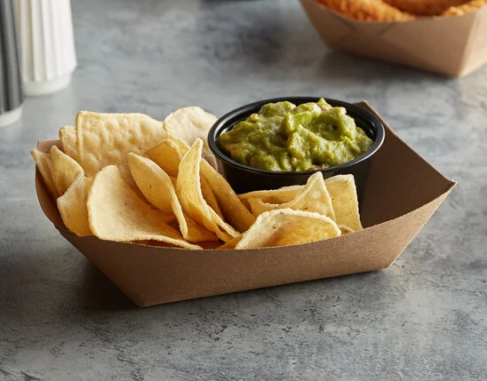



BEST PRACTICES FOR
COMPOSTABLE FOODWARE
ONLY USE COMPOSTABLE CUPS & DISHWARE IF YOUR VENUE’S COMPOSTER ACCEPTS THESE ITEMS
If the venue does not offer composting for cups and dishware, then plan to hire an outside company and ensure that takes dishware in addition to food waste
GET A LIST OF APPROVED ITEMS FROM YOUR COMPOSTER
Not all items labeled as compostable are accepted by composting vendors. Ask your composter for a list of dishware, utensils, and cups that they accept.
BUY BPI CERTIFIED COMPOSTABLE FOODWARE
BPI Certification process ensures that items can be cycled back into the soil safely at a commercial composting facility. Search for the product you are considering purchasing here.
STAY CONSISTENT
If dishware and utensils are compostable, also use compostable cups to make
it easier for event attendees to place their items in the correct bin alongside
food waste.
CONFIDENTIAL

Slide 7
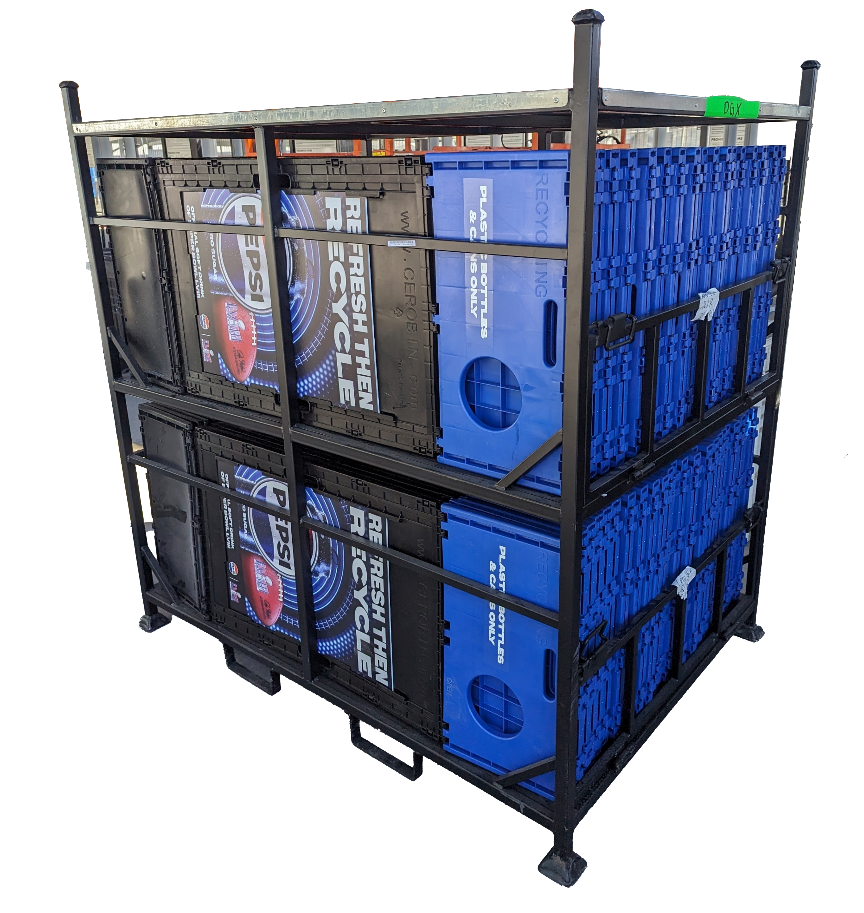
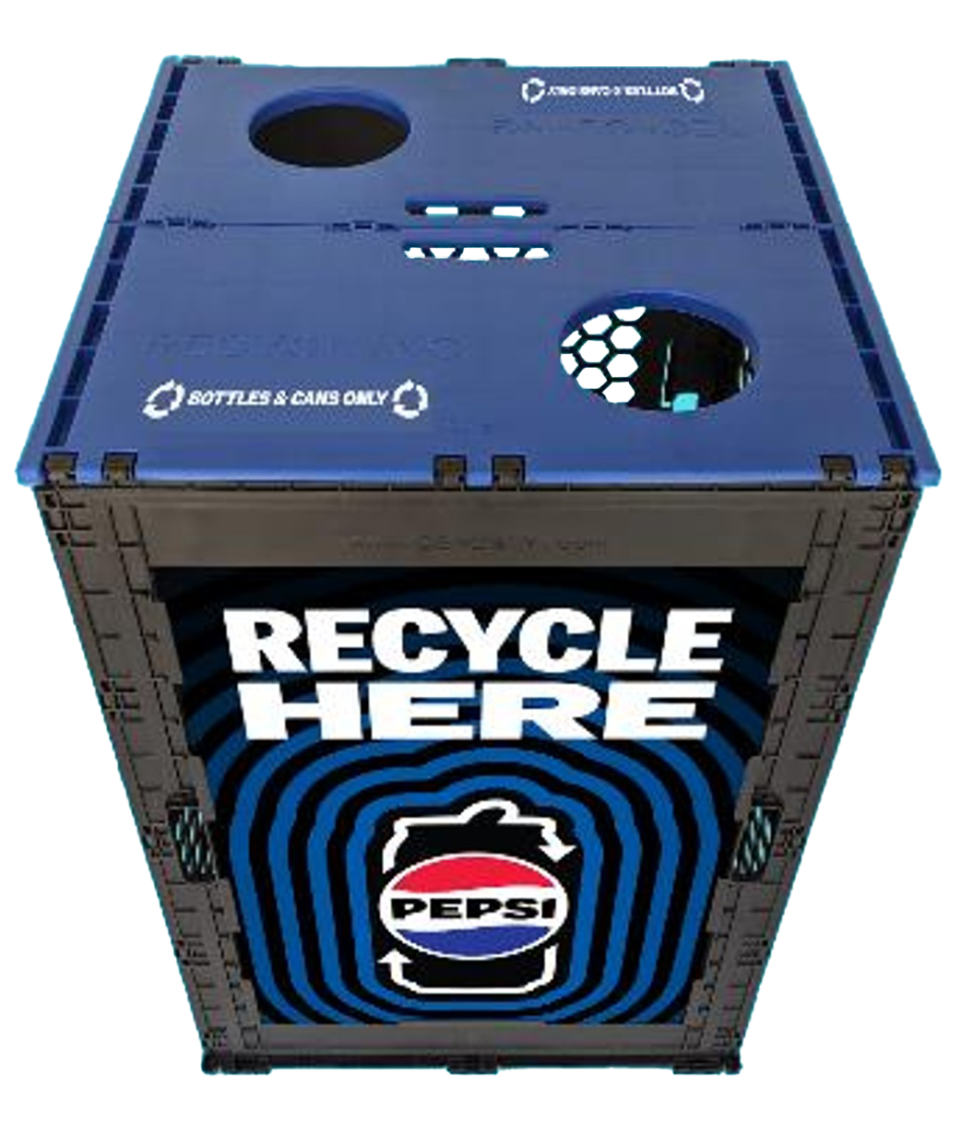
TO ORDER CEROBINS
(EVENT RECYCLING BINS)
INTERNAL ONLY
ABOUT
Cero Bins are a sustainable, weather-proof, durable alternative to disposable bins, perfect for special events. These reusable bins can be easily folded and stored away, making them a hassle-free solution. For smaller events that need less than 48 bins, please reach out to your division marketing contact to utilize the division’s allotment of bins.
Above:
1 crate of
48 bins,
Ready for debut at Super Bowl LVIII
PRICING
TO ORDER
Shipping:
FREE when you request crates of 24
or 48 bins
Signage:
~$12-16
per bin
Cero Bin Event Request: Start with this form to request Cero Bins for your event.
Cero Bin Event Order Form: Use this form once availability has been confirmed and you are ready to order your bins.
Below: Evergreen signage accompanied with “Bottles & Cans Only” stickers
TIMELINE
Please request Cero Bins at least 30 DAYS in advance of your event.
PBNA
APPROVER
All custom signage (NOT one of the 3 standard designs) must be approved by Pam Madigan (pamela.madigan@pepsico.com)
Notes:
Add three week prior to delivery for artwork for custom signage

Slide 8

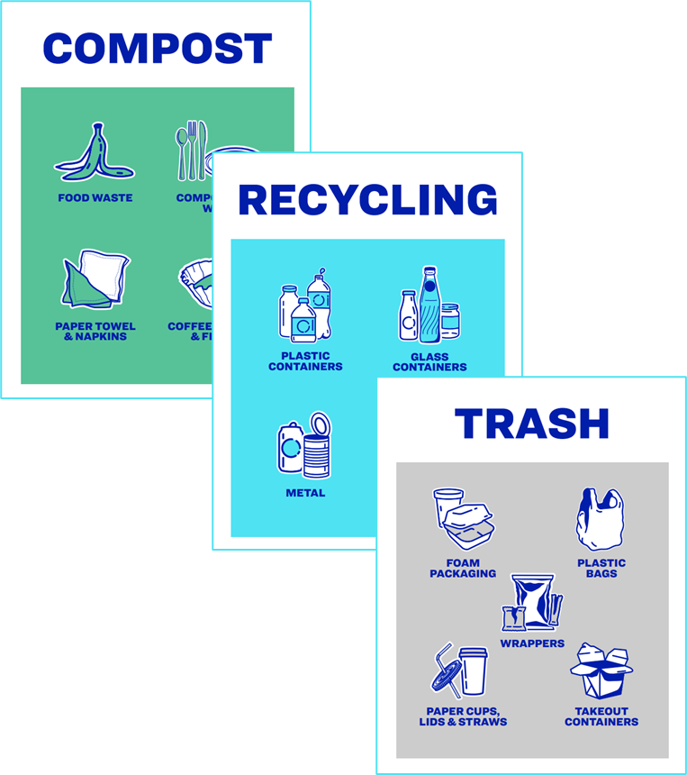
RECYCLING BIN MESSAGING AND PLACEMENT GUIDE
INCLUDES
FREE EDITABLE RECYCLING BIN SIGNAGE WITH 45 DIFFERENT ICONS
A comprehensive best practices document rooted in research
NEED BIN SIGNAGE OR PLACEMENT SUGGESTIONS FOR YOUR EVENTS? SEE THE GUIDE
available here
ABOUT THE GUIDE
Our customers are often interested to know if PepsiCo has specific best practices related to placing and designing recycling bins.
To fill this need, we’ve partnered with a recycling research organization to gather information on the best bin placement, design, and messaging strategies for optimal public participation in recycling.
CONFIDENTIAL

Slide 9
PRE-EVENT
Secure a venue with sustainability
in mind
Plan for diversion for food waste, sample cups, dishware & displays
EVENT SUSTAINABLE SAMPLING CHECKLIST
Order sampling items based on venue capacity (Recycling, Reuse, Composting)
Request Cero Bins from using the Event Request Form at least 30 DAYS in advance
EVENT ACTIVITIES
Ensure recycling and composting bins are places in key areas near trash bins
Ensure on-site staff sorts recyclables and compostables into the correct Back of House receptacles for pickup
POST EVENT
Return Cero Bins
Collect data from vendors on waste diverted including recyclable and compostables collected
Collect data from sampling team on the number of sampling
items used
CONFIDENTIAL
9

