Slide 1








INTERNAL USE ONLY
RESOURCE :
SUSTAINABILITY CUSTOMER SURVEY DATA TOOLKIT
ADDITIONAL RESOURCES:
FOR QUESTIONS OR
MORE INFORMATION:
PEPSICO SUSTAINABILITY
PepsiCo’s hub for strategy, goals, and progress on our PepsiCo Positive journey.
SHANNA PARRA
shanna.parra@pepsico.com
ESG TOPICS A-Z
This online resource explores the sustainability topics that matter to our business key stakeholders, from A-Z.
PREE SCHROEDER
preethika.schroeder@pepsico.com
LATEST ENVIRONMENTAL, SOCIAL AND GOVERNANCE (ESG)
REPORT
Access PepsiCo’s ESG metrics and reports, which are updated on a rolling basis.
NICOLE POPOWSKI
nicole.popowski@pepsico.com
UPDATED JANUARY 2026

Slide 2
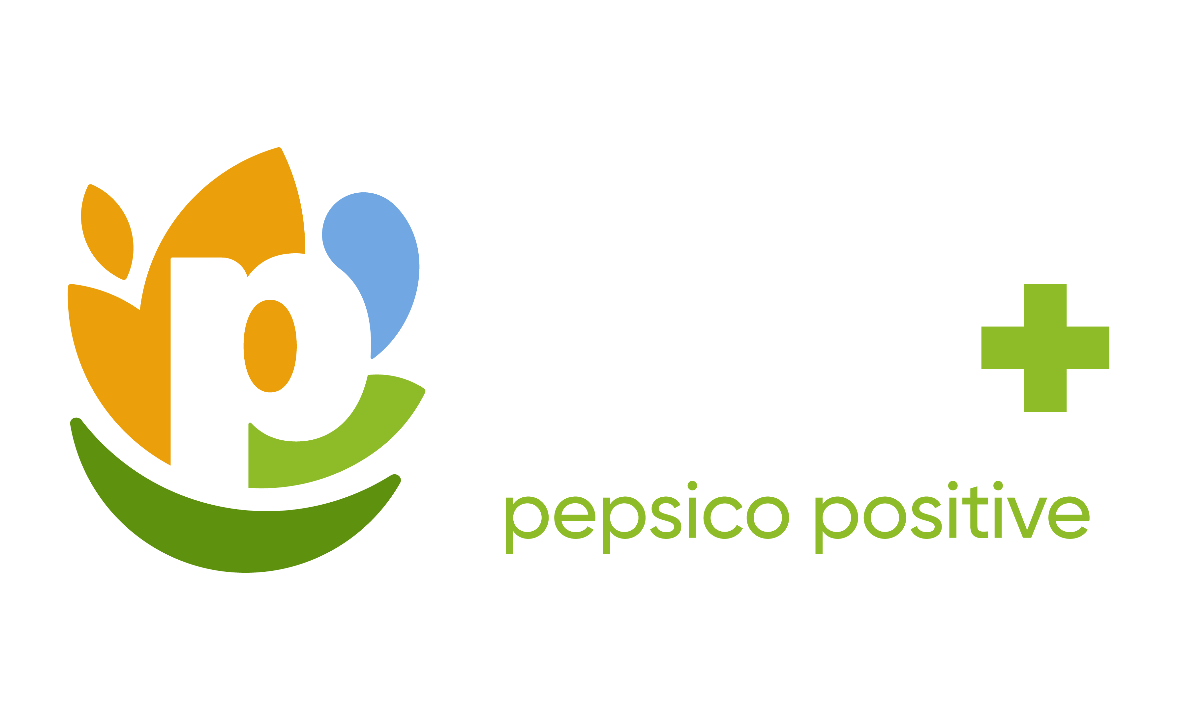
WHEN TO BEST LEVERAGE THIS CUSTOMER SURVEY TOOLKIT
MY CUSTOMER HAS REQUESTED EMISSIONS INFORMATION TO HELP THEIR DECARBONIZATION JOURNEY WITHIN SUSTAINABILITY”
I AM BEING ASKED FOR
THE RECYCLING CONTENT WITHIN OUR PACKAGING”
MY CUSTOMER WANTS TO KNOW
IF WE USE RENEWABLE ENERGY AND
WHAT % OF OUR ELECTRICITY IS RENEWABLE”
MY CUSTOMER WANTS A LIST OF INGREDIENTS FOR THE PEPSICO PRODUCTS THEY SELL”
CONFIDENTIAL

Slide 3

KEY TOPICS FOR CUSTOMER DATA REQUESTS
PepsiCo’s Policy​
Process for Data Completion
Approved Resources
Q&A
Pepsico Sustainability Contacts
CONFIDENTIAL

Slide 4




PEPSICO
POLICY
AVAILABLE
RESOURCES
CUSTOMER
REQUESTS
PepsiCo believes that transparent, consistent and comparable ESG data (environmental, social & governance) is a vital part of building a more sustainable food system, and essential to delivering on our pep+ ambitions.
We support and advocate for robust protocols for standardized reporting across our industry and value chain. We report our data, showing progress towards our pep+ global goals.
pep+ and our commitments
ESG Summary, our annual pep+ progress update
Key highlights 2023 ESG Performance Metrics Report.
ESG Topics A-Z, a directory of global sustainability topics
ESG Data Hub, a summary of our pep+ progress
Packaging vision, solutions & progress
Sustainable Product Design to deliver against our pep+ ambitions
CDP, a non-profit that manages global environmental data sharing
PepsiCo’s policy is to direct all customers who request ESG data, to the global report we publish on a yearly basis.
This is because the data:
Based on rigorous governance of the disclosures
Limits risk of inaccurate & inappropriate disclosures
Reflects a holistic view of our pep+ strategy
& progress
Enables consistent messaging
CONFIDENTIAL
4
Notes:
Approvals:
External Reporting
Comms
Legal

Slide 5
YOU HAVE THREE OPTIONS TO SELECT FROM WHEN COMPLETING CUSTOMER SUSTAINABILTY DATA REQUESTS
SUGGESTED
OPTION 1
OPTION 2
OPTION 3
CUSTOMER FORM
Complete the survey form provided by your customer using the publicly available data PepsiCo reports at a global level
PEPSICO TEMPLATE
Leverage the PepsiCo template letter to customize the response based on your customers information request
ECOVADIS
Direct customers to Ecovadis,
a membership platform for data sharing to evaluate sustainability of their supply chain through universal, comparable & benchmarks
Supporting resources
ON SLIDE 7
Supporting resources
ON SLIDE 8
Supporting resources
ON SLIDE 9
SEND COMPLETED FORMS TO SUSTAINABILITYSURVEY@PEPSICO.COM FOR CROSS FUNCTIONAL APPROVAL
APPROVALS CAN TAKE UP TO TWO WEEKS
Notes:
Approvals:
External Reporting
Comms
Legal

Slide 6

CROSS FUNCTIONAL APPROVAL PROCESS
SOLUTION
EXTERNAL RELATIONS
COMMS
LEGAL
SUSTAINABILITY OFFICE
OPTION 1
OPTION 2
OPTION 3
*Only where significant changes made to existing template and the Sustainability Office deems it necessary
SEND COMPLETED FORMS TO SUSTAINABILITYSURVEY@PEPSICO.COM FOR CROSS FUNCTIONAL APPROVAL
APPROVALS CAN TAKE UP TO TWO WEEKS
Notes:
Educate for customer dialog
When we engage in conversations with customers there are times when they want to understand how we are adding “value” or how we are helping them against their scope 3 goals. We are going to spend a few minutes to help you understand what they are and where we as a partner impact our customers sustainability goals.
GHG emissions have been classified into distinct scopes for corporate footprints, organized by level of ownership and control, to help with measurement and management.
Scope 1, 2, and 3 emissions are a way to categorize the different types of greenhouse gas (GHG) emissions a company creates.
The scopes are determined by where the emissions come from:
Scope 1
Direct emissions that a company generates while performing its business activities, such as emissions from fuel burned in buildings, vehicles, and equipment
Scope 2
Indirect emissions from purchased energy, such as electricity, steam, heat, and cooling
Scope 3
In this category go all the emissions associated, not with the company itself, but that the organization is indirectly responsible for, up and down its value chain. For example, from buying products from its suppliers, and from its products when customers use them. Emissions-wise, Scope 3 is nearly always the big one.

Slide 7

USE THESE RESOURCES FOR OPTION 1
Our ESG Summary, is our annual pep+ progress update. It is updated around June each year, with global data covering the previous full year calendar for all pep+ goals and results.
Key highlights in our 2023 ESG Performance Metrics Report.
Our ESG Topics A-Z is a directory of resources addressing in greater detail the broad range of global sustainability topics that matter to our business and stakeholders. It contains disclosures aligned with external ESG reporting frameworks, including the Global Reporting Initiative, the Task Force on Climate-related Financial Disclosures and the Sustainability Accounting Standards Board.
Our ESG Data Hub, which provides an easy summary of our progress over time towards our key pep+ goals.
Our PepsiCo Packaging vision, solutions and progress against our goals.
Sustainable Product Design To deliver against our pep+ ambitions, we embedded sustainability into product development, enabling our products and packaging to be designed with environmental impacts in mind from the very beginning.
pep+ will guide our business — how we operate within planetary boundaries and inspire positive change for the planet and people. Learn about pep+ and our commitments.
WE DO NOT PROVIDE
North America Specific Data, SKU Level Information, % of Recycling Content Per Package.
CONFIDENTIAL
Notes:
Revised headline from “Toolkit Content”

Slide 8
USE THESE RESOURCES FOR OPTION 2
CLIMATE
ENERGY
PACKAGING
We have provided template letters to use as a staring point
Click here to find the topic that best suits the type of customer request
Customize the letter as needed with the resources on slide 7
AGRICULTURE
WATER
WATER
NUTRITION
INCLUSION
TRANSPORTATION
WASTE
CONFIDENTIAL
Notes:
Revised headline from “Toolkit Content”

Slide 9

USE THESE RESOURCES FOR OPTION 3
END-TO-END SOLUTIONS FOR SUSTAINABLE SUPPLY CHAINS
Direct customers to Ecovadis, a membership platform for sustainability data across their supply chain
RELIABLE SCORECARDS WITH ACTIONABLE RATINGS
UNIVERSAL, COMPARABLE BENCHMARKS
COMPLETE AUDIT AND
IMPROVEMENT MANAGEMENT
FULL SPECTRUM
OF SUSTAINABILITY
RISK AND PERFORMANCE MANAGEMENT
BROAD-SCALE SUPPLY CHAIN RISK SCREENING AND MAPPING
www.ecovadis.com
CONFIDENTIAL
Notes:
Revised headline from “Toolkit Content”

Slide 10

WHAT IF CUSTOMERS ASK FOR MORE SPECIFIC DATA THAT IS NOT PUBLICLY AVAILABLE?
We are noticing an increase in tailored requests from customers.
We should politely push back wherever possible. There are a few good reasons for this:
In many cases, we do not yet have the capability to provide local data that is robust and accurate.
Poor quality data is not useful, may misrepresent our company, and could even create a legal, regulatory or reputational risk to PepsiCo.
Exceptions will be carefully considered. However, we must first understand:
Who is requesting the data
Why additional information is needed
How the information will be used
Requests must be properly signed off internally through an extensive process that can take up to two weeks.
WE DO NOT PROVIDE
North America Specific Data, SKU Level Information, % of Recycling Content Per Package.
CONFIDENTIAL

Slide 11
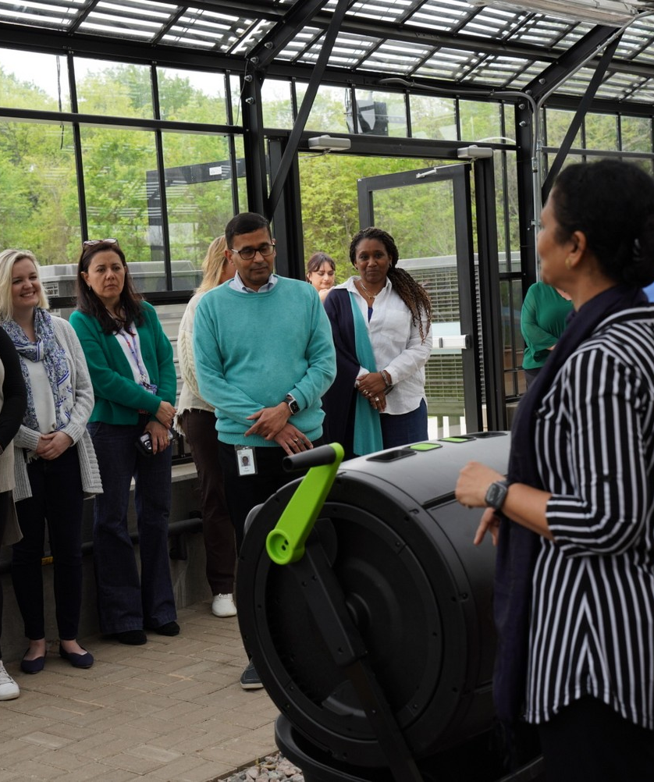
WHY ARE CUSTOMERS ASKING FOR SUSTAINABILITY DATA?
A critical first step in reduction efforts for the food
and beverage industry, as for all industries, is to understand the emissions associated with a company’s operations, its value chain, as well as the emissions associated with the life cycle of its products.
Our customers are at the heart of the food system
and face significant pressures to help make it more sustainable. Just like PepsiCo, many of them have set targets to manage the environmental and social impacts of their operations. They may need data to measure these impacts across their whole value chain and know what actions to take.
CONFIDENTIAL
11

Slide 12
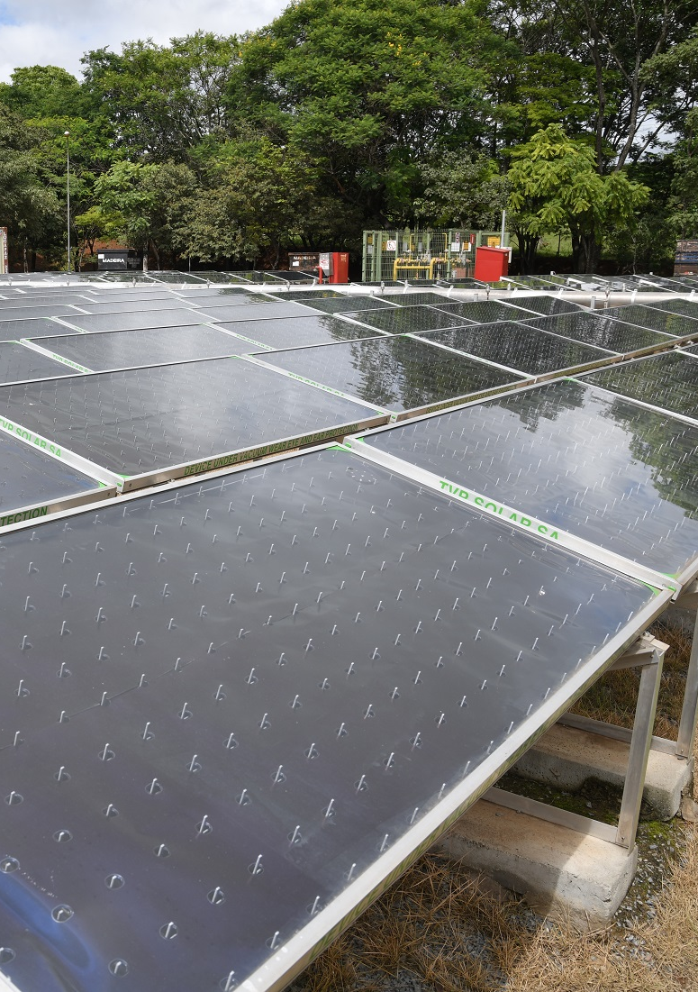
WHAT ARE SCOPES 1, 2, & 3
AND WHY CUSTOMER RELY ON OUR SCOPE 3?
Green House Gas emissions have been classified into distinct scopes for corporate footprints, organized by level of ownership and control, to help with measurement and management.
SCOPE 1
SCOPE 2
SCOPE 3
Direct emissions from operations owned or controlled by your company e.g. fuel combustion in boilers and company owned vehicles.
Indirect emissions from purchased energy, electricity, steam, heating, cooling that is consumed by your company.
Indirect emissions associated with your company’s activities that occur in your value chain (upstream/downstream), e.g. purchased goods and services, transportation and distribution, waste, use of sold products, end of life treatment of sold products.
CUSTOMERS RELY ON PEPSICO’S DATA FOR THEIR SCOPE 3 REPORTING
Notes:
When we engage in conversations with customers there are times when they want to understand how we are adding “value” or how we are helping them against their scope 3 goals. We are going to spend a few minutes to help you understand what they are and where we as a partner impact our customers sustainability goals.
GHG emissions have been classified into distinct scopes for corporate footprints, organized by level of ownership and control, to help with measurement and management.
Scope 1, 2, and 3 emissions are a way to categorize the different types of greenhouse gas (GHG) emissions a company creates.
The scopes are determined by where the emissions come from:
Scope 1 Direct emissions that a company generates while performing its business activities, such as emissions from fuel burned in buildings, vehicles, and equipment
Scope 2 Indirect emissions from purchased energy, such as electricity, steam, heat, and cooling
Scope 3 In this category go all the emissions associated, not with the company itself, but that the organization is indirectly responsible for, up and down its value chain. For example, from buying products from its suppliers, and from its products when customers use them. Emissions-wise, Scope 3 is nearly always the big one for customers

Slide 13
THE SCOPES REFLECT THE DIFFERENT KINDS OF EMISSIONS A COMPANY LIKE PEPSICO CREATES, INCLUDING IN OUR OWN OPERATIONS (SCOPE 1 & 2) AND OUR WIDER VALUE CHAIN VIA OUR SUPPLIERS AND CUSTOMERS (SCOPE 3)
CUSTOMERS RELY ON PEPSICO’S DATA FOR THEIR SCOPE 3 REPORTING
SCOPE 1
SCOPE 2
SCOPE 3
DIRECT EMISSIONS FROM FUEL THAT WE BURN
INDIRECT EMISSIONS FROM ELECTRICITY THAT WE USE
ALL OTHER EMISSIONS ACROSS OUR VALUE CHAIN
(upstream & downstream)
PepsiCo Owned Fleet
Fuel and energy related activities
Transportation and distribution
End-of-life treatment or sold products
Purchased
goods & services
Capital
goods
Business
travel
Franchises
Use of sold products
PepsiCo Owned manufacturing, warehouses and offices
Waste generated
Leased assets
Transportation and distribution
Processing of sold products
Purchased electricity, steam, heating & cooling for own use
Leased assets
Employee commuting
Investments
UPSTREAM ACTIVITIES
DOWNSTREAM ACTIVITIES
DIRECT
INDIRECT
INDIRECT
Notes:
Educate for customer dialog
When we engage in conversations with customers there are times when they want to understand how we are adding “value” or how we are helping them against their scope 3 goals. We are going to spend a few minutes to help you understand what they are and where we as a partner impact our customers sustainability goals.
GHG emissions have been classified into distinct scopes for corporate footprints, organized by level of ownership and control, to help with measurement and management.
Scope 1, 2, and 3 emissions are a way to categorize the different types of greenhouse gas (GHG) emissions a company creates.
The scopes are determined by where the emissions come from:
Scope 1
Direct emissions that a company generates while performing its business activities, such as emissions from fuel burned in buildings, vehicles, and equipment
Scope 2
Indirect emissions from purchased energy, such as electricity, steam, heat, and cooling
Scope 3
In this category go all the emissions associated, not with the company itself, but that the organization is indirectly responsible for, up and down its value chain. For example, from buying products from its suppliers, and from its products when customers use them. Emissions-wise, Scope 3 is nearly always the big one.

