Slide 1








RESOURCE :
PEPSICO SUSTAINABILITY RECOGNITION
ADDITIONAL RESOURCES:
FOR QUESTIONS OR
MORE INFORMATION:
PEPSICO SUSTAINABILITY
PepsiCo’s hub for strategy, goals, and progress on our PepsiCo Positive journey.
SHANNA PARRA
shanna.parra@pepsico.com
ESG TOPICS A-Z
This online resource explores the sustainability topics that matter to our business key stakeholders, from A-Z.
CATHERINE WALTON
catherine.walton@pepsico.com
LATEST ENVIRONMENTAL, SOCIAL AND GOVERNANCE (ESG)
REPORT
Access PepsiCo’s ESG metrics and reports, which are updated on a rolling basis.
NICOLE POPOWSKI
nicole.popowski@pepsico.com

Slide 2

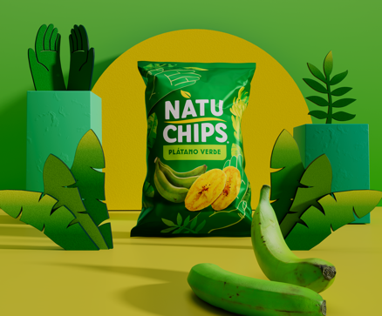




Pepsico is being recognized
for our sustainability efforts
2025
2023
2024
2020/2021/2023/2024
Ranked CSO the #1 Sustainability Leader & PepsiCo the 16th Most Sustainable Company
(out of 250)
Sustainability Initiative
of the Year
PARTNERS FOR TOMORROW
#1 FOOD & BEVERAGE INDUSTRY LEADER
#1 IN
SUSTAINABILITY
“PepsiCo has sustainability deeply ingrained in their
go-to-market approach”
Notes:
Fortune Most Innovative Companies ( Fortune unveiled their inaugural America’s Most Innovative Companies list. PepsiCo Beverages ranks 95 out of 300 companies on the list​
America’s Most Innovative Companies honors the 300 companies transforming industries from the inside out. Innovation can spark in a multitude of ways: R&D teams who invent new products; efficient processes that pad a company’s bottom line; inspiring leaders who foster brainstorming and collaboration that lead to original creations. And innovation isn’t just a nice-to-have—nearly every company on this list posted revenue growth in the last three years.​
Business Intelligence Group 2023 Sustainability Initiative of the Year for Partners For Tomorrow ​
PHILADELPHIA, PA—August 30, 2023—Today, the Business Intelligence Group announced the winners in the 2023 Sustainability Awards program. The Sustainability Awards honor those who have made sustainability an integral part of their business practice. For-profit and not-for-profit organizations of all sizes submitted nominations to reward team members and gain exposure for the organization, its initiatives, and the exemplary accomplishments of its leaders as they work to reduce their impact on our environment. ​
2024 Just Capital (https://justcapital.com/rankings/) #1 in Food&Bev industry. ​
Our annual Rankings reflect the performance of America’s largest publicly traded companies on the Issues that matter most in defining just business behavior today. The Issues, and their weights in our model, are determined by our polling of the American public. The top 100 performing companies – the JUST 100 – can be viewed below. Our Rankings assess performance of the largest U.S.-based corporations that collectively make up the Russell 1000. Use the search feature below to view a summary level of performance for every company included in the 2024 Rankings universe. If you are a corporate representative, please view the resources available to you, and reach out to our Corporate Engagement team to learn more about your company’s performance.​
Kantar - PepsiCo # 1 in Sustainability

