Slide 1








RESOURCE :
JOINT BUSINESS PLANNING SELL STORY
ADDITIONAL RESOURCES:
FOR QUESTIONS OR
MORE INFORMATION:
PEPSICO SUSTAINABILITY
PepsiCo’s hub for strategy, goals, and progress on our PepsiCo Positive journey.
SHANNA PARRA
shanna.parra@pepsico.com
ESG TOPICS A-Z
This online resource explores the sustainability topics that matter to our business key stakeholders, from A-Z.
CATHERINE WALTON
catherine.walton@pepsico.com
LATEST ENVIRONMENTAL, SOCIAL AND GOVERNANCE (ESG)
REPORT
Access PepsiCo’s ESG metrics and reports, which are updated on a rolling basis.
NICOLE POPOWSKI
nicole.popowski@pepsico.com

Slide 2



PEP+ OVERVIEW
Our vision is to Be the Global Leader in Convenient Foods
and Drinks by Winning with PepsiCo Positive (pep+).
pep+ is our strategic end-to-end transformation that places sustainability at the center
of our business strategy, seeking to drive growth and build a stronger, more resilient future for PepsiCo and the communities where we operate.
POSITIVE AGRICULTURE
We are working to source our crops
and ingredients in ways that restore
the earth and strengthen
farming communities.
POSITIVE VALUE CHAIN
We are helping to build
a circular and inclusive
value chain.
POSITIVE CHOICES
We are inspiring consumers
through our brands to make choices
that create more smiles
for them and the planet.
Notes:
pep+ is our end‑to‑end transformation strategy — embedding sustainability into how we operate, innovate, and grow. This slide defines pep+ as PepsiCo’s end-to-end transformation strategy with sustainability at the center of the business. The key feature is that pep+ is positioned as a driver of growth and resilience, not only an impact commitment. It also introduces the three interconnected pillars that structure the strategy. The benefit is a clear framework to understand how sustainability priorities translate into actions across the company. For customers, the takeaway is that pep+ is designed to create a stronger future for PepsiCo and the communities where we operate. This creates a foundation for partnership conversations that connect strategy to real initiatives.
pep+ NA Team: Shanna.Parra@pepsico.com or Catherine.Walton@pepsico.com

Slide 3
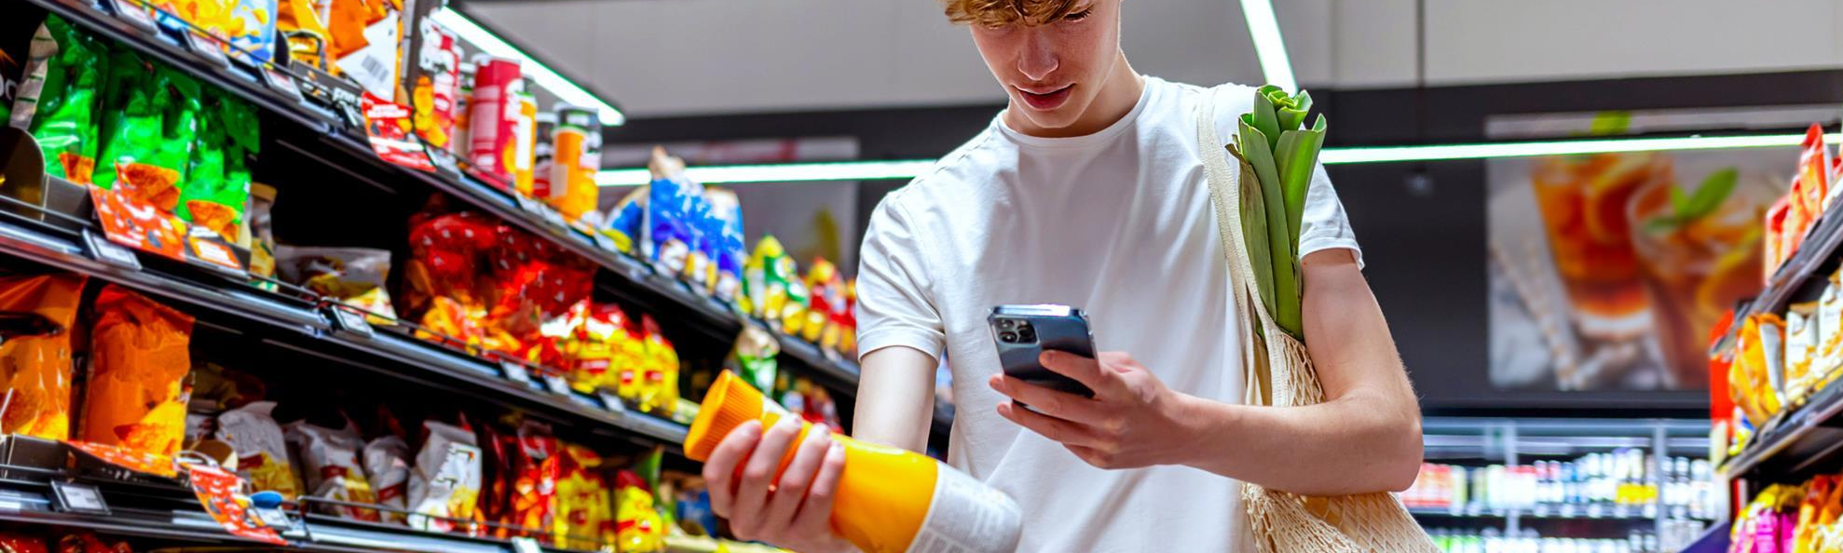
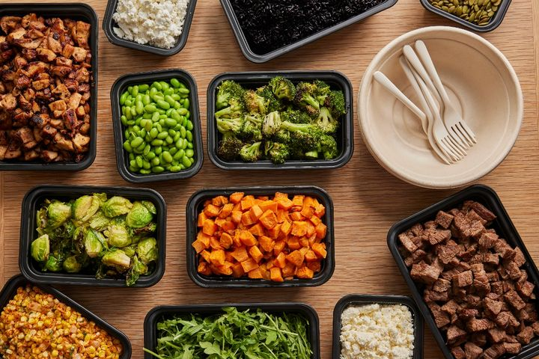
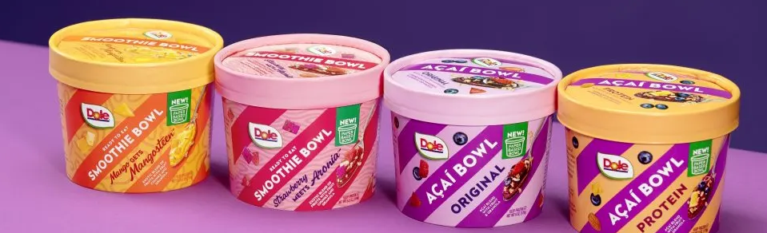
The Path to Consumer Relevance Runs Through Sustainability
zz
ss
Gen Z is Rewriting the Rules of Buying
Sustainability is Reshaping Foodservice
On‑Pack Messaging is Driving Growth
OVER 70% of younger consumers have specifically chosen a product for its SUSTAINABLE PACKAGING¹.
72% of adults are more likely to visit restaurants that use SUSTAINABLE business practices¹.
Sustainably-marketed products grew 2.3x FASTER than conventionally marketed CPGs between 2019 and 2024¹.
1 IN 4 GEN Zs RESEARCH environmental credentials BEFORE MAKING A PURCHASE².
3 in 4 restaurants are moving to waste tracking and smarter inventory to cut costs and reduce impact³.
3 in 4 consumers engage with sustainability-related information on beverage packaging and labels².
3
Source: 1. NYU Centre for Sustainable Business (2024) Sustainable Market Share 2. Kantar (2024) Sustainability insights 3. Restaurant365 State of the Restaurant Industry Report
Notes:
As we look at where growth is coming from in the market, one theme is absolutely unmistakable: sustainability has become a key driver of consumer relevance — and it’s directly shaping purchase decisions, brand loyalty, and customer traffic.
Let’s start with Gen Z — because they’re no longer an emerging segment; they are the segment shaping the next decade of demand. Over 70% of younger consumers say they’ve chosen a product specifically because of its sustainable packaging. That’s not a niche behavior — that is mainstream. And importantly for us, 1 in 4 Gen Z consumers actually researches a brand’s environmental credentials before they buy. That means sustainability isn’t a ‘nice to have’—it’s part of the consideration set. It’s part of how they decide between Brand A and Brand B.
The same trend is playing out in foodservice. 72% of adults say they’re more likely to visit a restaurant that uses sustainable business practices. Restaurants are responding. Three out of four are already moving toward waste tracking, smarter inventory systems, and operational choices that reduce environmental impact. What that means for us: sustainability is no longer a back‑of‑house conversation. Foodservice retailers are using it as a front‑of‑house value proposition to attract guests. Our ability to equip our foodservice partners with solutions — like lower‑impact packaging, waste‑reducing formats, and sustainability‑linked insights — becomes a competitive advantage. We’re not just selling products; we’re helping our customers meet very real consumer expectations.
Finally, let’s talk about what drives growth on the shelf. Products with sustainability‑related messaging are growing at 2.3x the rate of conventionally‑marketed CPGs. That’s a signal we should not ignore: when sustainability shows up clearly on pack, consumers engage. In fact, 3 in 4 shoppers say they interact with sustainability information directly on the packaging or label. For us, this means the pack is no longer just design real estate — it’s a growth lever. If we help our customers bring more sustainability communication to the shelf, we help them unlock faster‑moving categories and stronger shopper conversion.
So across retail, foodservice, and every generation—but especially Gen Zs and younger Millennials—sustainability is now a proven driver of choice, traffic, and growth. The brands that win are the ones that make sustainability visible, credible, and easy for the consumer to act on. Our opportunity is to connect our portfolio, our packaging, and our customer solutions directly to these behaviors — making sustainability not just the right thing to do, but a commercial accelerator.
Sources:
NYU Centre for Sustainable Business (2024) Sustainable Market Share Index. https://www.stern.nyu.edu/experience-stern/about/departments-centers-initiatives/centers-of-research/center-sustainable-business/research/csb-sustainable-market-share-index
Kantar (2024) Sustainability insights [‘72% Americans pay attention to information on beverage packaging/ labels’]

Slide 4
WE OFFER SOLUTIONS to drive ACTION with customers
Five key areas have been identified for growth and value
Energy
Agriculture
Recycling
Packaging
Water**
pep+ Renew
Why?
Help customers accelerate their renewable energy transition and achieve their climate targets on schedule.
Positive agriculture approach
Why?
Help customers build supply chain resilience and make measurable progress against their Scope 3 carbon reduction commitments.
Recycling programs
Why?
Help customers hit their recycling targets or position them as leaders and innovators in the circular economy.
Sustainable packaging portfolio
Why?
Help customers stay ahead of the curve on packaging innovation and lead the way in sustainable packaging solutions.
Net Water Positive programs
Why?
Help customers meet their water stewardship goals and implement effective water strategies across their operations.
Solutions available on PartnersforTomorrow.com
Notes:
Our framework focuses on five key areas for customer growth and value.
- Energy: Helps customers accelerate renewable energy adoption and stay on track to meet their climate targets, while strengthening PepsiCo’s role as a strategic partner in delivering measurable sustainability solutions.
- Ag: Helps customers strengthen supply chain resilience and make measurable progress toward their Scope 3 emissions reduction commitments
- Recycling: Supports customers in achieving recycling targets while positioning them as leaders in the circular economy
- Packaging: Helps customers stay ahead on packaging innovation while leading in sustainable packaging solutions
- Water: Supports customers’ water stewardship goals and enables effective water strategies for operational efficiencies
On the next slide, we will review our pep+ suite of resources available on www.partnersfortomorrow.com
pep+ NA Team: Shanna.Parra@pepsico.com or Catherine.Walton@pepsico.com

Slide 5






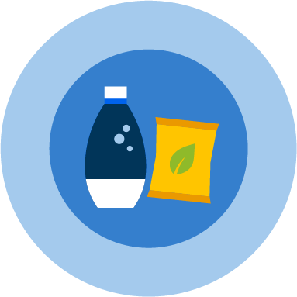



CUSTOMER RESOURCES TO ADVANCE SHARE GOALS
AGRICULTURE
ENERGY
Sow Positive
Ingredients
Pep+ REnew
WATER
LEARNING
Insights
Sales Academy
Action Centre
Awards/Recognition
Best Practice
Net Water
Positive
RECYCLING
PLAYBOOKS
PACKAGING
CIRQU
Oscar Sort
Recycling Bins
Olyn’s RVM
Recycling Toolkit
Customer Strategy
Commercial Sell Story
Common Goal Grids
C&U Programming
ESG Surveys
Environmental Tracker
RPet
Aluminium/Alumitek
Project Coral
Powders/Tablets
Sustainable Cups
Sampling Toolkit
Available on PartnersForTomorrow.com
Notes:
This slide shows the range of Partners for Tomorrow solutions across agriculture, learning, energy, water, packaging, and recycling. The key feature is category breadth—there are multiple ways to engage your customers depending on their sustainability goals. The benefit is that customers can choose solutions that fit their footprint, priorities, and timeline. It also reinforces that these solutions are designed to span education, infrastructure, and tangible packaging and recycling actions. The takeaway is that PepsiCo has a robust portfolio approach to sustainability partnerships that drive impact.
pep+ NA Team: Shanna.Parra@pepsico.com or Catherine.Walton@pepsico.com

