Slide 1








RESOURCE :
CUSTOMER BEST PRACTICES
ADDITIONAL RESOURCES:
FOR QUESTIONS OR
MORE INFORMATION:
PEPSICO SUSTAINABILITY
PepsiCo’s hub for strategy, goals, and progress on our PepsiCo Positive journey.
SHANNA PARRA
shanna.parra@pepsico.com
ESG TOPICS A-Z
This online resource explores the sustainability topics that matter to our business key stakeholders, from A-Z.
CATHERINE WALTON
catherine.walton@pepsico.com
LATEST ENVIRONMENTAL, SOCIAL AND GOVERNANCE (ESG)
REPORT
Access PepsiCo’s ESG metrics and reports, which are updated on a rolling basis.
NICOLE POPOWSKI
nicole.popowski@pepsico.com

Slide 2
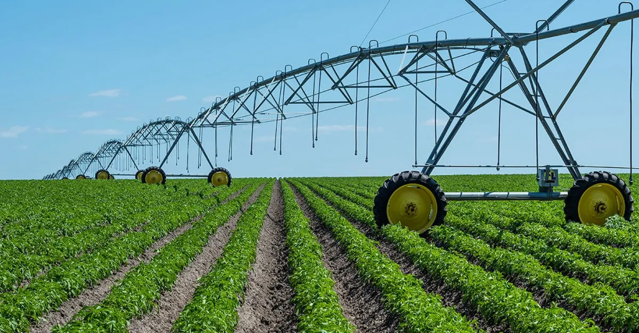
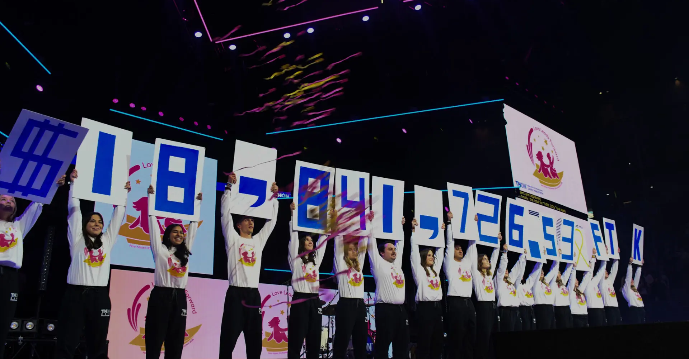
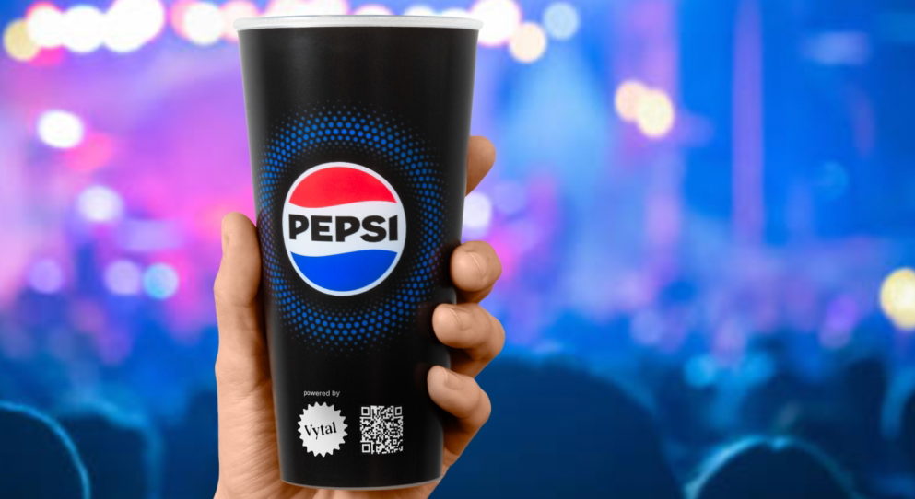








Delivering pep+ Through Customer-Focused Solutions
Regen Agriculture Partnership with Walmart
Implementing Zero Waste Strategies at PSU
nn
Reuse Program Pilots Across Major Stadiums & Arenas
Our Goal
Our Goal
Our Goal
Regenerate 2 million acres of farmland and achieve ~4 million metric tons of GHG reductions and removals by 2030.
Bring zero waste events to PSU for external support on waste assessment and future reduction.
Build a scalable, customer‑led reuse model that reduces single‑use waste while strengthening long‑term partnerships in high‑visibility venues.
The Results?
The Results?
The Results?
240,000 MT of GHG emissions reduced, 1,500+ farmers enrolled, over 1 million acres covered since 2023.
+2,900lbs diverted from landfill, 25+ cubic yards for recycling or compost, saving an estimated 3,700lbs of CO2 with a roadmap for scaling future events.
+60,000 single-use cups avoided, 3 out of 4 programs renewing for the 2026 season.
2
Notes:
These are real examples of how pep+ is delivering measurable impact today. These are not concepts, but customer‑driven solutions that are reducing emissions, cutting waste, and building circularity across some of our largest partners.
Let’s start with Walmart — a partnership that is the gold standard in our sustainability portfolio.
Together, we’ve launched one of the most significant regenerative agriculture partnerships in our industry.
Our shared goal:
- Regenerate 2 million acres of farmland
- Achieve roughly 4 million metric tons of GHG reductions and removals by 2030
The results so far:
- 240,000 metric tons of GHG emissions reduced
- 1,500+ farmers enrolled in programs that build soil health and long‑term resilience
- Over 1 million acres converted to regenerative practices since 2023
This is exactly the kind of customer outcome that transforms both our supply chain and our commercial relationship. It positions PepsiCo as a true thought partner, not just a supplier.
Next, Penn State — our most sustainably-enagaged C&U partner where we’ve brought our zero‑waste expertise directly into their campus events.
This is a great example of how we help customers solve operational challenges while aligning to their sustainability goals.
Our goal:
Bring zero‑waste activation to PSU events
Provide external support on waste audits and reduction strategies
The results:
2,900+ lbs of material diverted from landfill
More than 25 cubic yards recovered for recycling or compost
3,700 lbs of CO₂ saved
A clear roadmap for expanding zero‑waste efforts to future events
This is hands‑on partnership — solving a real problem, building student engagement, and giving PSU measurable proof of progress.
Finally, saw strong traction in reuse solutions — especially in sports and entertainment venues where single‑use waste is a massive challenge.
Our goal:
Bring zero‑waste and reuse pilots to major stadiums and arenas
Support customers with assessments, infrastructure planning, and behavior‑change tactics
The results:
60,000+ single‑use cups avoided
3 out of 4 pilot programs renewing for the 2026 season
Strong engagement from teams and venue operators across professional sports
This is a proof point that reuse is not only possible — it’s commercially viable when done in partnership with PepsiCo. What’s especially meaningful is that the partners who chose to renew these reuse pilots are now doing so with their own budgets. They’re investing because they see long‑term value — operationally, environmentally, and reputationally. These aren’t PepsiCo‑funded pilots anymore. They’re customer‑owned commitments.
These are just three examples, but they point to a larger truth:
When we bring the right tools, expertise, and partnership mindset, customers invite us deeper into their sustainability journeys.

