Slide 1








RESOURCE :
C&U SUSTAINABILITY PLAYBOOK
ADDITIONAL RESOURCES:
FOR QUESTIONS OR
MORE INFORMATION:
PEPSICO SUSTAINABILITY
PepsiCo’s hub for strategy, goals, and progress on our PepsiCo Positive journey.
SHANNA PARRA
shanna.parra@pepsico.com
ESG TOPICS A-Z
This online resource explores the sustainability topics that matter to our business key stakeholders, from A-Z.
CATHERINE WALTON
catherine.walton@pepsico.com
LATEST ENVIRONMENTAL, SOCIAL AND GOVERNANCE (ESG)
REPORT
Access PepsiCo’s ESG metrics and reports, which are updated on a rolling basis.
NICOLE POPOWSKI
nicole.popowski@pepsico.com

Slide 2


Contents
3.
4.
5.
6.
7.
8.
15
Approval Process
Overview & Objective
Insights
How It Works
Considerations
Activation Ideas
Awareness Strategies
9.
12.
Section 1 – Recycling
Section 2 – Greenhouse Gas Reduction
CONFIDENTIAL
2

Slide 3



Approval Process
Please do not pitch any concepts to clients or activate any playbook events without approval from the Sustainability Office.
No materials should be made or produced without Sustainability Office’s approval. This includes getting approval for print and digital assets.
Contact
NICOLE POPOWSKI
(Nicole.Popowski@pepsico.com)
SHANNA PARRA (shanna.parra@pepsico.com)
CATHERINE WALTON (catherine.walton@pepsico.com)

Slide 4
Overview & Objective
In response to the growing demand from C&U partners for sustainability-focused solutions, this playbook outlines a collection of activation ideas and tactics to address that demand. The goal is for PepsiCo associates to feel empowered to respond to requests by selecting from and leveraging these activations throughout the year. We hope to build equity with both students and C&U partners, while driving the business.

Slide 5




Insights
Gen Z is hungry for opportunities to live more sustainably and to feel like the actions they take are having an impact. PepsiCo is here to partner with you to provide opportunities to contribute to a more sustainable future in easy ways.
MEET THEM
WHERE THEY ARE
GIVE THEM
REASON TO BELIEVE
ROOM FOR
EDUCATION
STUDENTS
HATE WASTE
Only 36% students stated they know a “good amount” about sustainability.
Provide students with solutions that solve for this concern.
Students learn about
sustainability from social
media and chatting with
friends IRL.
54% of students reported
feeling overall positive
and hopeful about
sustainability.
We are here to make that
percentage higher!
Source: GoodQues x PepsiCo 2024 Student Sustainability & Alumni-Tek Report
5
CONFIDENTIAL

Slide 6
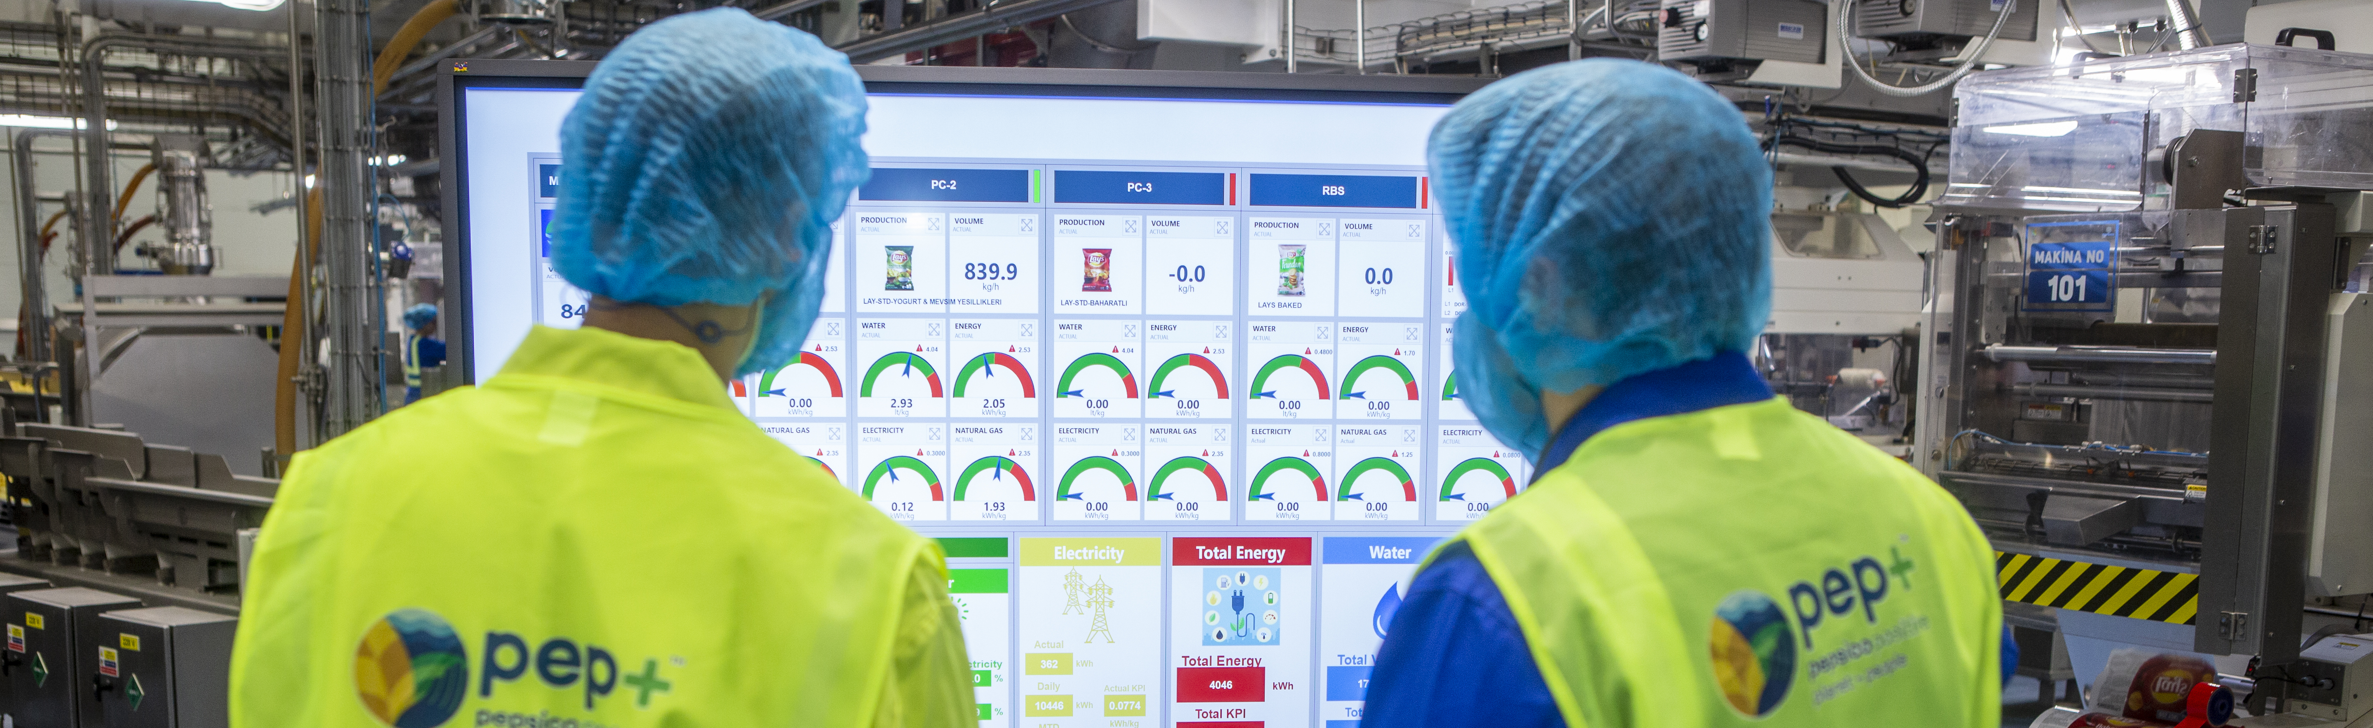
How It Works
ACTIVATION COST KEY*
#1
Select an activation idea based on common sustainability goals
#2
Determine how it scales to your campus
$0 – $5K
$6K – $10K
$11K – $20K
$21K – $30K
Sliding Scale
#3
Receive support for activation:
Digital assets and IRL tools
ACTIVATION COMPLEXITY KEY
#4
Track impact, results
Low
Medium
High
*Pricing will vary. Please work with your team to activate concepts within budget.
CONFIDENTIAL

Slide 7
Considerations
BEST PRACTICES
Focus on efforts to improve our practices instead of using “greenwashing” language, such as “green”, “eco-friendly”, “natural” and “sustainable”
Avoid using “pep+” or “PepsiCo Positive”
Avoid any language that insinuates a claim to accomplish or execute a task. Rather, utilize language that leans toward “striving to” or “working towards” the end goal
CONFIDENTIAL

Slide 8


ACTIVATION
IDEAS
All images FPO. Please work with your team to create imagery specific to your activation.
8
CONFIDENTIAL

Slide 9

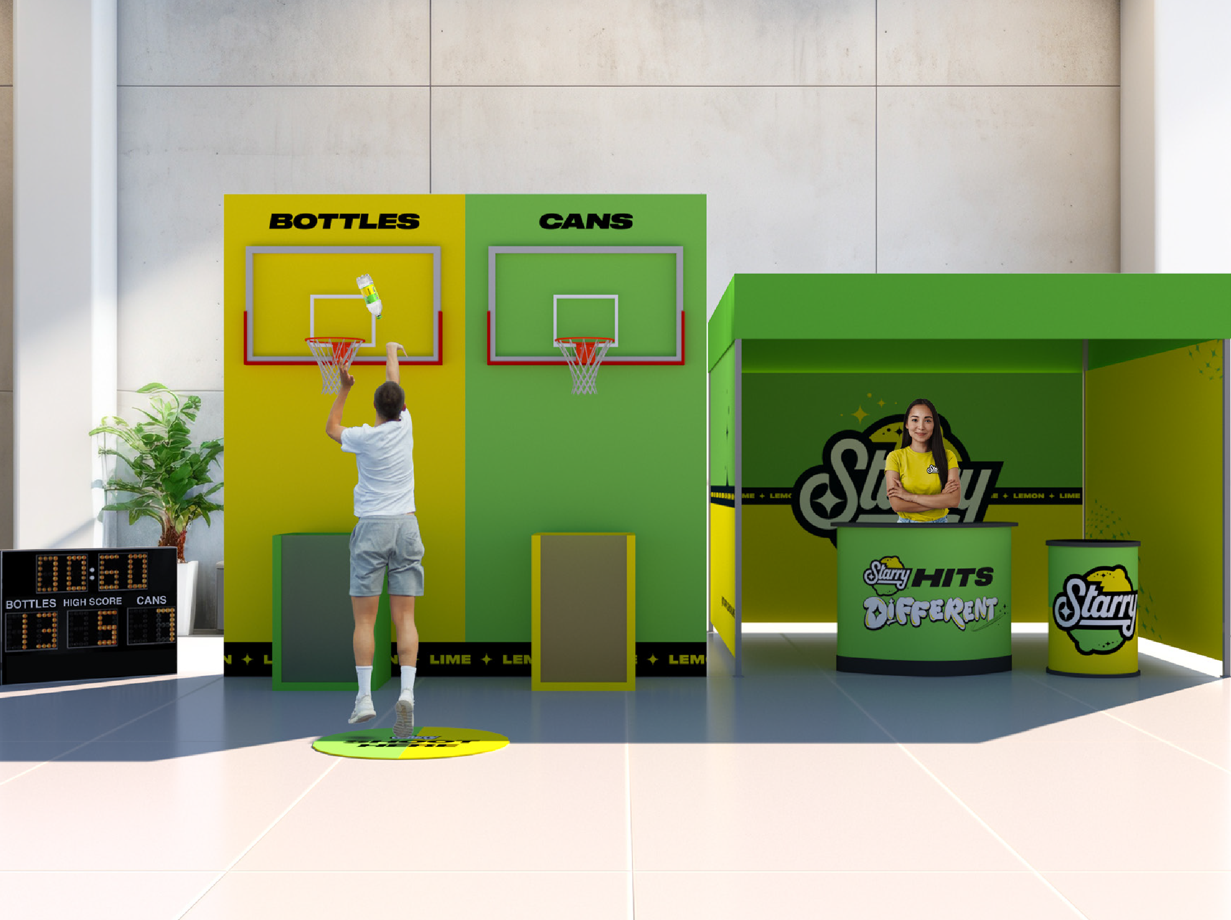
3-Points For The Planet
ACTIVATION IDEA
A basketball experience that lets students compete for prizes as they free-throw recyclable items. Two hoops are suspended over two recycling bins. Participants step up to the line and are timed to see how many free-throws they can make in 60 seconds. Students can see their recycling add up through the windows in each bin.
See cost sheet for pricing.

Slide 10
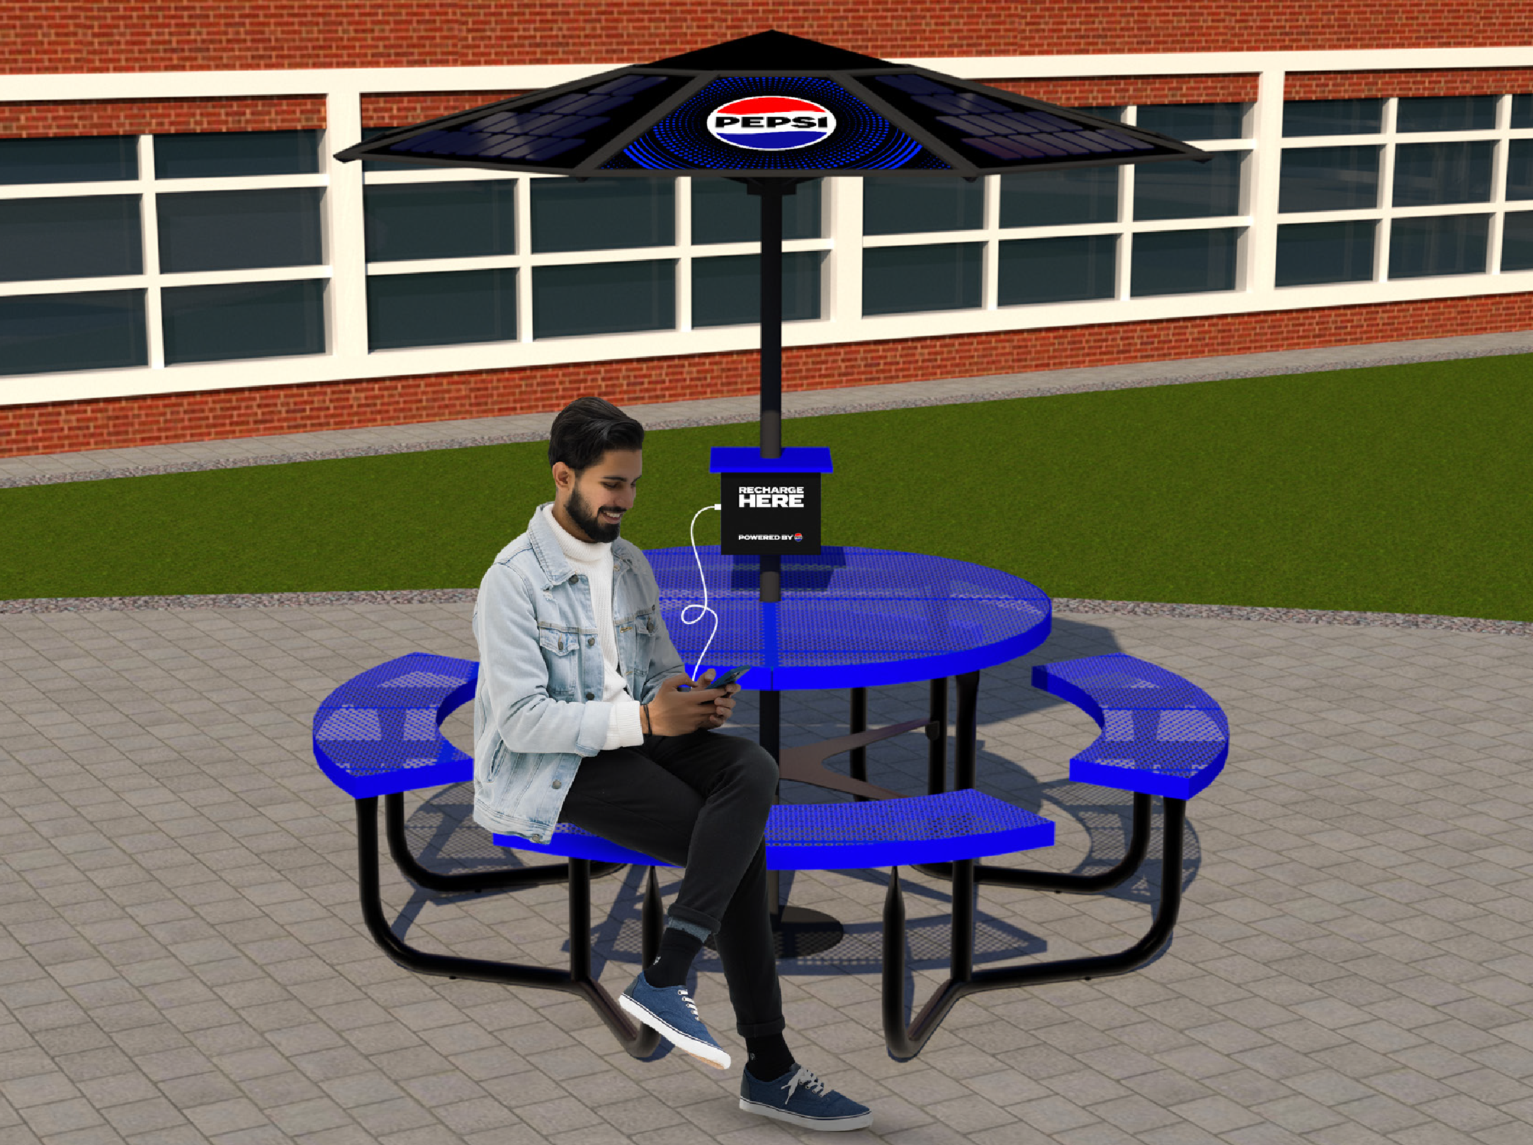
Solar-Powered Charging Stations
ACTIVATION IDEA
75% of Americans agree they are inspired by companies pledging to eliminate their carbon footprints.
Not only is PepsiCo working to reduce GHG emissions with the aim to decarbonize its operations and supply chain, but it is also helping students reduce their own. Install branded solar- powered charging stations in highly trafficked areas on campus, so students can work outside and keep their phones and laptops charged, decreasing personal energy consumption.
PLUS UP
Sponsor lunches and work with green teams to arrange club meetings at the benches.
See cost sheet for pricing. Source: GoodQues

Slide 11
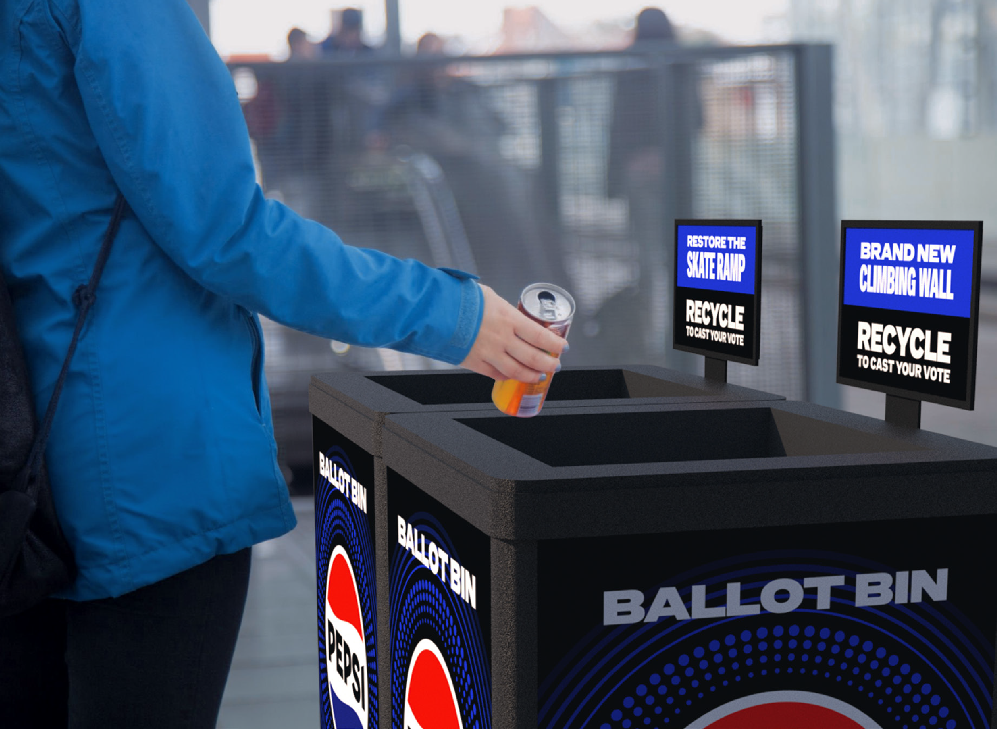
Ballot Bin
ACTIVATION IDEA
C&Us / student environmental club are provided with a recycling bin that incentivizes sustainable behavior
by allowing students to vote with their trash for campus rewards made from sustainable materials.
A single recycling deposit counts as one vote for the reward indicated on each compartment. Student clubs to work with their Pepsi representives to determine their rewards (e.g. skate ramp vs. climbing holds, etc.) and for counting deposits and selecting
winners. Cap donation at ~$5,000 per C&U.
See cost sheet for pricing.

Slide 12
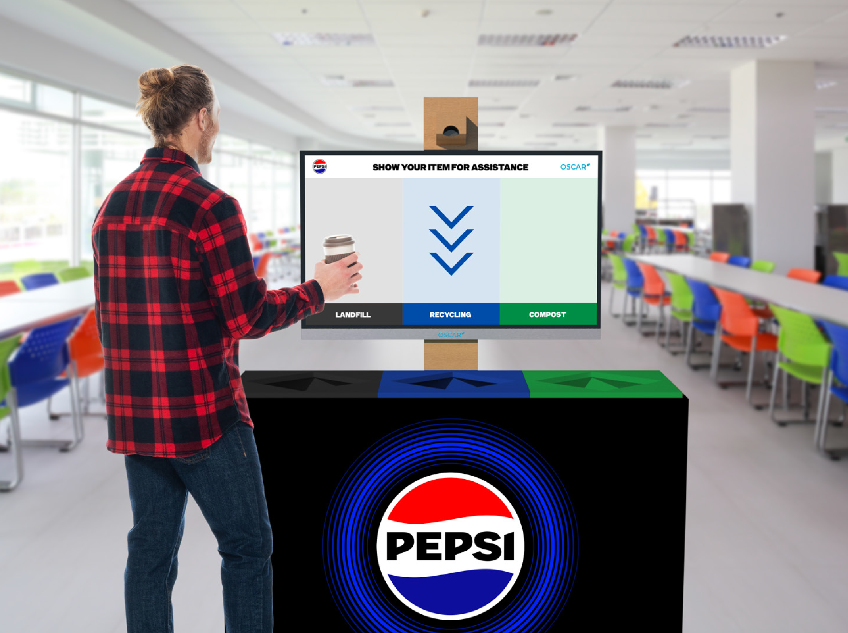
Oscar Sort Units
ACTIVATION IDEA
26% of students surveyed stated they do not feel they have the knowledge to start living sustainably. PepsiCo can help simplify. Oscar Sort is an AI
material sorting assistant that will guide students, faculty and all others to sort items into the correct streams in a fun and engaging way. Using advanced AI vision detection, Oscar Sort is designed to seamlessly integrate with facilities to make sure materials are properly sorted based on each C&U’s needs and recycling capabilities.
PLUS UP
Content could feature NIL athletes or influencers. Opportunities to gamify, including quizzes and enter-to-win prizes. Utilize screens for sustainability education, messaging and promoting related events on campus.
See cost sheet for pricing. Source: GoodQues

Slide 13
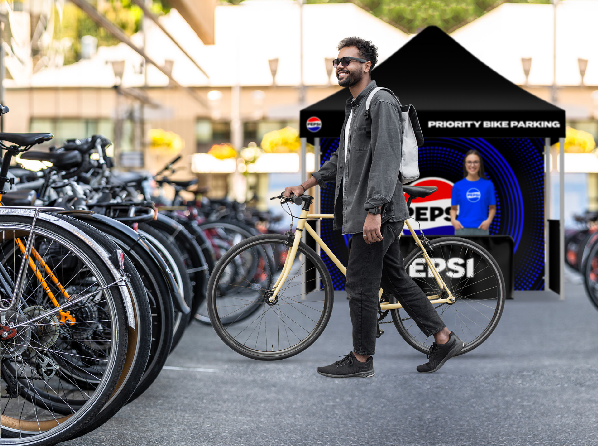
Ride In To Win
ACTIVATION IDEA
25% of students surveyed do not feel their small sustainable changes will create an actual difference.
If we want student buy-in to sustainable practices, it needs to be easy and rewarding.
Incentivize students and fans to ride to games by offering a free bike valet in a designated, convenient Pepsi parking area. Participants are further
incentivized with potential to win prizes and product.
PLUS UP
Each participant can have the chance to win prizes ranging from concessions gift cards to larger prizes like e-bikes. Can also offer free products/samples for those that use the valet.
See cost sheet for pricing. Source: GoodQues

Slide 14
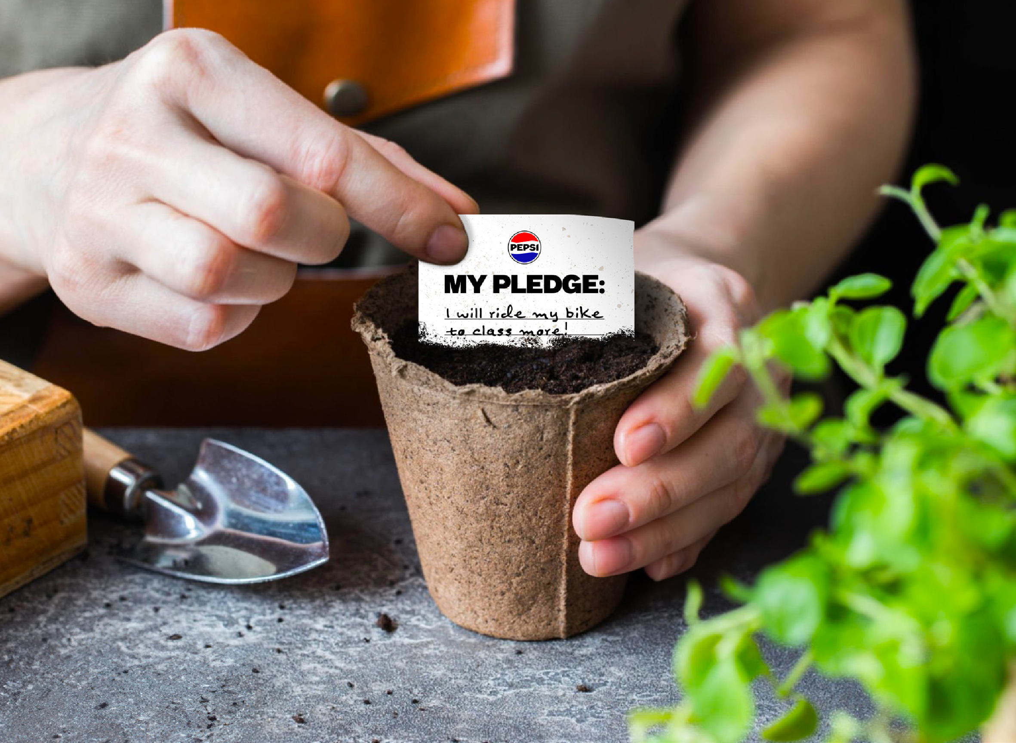
Planting Change
ACTIVATION IDEA
Partner with campus student organizations to educate on sustainable lifestyle changes. C&U organizations are provided with a toolkit for hosting events where students can learn and share sustainability tips.
The toolkit includes a tent, table, seed paper, biodegradable planters, potting soil, gardening gloves, recycled paper notebooks, and wooden pencils.
Students pledge to make small, daily changes for the planet, writing their pledges on seed paper to plant in biodegradable planters. With care instructions provided, they can watch their pledges grow over the coming weeks.
The tent can also serve as a venue for speaker series with sustainability influencers, crafting activities,
and coordination for off-campus sustainability initiatives.
See cost sheet for pricing.
See cost sheet for pricing.

Slide 15
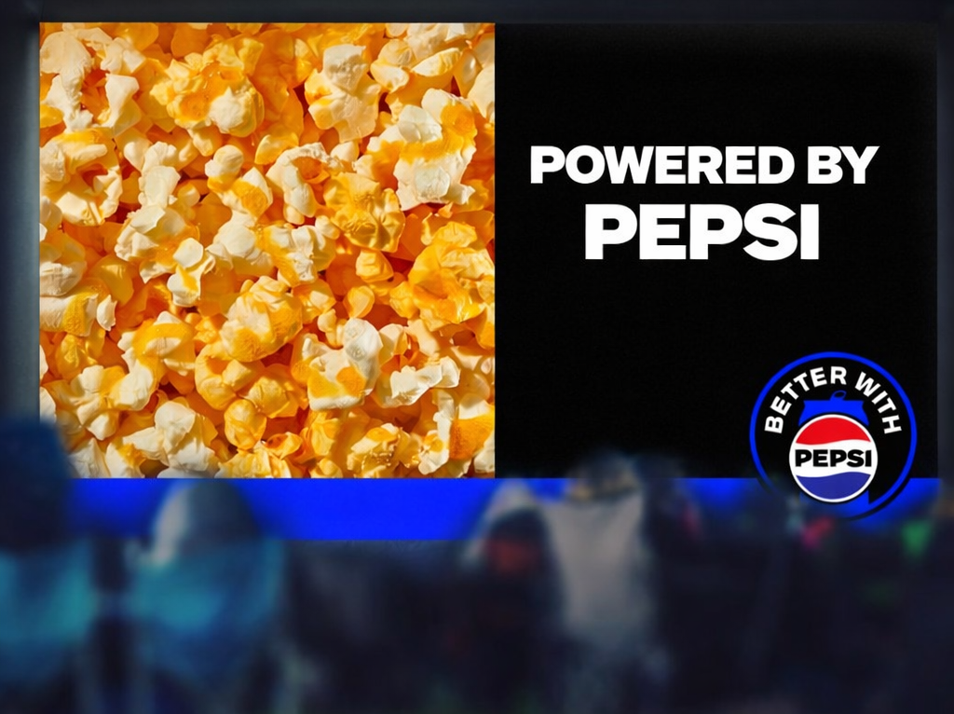
MOVIE NIGHT POP-UPS
ACTIVATION IDEA
Let’s bring students together to spark conversation, inspire action, and celebrate sustainable choices. Organize a movie night on campus that incorporates solar energy to help minimize its environmental impact.
PLUS UP
Run digital influencer programs and partner with student organizations to spread awareness on campus. Host student movie night contests, where the winning film is featured as a pre-screen during the event.
Note: Actual screen size will vary by rental partner.
See cost sheet for pricing. Source: GoodQues

Slide 16
ECO PRIZE PACK
ACTIVATION IDEA
Gen Z is hungry for opportunities to live more sustainably and have opportunities to make an impact. Promote a lottery on campus for students who engage with our onsite recycling activation. Select winners will receive an eco-friendly prize pack featuring biking and camping gear, reusables, gift-cards to local sustainable shops and more!
PLUS UP
Opportunity to add this as a plus- up option to other activation ideas such as Ride in to Win and Three Points for the Planet.
Note: Actual prizes will vary by location.
See cost sheet for pricing. Source: GoodQues

Slide 17
CASE
STUDIES
All images FPO. Please work with your team to create imagery specific to your activation.
17
CONFIDENTIAL

Slide 18


EARTH DAY MOVIE NIGHT POP-UP
Opportunity: Drive pep+ awareness & sustainability initiative education via engaging on-campus and digital student experiences.
For Earth Day 2024, pep+ hosted solar-powered movie nights, offering students PepsiCo drinks, Frito snacks, and popcorn in compostable bags—all powered by jackerie solar units.
Overview
Execution
pep+-branded Movie Night footprint (projector screen, seating, 10x10 “snack bar” tent with educational signage)
Student TikTok influencers and university social posts promoted free event to students
Relevant movie titles got students excited to tune in (Barbie = current/popular, The Lorax = strong Earth Day tie)
Distributed full-can PepsiCo beverages (Pepsi, MTN Dew, bubly), Frito products, and popcorn in compostable bags via solar-powered popcorn machine
Students encouraged to scan a digital QR code on banner signage to learn more about pep+ sustainability initiatives.
Leverage Earth Day celebrations as a key moment to spread the word around pep+ messaging.
Build connection moments with students to enable PepsiCo portfolio sampling.
Goals
Program Scorecard
Program Metric | Goal | Results | % to Goal
Event Days | 2 | 2 | 100%
Onsite Event Impressions (passersby, view, etc.) | 750 | 900 | 120%
Onsite Event Interactions (Active engagements) | 500 | 600 | 120%
Total Beverage Distributed (Pepsi, PZS, Pepsi Wild Cherry, bubly, MTN DEW) | 1,200 | 1,200 | 100%
Total Frito Lay Snacks Distributed | 660 | 660 | 100%
TikTok Creator Views | 100,000 | 136,600 | 137%
TikTok Creator Reach | 49,300 | 73,879 | 150%
Avg. TikTok Engagement rate | 3.00% (industry standard) | 1.02% | 1.98%* below industry benchmark
Partner Campuses
University of Florida
University of Washington

Slide 19

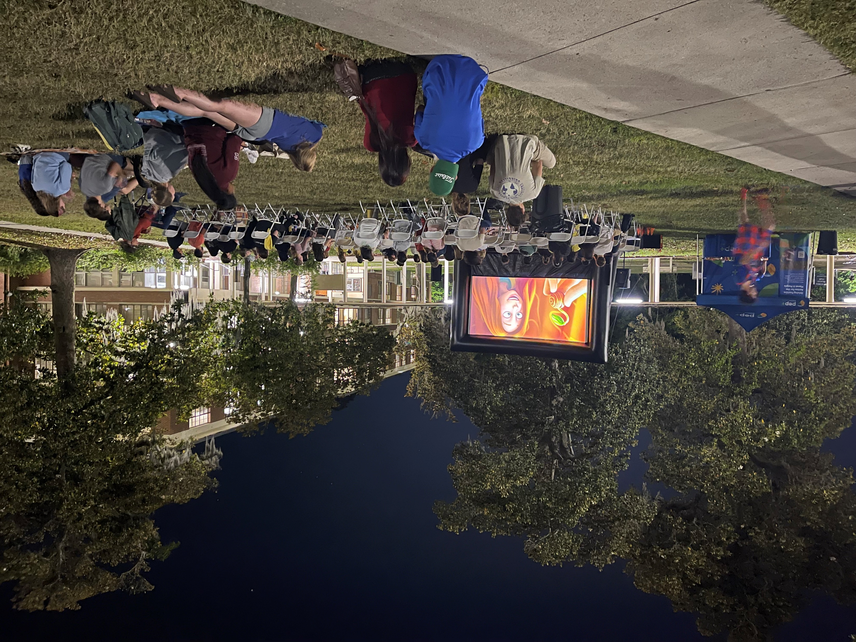
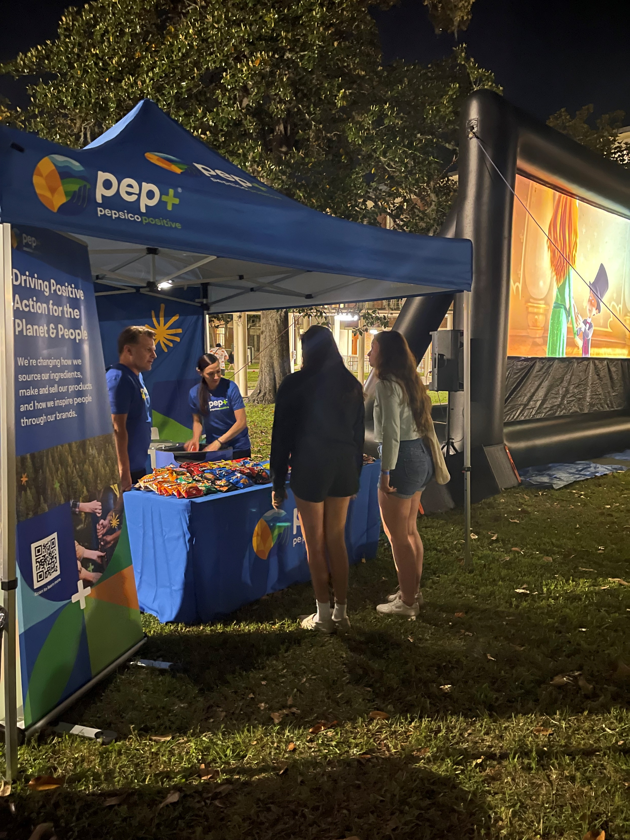
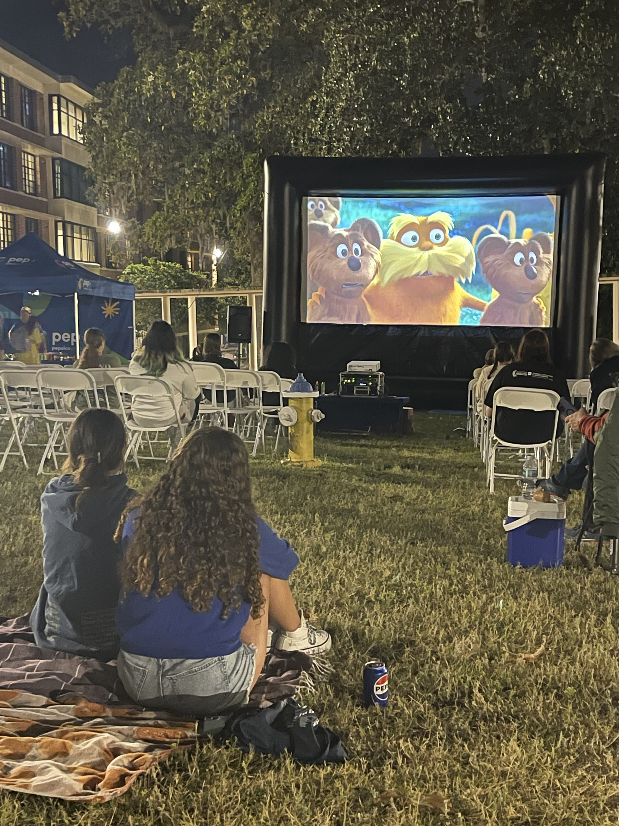
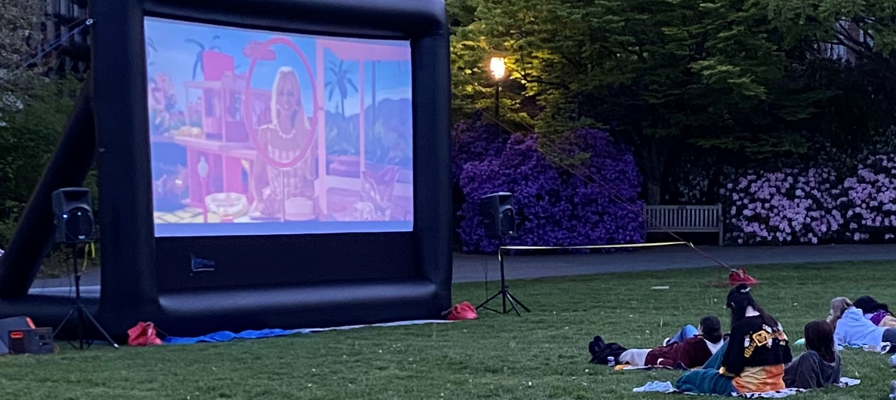

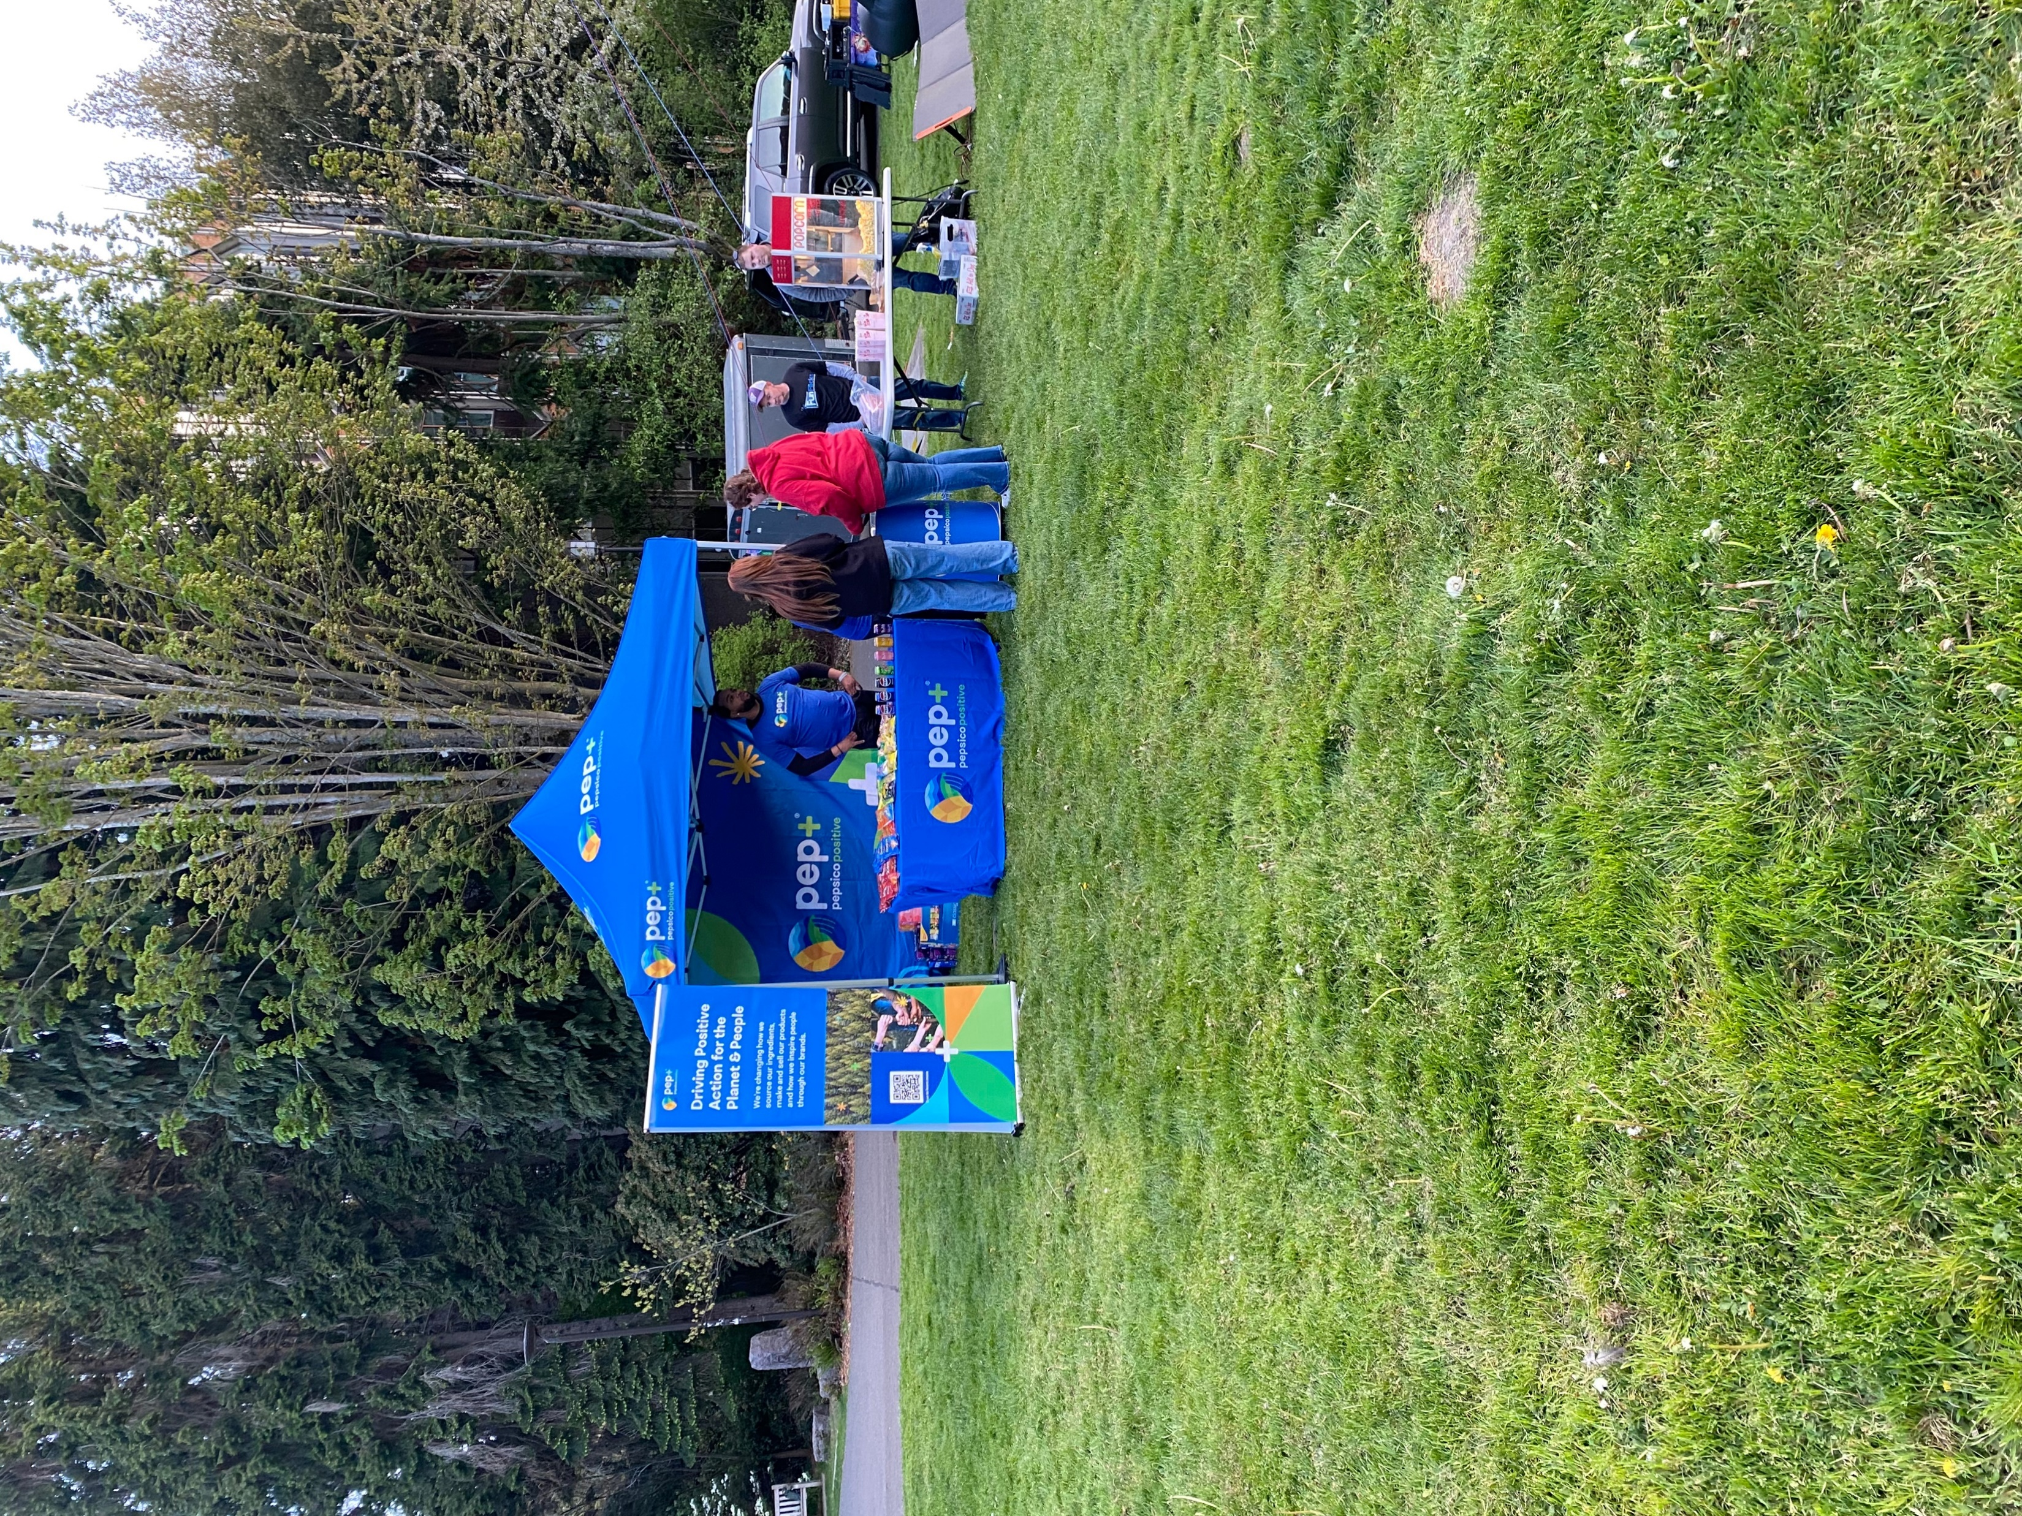
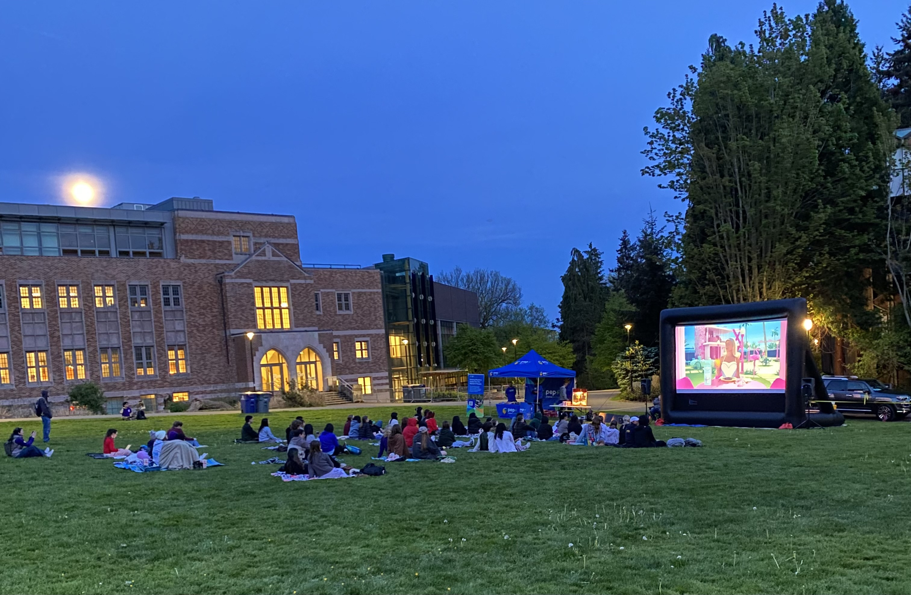
EARTH DAY MOVIE NIGHT POP-UP – CoNt.
Opportunity: Drive pep+ awareness & sustainability initiative education via engaging on-campus and digital student experiences.
Key Learnings
Event Photos
Movie nights are an exciting draw for students & strong campus integration creates an authentic experience
Students were excited by the offer of a free movie and plethora of PepsiCo beverages & snacks.
Organic campus tie-ins like the UF Late Night Breakfast event drove additional visibility, traffic and engagement opportunity.
Continue to work closely with C&U partners to plan curated activations that overlap with existing campus events that appeal strongly to each specific student body.
Solar-supported elements contrasted with nighttime activation window
While solar generators ran many of the onsite assets, some students were confused about how solar connected to an evening activation.
In the future, consider ways to strengthen the Movie Night sustainability hook (ex. activate during the day as well while charging the solar generator with the solar panel, to pre-promote event and drive pep+ conversation).
Earth Day is a hot-button issue on college campuses
Students are very involved in Earth Day campus events & activities; while some are celebratory in nature, others highlight student grievances & demands.
Ex. For a 2024 national C&U “Reclaim Earth Day” campaign UW students flyered to promote the campaign onsite at the event, and left comments on the UW TikTok content.
In the future, work closely with PepsiCo comms teams and partner C&Us to create a contingency plan for any negative student reaction to pep+ sustainability-related events.
University of Florida
x
University of Washington
x
“Can you come do this again during Welcome Week in the quad?”
“How did you capture the solar energy?”
“This is great; I had no clue what pep+ was all about!”
Student Quotes

Slide 20
AWARENESS
STRATEGIES
All images FPO. Please work with your team to create imagery specific to your activation.
20
CONFIDENTIAL

Slide 21
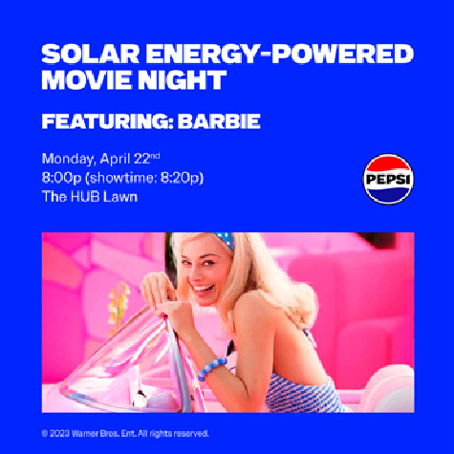


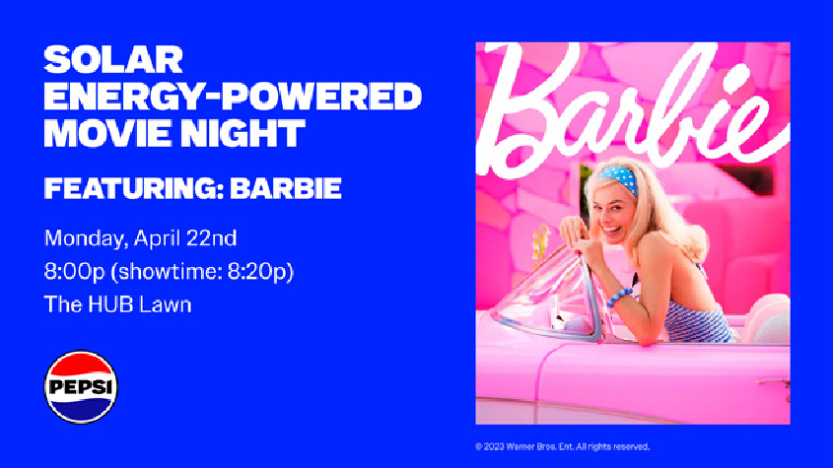
DIGITAL
ASSETS
Digital asset templates can be provided for any of the activation ideas shown in this playbook. C&Us will be provided with editable files to download and repurpose for their own activation needs, in order to drive student awareness and participation. C&U student organizations could also leverage digital assets for their own social media channels.
In-Feed Social Post
1080 x 1080px
Email Header
800 x 450px
On-Campus Digital Screen
1080 x 1920px
Story Social Post
1920 x 1080px
See cost sheet for pricing.

Slide 22
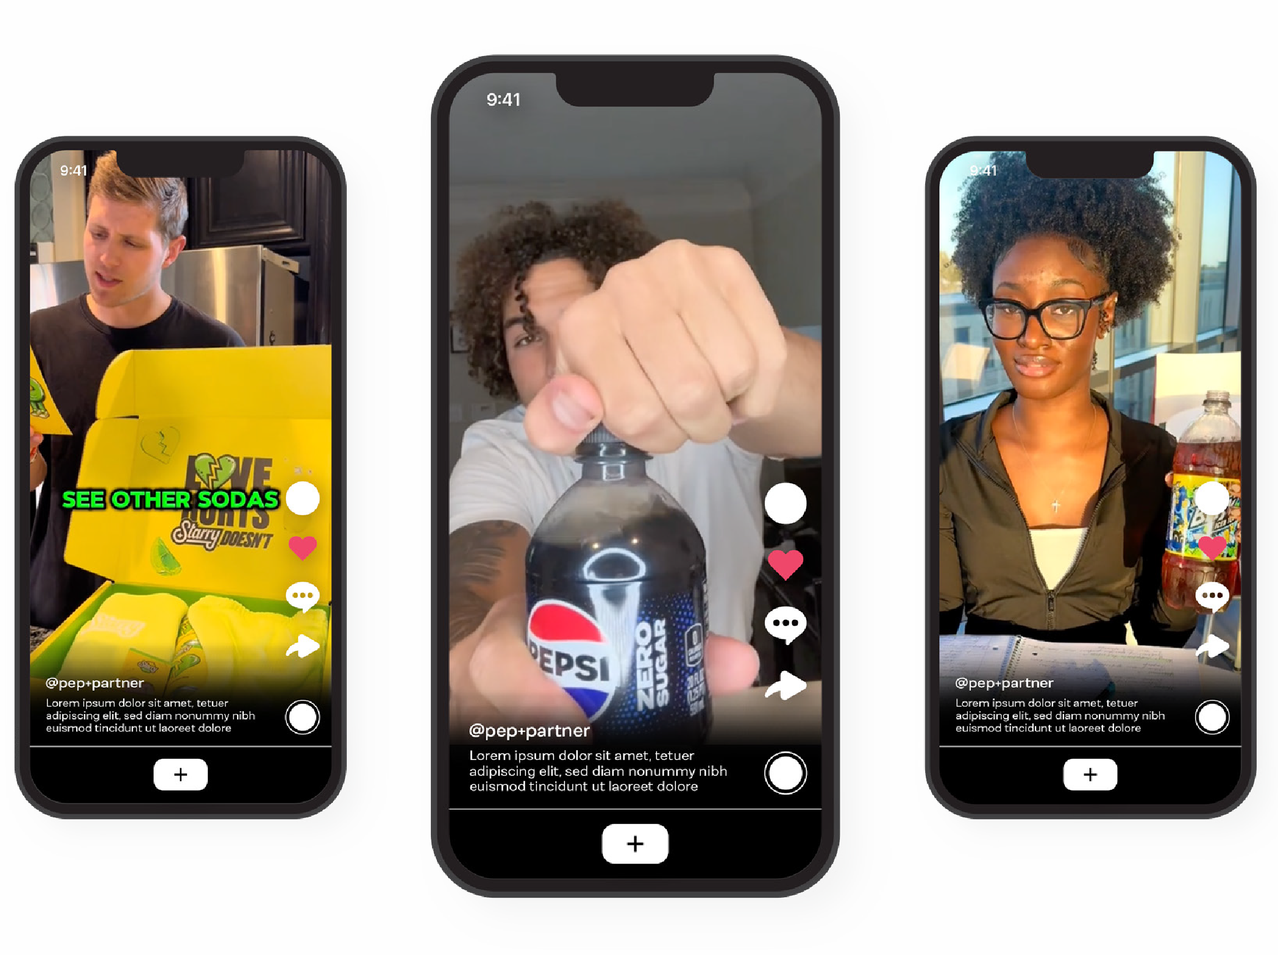
Campus Influencers
Hire college influencers to promote and generate content on their channels about PepsiCo activations taking place on their campuses.
Note: Agency partner will recruit, hire and manage campus influencers.
Agency partner will brief each campus influencer on the campaign, including brand speaking points, video content mandatories, prompts, etc.
PLUS UP
Boost influencer content in order to reach a larger audience of students.
See cost sheet for pricing.

Slide 23

Thank you!

