Slide 1
INTERNAL USE ONLY
INTERNAL CHANGE LOG - Be Sure to Use the Latest Iteration
Most recent revisions will be highlighted in red
Major Updates |  | Minor Updates
Date | Details | Date | Details
 |  | 12/2/26 | Updated slides 35,36 and 58, removed “Recycle Rally”
 |  | 12/2/26 | Updated C&U Playbook link, slide 57
 |  | 2/23/26 | Updated C&U Playbook link, slide 57
 |  | 2/24/26 | Removed CIRQU slides 37-41
 |  | 3/12/26 | Updated pep+ framework slide 26
 |  | 8/24/26 | Removed OLYNS slides 43-44; logo on slide 36
Notes:
This first slide is a version and update tracker so we know we’re using the most current toolkit. You’ll notice it’s labeled as internal, so in an external customer presentation you would typically skip or remove this slide. The benefit of having it in the source deck is quality control—everyone presenting from this toolkit stays aligned on the latest content. The key takeaway is that this toolkit is actively maintained, not static. That’s important because sustainability solutions and resources evolve, and we want to bring customers the most accurate story every time.

Slide 2
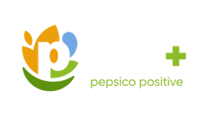
Pep+
2026 Commercial
Toolkit
December 2025
Notes:
This deck is designed to make sustainability practical and customer-relevant, connecting impact with business value. The core feature is that it combines strategy, proof points, and resources in one storyline. The benefit for you is a clearer view of how PepsiCo is approaching sustainability in a way that supports growth. As we go, we’ll focus on the areas that matter most to your goals and priorities.

Slide 3


TABLE OF CONTENTS
2026 Commercial Toolkit
Toolkit Objectives​
Customer Framework​
2026 AOP Priorities​
pep+ Strategy​
Consumer Insights​
pep+ Sell Story
Programming​
Tools & Resources ​
Notes:
Here’s how we’ll navigate the conversation today, from objectives and priorities to insights and activation tools. A key feature of this toolkit is that it’s modular—you don’t need every slide for every customer discussion. The benefit is flexibility, so we can tailor the story to what’s most relevant for your business. We’ll start with the framework and priorities, then move into the pep+ strategy and what consumers are telling us. Finally, we’ll land on practical programming ideas and tools that can support real execution.

Slide 4
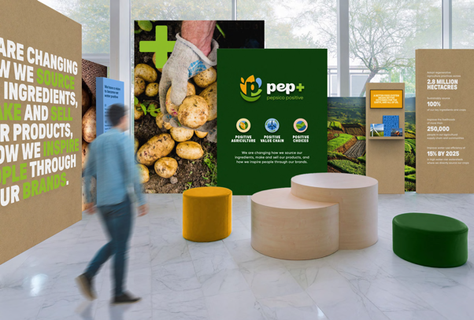
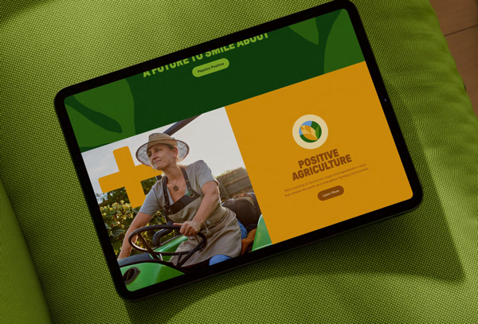




USE THIS TOOLKIT TO GAIN…
INTERNAL USE ONLY
CAPABILITIES TO UNLOCK
CUSTOMER GROWTH.
STRATEGY
SELL STORY
Tools & resources
Notes:
This slide summarizes what the toolkit is built to do: unlock customer growth through sustainability capabilities. The key feature is that it brings together strategy, a sell story, and tools and resources—so it’s not just high-level messaging. The benefit is that sales teams can move from “why sustainability” to “how we activate” in a clear way. For customers, the takeaway is that sustainability can be positioned as a competitive advantage and a partnership opportunity. We’ll use the rest of the deck to make those connections tangible and actionable.

Slide 5


ABOUT THIS TOOLKIT
INTERNAL USE ONLY
OBJECTIVE
This toolkit is designed
to empower PepsiCo associates with the sell story and resources to engage in customer planning sessions for commercial growth ​
and value.
DISCLAIMERS
Please disregard any versions of the toolkit prior to 10/31/25. Modifications to
the content require
approval. Content
and programming are subject to change.
CONTACTS
SHANNA PARRA
Retail/Bottler
shanna.parra@pepsico.com
CATHERINE WALTON
Away From Home
catherine.walton@pepsico.com
confidential and proprietary
Notes:
This toolkit is designed to empower PepsiCo teams with a clear sell story and practical resources that support customer planning sessions. One key feature is that it’s built for commercial conversations—linking sustainability to the potential for growth and value, not treating it as a separate topic. You’ll also see important disclaimers here: content updates are controlled and subject to change, which helps ensure consistency and accuracy. The benefit to customers is that the story you’re hearing is standardized and supported by an approved toolkit. And if you want to go deeper after today, you can follow up with SHANNA PARRA or CATHERINE WALTON using the contacts listed here.

Slide 6

INTERNAL USE ONLY
When to
Best leverage this toolkit
Position pep+
as a competitive advantage for new and existing business​
Enhance your capabilities to
deliver customer growth and value
Expand your knowledge on
our pep+ priorities
Understand key resources available for joint business planning sessions ​
confidential and proprietary
Notes:
This slide explains when this toolkit is most valuable—especially when sustainability can help differentiate a partnership or unlock growth. The feature here is the focus on capability-building: it’s meant to strengthen how teams talk about pep+ priorities and how they show up in customer planning. The benefit is that it supports joint business planning discussions with clear resources and a consistent message. It’s also intended to help teams secure time on the agenda and elevate sustainability as part of the commercial story. The takeaway is simple: this is a tool to help turn sustainability into a structured, repeatable customer conversation.
Our strategy is designed to meet varying customer needs
Sustainability agenda is becoming much more important to our customers, but they have limited internal expertise
PepsiCo has strong sustainability goals and capabilities, and we need our partners to help achieve our goals
There is an opportunity to drive both positive sustainability impact and commercial value

Slide 7
Customer engagement model
INTERNAL USE ONLY
DISCOVERY
BIG BETS
ACTIVATION
1. INSPIRE
3. ACTIVATE
2. IDEATE
Next customer meeting: secure ~10 mins on the agenda for sustainability
Inspire customer with
our pep+ framework and PARTNERSFORTOMORROW.COM platform to ignite interest
Host a dedicated sustainability session
with the customer
Understand customers’ sustainability strategy
Identify areas for common sustainability goals
Align scope, timelines,
and goals for the 2-3
key projects
Internal alignment
with pep + team
Top management alignment via T2T
Include pep+ initiatives in annual JBP
OBJECTIVE
Secure a dedicated sustainability meeting with the right contacts from the customer.
GOAL
Align on 2-3 strategic opportunities.
SHARE
Share learnings, insights, and results.
VISIT PARTNERSFORTOMORROW.COM AND CLICK ON THE PEPSICO ASSOCIATE PORTAL FOR ADDITIONAL RESOURCES
Notes:
This slide lays out a simple engagement model: Inspire, Ideate, and Activate. The key feature is that it provides a repeatable path to move from initial interest to concrete projects and business planning. First, we “inspire” using the pep+ framework and PartnersForTomorrow.com to spark relevance and secure time with the right contacts. Then we “ideate” in a dedicated session—understanding your sustainability strategy and identifying shared goals. Finally, we “activate” by aligning on 2–3 strategic opportunities and embedding initiatives into the annual JBP. The takeaway is a clear, practical way to turn sustainability into a focused plan with measurable actions.

Slide 8


Ask of the Commercial Organization
INTERNAL USE ONLY
2026 AOP Priorities
OPTIMIZE PACKAGING SOLUTIONS
Expand reusable, aluminum, and
alternative packaging.
DRIVE CUSTOMER ENGAGEMENT
Leverage pep+ resources
for integrated customer planning sessions.
confidential and proprietary
8
Notes:
This slide captures our 2026 priorities and the ask of the commercial organization. The first feature is the focus on optimizing packaging solutions—expanding reusable, aluminum, and alternative packaging options. The second is driving customer engagement by leveraging pep+ resources during integrated planning sessions. The benefit is that these priorities help align sustainability with commercial growth levers, not separate from them. For customers, the takeaway is that PepsiCo is prioritizing both packaging innovation and stronger collaboration through planning. This creates a clear starting point for identifying where we can partner in a way that supports your goals.
Sustainability agenda is becoming much more important to our customers, but they have limited internal expertise
PepsiCo has strong sustainability goals and capabilities, and we need our partners to help achieve our goals
There is an opportunity to drive both positive sustainability impact and commercial value

Slide 9
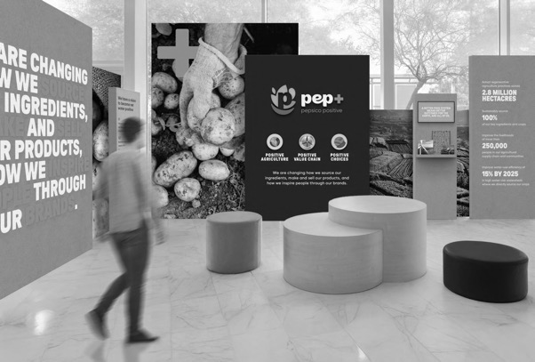
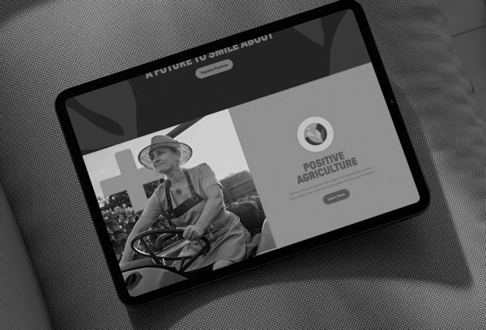

PEP+ STRATEGY
STRATEGY
SELL STORY
Tools & resources
Notes:
This slide marks the shift into the pep+ strategy portion of the conversation. A key feature of the deck is that it separates the “what” and “why” from the “how” so the story flows logically. The benefit is clarity—we can align first on what pep+ is and what it aims to achieve before moving into execution. This section helps ground the conversation in a consistent framework. The takeaway is that the next slides will explain the pep+ goals and pillars that guide where we invest and how we partner. From there, we’ll connect those goals to customer-relevant opportunities.

Slide 10




Pep+ goals overview
CLICK ON EACH GOAL TO VIEW IN DETAIL
POSITIVE AGRICULTURE
POSITIVE
VALUE CHAIN
POSITIVE CHOICES
REGENERATIVE
AGRICULTURE
DEFORESTATION- AND CONVERSION-FREE SOURCING
SUSTAINABLY SOURCED
INGREDIENTS
LIVELIHOODS
CLIMATE
SCOPE 1 & 2 EMISSIONS
SCOPE 3 FLAG
SCOPE 3 E&I EMISSIONS
RENEWABLE ENERGY
WATER
2030 OPERATIONAL
WATER-USE EFFICIENCY
2025 REPLENISHMENT
2030 REPLENISHMENT
WATERSHED (AWS)
NET WATER POSITIVE
PACKAGING
VIRGIN PLASTIC REDUCTION (TONNAGE)
RECYCLED CONTENT
RCBR/RRC
INNOVATIVE PACKAGING MATERIALS
PEOPLE
VOLUNTEER GROWTH
FOOD SECURITY
INJURY-FREE WORK ENVIRONMENT
HUMAN RIGHTS
SUPPLIER CODE OF CONDUCT
PAY EQUITY
SAFE WATER ACCESS
JOB GROWTH
REDUCE ADDED SUGARS
REDUCE SATURATED FATS
PLANET & PEOPLE BRANDS
REDUCE SODIUM
DIVERSE INGREDIENTS
Notes:
This slide gives a full snapshot of pep+ goals across major areas like agriculture, climate, water, packaging, people, and nutrition. The key feature is breadth—it shows sustainability as an end-to-end strategy rather than a single initiative. The benefit is that it creates multiple entry points for customer partnership depending on what matters most to you. It also helps clarify that pep+ includes both environmental and social priorities. The takeaway is that these goals are structured and specific, and we’ll zoom into key areas next. If any topic here aligns closely with your priorities, we can spend more time there.

Slide 11



ESG Topics A-Z
For a full list of pep+
goals, click here
Positive agriculture
ESG Topics A-Z
Our Approach
We're collaborating to help transform the way the crops we source are grown, by supporting agricultural practices that aim to restore soil health, reduce water use and emissions and improve biodiversity — all while supporting farmers and farming communities.​
Regenerative Agriculture
Spread the adoption of regenerative agriculture, restorative, or protective practices across 10 Million acres of land by 2030* supporting the growth of our key crops and ingredients by ​
Sustainably Sourced Ingredients
Sustainably source 90% of our key ingredients and progress volumes (10% or less) that face systemic barriers towards being sustainably sourced in accordance with our guidelines, by 2030*​
*See PepsiCo’s Regenerative Agriculture Guidelines for additional information, including details on key crops and regeneration, restoration and protection criteria. Results represent the total acreage meeting these criteria as of the end of the reported year.​
*Sustainably sourced refers to in-scope ingredient volumes that meet the established criteria outlined in PepsiCo’s Sustainable Sourcing Guidelines. Sustainable Sourcing practices can help manage risks, but challenges like deforestation or social issues can persist in some regions​.
Deforestation and
Conversion-Free Sourcing
Continue to strive toward deforestation-free sourcing by 2025 and toward deforestation- and conversion-free sourcing by 2030 for high-risk commodities in our company-owned and -operated activities*​
Livelihoods
Improve the livelihoods of more than 250,000 people in our agriculture supply chain and supporting communities by 2030*​
*PepsiCo set this ambition in its Stewardship of Forests and Natural Ecosystems Policy. High-risk commodities include ingredients and materials at high risk of deforestation and conversion as defined in our Calculation Methodology. Systemic challenges continue to be an industry-wide barrier to reaching fully deforestation-free sourcing, but we continue striving toward this ambition and expect to reach more than 90% by the end of 2025​.
*This goal captures the number of livelihoods reached through an outcome-focused evaluation measuring improvements in economic prosperity and farmer and farm worker security. Metric counts the cumulative people impacted since 2021​.
11
Notes:
This slide focuses on Positive Agriculture, which is about how we source and grow key crops and ingredients. Key features include expanding regenerative practices, increasing sustainably sourced ingredients, improving livelihoods, and advancing deforestation- and conversion-free sourcing over time. The benefit is stronger supply chain resilience and improved environmental and community outcomes. It also signals that PepsiCo is using defined guidelines and methodologies to track progress. For customers, the takeaway is that upstream agriculture practices are a meaningful part of sustainability impact, and they influence long-term stability and responsible sourcing. If agriculture is a priority area for you, this is a place where shared goals can be identified.

Slide 12

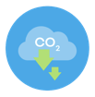
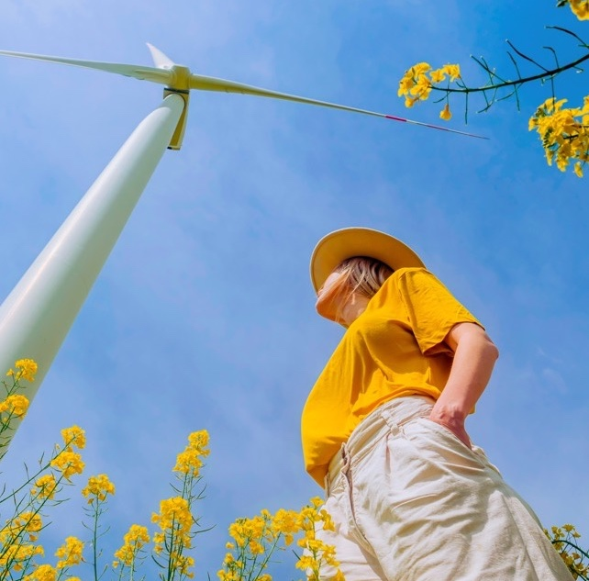

For a full list of pep+
goals, click here
Positive VALUE
CHAIN: CLIMATE
ESG Topics A-Z
Our Approach
We’re transforming our value chain to be more circular, inclusive, and innovative to benefit communities and the planet.
Scope 1 & 2 Emissions
Achieve a 50% reduction
in Scope 1 and 2 emissions
by 2030 (vs 2022 baseline)
Scope 3 E&I Emissions
Achieve a 42% reduction in
Scope 3 Energy and Industry
(E&I) by 2030 (vs 2022 baseline)*
Goal tracks Scope 1 and 2 emissions consistent with the Greenhouse Gas Protocol.
See Calculation Methodology for detail.
Scope 3 FLAG
Achieve a 30% reduction in Scope 3 Forest, Land and Agriculture (FLAG) emissions by 2030 (vs 2022 baseline)
*Goal tracks energy- and industry-related Scope 3 emissions consistent with the Greenhouse Gas Protocol's Scope 3 Standard and the Science Based Target Initiative’s Corporate Net-Zero Standard V1.2. See Calculation Methodology for details on how these emissions are calculated and categories included in scope of this goal.
Renewable Electricity
Achieve 100% renewable
electricity in company —
owned operations by 2030
Goal tracks Scope 3 emissions based on purchased goods emissions consistent with the Greenhouse Gas Protocol's draft Land Sector and Removals Guidance and Standard and the Science Based Target Initiative's Forest, Land and Agriculture (FLAG) Guidance. See Calculation Methodology for details on how these emissions are calculated and categories included in scope of this goal.
Net-Zero Ambition
Achieve net-zero emissions
by 2050 or sooner
Refer to our Climate Transition Plan for more information.
In working to achieve this goal, PepsiCo uses a diversified portfolio of solutions, including energy attribute certificates.
12
Notes:
This slide covers our climate approach within the Positive Value Chain pillar. A key feature is that it spans Scope 1 and 2 emissions, Scope 3 emissions (including FLAG and Energy & Industry), and renewable electricity—showing a full value chain perspective. The benefit is a more comprehensive strategy that addresses both direct operations and broader supply chain impacts. It also includes a longer-term net-zero ambition, reinforcing direction and accountability. For customers, the takeaway is that climate progress requires collaboration across the system, and PepsiCo is aligning goals and tracking methods to support that. This sets a strong foundation for identifying where customer partnership can accelerate shared progress.

Slide 13
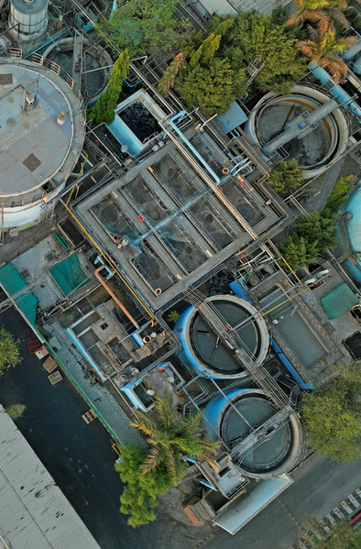



For a full list of pep+
goals, click here
Positive VALUE
CHAIN: WATER
ESG Topics A-Z
2030 Operational
Water-Use Efficiency
Reach average water-use efficiency ratios
of 1.4 liters/liter of production in beverages sites and 1.7 liters/kilogram of production
in convenient foods sites for 100% of high
water-risk PepsiCo and franchise bottler manufacturing facilities by 2030*
2025 Replenishment
Achieve 100% water replenishment
at company-owned facilities
designated in high water-risk
areas by 2025*
*World Resource Institute’s Aqueduct water stress assessment tool is used to reconfirm
high water-risk areas every three years. We continue to measure progress against our original 2025 goal and our extended 2030 goal. In 2022, an updated water risk assessment identified additional company-owned high water-risk facilities, which are in-scope for calculating progress against our 2030 goal only. The reported replenishment volumes
for company-owned facilities are currently being capped at 100% per location. Once
we achieve 100% for each company-owned location, we will start to then report progress
of more than 100% replenishment. We do not currently capture data from third-party manufacturers and are evaluating how to obtain and include information from our
top third-party manufacturers in future calculations
*Contract manufacturers and co-packers are excluded. Our progress toward this goal relies in part on water-use efficiency at high water-risk franchise bottler manufacturing facilities. We are working to integrate their data into future calculations
Watershed (AWS)
Adopt the Alliance for Water Stewardship (AWS) Standard in high water-risk manufacturing facilities by 2025
2030 Replenishment
Replenish back into the watershed
100% of the water we use in high
water-risk PepsiCo and franchise
bottler manufacturing facilities
by 2030*
Net Water Positive
Achieve net water positive by 2030
*Contract manufacturers and co-packers are excluded. Our progress toward this goal relies in part on replenishment associated with high water-risk franchise bottler manufacturing facilities. We are working to integrate their data into future calculations
13
Notes:
This slide highlights water stewardship goals, with a focus on high water-risk areas. Key features include replenishment goals, adoption of the Alliance for Water Stewardship standard, net water positive ambition, and operational water-use efficiency targets. The benefit is protecting shared water resources and improving resilience in water-stressed regions. It also reflects an approach that considers both PepsiCo and franchise bottler facilities in high-risk watersheds over time. For customers, the takeaway is that water is a local issue with local impact, and stewardship can be a strong partnership opportunity. If water risk is a concern in your footprint, we can explore where our focus areas align.

Slide 14
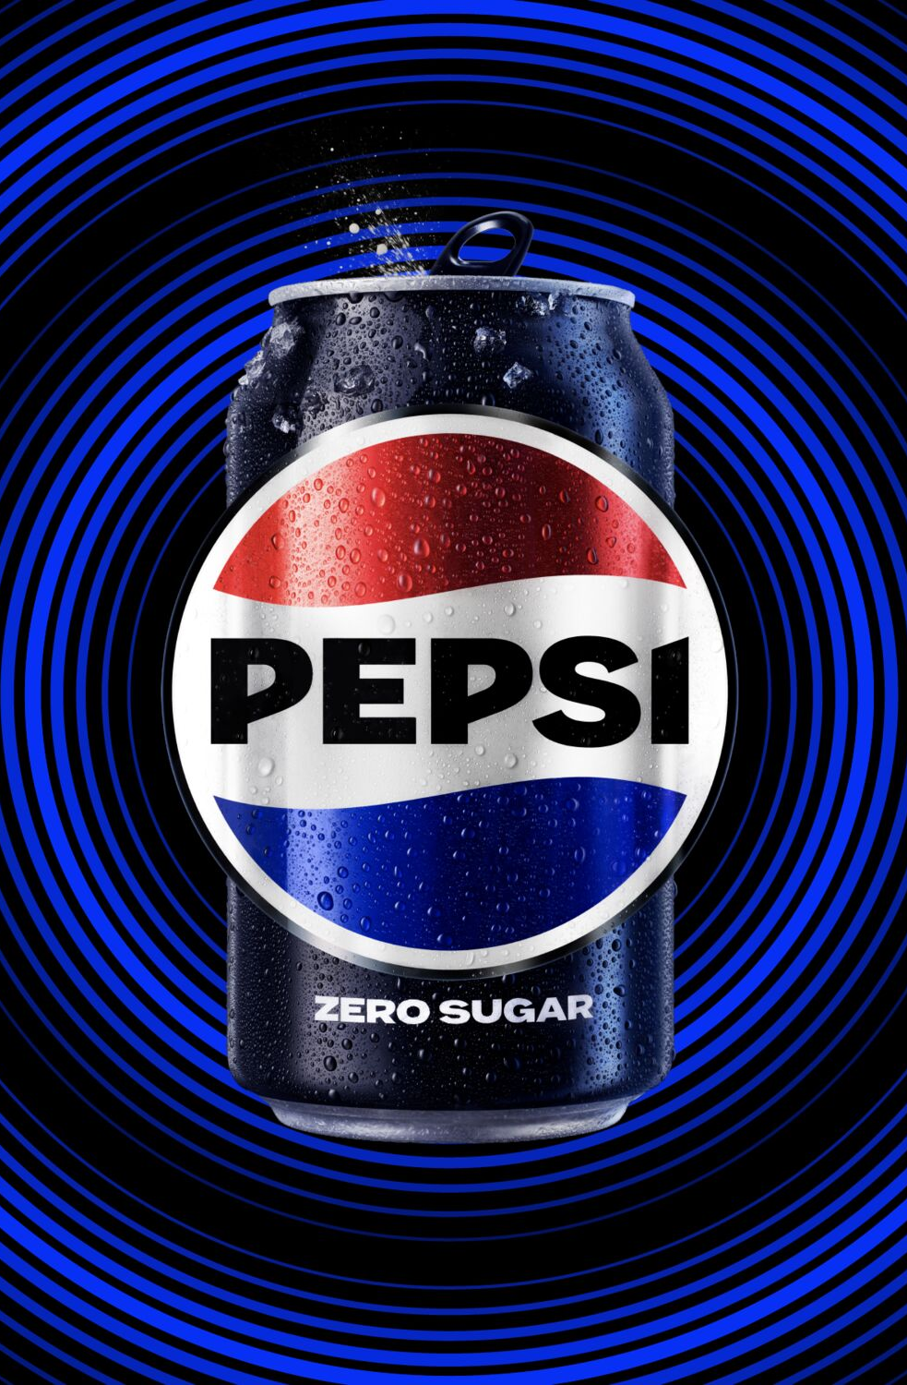



For a full list of pep+
goals, click here
Positive VALUE
CHAIN: PACKAGING
ESG Topics A-Z
FOR OUR PRIMARY PLASTIC PACKAGING IN KEY PACKAGING MARKETS, OUR GOALS ARE:
Recycled Content
Use 40% or greater recycled
content in our plastic packaging
by 2035 or sooner*
Virgin Plastic Reduction (Tonnage)
Achieve an average of 2% year-over-year reduction in our absolute tonnage of virgin plastics through 2030*
*Goal tracks primary plastic packaging in PepsiCo’s key packaging markets. This scope represents more than 80% of PepsiCo’s 2024 global plastic packaging footprint (by weight)
Innovative Packaging Materials
Develop and support innovation,
in collaboration with our partners
and external organizations, of new
packaging material technologies
and solutions
*Goal tracks primary plastic packaging in PepsiCo’s key packaging markets. This scope represents more than 80% of PepsiCo’s 2024 global plastic packaging footprint (by weight)
RCBR/RRC
Achieve 97% or greater reusable, recyclable, or compostable (RRC)
packaging by design by 2030 in
our primary and secondary
packaging in our key
packaging markets*
Recycling Rates
Invest to increase recycling rates
in our key packaging markets*
*Goal tracks primary and secondary packaging in PepsiCo’s key packaging markets. This scope represents more than 85% of PepsiCo’s 2024 global packaging footprint (by weight). Reusable packaging must also be designed to be recyclable or compostable
*Goal relates to primary and secondary packaging in PepsiCo’s key packaging markets. This scope represents more than 85% of PepsiCo’s 2024 global packaging footprint (by weight)
14
Notes:
This slide focuses on packaging goals and the push toward more circular solutions. Key features include increasing recycled content, reducing virgin plastic tonnage, investing to improve recycling rates, and advancing reusable/recyclable/compostable design targets. The benefit is a clear roadmap to reduce packaging impact while supporting scalable packaging innovation. It also highlights the importance of both material choices and system-level recycling infrastructure. For customers, the takeaway is that packaging is one of the most visible areas for sustainability progress, and partnership can help accelerate solutions. This section sets up the later slides that show practical packaging and recycling options.

Slide 15
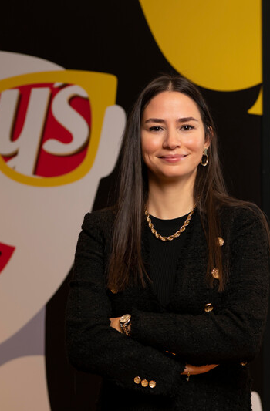


For a full list of pep+
goals, click here
Positive VALUE
CHAIN: PEOPLE
ESG Topics A-Z
Volunteer Growth
Empower our associates with the
resources and time needed to build
and cultivate prosperity in our communities
Supplier Code of Conduct
Extend the principles of our Supplier Code
of Conduct to all of our franchisees and joint ventures by 2025
Food Security
Partner with communities to advance food security and make nutritious food accessible to 50 million people*
Pay Equity
Achieve and sustain pay equity for our global professional population by maintaining a comprehensive global pay equity review process*
*After controlling for legitimate drivers of pay such as job level, geographic location, and performance ratings; based on base compensation
*Results represent the cumulative sum of people reached with nutritious meals per annual reporting period through programs funded by the PepsiCo Foundation, as well as through commercial efforts that are intended to provide nutritious meals. Initial target setting for this metric did not include Pioneer Foods, which delivered accessibility to more than 20 million people in each reported year. The target will be reassessed in the future to fully account for both commercial and charitable efforts. See Calculation methodology in our ESG Topics A-Z for further explanation of how we calculate this goal
Safe Water Access
Reach 100 million people with safe water
access by 2030*
Injury-free Work Environment
Continue to strive for an injury-free
work environment*
*Metric counts the cumulative number of people provided with access to safe water since 2010
Job Growth
Increase the employability of our people through increased access to degrees, skill development and new roles, providing meaningful growth opportunities to everyone at every stage
Human Rights
Promote fair and safe working conditions
by advancing respect for human rights
15
Notes:
Our people goals focus on safety, human rights, pay equity, community impact, and access to safe water — reinforcing that sustainability is about people as much as the planet. This slide underscores that sustainability includes people and communities, not just environmental metrics. Key features include commitments related to volunteering, human rights, food security, injury-free work environment, supplier code of conduct principles, pay equity, safe water access, and job growth. The benefit is stronger trust and accountability across the value chain—especially in how people are treated and supported. It also reflects programs designed to advance community impact at scale. For customers, the takeaway is that responsible business practices are increasingly part of partner expectations, and these commitments help reinforce credibility. If social impact is important in your sustainability agenda, this provides areas for alignment and discussion.
MEANINGFUL JOBS AND OPPORTUNITIES
Provide meaningful jobs and growth opportunities for our people and empower them to enhance their well-being and make a positive impact at work, at home and in their local communities.
INCLUSION FOR GROWTH
Our company has a deep history of
building an inclusive and respectful workplace culture. PepsiCo has always
been a company that thrives on bringing together the best talent, empowering people to grow, and delivering innovative products that meet the needs of our consumers. This legacy inspires the way we work today.

Slide 16


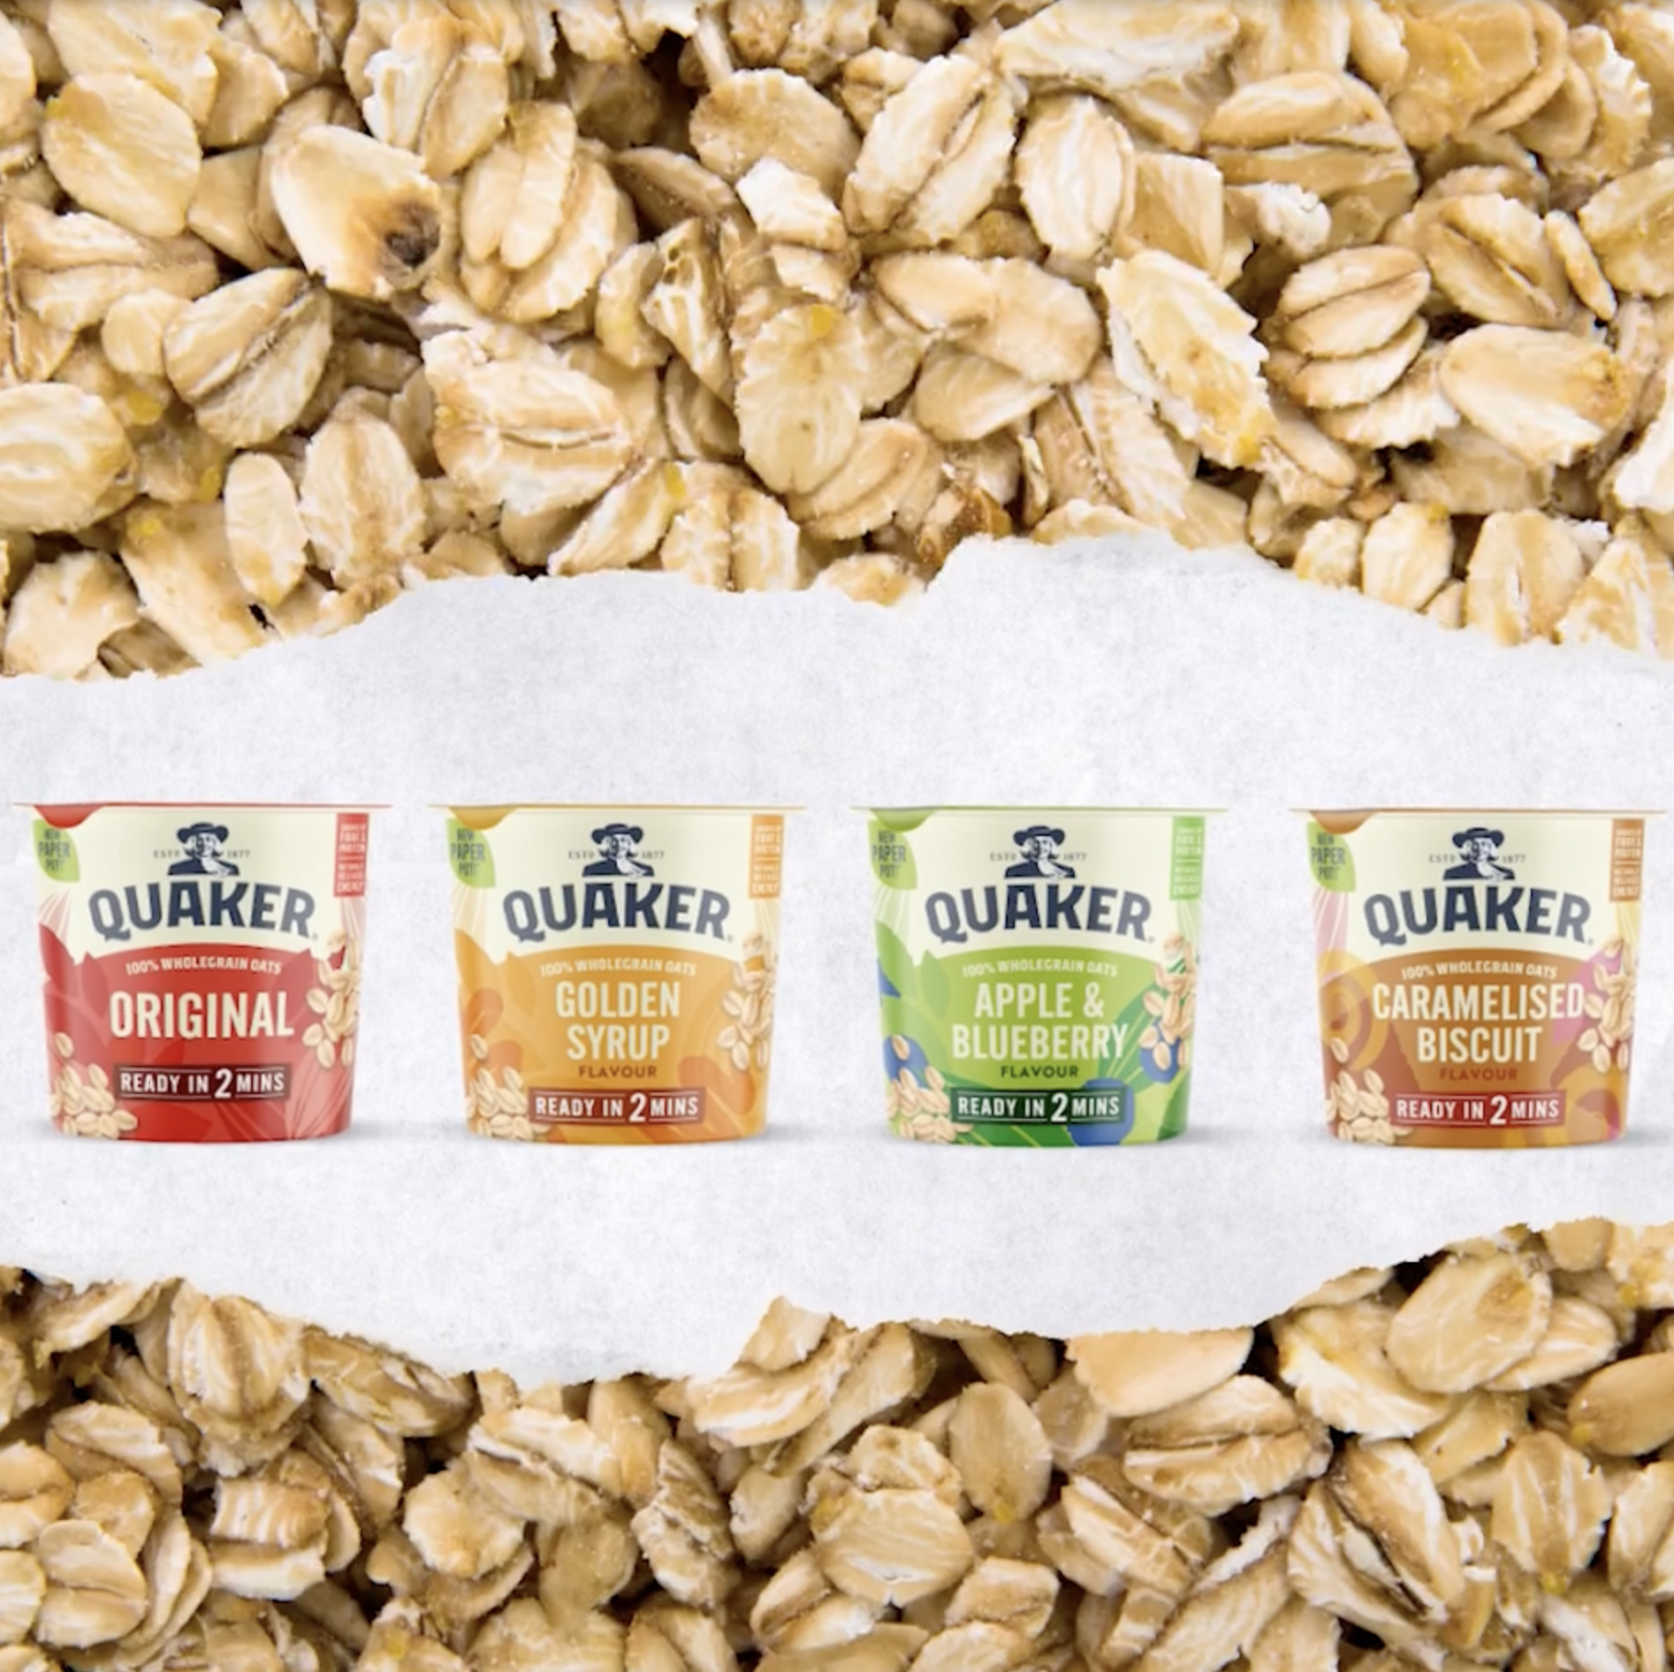
For a full list of pep+
goals, click here
Positive
CHOICES
ESG Topics A-Z
Our Approach
We’re aiming to create more smiles by evolving our portfolio to offer more nutritious choices while harnessing our trusted brands
to make a positive impact.
Reduce Added Sugars
Reduce added sugars: ≥ 67% of
beverage portfolio volume will have
≤100 Calories from added sugars
per 12oz. serving by 2025*
Reduce Sodium
Reduce sodium: ≥ 75% of convenient
foods portfolio volume will not exceed
1.3 milligrams of sodium per Calorie by 2025*
Reduce sodium: ≥ 75% of our global convenient foods portfolio volume meet or
be below category sodium targets by 2030*
*Our global results are based on our Top 23 convenient foods markets
*Our global results are based on our Top 23 convenient foods markets
Reduce Saturated Fats
Reduce saturated fats: ≥ 75% of convenient foods portfolio volume will not exceed 1.1 grams of saturated fat per 100 Calories by 2025*
*Our global results are based on our Top 23 convenient foods markets. Refer to the Nutrition ESG Topics A-Z page for complete list of food categories
Diverse Ingredients
Deliver 145 billion portions of diverse ingredients annually in our global convenient foods portfolio; such as legumes, whole grains, plant-based proteins, fruits and vegetables, and nuts and seeds. Each
portion will provide approximately
10% of the suggested daily amount
of a diverse ingredient*
*Our global results are based on our Top 23 convenient foods markets
Planet & People Brands
Leverage our scaled brands to embody and amplify positive outcomes for the planet and people, including empowering consumers with transparent environmental labeling on our key products*
*Our global results are based on our Top 23 convenient foods markets
*Our global results are based on our Top 23 convenient foods markets
16
Notes:
We continue to evolve our portfolio of food and beverage products so that they are better for the planet and people. Our Positive Choices pillar includes goals to reduce added sugars, saturated fats, and sodium, along with expanding diverse ingredients and advancing “Planet & People Brands.” The benefit is meeting consumer demand for better-for-you choices while supporting long-term brand relevance. It also reinforces that pep+ includes product and consumer-facing commitments, not just operational changes. For customers, the takeaway is that sustainability and health expectations increasingly influence purchase decisions and brand loyalty. This creates a natural bridge between customer goals, consumer trends, and portfolio choices

Slide 17

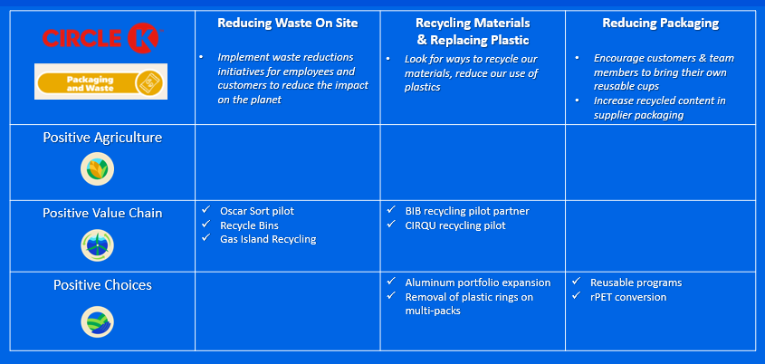
INTERNAL USE ONLY
Customer common goals matrix
CIRCLE K MATRIX (EXAMPLE ONLY)
We look to align our pep+ goals with our customer’s sustainability priorities through a Common Goals Matrix designed for most partners.
These common goals reflect an understanding of the interconnectedness to aid your business planning sessions for customer growth and value.
Use the link here for access to top
National and Division customers.
Notes:
This slide introduces the Common Goals Matrix, designed to align PepsiCo pep+ goals with a customer’s sustainability priorities. The key feature is that it provides a structured, practical way to identify shared focus areas across common sustainability themes. The benefit is a faster path from broad ambition to specific opportunities we can explore together. It also helps make joint planning conversations more consistent and repeatable across teams. For customers, the takeaway is that we’re not approaching sustainability in a one-size-fits-all way—we’re aiming to align to your priorities. This is a helpful tool for narrowing down 2–3 strategic opportunities to explore in more detail.
When we engage in conversations with customers there are times when they want to understand how we are adding “value” or how we are helping them against their scope 3 goals. We are going to spend a few minutes to help you understand what they are and where we as a partner impact our customers sustainability goals.

Slide 18








Pepsico sustainability goal resources
ANNOUNCEMENT
PepsiCo Refines Sustainability Goals to Position Business for
the Long-Term
EVALUATION OF SUSTAINABILITY
GOALS INFOGRAPHIC
Detailed list of all sustainability
goals former and current
CLIMATE TRANSITION PLAN
Climate plan as of May 2025
ESG TOPICS A-Z
Resource is kept up-to-date
by our Global team
LATEST ENVIRONMENTAL, SOCIAL AND GOVERNANCE
(ESG) REPORT
2024 ESG Summary
FOR QUESTIONS OR
MORE INFORMATION:
SHANNA PARRA
shanna.parra@pepsico.com
CATHERINE WALTON
catherine.walton@pepsico.com
Notes:
This slide highlights key resources — from ESG reporting to our climate transition plan — for customers who want deeper detail or transparency. This slide provides supporting resources for customers who want more detail or documentation behind the goals. Key features include links to an announcement about refined goals, an evaluation infographic, a climate transition plan, ESG Topics A–Z, and the latest ESG report summary referenced here. The benefit is transparency—customers can explore the depth of information at the level that matches their needs. It also supports credibility by pointing to formal, maintained resources. The takeaway is that PepsiCo backs pep+ with published materials and a clear method for sharing updates. If you’d like, we can direct you to whichever resource best supports your sustainability planning or reporting needs.
Feature/benefits of participating as a partner

Slide 19



PEP+ Sell Story
strategy
SELL STORY
Tools & resources
Notes:
This section brings the strategy to life with a customer‑facing sell story — helping connect sustainability to real‑world business outcomes.

Slide 20


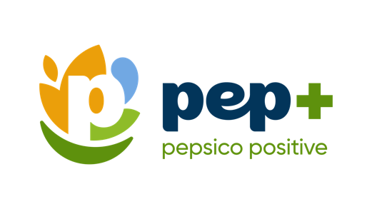
Change customer name here
CUSTOMER NAME
Let’s partner today for a
more sustainable tomorrow
confidential and proprietary
20
Notes:
This is where we personalize the conversation — reinforcing that sustainability is a partnership and tailoring the story to the specific customer. This slide is designed to make the conversation personal and partnership-oriented right from the start. The key feature is customization—you can insert the customer’s name so it feels specific and intentional. The benefit is a warmer opening that signals collaboration rather than a generic presentation. It sets the tone that sustainability is something we can work on together for shared value. The takeaway for customers is that PepsiCo is here to partner “today” while building a more sustainable future. From here, we’ll walk through why the topic matters and where practical opportunities exist.

Slide 21

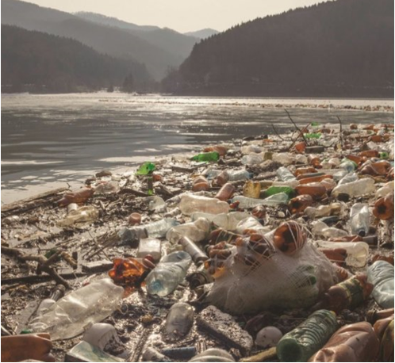

The world is facing unprecedented impacts of climate change —
threatening
our planet, our communities and
our livelihood
Notes:
This slide sets the context — climate change is impacting communities, livelihoods, and long‑term business resilience. This slide sets the context: climate change is creating real impacts across communities and livelihoods. The feature here is the clear framing of urgency—this isn’t theoretical; it’s affecting the world we all operate in. The benefit of stating this upfront is it creates a shared understanding of why sustainability needs action now. It also helps explain why companies and partners are accelerating commitments. For customers, the takeaway is that sustainability is increasingly tied to resilience and long-term business continuity. This leads into the next slide, which shows how expectations are rising from multiple stakeholders.
As many of you are aware, global climate change is threatening our planet, our communities and our livelihood ​
Sustainability is an increasingly important and relevant topic and we are seeing more and more evidence of its significance every day: Over the last couple years we’ve witnessed an increasing number of wildfires, droughts, flash floods and rising sea levels…[fires in California, floods in Texas, sea levels rising in Miami Beach, half of Pakistan currently under water]​
​
These are a result of decades of burning fossil fuels and destroying nature [forests being cut down], altering the delicate balance of gases in Earth’s atmosphere and destabilizing its heating and cooling systems and its weather patterns.​

Slide 22
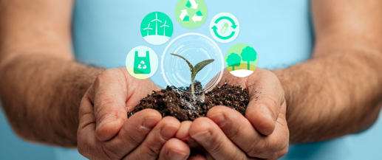


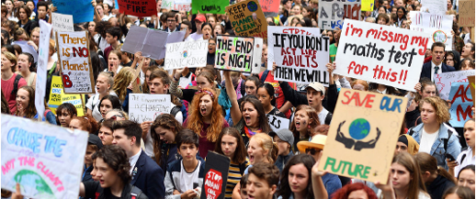


Consumers are expanding their expectations of sustainability
Peer advancement and innovation
THERE IS INCREASED DEMAND THAT BUSINESSES ACT MORE SUSTAINABLY
Regulatory pressure
and changes
Civil society/activist pressure
Investor scrutiny
Colleagues and team members
Notes:
Today, sustainability expectations come from all directions — consumers, regulators, investors, employees, and communities. This slide highlights the forces pushing sustainability forward—consumer expectations, regulatory pressure, investor scrutiny, peer advancement, and activism. The key feature is that it shows sustainability demand coming from every angle, not just one audience. The benefit is that it explains why sustainability is now a business requirement and a brand expectation. It also reinforces that customer and employee expectations are part of the pressure landscape. For customers, the takeaway is that responding proactively can reduce risk and create competitive advantage. This sets up the consumer insights next, where we look at what people actually value and where barriers still exist.
And our customers are feeling the pressure to act more sustainably…​
​
In the U.S. 58% of consumers are willing to pay more for products that are better for the environment
There is increasing regulation across the world about transparency and disclosure on ESG topics
Since 2018 there has been 42% increase in sustainable investments and are considering more non-financial information
Corporates like PepsiCo which can tackle sustainability challenges, customers face a competitive environment where sustainability has become a differentiator
There is a healthy tension and pressure from activist groups on range of topics and effective public benchmarking of customers by organizations like Greenpeace’s supermarket plastic ranking
The workforce is also a key stakeholder and driver of change for many customers. Walkouts over key ESG issues (e.g., recent walk outs at amazon over pay and covid protection)
In addition inclusion in business audits becoming a reality. DEI audit is a large undertaking and a variety of perspectives will enrich and define the areas to focus on — from gender, sexuality, race, educational attainment, socioeconomic status, disability, age, and other areas relevant to your business. For example, the demographics from department to department can be vastly different. According to the U.S. Bureau of Labor Statistics’ 2020 data, women accounted for 66% of public relations professionals and 91% of public relations professionals were white. Departments will have different demographics based on their work, so including all the perspectives is critical

Slide 23
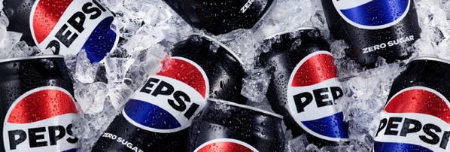

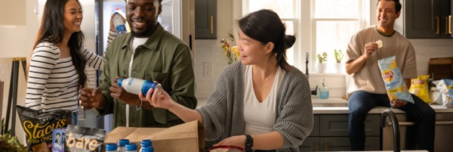

Consumer choices and
barriers in sustainability
Recyclable Packaging
38%
of Americans feel that 100% recyclable beverage packaging is the most eco-friendly packaging option — followed by refillable/reusable packaging.
But just 24%
of Americans will pay more for
100% recyclable beverage packaging.
Messaging on Pack
29%
of Americans find information directly on packaging the most useful to learn more about environmental issues.
~72%
of Americans pay attention
to information on beverage packaging/labels.
Barriers to Solve
More than 2/3
of Americans fail to buy sustainably due to affordability — and this continues to increase this year.
Thereafter 1 in 2
don’t feel like experts and thus
need more education to make adequately informed decisions
around sustainability.
Fielded June 2024, 6110 (n) total survey respondents (18+), 6618 (13+)
Notes:
These insights highlight both opportunity and challenge — consumers care about sustainability, but affordability and clarity remain key barriers. This slide shares consumer insights on packaging and sustainability information—what people believe is most eco-friendly and where they want to learn more. A key feature is the contrast: many consumers say recyclable packaging matters, but fewer are willing to pay more for it. Another feature is that on-pack messaging is viewed as useful, and a large share of consumers pay attention to packaging information. The benefit for customers is understanding that education and clarity can influence behavior, especially at the moment of purchase. The takeaway is that affordability and confidence are major barriers, so solutions need to be easy to understand and accessible. This insight helps shape what kinds of sustainability actions are most likely to resonate with shoppers.
When we engage in conversations with customers there are times when they want to understand how we are adding “value” or how we are helping them against their scope 3 goals. We are going to spend a few minutes to help you understand what they are and where we as a partner impact our customers sustainability goals.
GHG emissions have been classified into distinct scopes for corporate footprints, organized by level of ownership and control, to help with measurement and management.
Scope 1, 2, and 3 emissions are a way to categorize the different types of greenhouse gas (GHG) emissions a company creates.
The scopes are determined by where the emissions come from:
Scope 1
Direct emissions that a company generates while performing its business activities, such as emissions from fuel burned in buildings, vehicles, and equipment
Scope 2
Indirect emissions from purchased energy, such as electricity, steam, heat, and cooling
Scope 3
In this category go all the emissions associated, not with the company itself, but that the organization is indirectly responsible for, up and down its value chain. For example, from buying products from its suppliers, and from its products when customers use them. Emissions-wise, Scope 3 is nearly always the big one.

Slide 24

Younger consumers (18-29) represent an opportunity
PURCHASE
DECISIONS
PEP+
ACTIONS
Younger consumers make sustainable choices at the time of purchase…
Our pep+ goals are aligned to address young consumers concerns…
They are more skeptical about recycling 123 ix (vs 50+).
More 18-29 y/o’s stopped buying products because of (-) environmental impact 203 ix (vs 50+).
Over index on reusables such as fabric bags and refillables (vs. gen pop)
Our plastic reduction in packaging and large assortment of sustainable packaging.
Portfolio of recycling solutions to customers providing a circular economy model for bottles and cans.
Portfolio of alternative format beverages
and testing reusables pilot programs.
Fielded June 2024, 6110 (n) total survey respondents (18+), 6618 (13+)
confidential and proprietary
Notes:
Younger consumers are especially engaged — making sustainability‑driven choices and holding brands accountable. This slide emphasizes that younger consumers represent a major opportunity for sustainability-driven growth. Key features include the insight that younger consumers are more likely to change behavior due to environmental concerns and are more skeptical about recycling. It also highlights that they over-index on reusables and refillables compared to the general population. The benefit is that it reinforces why reusable packaging and circular solutions can be strategically important for engagement and loyalty. For customers, the takeaway is that sustainability messaging and visible action can be a differentiator with younger audiences. This is where pep+ priorities can align naturally with consumer expectations and customer brand goals.

Slide 25

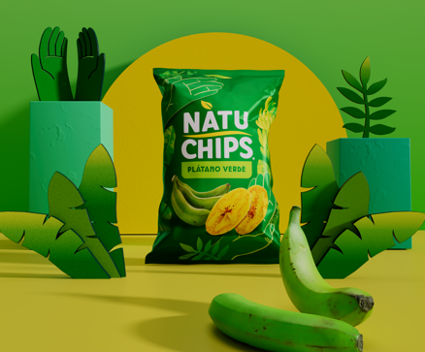




Pepsico is being recognized
for our sustainability efforts
2025
2023
2024
2020/2021/2023/2024
Ranked CSO the #1 Sustainability Leader & PepsiCo the 16th Most Sustainable Company
(out of 250)
Sustainability Initiative
of the Year
PARTNERS FOR TOMORROW
#1 FOOD & BEVERAGE INDUSTRY LEADER
#1 IN
SUSTAINABILITY
“PepsiCo has sustainability deeply ingrained in their
go-to-market approach”
Notes:
This slide reinforces credibility — PepsiCo and pep+ continue to be recognized for sustainability leadership. This slide reinforces that PepsiCo’s sustainability efforts are recognized externally, which helps validate the approach. The key feature is credibility—third-party recognition can build trust and confidence in partnership conversations. The benefit for customers is reassurance that sustainability is embedded in PepsiCo’s go-to-market approach, not treated as a side project. It also supports the idea that PepsiCo is actively investing and innovating in this space. The takeaway is that recognition isn’t the goal, but it signals momentum and seriousness. From here, we transition into what pep+ is and how it’s structured as an enterprise strategy.
Fortune Most Innovative Companies ( Fortune unveiled their inaugural America’s Most Innovative Companies list. PepsiCo Beverages ranks 95 out of 300 companies on the list​
America’s Most Innovative Companies honors the 300 companies transforming industries from the inside out. Innovation can spark in a multitude of ways: R&D teams who invent new products; efficient processes that pad a company’s bottom line; inspiring leaders who foster brainstorming and collaboration that lead to original creations. And innovation isn’t just a nice-to-have—nearly every company on this list posted revenue growth in the last three years.​
Business Intelligence Group 2023 Sustainability Initiative of the Year for Partners For Tomorrow ​
PHILADELPHIA, PA—August 30, 2023—Today, the Business Intelligence Group announced the winners in the 2023 Sustainability Awards program. The Sustainability Awards honor those who have made sustainability an integral part of their business practice. For-profit and not-for-profit organizations of all sizes submitted nominations to reward team members and gain exposure for the organization, its initiatives, and the exemplary accomplishments of its leaders as they work to reduce their impact on our environment. ​
2024 Just Capital (https://justcapital.com/rankings/) #1 in Food&Bev industry. ​
Our annual Rankings reflect the performance of America’s largest publicly traded companies on the Issues that matter most in defining just business behavior today. The Issues, and their weights in our model, are determined by our polling of the American public. The top 100 performing companies – the JUST 100 – can be viewed below. Our Rankings assess performance of the largest U.S.-based corporations that collectively make up the Russell 1000. Use the search feature below to view a summary level of performance for every company included in the 2024 Rankings universe. If you are a corporate representative, please view the resources available to you, and reach out to our Corporate Engagement team to learn more about your company’s performance.​
Kantar - PepsiCo # 1 in Sustainability

Slide 26

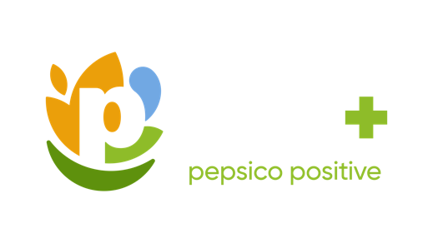



Pep+ has 3 interconnected pillars:
Guiding PepsiCo is our vision to
Be the Global Leader in Drinks and Convenient Foods by Winning with
pep+ (PepsiCo Positive).
pep+ is our strategic end-to-end transformation that places sustainability at the center of our business strategy, seeking to drive growth and build a stronger, more resilient future for PepsiCo and the communities where we operate.
Positive agriculture
We are working to source our crops and ingredients in ways that restore the earth and strengthen farming communities.
Positive
Value Chain
We’re transforming our value chain to be more circular, inclusive, and innovative to benefit communities and the planet.
Positive Choices
We’re empowering people with our brands to make mindful choices, bring smiles to their lives, and positively impact the world.
26
Notes:
pep+ is our end‑to‑end transformation strategy — embedding sustainability into how we operate, innovate, and grow. This slide defines pep+ as PepsiCo’s end-to-end transformation strategy with sustainability at the center of the business. The key feature is that pep+ is positioned as a driver of growth and resilience, not only an impact commitment. It also introduces the three interconnected pillars that structure the strategy. The benefit is a clear framework to understand how sustainability priorities translate into actions across the company. For customers, the takeaway is that pep+ is designed to create a stronger future for PepsiCo and the communities where we operate. This creates a foundation for partnership conversations that connect strategy to real initiatives.

Slide 27
For a full list of pep+
goals, click here
Pep+ key pillars
ESG Topics A-Z
We’re charting a new course to drive positive action for the planet and people.
POSITIVE AGRICULTURE
POSITIVE
VALUE CHAIN
POSITIVE CHOICES
Spread the adoption of regenerative agriculture, restorative, or protective practices across 10 MILLION ACRES of land supporting the growth of our key crops and ingredients by 2030*
*See PepsiCo’s Regenerative Agriculture Guidelines for additional information, including details on key crops and regeneration, restoration and protection criteria. Results represent reflect total acreage meeting these criteria within the annual reporting period
Achieve an average of 2% year-over-year reduction in our absolute tonnage of virgin plastics through 2030*
*Goal tracks primary plastic packaging in PepsiCo’s key packaging markets. This scope represents more than 80% of PepsiCo’s 2024 global plastic packaging footprint (by weight)
Adopt the Alliance for Water Stewardship
(AWS) Standard in high water-risk manufacturing facilities by 2025
Achieve NET ZERO emissions by 2050
or sooner*
*Refer to our Climate Transition Plan for more information
Use 40% or greater recycled content in
our plastic packaging by 2035 or sooner*
*Goal tracks primary plastic packaging in PepsiCo’s key packaging markets. This scope represents more than 80% of PepsiCo’s 2024 global plastic packaging footprint (by weight)
REDUCE SODIUM
≥ 75% of convenient foods portfolio volume will not exceed 1.3 milligrams
of sodium per Calorie by 2025*
*Our global results are based on our Top 23 convenient foods markets
REDUCE SATURATED FATS
≥ 75% of convenient foods portfolio volume will not exceed 1.1 grams of saturated fat per 100 Calories by 2025*
*Our global results are based on our Top 23 convenient foods markets
REDUCE ADDED SUGARS
≥ 67% of beverage portfolio volume will have ≤100 Calories from added sugars per 12oz. Serving by 2025*
*Our global results are based on our Top 26 beverage markets
Sustainably source 90% OF OUR KEY INGREDIENTS and progress volumes
(10% or less) that face systemic barriers towards being sustainably sourced in accordance with our guidelines, by 2030*
*Sustainably sourced refers to in-scope ingredient volumes that meet the established criteria outlined in PepsiCo’s Sustainable Sourcing Guidelines. Sustainable Sourcing practices can help manage risks, but challenges like deforestation or social issues can persist in some regions
Notes:
These three pillars — Positive Agriculture, Positive Value Chain, and Positive Choices — work together to drive impact and growth. This slide summarizes the three pep+ pillars and highlights sample goals under each—agriculture, value chain, and positive choices. A key feature is the integrated approach: it connects how ingredients are grown, how products are made and packaged, and how the portfolio evolves. The benefit is that it creates multiple ways to engage based on customer sustainability priorities—whether packaging, climate, sourcing, or nutrition. It also reinforces that goals are time-bound and anchored in specific focus areas. For customers, the takeaway is that pep+ is broad but structured, making it easier to find alignment points. This sets up the next slide with proof points that show progress and momentum.

Slide 28

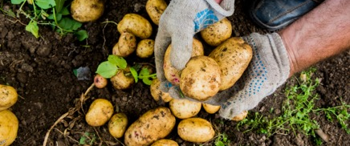
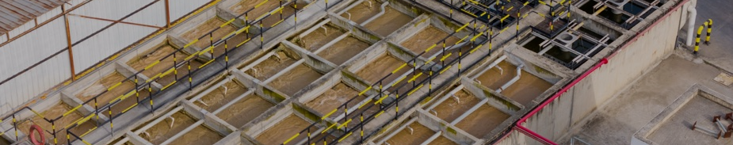
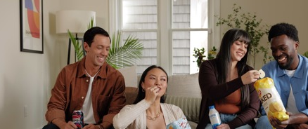
2024 Highlights—Global Results
For a full list of pep+
goals, click here
ESG Topics A-Z
POSITIVE AGRICULTURE
POSITIVE
VALUE CHAIN
POSITIVE CHOICES
>3.5MM
acres used regenerative agriculture,​ restorative or protective practices in 2024¹​
~80%
compressed natural gas for our North American foods fleet was renewable in 2024³
18%
reduction in Scope
1 and 2 emissions (verses 2022 baseline)⁵
75%
Replenished ~75%
of the water we use in
our company-owned manufacturing facilities in high-risk watersheds in 2024⁷
~66%
of our key ingredients
are sustainably sourced
in accordance with our
guidelines in 2024²
>185K
Measurable improvements in more than 185,000 livelihoods since 2021^{2​}
89%
of company-owned operations using 100% renewable electricity⁴
12%
reduction in Scope 3 emissions (verses 2022 baseline)⁶
5%
reduction in our absolute tonnage of virgin plastics between 2023 and 2024 in key packaging markets⁸
~77%
of our convenient
foods portfolio volume⁶ already meets our
2025 goal⁶
1. Refined goal announced on May 22, 2025. 2024 performance calculated retroactively. For more information, see Calculation Methodology
2. This goal captures the number of livelihoods reached through an outcome-focused evaluation measuring improvements in economic prosperity and farmer and farm worker security. Metric counts the cumulative people impacted since 2021
3. 100% renewable electricity includes energy attribute certificates.
4. Former ambition became a pep+ goal in 2025. 2024 performance calculated retroactively. For more information, see Calculation Methodology
5. Refined goal (including 2022 baseline) announced on May 22, 2025. Past performance against the baseline calculated retroactively. For more information, see Calculation Methodology.
6. Refined goal (including 2022 baseline) announced on May 22, 2025. Past performance against the baseline calculated retroactively. For more information, see Calculation Methodology
7. Redefined 2030 goal announced on May 22, 2025. 2024 performance calculated retroactively. We continue to measure progress against our original 2025 goal and our extended 2030 goal. In addition to internal site-specific data, World Resource Institute’s Aqueduct water stress assessment tool is used to reconfirm high water-risk areas every three years. In 2022, an updated water risk assessment identified additional company-owned high water risk facilities, which are in-scope for calculating progress against our 2030 goal only. Reported performance does not include data from franchise bottler manufacturing facilities but work is underway to obtain it for inclusion in future years. For more information, see Calculation Methodology
8. Refined goal announced on May 22, 2025. 2024 performance calculated retroactively. For more information, see Calculation Methodology
2. Refined goal announced on May 22, 2025. 2024 performance calculated retroactively. For more information, see Calculation Methodology
6. As of 2024, Top 26 beverage markets represented 78% of our global beverages volume and Top 23 convenient foods markets represented 86% of our global convenient foods volume. Results reflect the exclusion of Be & Cheery portfolio
Notes:
This slide shows real progress against our goals, reinforcing that pep+ is already delivering measurable results. This slide shares highlights of progress across pep+ pillars, offering evidence that the strategy is delivering results. The key feature is that it includes performance across agriculture, climate, water, packaging, and renewable electricity, showing broad action. The benefit is credibility—customers can see that pep+ is backed by measurable progress and defined tracking notes. It also signals that some goals were refined and that performance is calculated using stated methodologies. For customers, the takeaway is that PepsiCo is tracking progress and evolving goals transparently as the strategy matures. This creates confidence for customers who want partners with momentum and accountability.

Slide 29



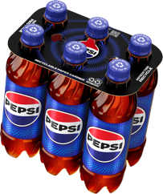

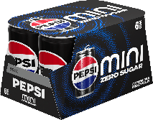
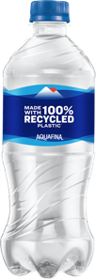

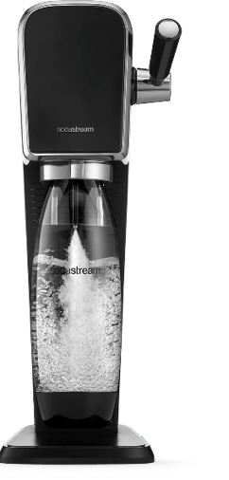


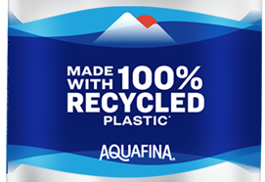
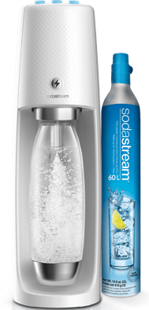
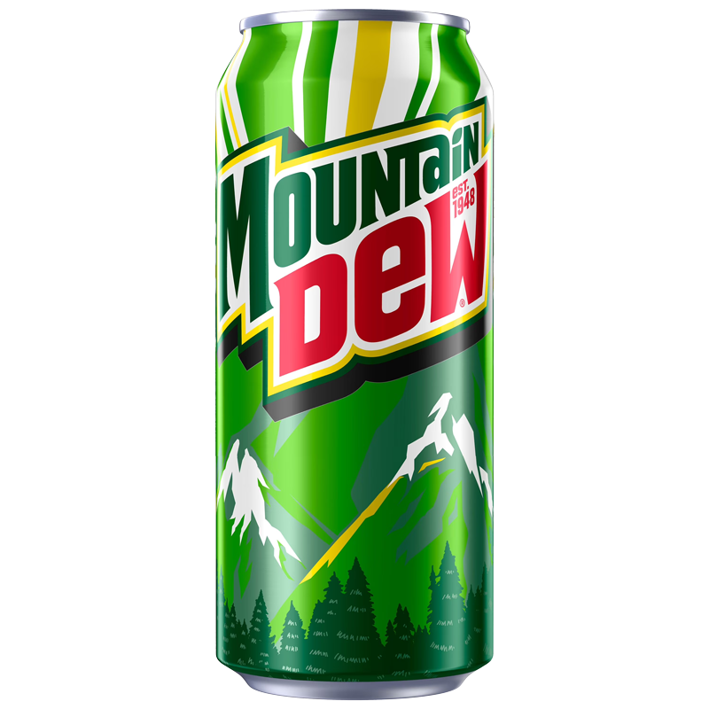
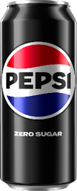


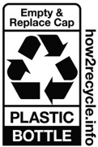
Use in customer meeting. Do not leave behind
THREE KEY LEVERS WILL HELP US
ACHIEVE OUR PACKAGING GOALS
Removal of Virgin Plastic
Increase Recycled
Content & Messaging
Alternative Formats
confidential and proprietary
Notes:
These three levers — alternative formats, recycled content, and virgin plastic reduction — are key ways we partner with customers on packaging solutions. This slide highlights three key levers that support packaging goals: alternative formats, increasing recycled content and messaging, and removal of virgin plastic. The key feature is practicality—it breaks a big topic into clear levers teams can discuss with customers. The benefit is that it helps identify which lever best fits a customer’s operations, brand goals, or consumer needs. It also reinforces that packaging progress involves both the material choice and how it’s communicated. For customers, the takeaway is that there are multiple pathways to improve packaging sustainability without needing a one-size-fits-all approach. This sets up the next slide, which shows examples of how these levers show up in real solutions.

Slide 30
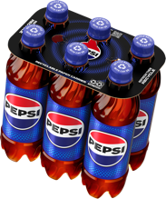



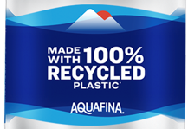
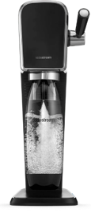











Key Packaging for
positive impact
Plastic Ring Removal
Plastic-free Portfolio
Recycled Content
Recycling Communication
SodaStream
Alternative Formats
confidential and proprietary
Notes:
Here are examples of how those levers come to life — from plastic‑free options to recycled content and reuse. This slide provides a visual overview of packaging-related solutions such as plastic ring removal, recycling communication, alternative formats, and recycled content. The key feature is that it shows the breadth of options and how they map to different impact areas. The benefit is that customers can quickly see what types of solutions might fit their needs—whether it’s reducing plastic, improving recyclability, or shifting formats. It also helps make the packaging conversation more tangible and less abstract. The takeaway is that packaging sustainability can be activated through multiple solution types, not a single change. From here, we summarize the broader sustainable packaging vision and goals.
PepsiCo bevs NA has ambitious goals to achieve our vision of a world where packaging never becomes waste, reducing virgin (fossil fuel) plastic by 50% by 2030 and increasing % of all bev servings delivered thru reusable models to 20% by 2030:
1. Removing plastic across NA. Announced removal of plastic rings around our multipack bevs, switching to paperboard. 100% RECYCLABLE BY 2025
2. Expanding plastic-free portfolio:
Major brands available in plastic-free vessels like aluminum cans (all CSDs, Brisk tea, Starbucks energy, Rockstar energy) & aluminum bottles (Aquafina) w commercial activities designed to shift mix toward plastic-free products
Expand avail. of major brands in aluminum cans in 2024 including Propel & Aquafina; further expansion to LifeWTR, GTQ, and G-Zero for 2025
R&D & commercialization programs underway w major aluminum can manufacturers to expand resealable options for major brands starting next 12 months
3. Accelerating incorporation of recycled plastic (rPET) across NA, prioritizing SS
4. Roll out graphic changes to communicate messaging reminders for consumers to R
5. Actively growing alternative formats – SodaStream + powders and tablets
6. Work to increase reusable formats and vessels

Slide 31
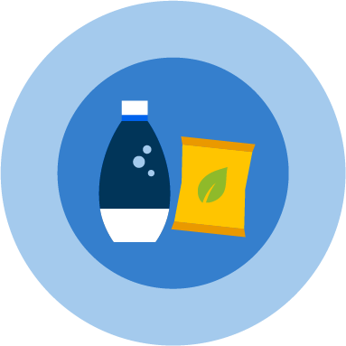



OUR SUSTAINABLE PACKAGING
VISION – KEY MARKETS
Reduce
Reuse
Reinvent
Achieve an average of 2%
Use
40%
ACHIEVE
97%
year-over-year reduction
in our absolute tonnage of virgin plastic through 2030¹
or greater recycled content in our plastic packaging
by 2035 or sooner¹
or greater reusable, recyclable or compostable (RRC)2 packaging by design by 2030 in our primary and secondary packaging in our key packaging markets
1 Goal tracks primary plastic packaging in PepsiCo’s key packaging markets. This scope represents more than 80% of PepsiCo’s 2024 global plastic packaging footprint (by weight)
2 Goal tracks primary and secondary packaging in PepsiCo’s key packaging markets. This scope represents more than 85% of PepsiCo’s 2024 global packaging footprint (by weight). Reusable packaging must also be designed to be recyclable or compostable
Notes:
This slide summarizes the sustainable packaging vision in key markets using the concepts of reuse, reinvent, and reduce. The key features are the long-term targets around virgin plastic reduction, recycled content, and reusable/recyclable/compostable design. The benefit is a clear, goal-driven roadmap that helps guide innovation and decision-making over time. It also reinforces that the approach balances multiple strategies, including material innovation and circular design. For customers, the takeaway is that PepsiCo is setting direction with measurable goals, which supports planning and partnership alignment. This naturally connects to the next slide, which highlights where plastic-free options show up in the portfolio.

Slide 32






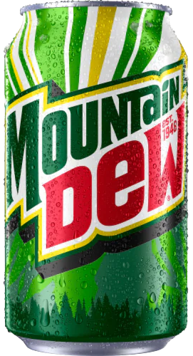
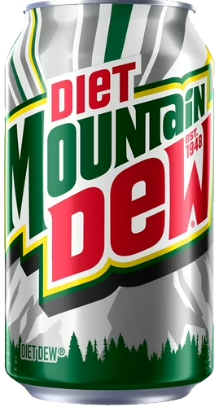
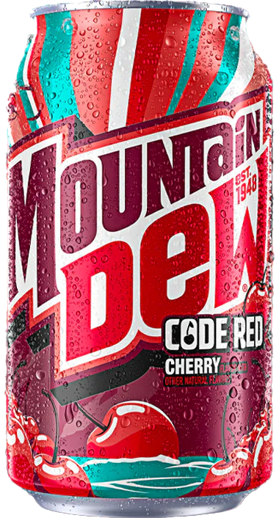



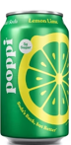






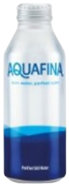







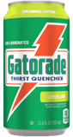
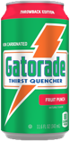
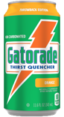





Use in customer meeting. Do not leave behind
*Update and confirm assortment with marketing in your area*
PLASTIC FREE PORTFOLIO
Available now
CSDs
WEST ONLY
Primarily Lodging
Primarily
Healthcare
Sports
Energy
Water
Tea
Coffee
Juice
Notes:
Call out that it’s reactive page. Provide this page only if customer asks. This slide highlights areas of a plastic-free portfolio across beverage types and select channels. The key feature is that it shows plastic-free packaging as a portfolio approach, not limited to one product type. The benefit is that it creates options for customers who are looking to reduce plastic use in specific settings or categories. It also signals that availability can vary by channel and region, which supports a tailored discussion. For customers, the takeaway is that plastic-free solutions may be an option depending on assortment and location. This helps open a practical conversation about what’s feasible now and where future opportunities may exist.

Slide 33

Tools & RESOURCES
strategy
SELL STORY
Tools & resources
Notes:
This slide marks the transition into tools and resources that support activation. The key feature of this section is practicality—it’s meant to help teams move from strategy into execution support. The benefit for customers is that it enables action, not just conversation. It also helps standardize resources so planning sessions can be more productive. The takeaway is that the next slides will show specific programs and solutions customers can engage with. We’ll focus on the areas that best match your sustainability priorities and operational reality.

Slide 34
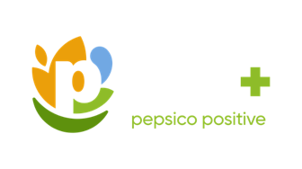
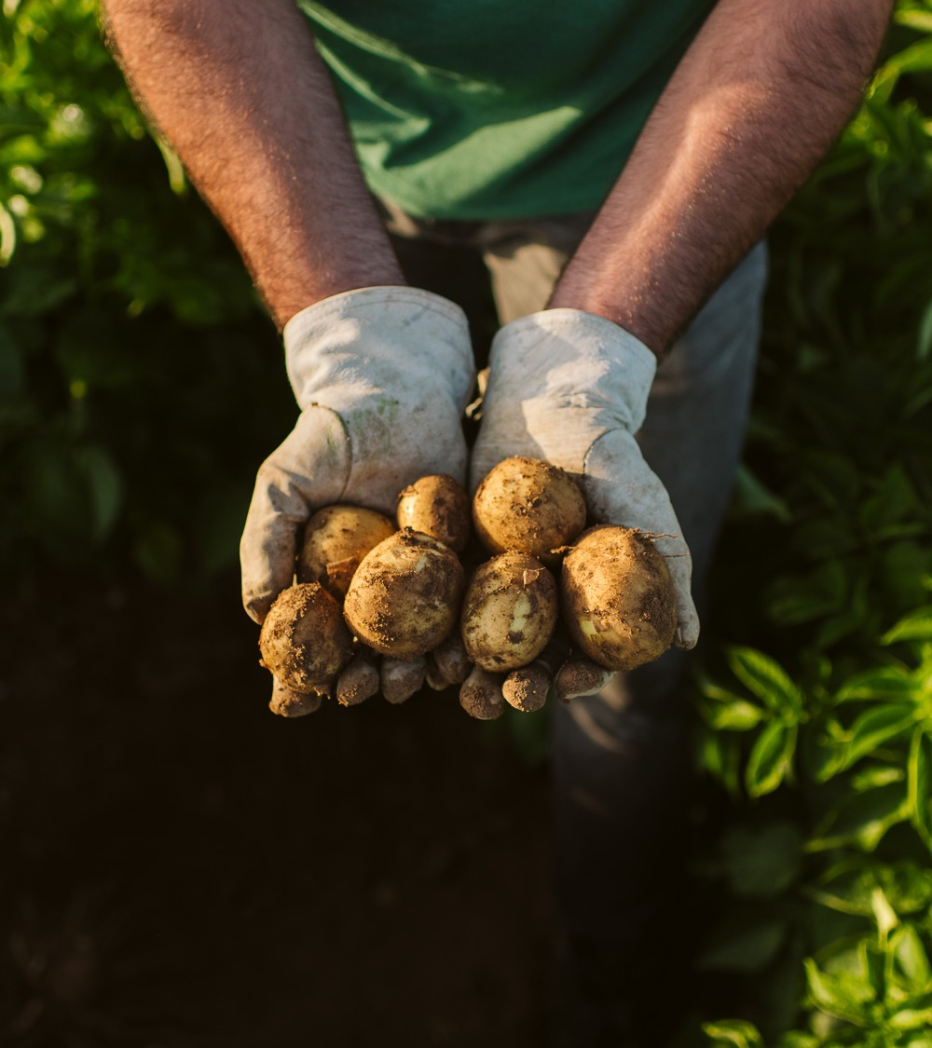
WHAT IS PARTNERS FOR TOMORROW?
A Portfolio of Advantaged
Sustainability Solutions.
Mutually beneficial
for our customers
and PepsiCo
Driving progress toward sustainability goals and commercial value
34
Notes:
This slide introduces Partners for Tomorrow as a portfolio of sustainability solutions designed to create mutual value. The key feature is that it’s a set of advantaged solutions spanning sustainability categories, rather than a single program. The benefit is flexibility—customers can engage in the areas most relevant to their needs, whether packaging, recycling, learning, or energy. It also reinforces the idea that sustainability can drive commercial value when activated thoughtfully. The takeaway is that Partners for Tomorrow is a platform for partnership and progress. From here, we’ll show the categories of solutions and what they can enable.

Slide 35






PARTNERS FOR TOMORROW:
Solutions that span key sustainability categories
AGRICULTURE FOR TOMORROW
Sow Positive (Sow+)
RECYCLING
FOR TOMORROW
CIRQU
Oscar Sort
Recycling Bins
Olyn’s Reverse Vending
LEARNING FOR TOMORROW
Sustainability Summit
Sustainability Action Center
PACKAGING
FOR TOMORROW
Sustainable Cups
ENERGY
FOR TOMORROW
pep+ REnew
CLICK HERE TO VISIT PARTNERSFORTOMORROW.COM
confidential and proprietary
Notes:
This slide shows the range of Partners for Tomorrow solutions across agriculture, learning, energy, packaging, and recycling. The key feature is category breadth—there are multiple ways to engage depending on your sustainability goals and customer environment. The benefit is that customers can choose solutions that fit their footprint, priorities, and timeline. It also reinforces that these solutions are designed to span education, infrastructure, and tangible packaging or recycling actions. The takeaway is that PepsiCo has a portfolio approach to sustainability partnerships, not isolated ideas. If any category stands out, we can go deeper into the solutions underneath it next.

Slide 36





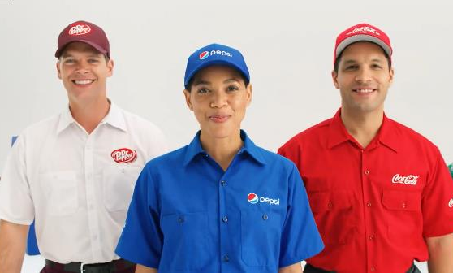


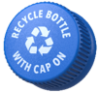
Customer Programs
Infrastructure Investment
We are working to improve recycling rates across the usa
Industry Partnership
Notes:
This slide summarizes the three-part approach to improving recycling rates: customer programs, industry partnership, and infrastructure investment. The key feature is that it acknowledges recycling requires system-level collaboration—not just consumer intent. The benefit is that it highlights multiple levers that can drive measurable improvement over time. It also signals that partnerships and investments are needed to expand access and strengthen outcomes. For customers, the takeaway is that PepsiCo is approaching recycling as a shared challenge where collaboration matters. This sets up the next slides, which show specific recycling solutions that can be activated in customer environments.

Slide 37
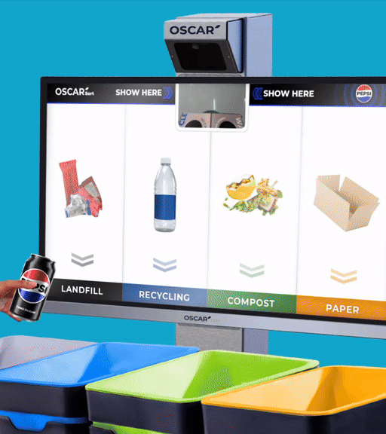

MEET OSCAR SORT!
The smart recycling sorting solution
Oscar Sort is an AI trash sorting assistant that will guide customers to sort items into the correct streams in a fun and engaging way. Using advanced AI vision detection, Oscar Sort is designed to seamlessly integrate with your facility.
confidential and proprietary
Notes:
This slide introduces Oscar Sort as a smart recycling sorting solution. The key feature is AI-powered guidance that helps users sort items into the correct waste streams in an engaging way. The benefit is improved sorting accuracy at the moment of disposal, which supports better recycling outcomes downstream. It’s also designed to integrate into facilities, making it relevant for high-traffic customer environments. The takeaway for customers is that Oscar Sort can help improve recycling behavior without requiring people to already be experts. Next, we’ll walk through what the consumer experience looks like step-by-step
See Oscar in Action
Oscar Sort, an artificial intelligence fun/entertaining waste-sorting system to aid consumer error on which bin to use
Zero touch – zero waste
Automatically identifies recyclables from waste, by using AI tech to understand the item that a person is trying to dispose of
Instruct users on which waste bin to use

Slide 38





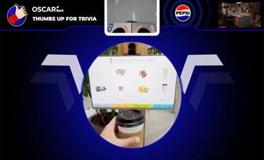

The Oscar experience
1. OSCAR IS IDLE
Consumer may view mix of Third-Party Ad Content (aligning with your exclusions) and your own static or video messaging
2. APPROACH
Oscar introduces itself and instructs how to show an item
3. SORT
Oscar then instructs how to sort the item in the correct bin
4. FEEDBACK/
REWARD
Oscar responds
with real time good job/bad job feedback.
Strategic PEP reward campaigns possible across multiple Oscars during
a specified time.
5. TRIVIA
Intuitive AI may choose to display
a quiz or trivia to engage users with environmental or climate literacy content.
Notes:
This slide breaks down the Oscar experience into clear steps—from idle mode through approach, sorting, feedback, and trivia engagement. The key feature is the interactive flow, which makes recycling decisions easier in real time. The benefit is that it helps turn recycling into a positive and memorable moment, which can encourage repeat behavior. It also supports optional engagement like trivia and reward campaigns to build participation. The takeaway is that Oscar doesn’t just provide bins—it provides guidance, engagement, and behavior reinforcement. That combination is what can help drive more correct sorting and improved recycling outcomes.
THE OSCAR EXPERIENCE
OSCAR IS IDLE: During this time, you have the option to show custom static or video content (~30%). Intuitive AI will also be able to display their curated ad content that aligns with any exclusions that you have (~70%). Custom content can be updated on a monthly basis.
APPROACH: Here, Oscar introduces itself instructs how to show an item. This is a co-branded Pepsi & customer interface, which continues throughout the rest of the experience.
SORT: Oscar then instructs how to sort the item in the correct bin. The items shown as examples of each waste stream can be customized according to the specific waste streams you have on site.
FEEDBACK/REWARD: Oscar then responds with real time good job/bad job feedback. [INTERNAL NOTE: Customization not available here] It may also be possible to participate in a PepsiCo-led rewards campaign across multiple Oscars during a specified period, one time per year for a month.
TRIVIA: At this stage, at the end of the sorting process, Intuitive AI may choose to display a quiz or trivia to engage users with environmental or climate literacy content.
FUNDING
This Oscar Experience is based on an investment of $2,000/year per Oscar Sort for software subscription services (starting in Y2 of placement). Funding can be covered by marketing or sustainability budgets.
Year 1 is fully funded by the PBNA Sustainability team.
At the end of the first year, there are three options to proceed:
Customer can choose to keep their Oscars onsite with current co-branded UX ($2,000 per Oscar for the following year should be transferred to PBNA Sustainability team)
Customer can choose to keep their Oscars onsite for $365 per year, but without any co-branding (customer and PepsiCo), custom content, or waste analytics. Oscar simply keeps nudging consumers to sort their waste.
Customer can choose to have the Oscars removed. Before 1 year from placement, there is no charge. After Y1, PBNA sustainability charges $1,000 (to marketing/sustainability funding) to decommission each Oscar Sort.

Slide 39






Features & Benefits
Oscar Sort makes recycling decisions easier and fun
SUSTAINABILITY
Oscar is a proven way to increase the amount of correct decisions made at the bin. Items ending up in the correct bin is the first and most important step on the journey to a true circular economy
GAMIFY RECYCLING
Oscar transforms the dull task of disposing trash into a memorable experience by engaging
with customers in a fun, and educational way directly at
the moment of disposal.
REPORTING
Waste analytics provides granular insights into the behaviors of customers. What is being sorted and when is it being sorted correctly. Equivalent to a waste audit, up to 4 days/year.
ADAPTS SEAMLESSLY
Oscar retrofits to existing bin style
in place. Oscar also is customized to align with the waste regulations per location
39
Notes:
This slide highlights why Oscar Sort can be effective: it makes recycling easier, more fun, and more measurable. A key feature is gamification, which helps transform disposal into an engaging moment rather than a chore. Another feature is reporting and waste analytics, providing insights into what’s being sorted and when—similar to a waste audit. The benefit is both behavioral improvement and data visibility, which can support sustainability reporting and operational decisions. It also adapts to local waste regulations and retrofits to existing bin styles, which supports easier adoption. The takeaway is that Oscar offers a combination of engagement plus insight, not just a physical solution.

Slide 40
OSCAR SORT FAQs
Where Should I have my Oscars?
High traffic, public spaces, high consumption onsite – Indoors
Cannot deploy in outdoor settings. Covered outdoor areas may apply, further details needed to provide deployment approval
Network/Data Connection
Operates on a cellular connection, network/WiFi not required– Detailed technical specifications available here.
Power
Standard 120V power outlet
Privacy
Oscar adheres to the strictest privacy standards globally including the global gold standard–GDPR
What does the installation look like?
2-4 hours for setup per unit
Power on-site need to be confirmed before scheduling installation
If applicable, drilling on site to be done by facility personnel
Lead time: 1-3 weeks from site details verification, Q2 2024 onwards
What Local Support will I have?
Installation is done by Intuitive approved partners
Each site is assigned a local partner for installation
Onboarding, Tech Support & Training
Each site to be assigned with their Intuitive Account Manager for Customer Success and on-going support
Notes:
This slide answers practical questions customers often ask about deployment. Key features include where Oscars can be placed, how connectivity works, power requirements, and privacy standards. The benefit is that customers can quickly assess feasibility in their environment without guessing about technical needs. It also outlines installation expectations and lead time considerations, helping planning and coordination. The takeaway is that Oscar is designed to be workable in high-traffic indoor environments with straightforward requirements. If you’re interested, the next step would be confirming site details and alignment on placement needs.

Slide 41


RECYCLING BINS
Recycling matters.
Consumers want to make the responsible decision to recycle after consuming our products, and we’re happy to provide recycling bins for plastic bottles and aluminum cans.
Together, let’s increase consumer access to recycling.
confidential and proprietary
Notes:
This slide introduces PepsiCo recycling bins as a way to increase consumer access to recycling. The key feature is that the bins are designed to support responsible disposal for plastic bottles and aluminum cans. The benefit is convenience—making it easier for consumers to do the right thing after enjoying a beverage. It also supports visibility, which can help reinforce sustainability behavior in a space. The takeaway for customers is that bins are a simple, scalable step toward improved recycling access. Next, we’ll show the different bin options available to match different customer needs.

Slide 42





Pepsico offers recycling bins to suit customer needs
DURABLE, REUSABLE EVENT RECYCLING BINS
Available upon request for special events
BOTTLE COLLECTION BINS
Indoor or
Outdoor Use
Made of
100% recycled material
Recycling bins are optimized for beverage container recycling with round disposal holes and come with labeling for various waste streams such as:
Bottles Only
Cans Only
Bottles & Cans Only
Customization for some bins
may be available upon request.
CAN COLLECTION BINS
Indoor or
Outdoor Use
Made of
100% recycled material
96 GALLON TOTER
Best for
Outdoor Use
Made of
100% recycled material
42
Notes:
This slide outlines different recycling bin options that can fit various customer environments and use cases. Key features include indoor/outdoor options, bins made from 100% recycled material, and formats designed for specific container types. The benefit is flexibility—customers can choose what fits their site footprint, traffic patterns, and operational needs. It also includes labeling options for different waste streams, which can help reduce confusion and contamination. The takeaway is that recycling access can be expanded in a way that fits the space, not forced into one standard solution. If customization is needed, the slide notes that some options may be available upon request.

Slide 43






OLYNS REVERSE VENDING SOLUTION
Olyns cubes are AI-powered reverse vending machines for beverage container recycling. PepsiCo is investing in Olyns to drive circularity and provide an advanced recycling solution for consumers.
INNOVATIVE RECYCLING SOLUTION
TURNKEY COLLECTION
ADVERTISING CAPABILITIES
CONSUMER DATA & ANALYTICS
confidential and proprietary
Notes:
This slide introduces Olyns as an AI-powered reverse vending solution for beverage container recycling. A key feature is that PepsiCo is investing in Olyns to drive circularity and provide an advanced recycling option for consumers. It’s positioned as a turnkey collection approach, which can reduce operational burden for a host location. Another feature is the ability to support advertising and consumer analytics capabilities, adding engagement and insight. The benefit is a more modern, high-visibility recycling experience that can encourage participation. The takeaway is that Olyns can be a strong fit for high-traffic venues where scale and engagement matter.

Slide 44




OLYNS: How it works
1. COLLECT MATERIAL
Eye-catching display calls on consumers to deposit empty bottles and cans via mobile app.
2. COMPACT & SORT
Bottles and cans are sorted and compacted inside the cube – capacity > 2,000 containers.
PILOT DETAILS
PepsiCo is partnering with Olyns to with expand the network in the state of Texas.
LOCATION: Austin, TX
REQUIREMENTS: High foot traffic
(~70K impressions/month required)
CHANNELS: Example venues include colleges & universities, stadiums, and transit hubs
TIMELINE: H2 2025 for placement
3. PICK UP
Retail or Foodservice Host does not need to touch. App enlists “gig workers” to service machine before it fills up.
4. BALE
& SHIP
Extremely high-quality bales are generated and shipped to bottle-to-bottle rPET processors.
44
Notes:
This slide walks through how Olyns works end-to-end: consumers deposit containers, the system compacts and sorts, service happens through app-enabled pickups, and bales are shipped for bottle-to-bottle processing. The key feature is automation and quality—high-quality bales support circular outcomes. The benefit is that host locations don’t need to touch the material, which can simplify operations. The slide also outlines pilot details, including location requirements like high foot traffic and example venues such as colleges and stadiums. The takeaway is that Olyns is designed for places where recycling volume and visibility are high. If you’re exploring this, we’d evaluate site fit against the stated requirements and timeline.

Slide 45


Sustainable fountain packaging portfolio
PepsiCo provides a suite of RECYCLABLE, REUSABLE, and COMPOSTABLE fountain packaging solutions.
Notes:
This slide introduces PepsiCo’s sustainable fountain packaging portfolio across recyclable, reusable, and compostable options. The key feature is choice—customers can select packaging strategies that match their sustainability goals and operational constraints. The benefit is that you can make progress without needing a single “perfect” solution for every environment. It also supports consumer expectations, since packaging is visible and often linked to sustainability perceptions. The takeaway is that fountain packaging can be a practical, scalable entry point for sustainability improvements. Next, we’ll show the specific cup and vessel options included in the portfolio.

Slide 46








SUSTAINABLE FOUNTAIN PACKAGING PORTFOLIO
COMPOSTABLE
RECYCLABLE
REUSABLE
COMPOSTABLE CUPS
Commercially compostable
Sizes: 12, 16oz, 22oz, 32oz
PLASTIC CUPS
Recyclable plastic
Coming soon!
PERSONAL VESSELS
Personal cups for ‘bring-your-own-cup’ programs
Multiple styles
and sizes
Available on PepsiCo Premiums website
TRADITIONAL TUMBLERS
Dishwasher-safe tumblers
Sizes: 16oz, 20oz, 24oz plastic
Available on PepsiCo Partners website and PepsiCo Premiums website
EMBOSSED TUMBLERS
*NEW* updated design
Sizes: 20oz, 24oz plastic, 20oz glass
Available on PepsiCo Premiums website or through POS Direct
For more information on our sustainable
disposable cups, please visit the
PepsiCo Partners website
Notes:
This slide details the specific solutions within sustainable fountain packaging, including compostable cups, recyclable plastic cups (noted as coming soon), personal vessels, traditional tumblers, and embossed tumblers. The key feature is range—different materials and formats support different customer needs and experiences. The benefit is flexibility: you can support sustainability goals while maintaining guest experience and operational practicality. It also points to where options are available, which helps teams and customers know how to explore or source them. The takeaway is that sustainable packaging can be implemented in stages, starting with what’s available and expanding over time. If you tell us what your priority is—compostable, reusable, or recyclable—we can focus on the best-fit set of options.
Compostable cups should be commercially composted. The plastic cups are made of polypropylene plastic and can be recycled with many recycling partners.

Slide 47



Our reusable cup strategy has three key levers
Industry Partnerships
VALUE CHAIN-WIDE COLLABORATION
We participate in industry collaborations to identify and scale circular-solutions that can lead to systemic transformation.
Through the NextGen Consortium, we advance innovative projects with partners and our customers.
The Consortium is currently scoping a 2026 citywide multi-channel reusable cup pilot in California with opportunities to participate.
Turn-Key Solutions
SUSTAINABLE CUP SOLUTIONS
We offer easy-to-implement
solutions to help our restaurant
customers make sustainable choices
for fountain beverage cups.
Cups for Tomorrow includes cup options, plus FREE customer resources:
Cost savings calculator
Toolkit with step-by-step guidance for making the switch
Free downloadable signage
Customer Partnerships
PILOTS TO TEST
AND SCALE REUSE
We work with our customers on reuse pilot programs to:
Help our customers achieve their sustainability goals
Gather learnings that can help create better reuse programs & scale reuse systems
These pilots are focused on contained spaces and have included: Levi’s Stadium, Chase Field, and the Alaska Airlines Arena.
Participation details & contact info available on the Closed Loop Partners website.
For more information reach out to
your PepsiCo Account Manager!
Notes:
One pager

Slide 48
Our reusable cup strategy has three key levers
Industry Partnerships
VALUE CHAIN-WIDE COLLABORATION
We participate in industry consortium alongside our customers to identify and scale circular-solutions that can lead to systemic transformation
Turn-Key Solutions
SUSTAINABLE CUP
SOLUTIONS
We offer easy-to-implement solutions to help our customers make sustainable choices for fountain beverage cups
Customer Partnerships
CUSTOMER PARTNERSHIPS
TO TEST AND SCALE REUSE
We partner on reusable cup pilot programs with our customers to help them achieve their sustainability goals and gather learnings that can help scale reuse systems
1
2
3
Notes:
This slide summarizes the reusable cup strategy using three key levers: industry partnerships, customer partnerships to test and scale, and turnkey solutions. The feature is a structured approach—reuse can feel complex, so this breaks it into actionable pathways. The benefit is faster progress: customers can participate through pilots, adopt ready-made tools, or engage through broader collaboration. It also reinforces that reuse is a system change, not just a product swap. The takeaway is that we can meet customers where they are—starting small, learning quickly, and scaling thoughtfully. Next, we’ll go deeper into each of the three levers and what they enable.

Slide 49




1. INDUSTRY PARTNERSHIPS
PepsiCo participates in industry partnerships to identify and scale circular-solutions that can lead to systemic transformation.
Through the NextGen Consortium, we advance innovative fountain cup projects with our customers and partners. One recent example is the Petaluma Reusable Cup Project, a 3-month pilot of a city-scale reusable cup program with both local and national partners. This project helped avoid over 220,000 single-use cups.
The Consortium is currently scoping a 2026 citywide multi-channel reusable cup pilot in California with opportunities for our customers to join the initiative. Additional details and contact information available on the Closed Loop Partners website.
Notes:
This slide highlights the role of industry partnerships in driving reuse and circular solutions at scale. A key feature is participation in consortium efforts that bring together partners and customers to test innovative approaches. The benefit is shared learning—pilots can generate insights that help the entire system improve, not just one location. The slide references an example project that helped avoid a significant volume of single-use cups, reinforcing the potential impact of coordinated pilots. It also notes future reuse pilot scoping opportunities, creating a pathway for customers to participate. The takeaway is that industry collaboration can accelerate solutions faster than isolated efforts, especially for reuse systems.

Slide 50

2. Turnkey solutions
REUSABLE TUMBLERS
Reusable tumblers for our restaurant
customers interested in transitioning
from single-use to reusable cups
ACTION PLAN
Step-by-step guide to switching to
reusables including staff training
materials and printable signage
SAVINGS MODEL FOR SMALL, MEDIUM, LARGE RESTAURANTS
Data from reuse non-profit Upstream showing the economic and environmental savings for restaurants switching to reusables
The Cups for Tomorrow website offers FREE resources that equip our restaurant partners with the tools they need to transition from disposable cups to reusable cups for on-site dining seamlessly.
50
Notes:
This slide focuses on turnkey solutions that help restaurant partners transition from single-use to reusables. Key features include reusable tumblers, step-by-step action plans with training and signage, and a savings model for different restaurant sizes. The benefit is simplicity—customers get practical tools that reduce the friction of change management. It also supports business planning by helping quantify savings and operational considerations. The takeaway is that reuse adoption can be made easier with ready-to-use resources, not just aspirational goals. If you’re interested in reuse but want a manageable starting point, this turnkey path is often the most approachable.

Slide 51












3. Pepsico reusable cup pilot partnerships
CFG BANK ARENA
CHASE FIELD
ALASKA AIRLINES ARENA
OREGON CONVENTION CENTER
LEVI’S STADIUM
13,000+
SINGLE-USE
CUPS AVOIDED
Apr 2023-Jun 2023
Three-month full arena pilot for all beverages including CSD’s and alcoholic beverages
30,000+
SINGLE-USE
CUPS AVOIDED
Jul 2024-Sep 2025
12 oz. cups in Bar S
All You Can Eat Seats & 16 oz. cups in Estrella Jalisco Cantina
12,000+
SINGLE-USE
CUPS AVOIDED
Nov 2024-April 2025
20 oz. cups for Alaska Airlines Arena for Basketball, Volleyball, Gymnastics
3,000+
SINGLE-USE
CUPS AVOIDED
Permanent as of March 2025
Added 24 oz. cups for CSDs to the customer’s existing reuse tray program
1,000s
SINGLE-USE CUPS AVOIDED PER GAME (PROJECTED)
Aug 2025-Jan 2026
16 oz. cups for United and Graton Winner’s Clubs for all 10 games of
2025-2026 season
Notes:
This slide provides proof points from reusable cup pilots and partnerships, highlighting avoided single-use cups across different venues and timeframes. The key feature is real-world validation—these are operational environments like arenas and stadiums where reuse systems can be tested at scale. The benefit is confidence: customers can see reuse isn’t just theoretical; it can work in high-volume, high-traffic settings. It also shows that reuse can be designed in different ways, depending on the venue and service model. The takeaway is that pilots create measurable impact and learning, which is what enables broader rollout. If your environment is similar to any example shown, we can talk about what made those pilots workable.

Slide 52




Marketing programs to engage customers and consumers
A suite of C&U-targeted insights and activation ideas to engage student bodies and campus communities
OPPORTUNITY
Ever-growing demand from universities and student bodies for brands to act in sustainable ways. Opportunity to show that PepsiCo is doing its part to operate sustainably for a positive impact.
FEATURES & BENEFITS
Turnkey activation & engagement options
to address the desire for more sustainably
focused initiatives, actions, and education.
ACCESS THE TOOLKIT HERE
Notes:
This slide highlights marketing programs designed to engage customers and consumers—specifically noting opportunities in college and university environments. The key feature is turnkey activation and engagement options, meant to address demand for sustainability-focused initiatives and education. The benefit is that it supports both sustainability storytelling and community engagement in a structured way. It also references a set of targeted insights and activation ideas that can help engage campus communities. The takeaway for customers is that sustainability can be activated not only through packaging and infrastructure, but also through education and engagement programs. If this type of programming is relevant, we can explore the toolkit referenced here and discuss which ideas best fit your campus or community setting.

Slide 53
Unlock tools and resources for success at partners for tomorrow
CLICK HERE TO VISIT PARTNERSFORTOMORROW.COM
Solutions that span key sustainability categories
AGRICULTURE
FOR TOMORROW
Sow Positive (Sow+)
LEARNING FOR TOMORROW
Sustainability Summit
Sustainability Action Center
ENERGY
FOR TOMORROW
pep+ REnew
PACKAGING
FOR TOMORROW
Sustainable Cups
RECYCLING
FOR TOMORROW
CIRQU
Oscar Sort
Recycling Bins
Olyn’s Reverse Vending
confidential and proprietary
Notes:
This slide reinforces that Partners for Tomorrow is a central hub where sustainability solutions and resources come together. The key feature is accessibility—customers and teams can explore solutions across agriculture, learning, energy, packaging, and recycling in one place. The benefit is ongoing enablement: the conversation doesn’t end when the meeting ends, because resources are available for deeper exploration. It also supports better planning by keeping solution categories organized and easy to navigate. The takeaway is that PepsiCo is building a connected portfolio of solutions, not disconnected initiatives. If you’d like, we can use this hub to focus in on the few solutions that best match your goals and timeline.

Slide 54



Commercial sustainability contacts
Let’s partner!
SHANNA PARRA
CATHERINE WALTON
Director
Commercial Sustainability
shanna.parra@pepsico.com
Senior Manager
Commercial Sustainability
catherine.walton@pepsico.com
Notes:
This slide provides clear points of contact for sustainability partnership support. The key feature is direct access to the commercial sustainability team, including SHANNA PARRA and CATHERINE WALTON. The benefit is continuity—customers can get follow-up support, deeper detail, and help identifying best-fit solutions after the initial conversation. It also reinforces that this work is supported by dedicated roles, not just general messaging. The takeaway is that PepsiCo is serious about sustainability engagement and has a team to help move from discussion to action. If you want to explore next steps, these contacts are the easiest way to continue the conversation.

Slide 55
THANK YOU!
Notes:
The key takeaway is that sustainability can be a partnership opportunity that supports both impact and commercial value. We shared how pep+ provides a clear strategy and how Partners for Tomorrow offers solutions that can be activated in real settings. The benefit of collaborating is that we can align goals, identify practical opportunities, and build a plan that fits your business. As a next step, we’d love to understand your top priorities and where you see the biggest opportunities. When you’re ready, we can follow up and map the best-fit solutions to your goals.

