Slide 1

WHAT IS PARTNERS FOR TOMORROW?
A Portfolio of Advantaged Sustainability Solutions.
Driving progress toward sustainability goals and commercial value
Mutually beneficial for our customers and PepsiCo
CONFIDENTIAL
1

Slide 2










PARTNERS FOR TOMORROW:
Solutions that span key sustainability categories
AGRICULTURE FOR TOMORROW
Sow Positive (Sow+)
RECYCLING FOR TOMORROW
CIRQU
Oscar Sort
Recycling Bins
Olyn’s Reverse Vending
LEARNING FOR TOMORROW
Sustainability Summit
Sustainability Action Center
PACKAGING FOR TOMORROW
Sustainable Cups
ENERGY FOR TOMORROW
pep+ REnew
CLICK HERE TO VISIT PARTNERSFORTOMORROW.COM
confidential and proprietary
Notes:
Partners for Tomorrow – a suite of sustainability solutions available to value chain partners, notably our customers. The program was named the “sustainability initiative of the year” by Business Intelligence Group.
We have launched programs with partners in agriculture, we have a number of sources available for our customers and partners to leverage – e.g. the sustainability summit and the sustainability action center and we launched pep+ renew which helps our partners to convert to renewable energy. The two categories of solutions we’re going to focus on today are packaging and recycling.
www.partnersfortomorrow.com

Slide 3
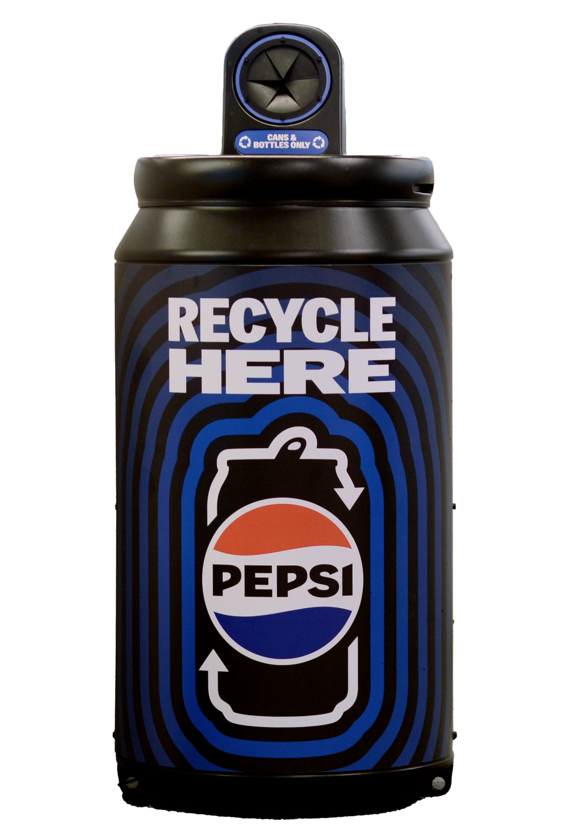
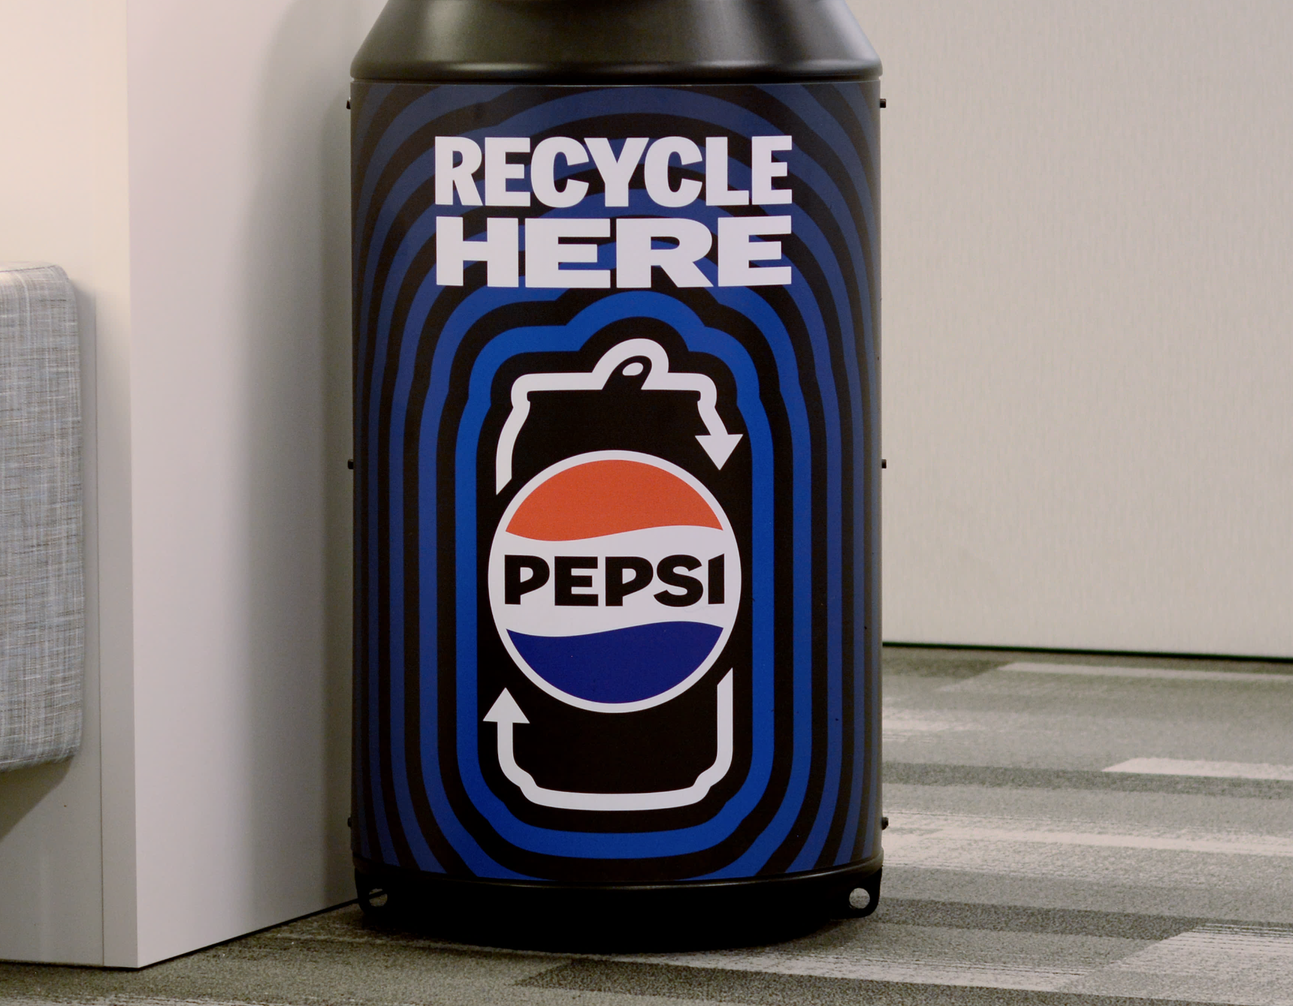
RECYCLING BINS
Recycling is no longer optional — it’s a must
Consumers want to make the responsible decision to recycle after consuming our products, and we’re happy to provide recycling bins for plastic bottles and aluminum cans
TOGETHER, LET’S INCREASE CONSUMER ACCESS TO RECYCLING
CONFIDENTIAL
3

Slide 4
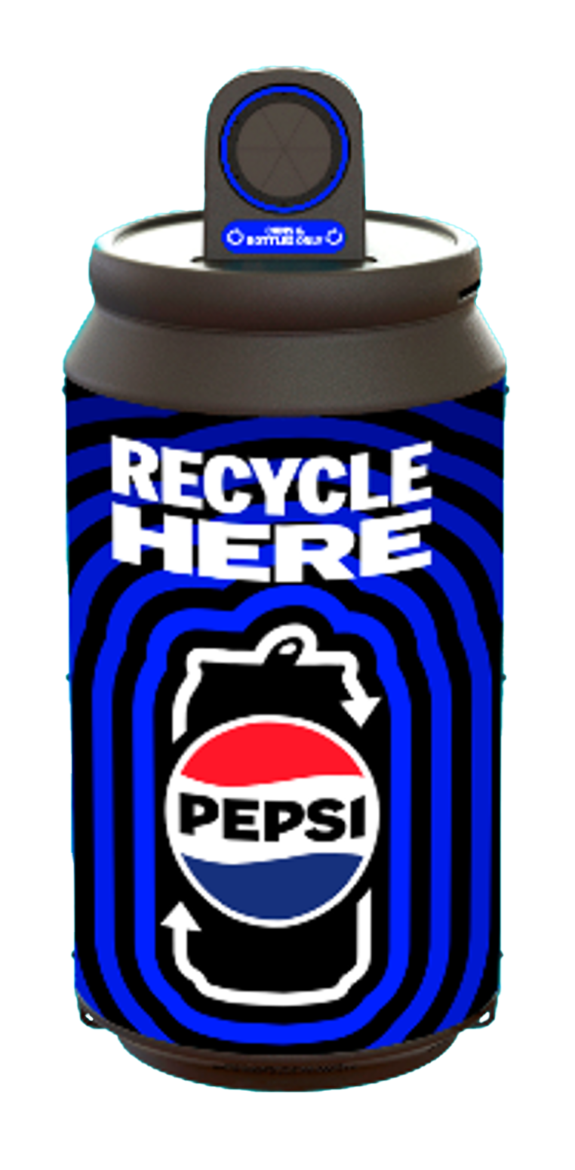
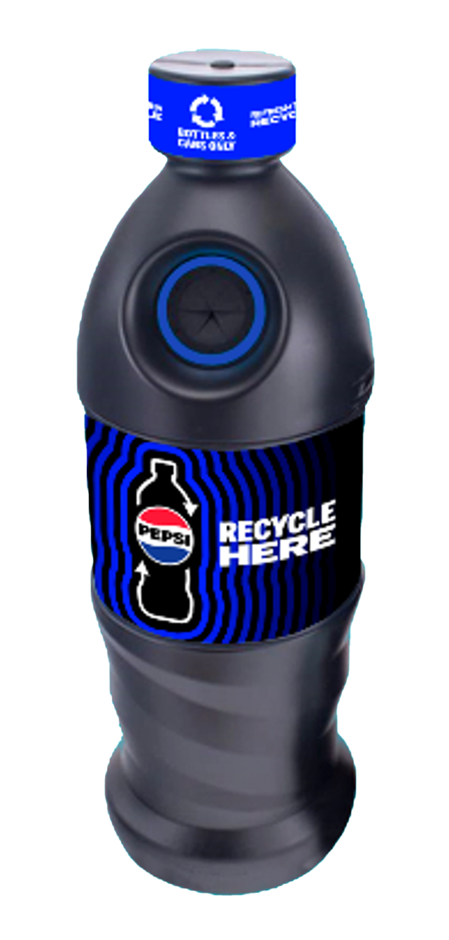
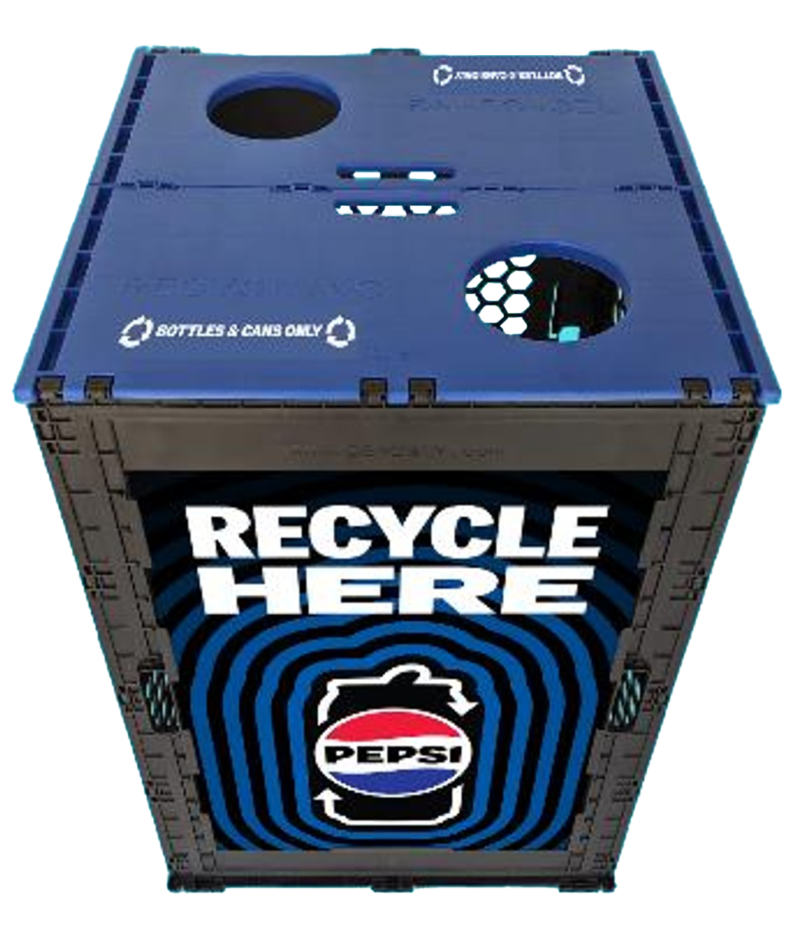
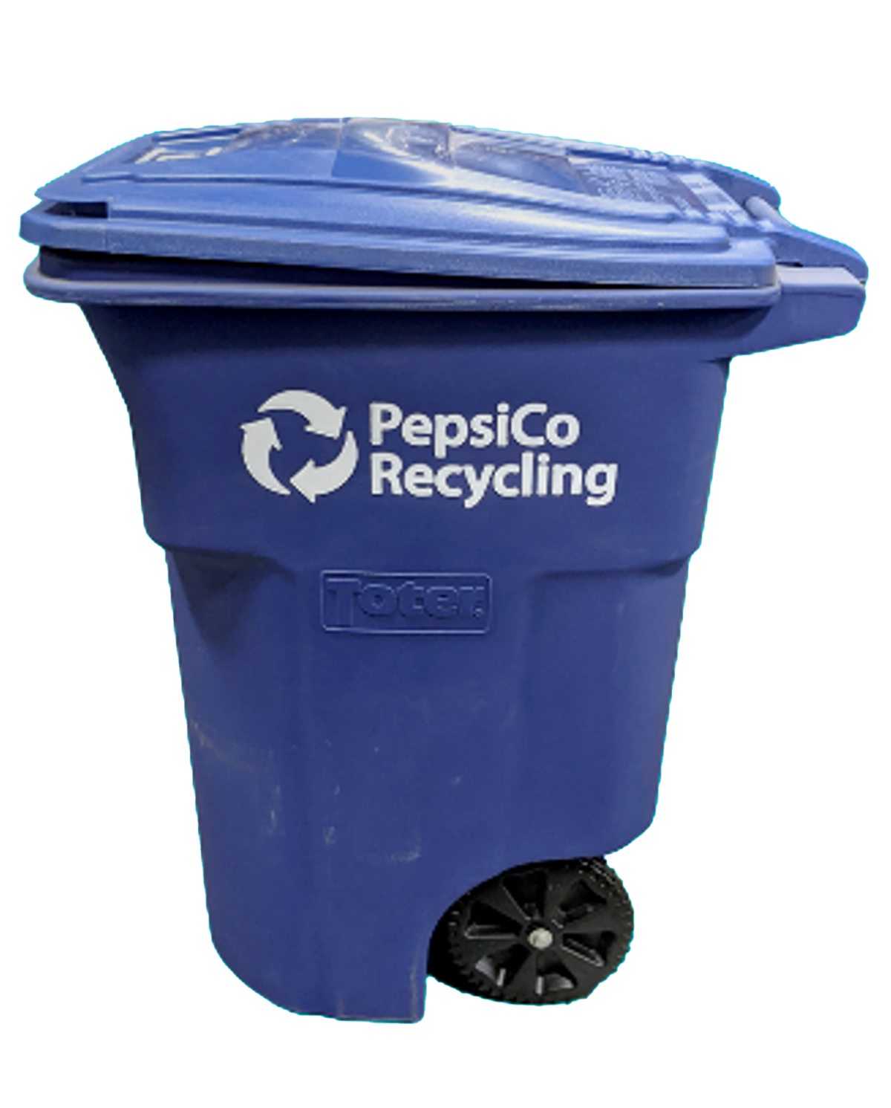
Recycling bins are optimized for beverage container recycling with round disposal holes and come with labeling for various waste streams such as:
Bottles Only
Cans Only
Bottles & Cans Only
Customization for some bins may be available upon request
PEPSICO OFFERS RECYCLING BINS TO SUIT CUSTOMER NEEDS
FPO
DURABLE, REUSABLE EVENT RECYCLING BINS
CAN COLLECTION BINS
BOTTLE COLLECTION BINS
96 GALLON TOTER
Available upon request for special events
Indoor or Outdoor Use
Made of 100% recycled material
Indoor or Outdoor Use
Made of 100% recycled material
Best for Outdoor Use
Made of 100% recycled material
CONFIDENTIAL
4

Slide 5



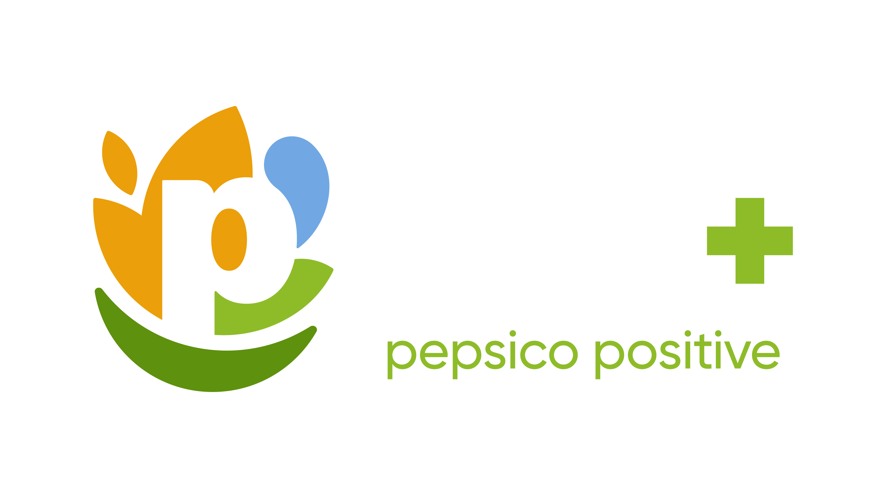
COMMERCIAL SUSTAINABILITY CONTACTS
NICOLE POPOWSKI
Commercial Sustainability Manager
Nicole.Popowski@pepsico.com
SHANNA PARRA
Director Commercial Sustainability
shanna.parra@pepsico.com
CATHERINE WALTON
Senior Manager Commercial Sustainability
catherine.walton@pepsico.com
CONFIDENTIAL
5
Notes:
Add Pree?

