Slide 1



A Portfolio of Advantaged
Sustainability Solutions
What is Partners for Tomorrow?
Mutually beneficial for our customers and PepsiCo
Driving progress toward sustainability goals and commercial value
1

Slide 2

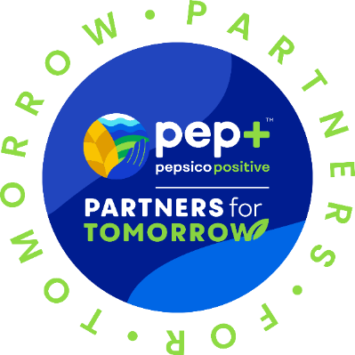
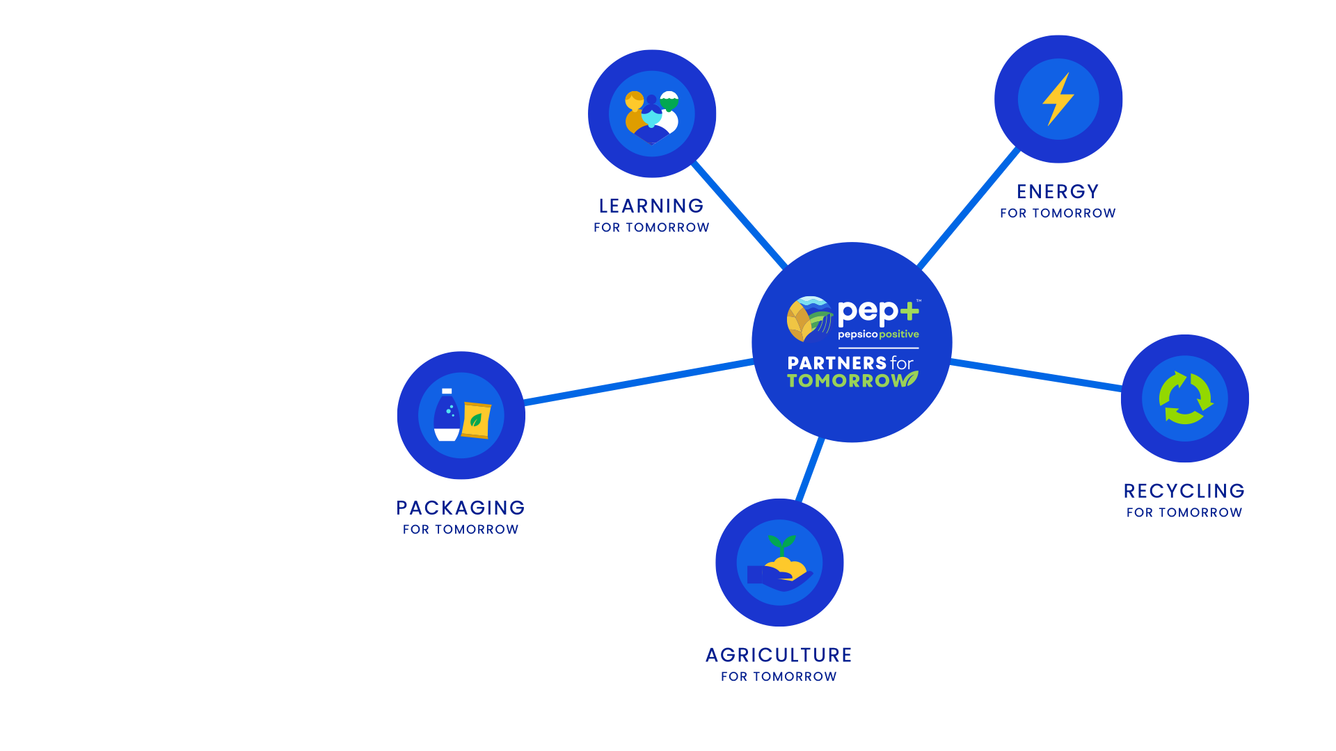
AGRICULTURE
FOR TOMORROW
RECYCLING
FOR TOMORROW
Sow Positive (Sow+)
CIRQU
Oscar Sort
Recycling Bins
Recycle Rally
Olyns Reverse Vending
LEARNING
FOR TOMORROW
PACKAGING
FOR TOMORROW
Sustainability Summit
Sustainability
Action Center
Sustainable Cups
ENERGY
FOR TOMORROW
pep+ REnew
Solutions that span key sustainability categories
2
Notes:
Partners for Tomorrow – a suite of sustainability solutions available to value chain partners, notably our customers. The program was named the “sustainability initiative of the year” by Business Intelligence Group.
We have launched programs with partners in agriculture, we have a number of sources available for our customers and partners to leverage – e.g. the sustainability summit and the sustainability action center and we launched pep+ renew which helps our partners to convert to renewable energy. The two categories of solutions we’re going to focus on today are packaging and recycling.
www.partnersfortomorrow.com

Slide 3

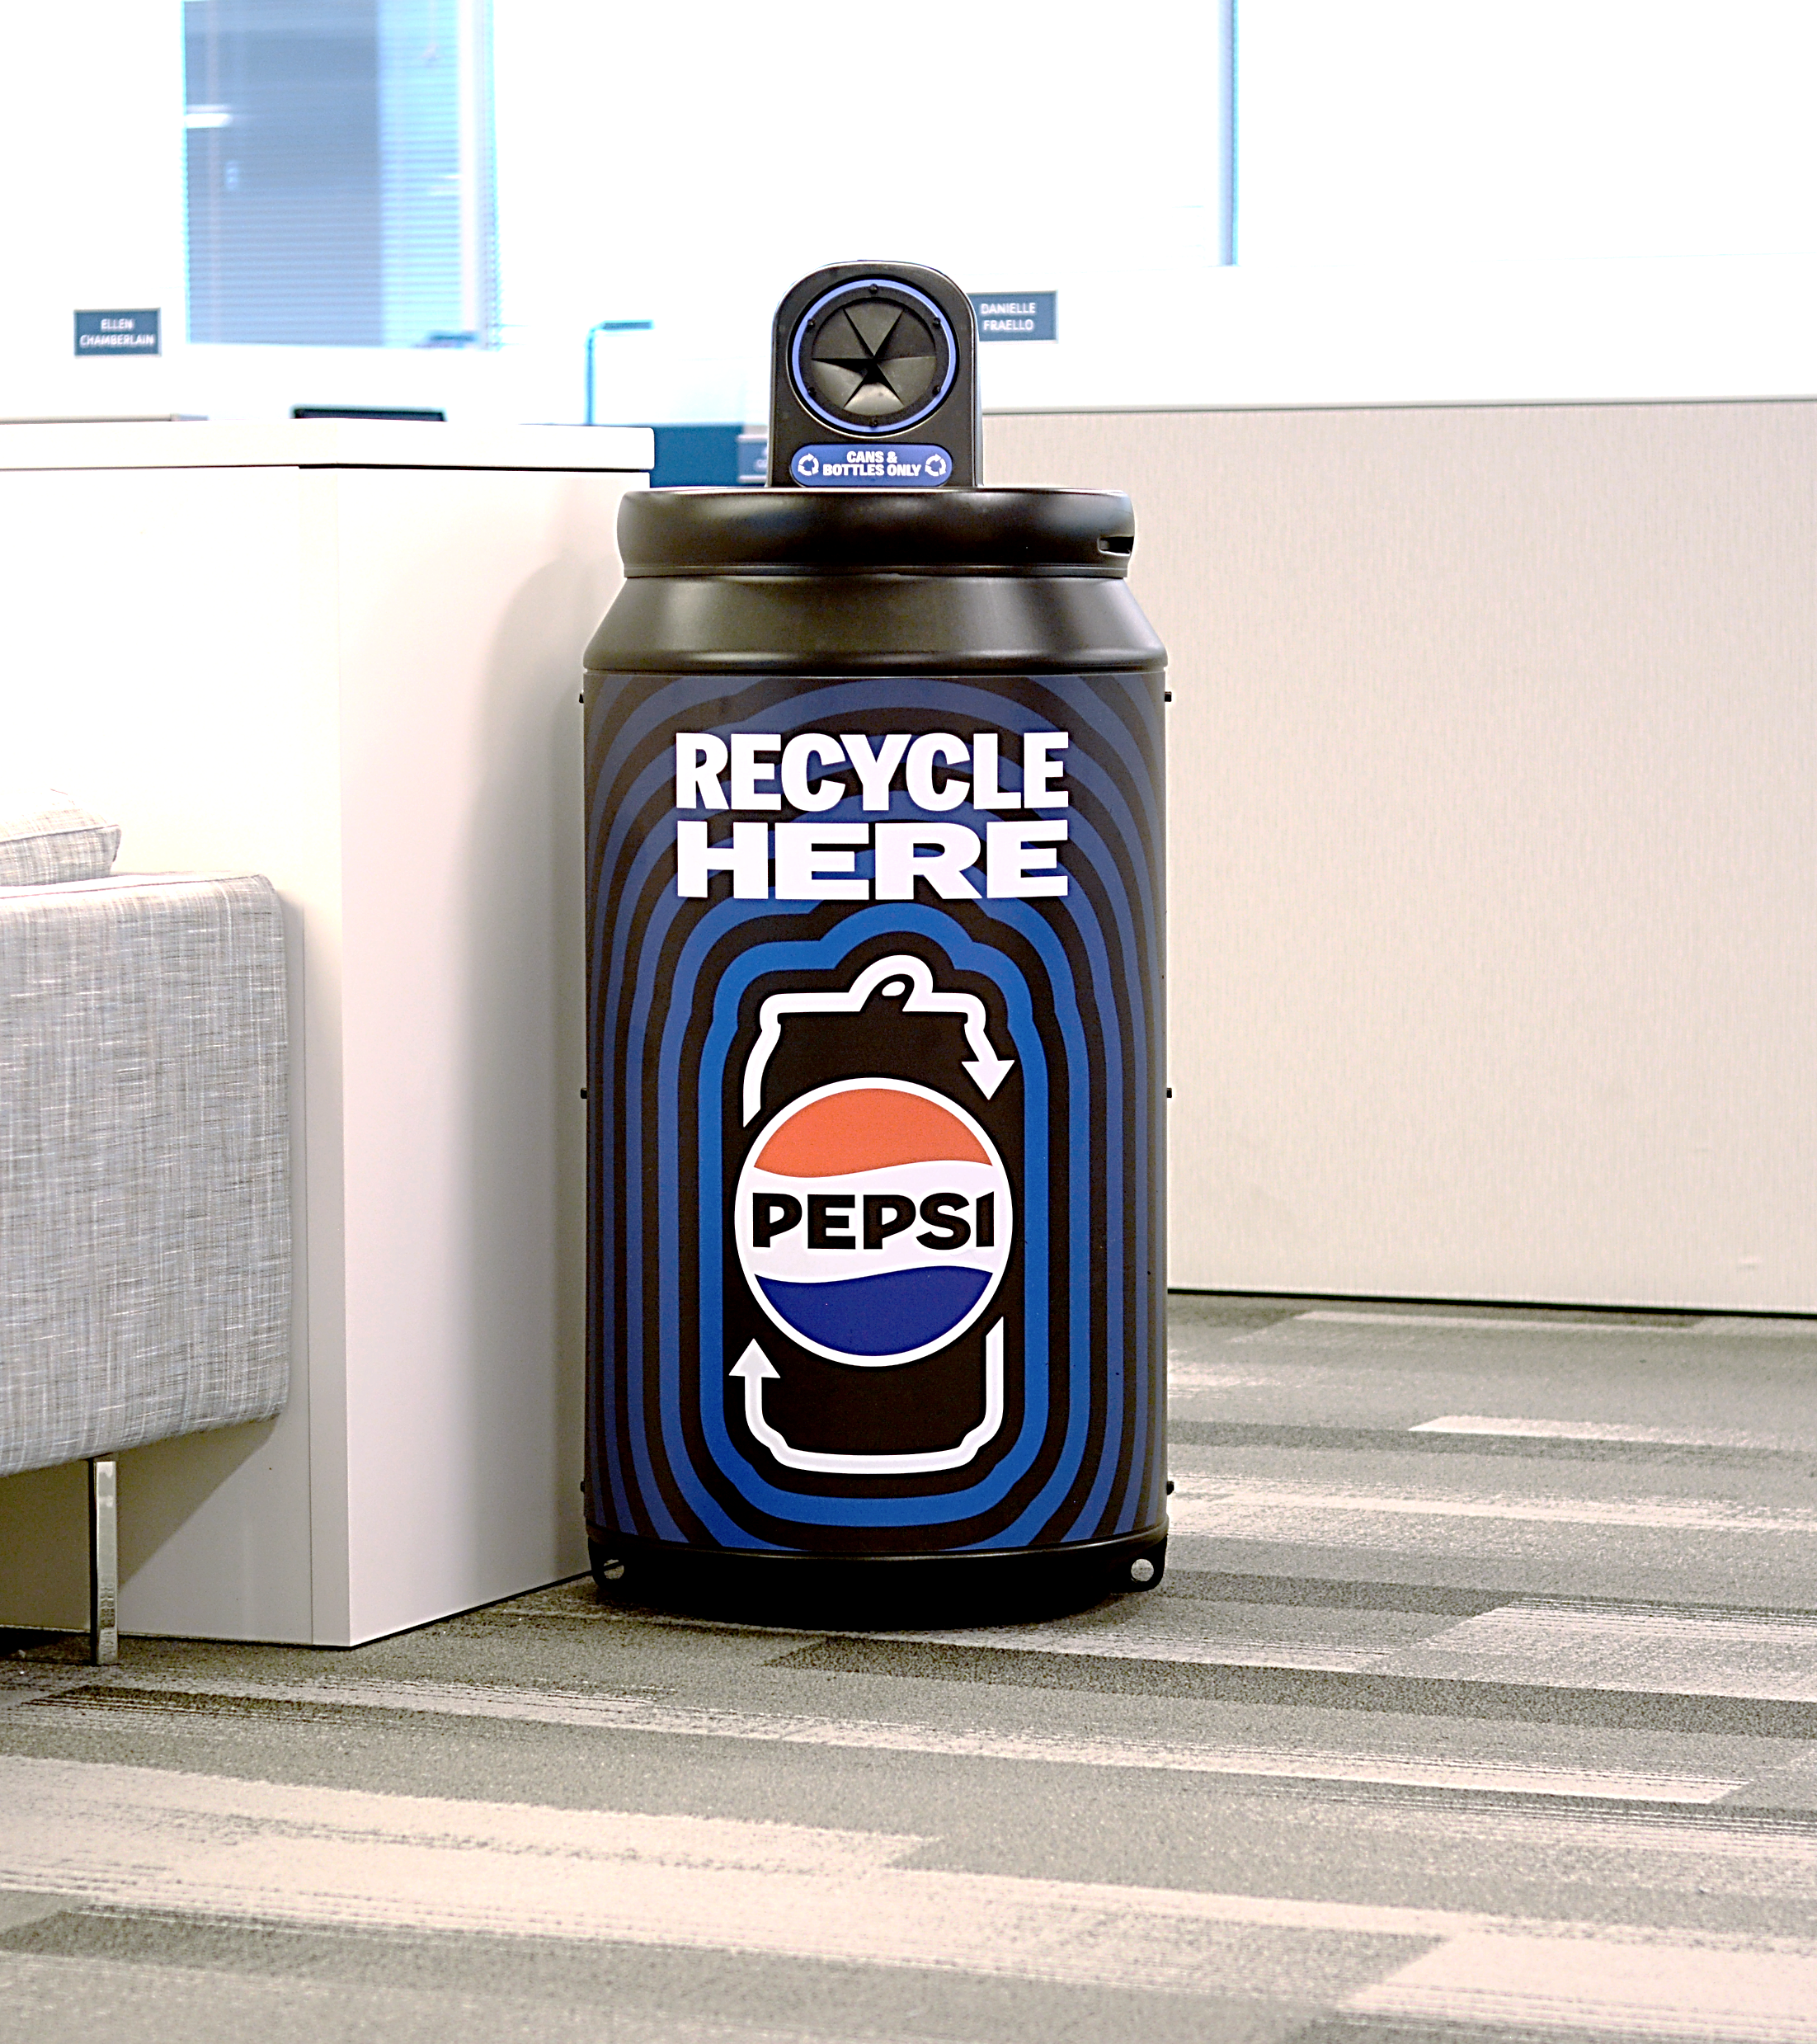

RECYCLING BINS
POSITIVE
VALUE CHAIN
Recycling is no longer optional —
it’s a must
Consumers want to make the responsible decision to recycle after consuming our products, and we’re happy to provide recycling bins for plastic bottles and aluminum cans
Together, let’s increase consumer access to recycling
3

Slide 4

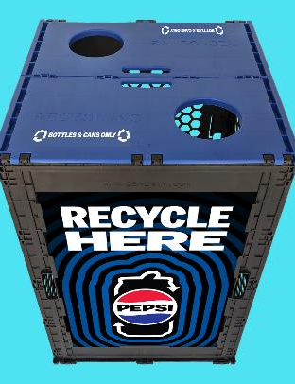
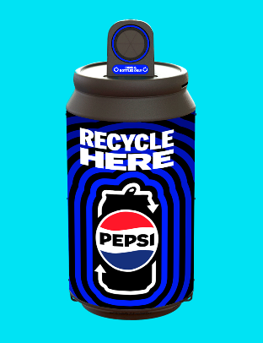
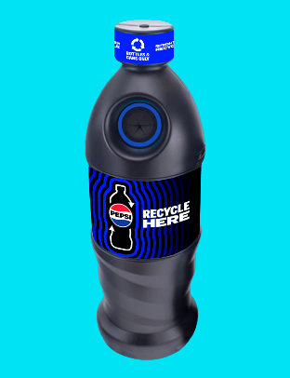
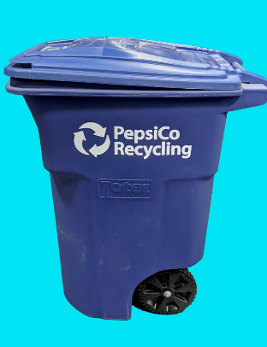

PEPSICO OFFERS RECYCLING BINS TO SUIT CUSTOMER NEEDS
POSITIVE
VALUE CHAIN
Recycling bins are optimized for beverage container recycling with round disposal holes and come with labeling for various waste streams such as:
Bottles Only
Cans Only
Bottles & Cans Only
Customization for some bins may be available upon request
FPO
Durable, Reusable Event Recycling Bins
Available upon request for special events
Can
Collection Bins
Indoor or
Outdoor Use
Made of 100% recycled material
Bottle
Collection Bins
Indoor or
Outdoor Use
Made of 100% recycled material
96
Gallon Toter
Best for
Outdoor Use
Made of 100% recycled material
4

Slide 5
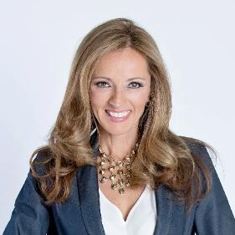
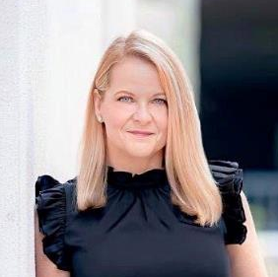
COMMERCIAL SUSTAINABILITY CONTACTS
LET’S PARTNER!
Shanna Parra
Director Commercial Sustainability
Email: shanna.parra@pepsico.com
Catherine Walton
Senior Manager Commercial Sustainability
Email: catherine.walton@pepsico.com
5
Notes:
Add Pree?

