Slide 1



A Portfolio of Advantaged
Sustainability Solutions
What is Partners for Tomorrow?
Mutually beneficial for our customers and PepsiCo
Driving progress toward sustainability goals and commercial value
1

Slide 2


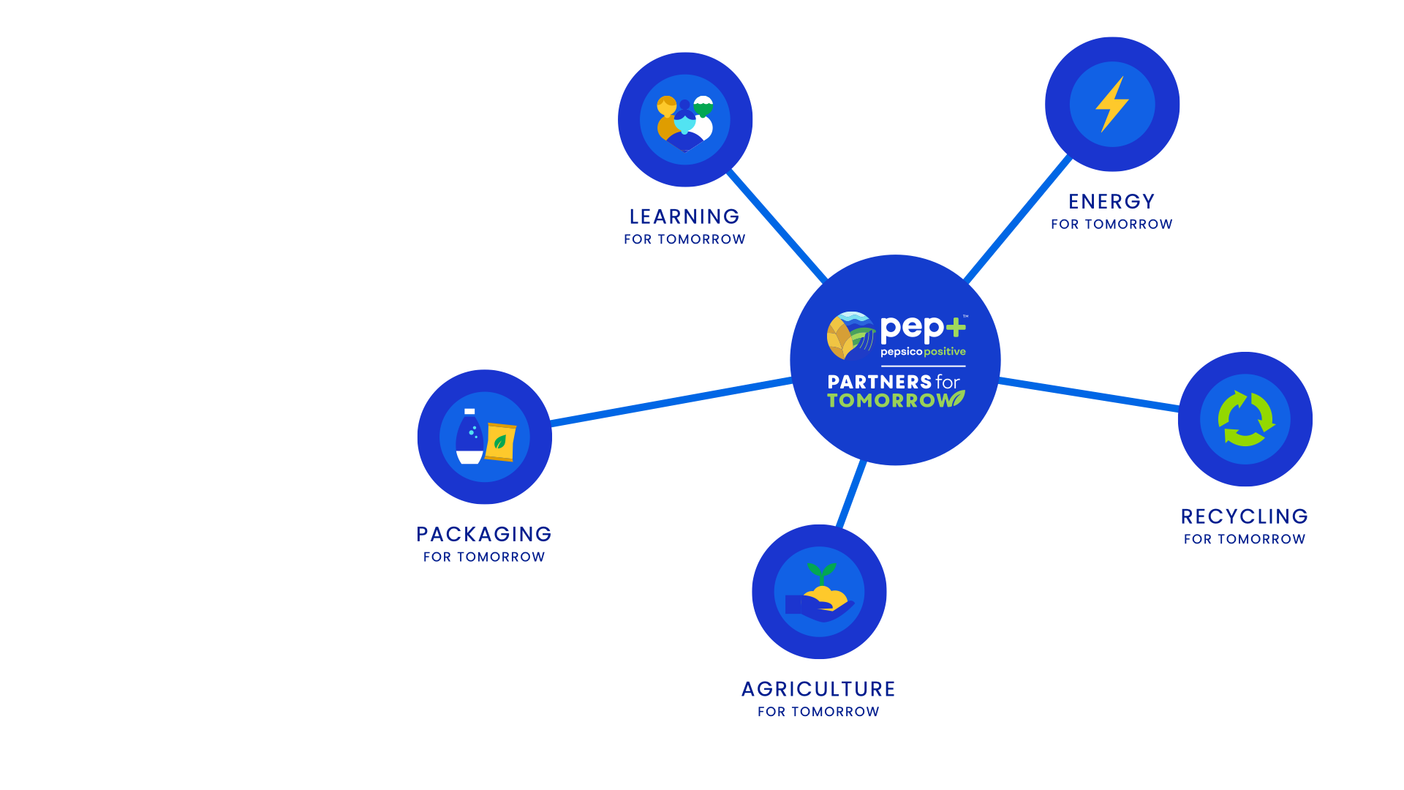
AGRICULTURE
FOR TOMORROW
RECYCLING
FOR TOMORROW
Sow Positive (Sow+)
CIRQU
Oscar Sort
Recycling Bins
Recycle Rally
Olyns Reverse Vending
LEARNING
FOR TOMORROW
PACKAGING
FOR TOMORROW
Sustainability Summit
Sustainability
Action Center
Sustainable Cups
ENERGY
FOR TOMORROW
pep+ REnew
Solutions that span key sustainability categories
2
Notes:
Partners for Tomorrow – a suite of sustainability solutions available to value chain partners, notably our customers. The program was named the “sustainability initiative of the year” by Business Intelligence Group.
We have launched programs with partners in agriculture, we have a number of sources available for our customers and partners to leverage – e.g. the sustainability summit and the sustainability action center and we launched pep+ renew which helps our partners to convert to renewable energy. The two categories of solutions we’re going to focus on today are packaging and recycling.
www.partnersfortomorrow.com

Slide 3

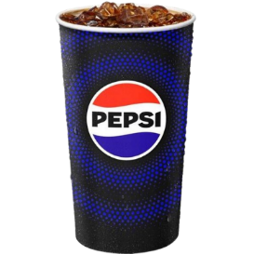
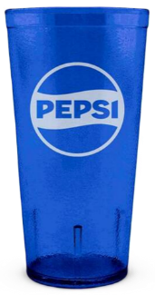
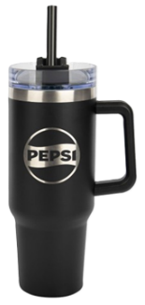
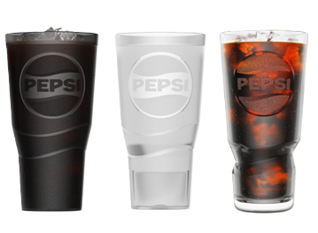


WE CONTINUE TO EVOLVE OUR SUSTAINABLE
CUP PORTFOLIO
POSITIVE
VALUE CHAIN
Single-use
Reusable Vessels
Compostable Cups
Tumblers
Personal Cups
Equity Tumblers
Commercially compostable paper cups
Sizes: 12, 16oz, 22oz, 32oz
Available on PepsiCo Partners website or Pepsi Direct
Limited availability for some sizes
Durable, dishwasher-safe tumblers
Sizes: 16oz, 20oz, 24oz
Available on PepsiCo Partners website or Pepsi Direct
Personal cups for ‘bring-your-own-cup’ programs
Multiple styles and sizes
Available on PepsiCo Premiums website
*NEW* updated design
Durable, dishwasher-safe tumblers
Sizes: 20oz, 24oz
20oz glasses, January 2025
Available on PepsiCo Premiums website or POS Direct
3

Slide 4
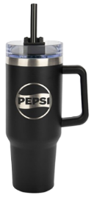
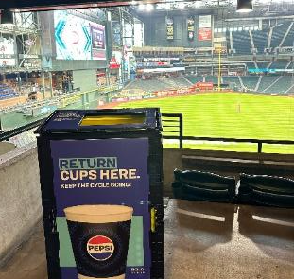
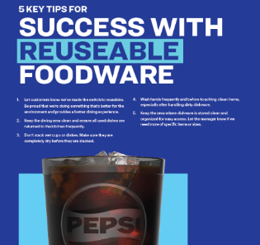
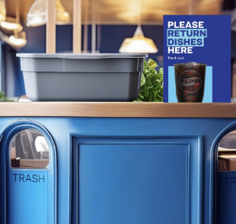
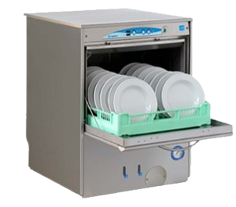
INTERESTED IN EXPLORING REUSABLE CUPS?
Determine Cups
Access Dishwashing
Order Assets
Train Staff
Launch
Align if customer needs personal cups or shared cups/tumblers?
Determine # of reusable assets needed
Decide if wash on-site or hire a third-party service is best?
Determine any additional staffing needs
Order cups & any food ware if including
Order bus tubs or dedicated return bins
If needed, order dish & drying racks
Educate all staff handling reusables
Include 3rd party janitorial and event teams in trainings
Dedicate collection points for reusables
Hang information signage for consumers & staff
4

Slide 5
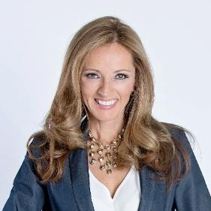
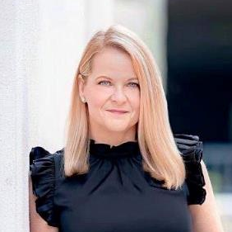
COMMERCIAL SUSTAINABILITY CONTACTS
LET’S PARTNER!
Shanna Parra
Director Commercial Sustainability
Email: shanna.parra@pepsico.com
Catherine Walton
Senior Manager Commercial Sustainability
Email: catherine.walton@pepsico.com
5
Notes:
Add Pree?

