Slide 1
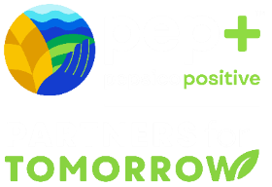
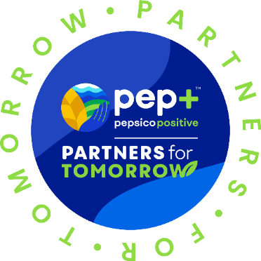

A Portfolio of Advantaged
Sustainability Solutions
What is Partners for Tomorrow?
Mutually beneficial for our customers and PepsiCo
Driving progress toward sustainability goals and commercial value
1

Slide 2


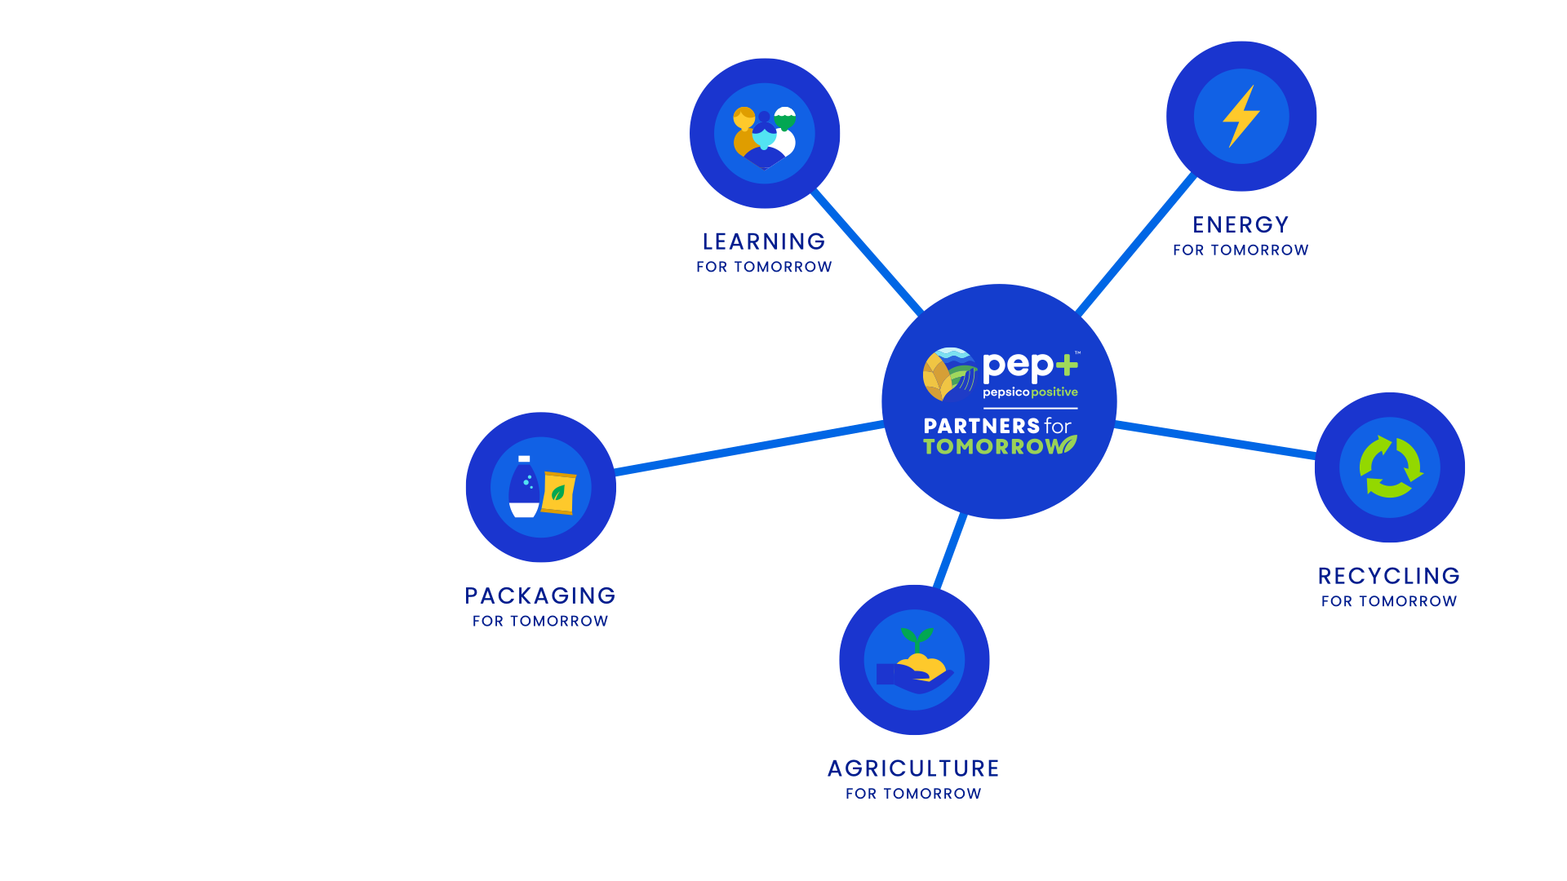
AGRICULTURE
FOR TOMORROW
RECYCLING
FOR TOMORROW
Sow Positive (Sow+)
CIRQU
Oscar Sort
Recycling Bins
Recycle Rally
Olyns Reverse Vending
LEARNING
FOR TOMORROW
PACKAGING
FOR TOMORROW
Sustainability Summit
Sustainability
Action Center
Sustainable Cups
ENERGY
FOR TOMORROW
pep+ REnew
Solutions that span key sustainability categories
2
Notes:
Partners for Tomorrow – a suite of sustainability solutions available to value chain partners, notably our customers. The program was named the “sustainability initiative of the year” by Business Intelligence Group.
We have launched programs with partners in agriculture, we have a number of sources available for our customers and partners to leverage – e.g. the sustainability summit and the sustainability action center and we launched pep+ renew which helps our partners to convert to renewable energy. The two categories of solutions we’re going to focus on today are packaging and recycling.
www.partnersfortomorrow.com

Slide 3

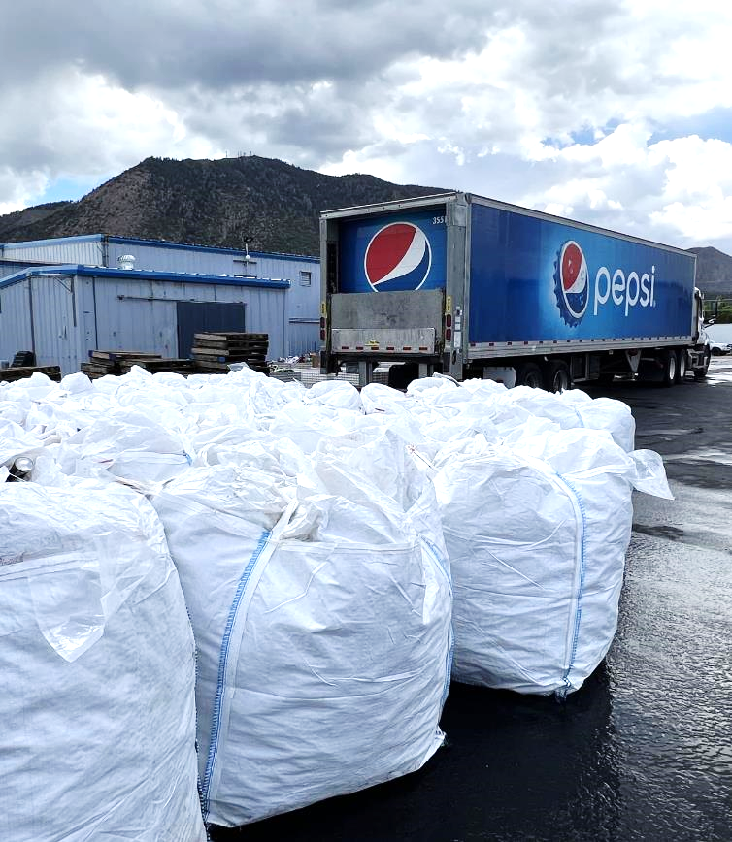


POSITIVE
VALUE CHAIN
CIRQU - RECYCLING GETS SMART
Helping to build a circular & inclusive value chain.
CIRQU provides the services and tools that customers need to make it easy to recycle. The model is designed to ensure materials get worked back into our supply chain so they can be used again and again!
In partnership with
Supersacks full of recycled material collected through CIRQU
3
Notes:
See Oscar in Action
Oscar Sort, an artificial intelligence fun/entertaining waste-sorting system to aid consumer error on which bin to use
Zero touch – zero waste
Automatically identifies recyclables from waste, by using AI tech to understand the item that a person is trying to dispose of
Instruct users on which waste bin to use

Slide 4

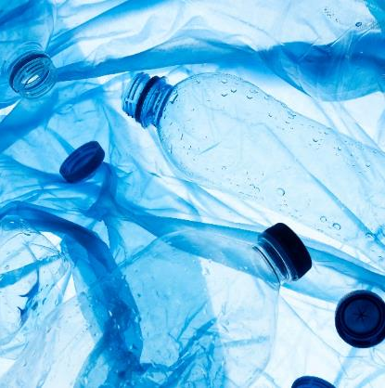
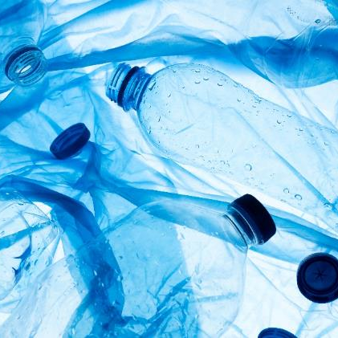

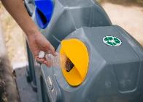



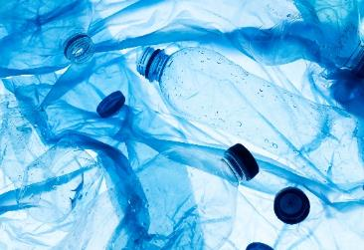

BRINGING PACKAGING CIRCULARITY
TO REDUCE WASTE
POSITIVE
VALUE CHAIN
Recycling Today
Recycling with CIRQU
Insert Customer Logo
Insert Customer Logo
Bottles Become Bottles Again…
And Again!
Landfill
Traditional
Recycling Hauling
No Cost to Participate! PepsiCo Funded
4
Notes:
How makes a difference/or is a solution in pep+ agenda

Slide 5

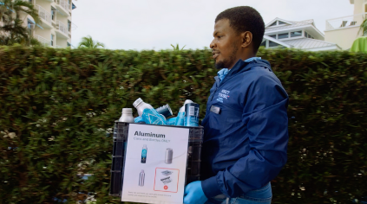
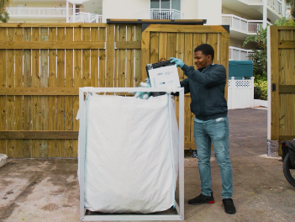
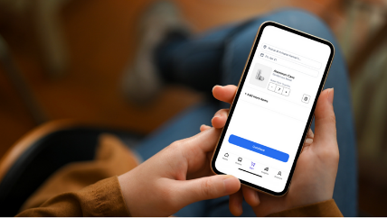

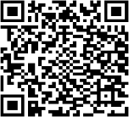
HOW IT WORKS
Eligibility
Collect
Material
Sort
& Store
Request
Pick Up
Share
Impact
Current Markets
    Jackson, MS
    Miami, FL
    Denver, CO
    Phoenix, AZ
    Flagstaff, AZ
    Chicago, IL
    San Antonio, TX
    Houston, TX
    Dallas, TX
    Tulsa, OK
    Oklahoma City, OK
    Los Angeles, CA
New markets possible (3-week lead time to confirm)
Partners with high volume, traffic, onsite consumption
Onsite storage space for 28 super sacks (3’x 3’ x 4’ each), or placement of 20 ft shipping container. Storage requirement not applicable for markets in which Pepsi can backhaul recyclables (TBC)
Collect recyclable materials from customers across the property
We provide super sacks to store your plastic and aluminum. Material must be separated.
Once enough material has been collected, a local operator will swap your full super sacks for empty ones; recurring pickups available
Customized impact report updated in real-time and ready to share with
the world
5

Slide 6
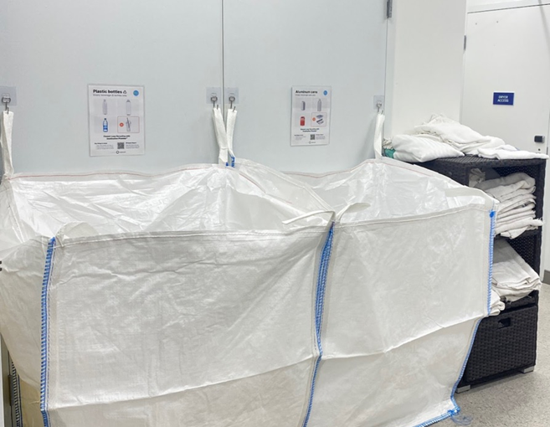


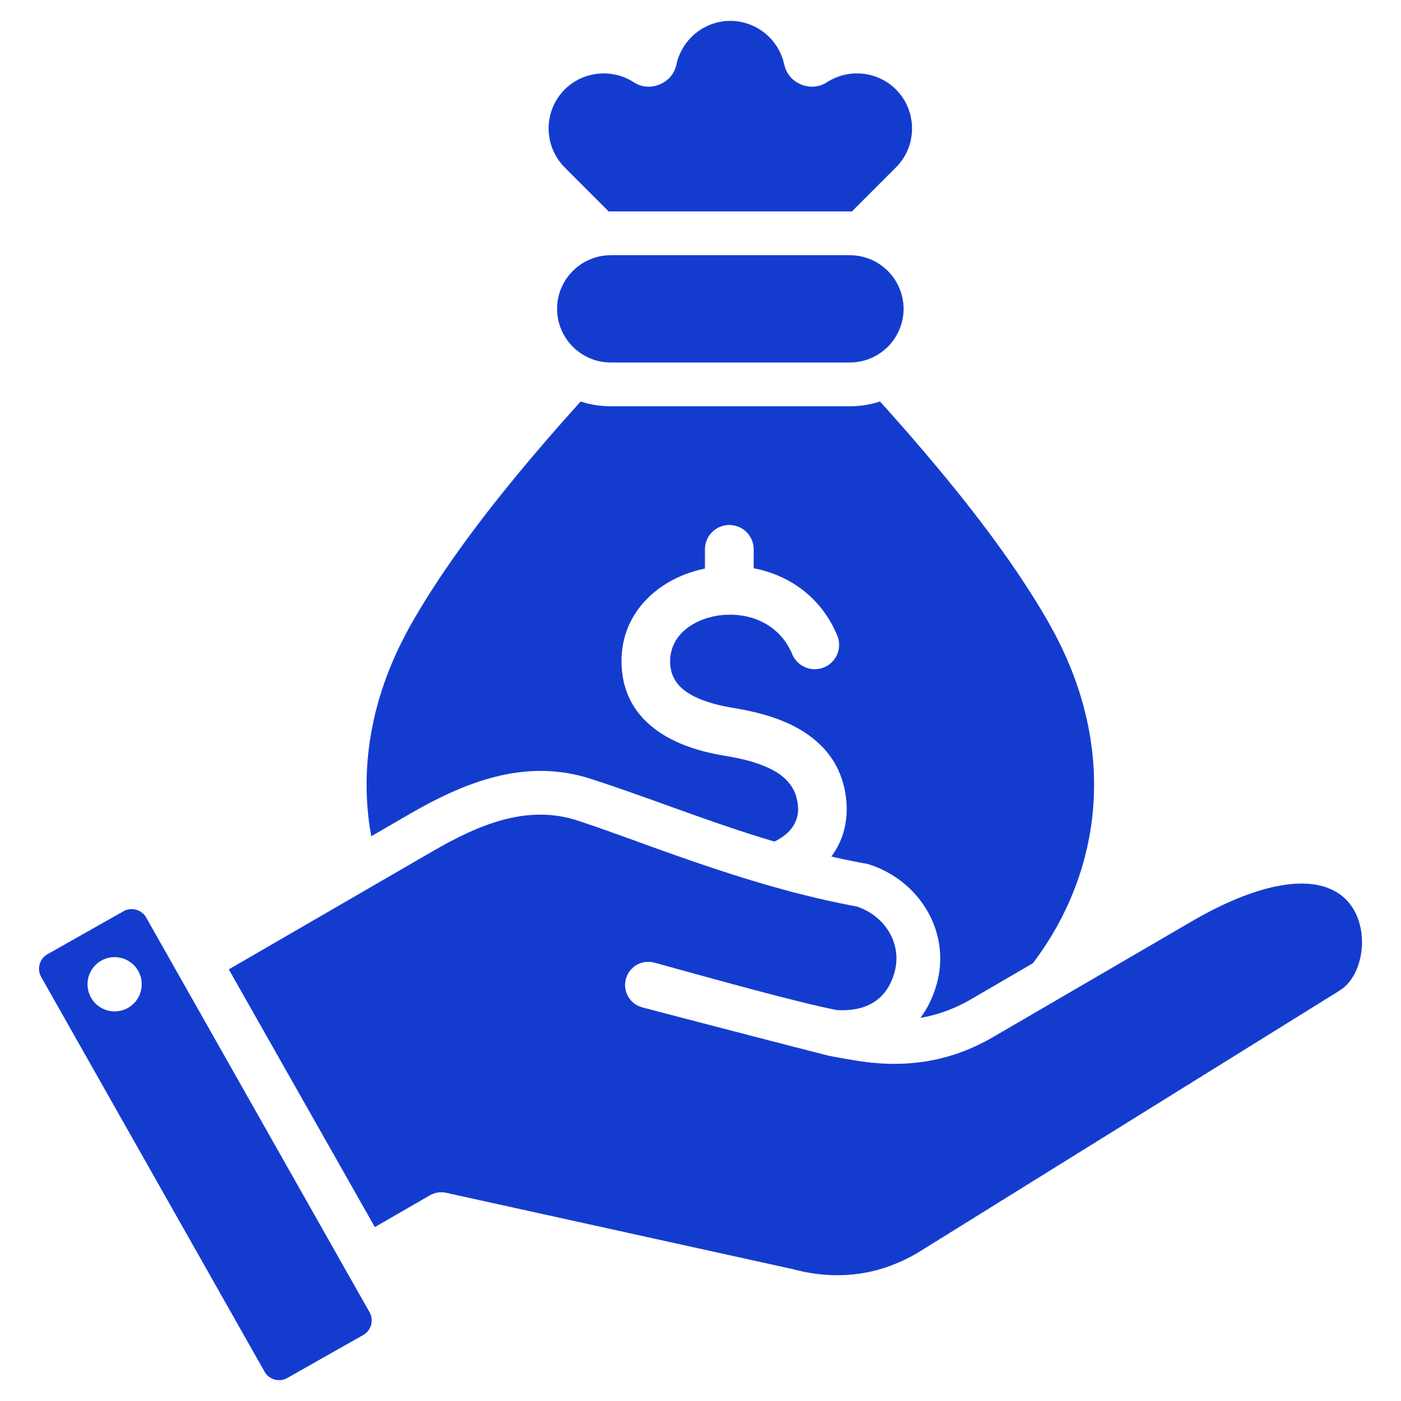

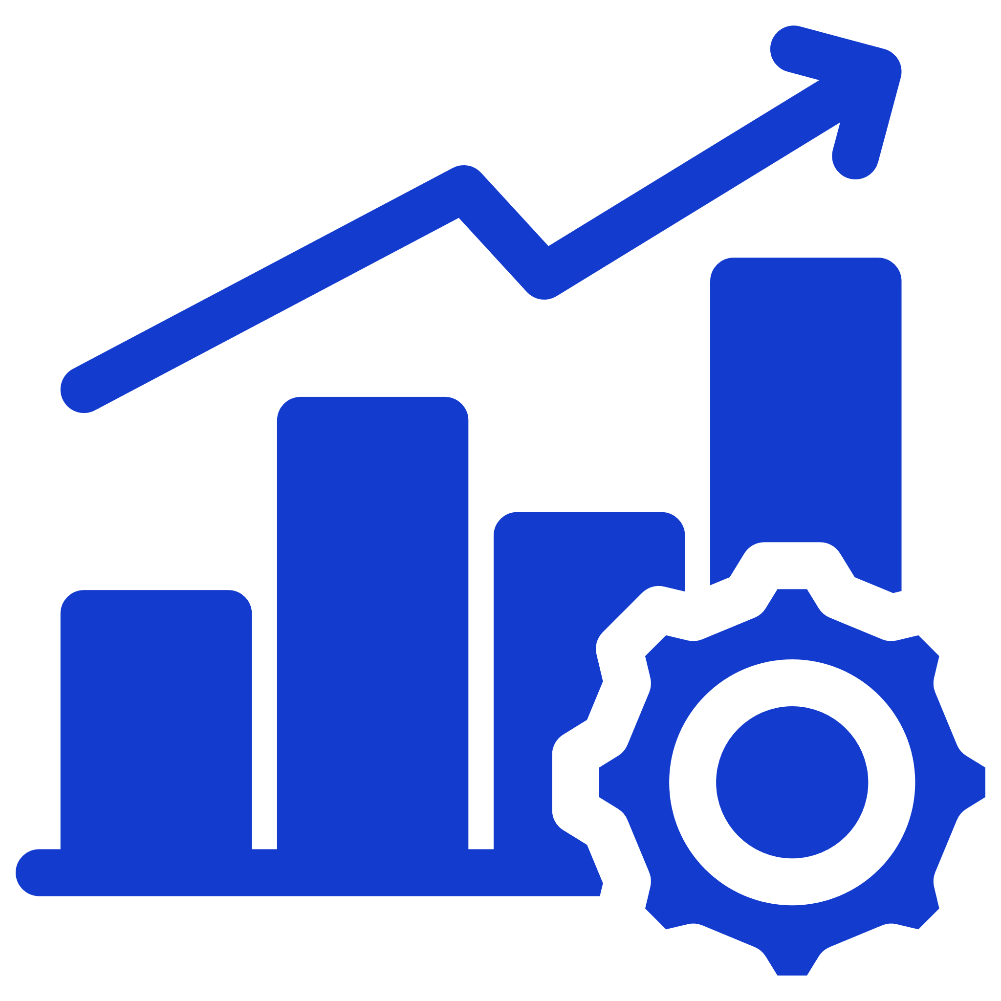
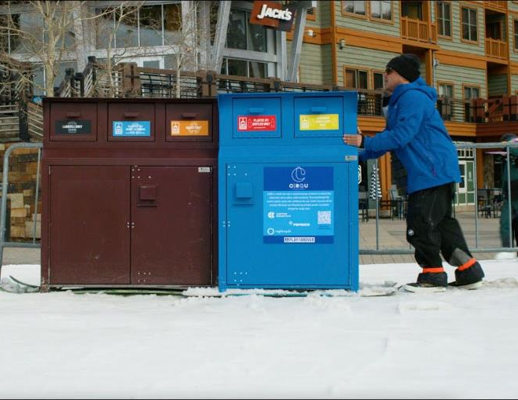
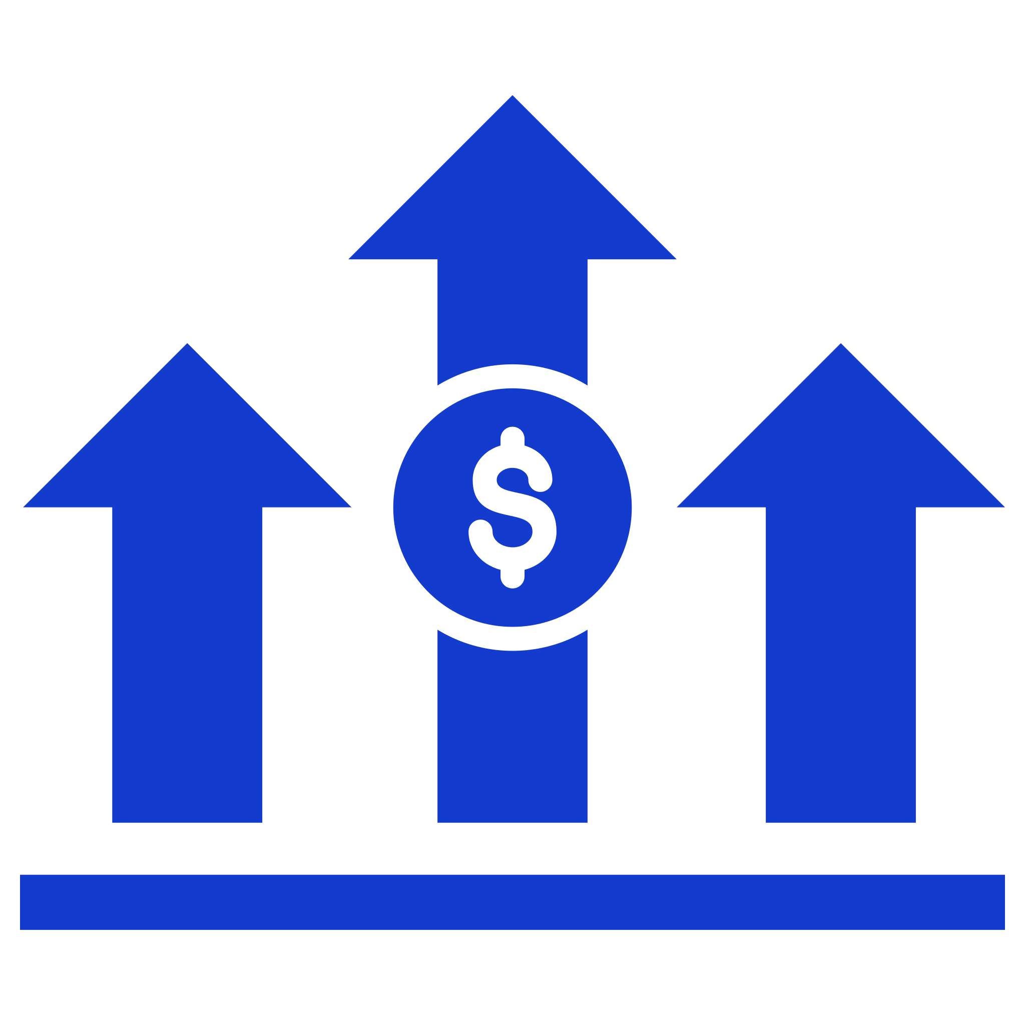

FEATURES & BENEFITS
Showcasing Your Commitment To Sustainability
FUNDED BY PEPSICO
Supplies, training, and support make it easy to get started and involve your team!
IMPACT REPORTING
Trust that your material is being recycled and get shareable impact reports to publicly demonstrate your commitment to sustainability
FINANCIAL ADVANTAGES
Potentially reduce your waste service fees
ENGAGEMENT
Opportunities to engage employees, partners, and the broader community in your efforts
6
Notes:
Feature/benefits of participating as a partner

Slide 7
CIRQU FAQ’s
What type of materials can I recycle through the CIRQU program? We accept PET beverage bottles (clear bottles with a “#1” stamped on the bottom) and aluminum beverage cans.
Can I recycle other non-Pepsi bottles and cans in this recycling program? Absolutely! All PET bottles and aluminum cans, regardless of brand, are accepted.
Is there a minimum amount of material I need to collect to participate in CIRQU? There is a monthly collection volume minimum of 200 pounds. This is approximately 5,300 containers. You can ramp up your collection over a few months.
Do I have to sort my recyclables? Yes, but the effort level depends on your collection strategy. We can help you identify efficiencies that maximize collection through low-lift back-of-house efforts. This typically requires a few trained staff to separate materials at the point of collection, which minimizes the need to sort.
How big is a super sack? Each super sack measures 3x3x4 ft and weighs between 50 to 65 pounds when full.
How much space do I need for the collection setup? Up to 6x3 ft as the collection set up (2 super sacks side by side)
How much material do I need to collect before scheduling a pickup? We will inform you at the time we check your site's eligibility how much needs to be collected and stored onsite. In some cases, it can be up to 28 super sacks. Storage requirement is not applicable for markets in which Pepsi can backhaul.
We do not have storage space. Is there another storage solution? Yes, we have a solution that fits in your parking lot. We offer a 20 ft shipping container as a storage solution that stores up to 28 super sacks. The shipping container measures 8x9x20 ft, roughly the size of an average parking space.
7

Slide 8
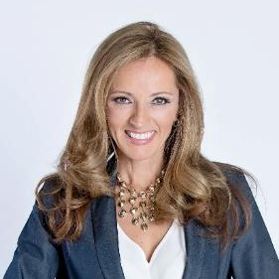
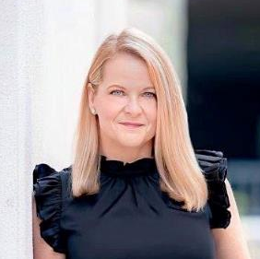
COMMERCIAL SUSTAINABILITY CONTACTS
LET’S PARTNER!
Shanna Parra
Director Commercial Sustainability
Email: shanna.parra@pepsico.com
Catherine Walton
Senior Manager Commercial Sustainability
Email: catherine.walton@pepsico.com
8
Notes:
Add Pree?

