Slide 1


Let’s partner today for a more sustainable tomorrow.
Introducing:

Slide 2

What is Partners for Tomorrow?

Slide 3
Partners for Tomorrow:
A robust portfolio of sustainability solutions for our partners designed to help meet shared sustainability goals.
AGRICULTURE
FOR TOMORROW
RECYCLING
FOR TOMORROW
LEARNING
FOR TOMORROW
PACKAGING
FOR TOMORROW
ENERGY
FOR TOMORROW

Slide 4
Partners for Tomorrow:
A robust portfolio of sustainability solutions for our partners designed to help meet shared sustainability goals.
AGRICULTURE
FOR TOMORROW
RECYCLING
FOR TOMORROW
sow+ Agriculture
CIRQU
LEARNING
FOR TOMORROW
PACKAGING
FOR TOMORROW
Recycling Bins
Recycle Rally
Sustainability Summit
SodaStream Professional
Sustainability Action Center
ENERGY
FOR TOMORROW
Sustainable Cups
pep+ REnew

Slide 5
Partners for Tomorrow:
A robust portfolio of sustainability solutions for our partners designed to help meet shared sustainability goals.
AGRICULTURE
FOR TOMORROW
RECYCLING
FOR TOMORROW
LEARNING
FOR TOMORROW
PACKAGING
FOR TOMORROW
ENERGY
FOR TOMORROW

Slide 6
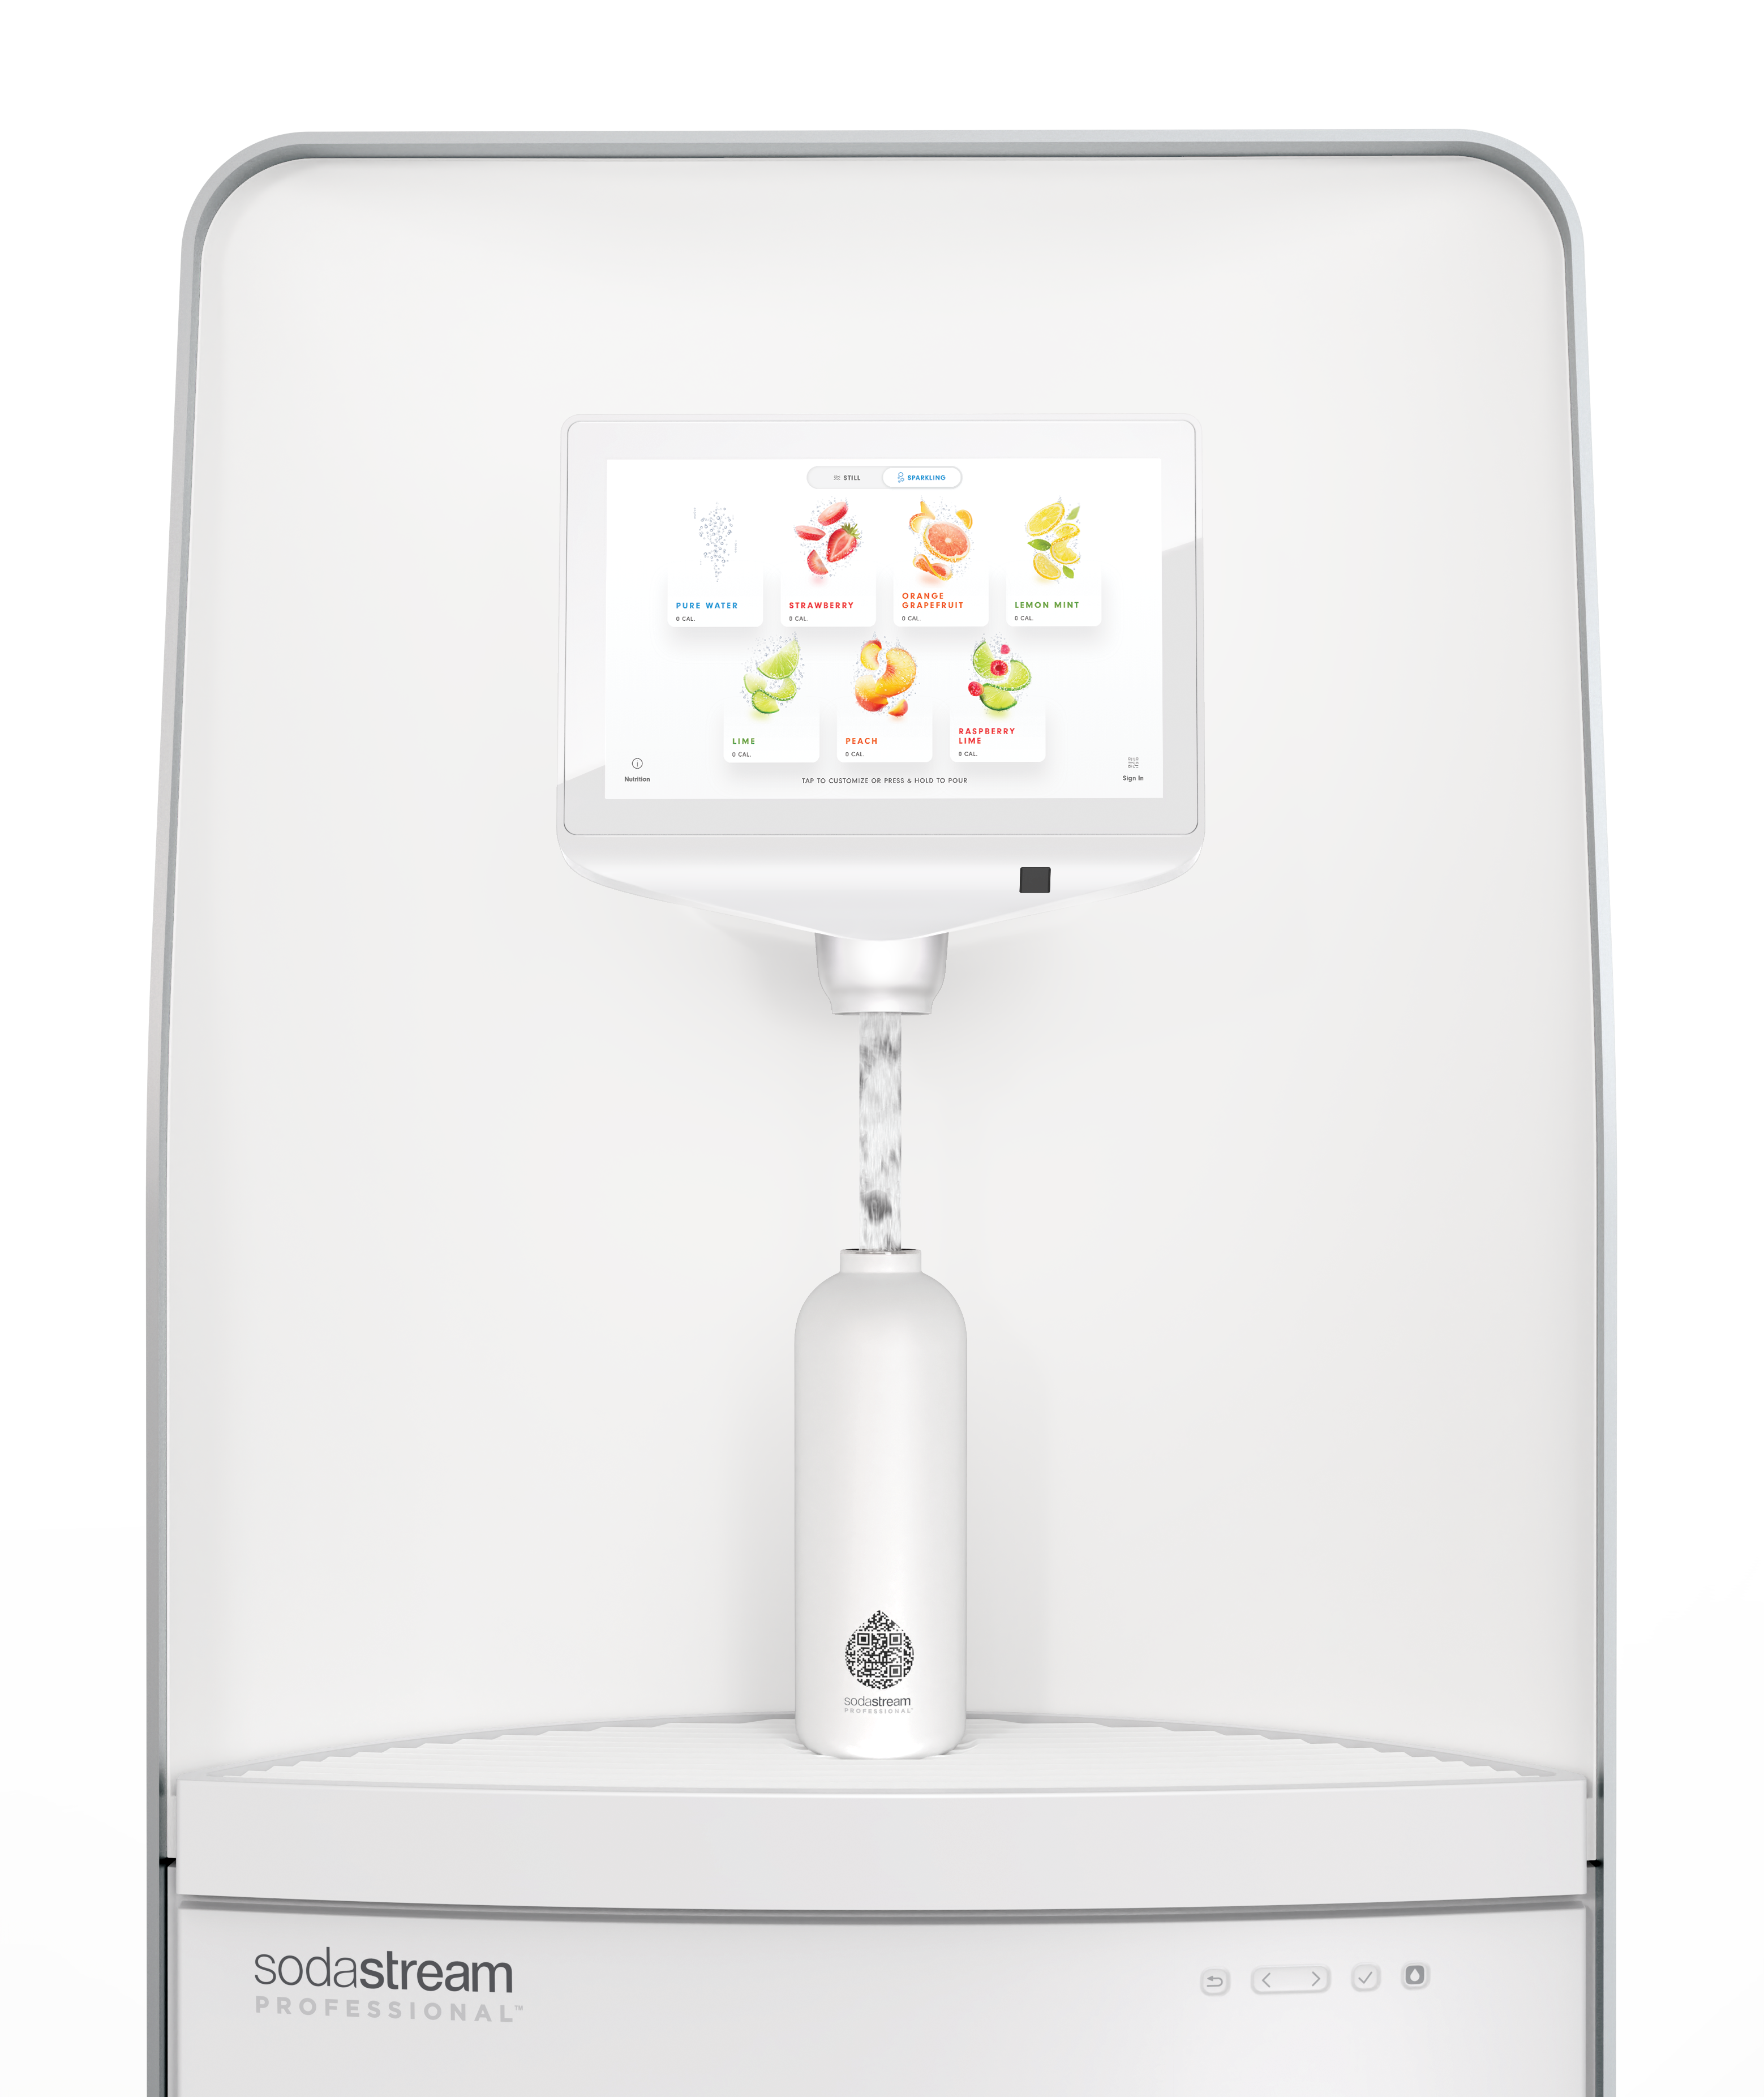
6

Slide 7
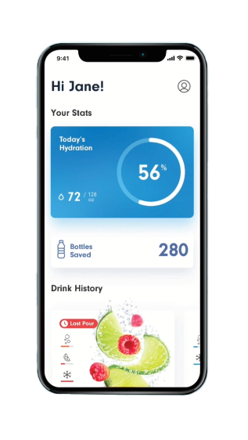


THIS IS WATER. COOLER.
Customize
carbonation level, temperature, flavor intensity
Track
personal hydration goals, save preferences
Count
single-use plastic bottles saved

Slide 8

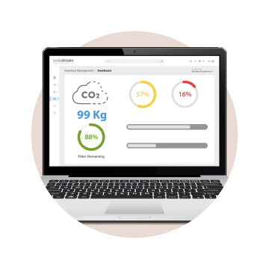
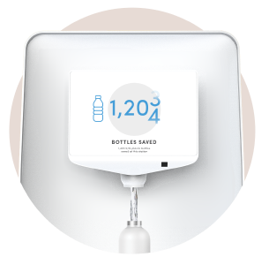
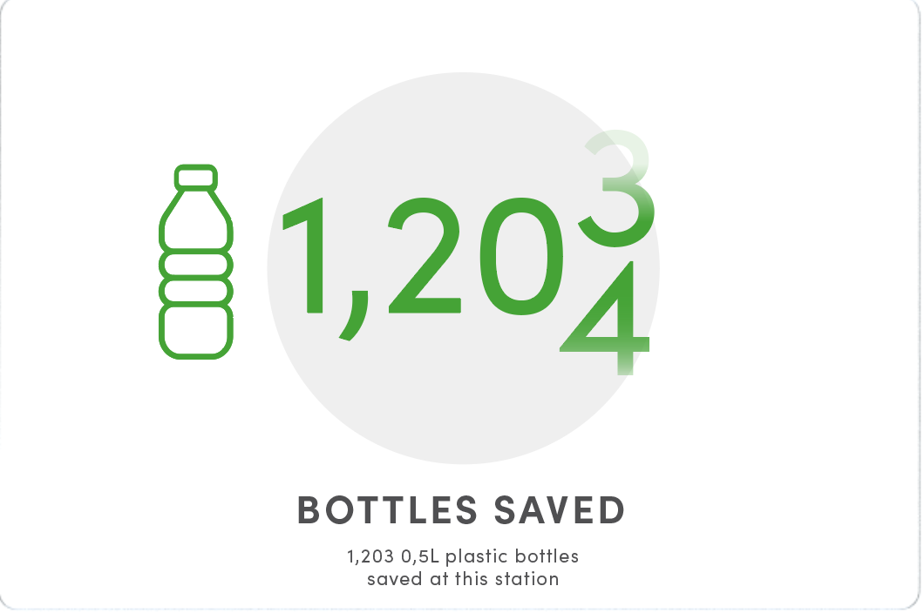
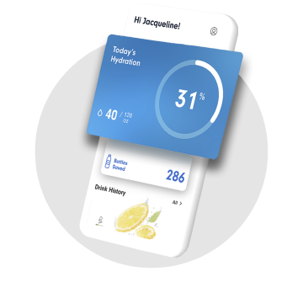
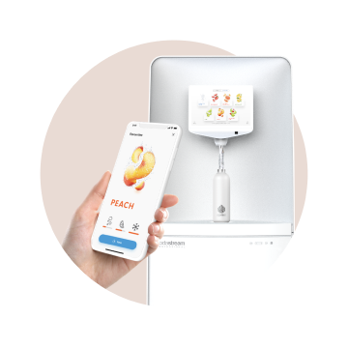
Consumer Benefits
A Connected Eco-System Delivering Personalized
and Sustainable Hydration
Personalized Drinks
Customize flavor, temperature and sparkling levels and save favorite
Operational Efficiency Through Data
Enables proactive pre-order, and remote equipment monitoring
Measurable Impact
Reduce plastic waste and celebrate
eco-conscious culture
Hydration Tracking
Achieve daily wellness goals with automatic progress tally
Safe and Accessible
Offers advanced accessibility and contactless pouring
7,000,000
BOTTLES AVOIDED AND COUNTING!
8

Slide 9


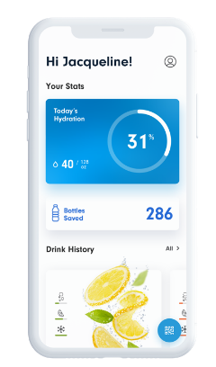
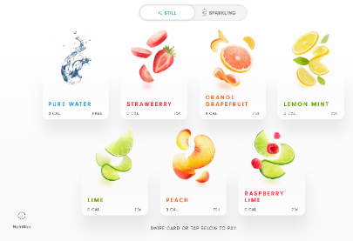
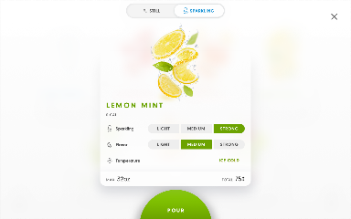
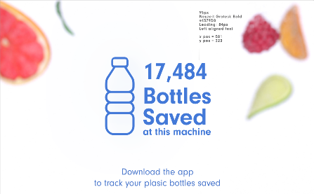
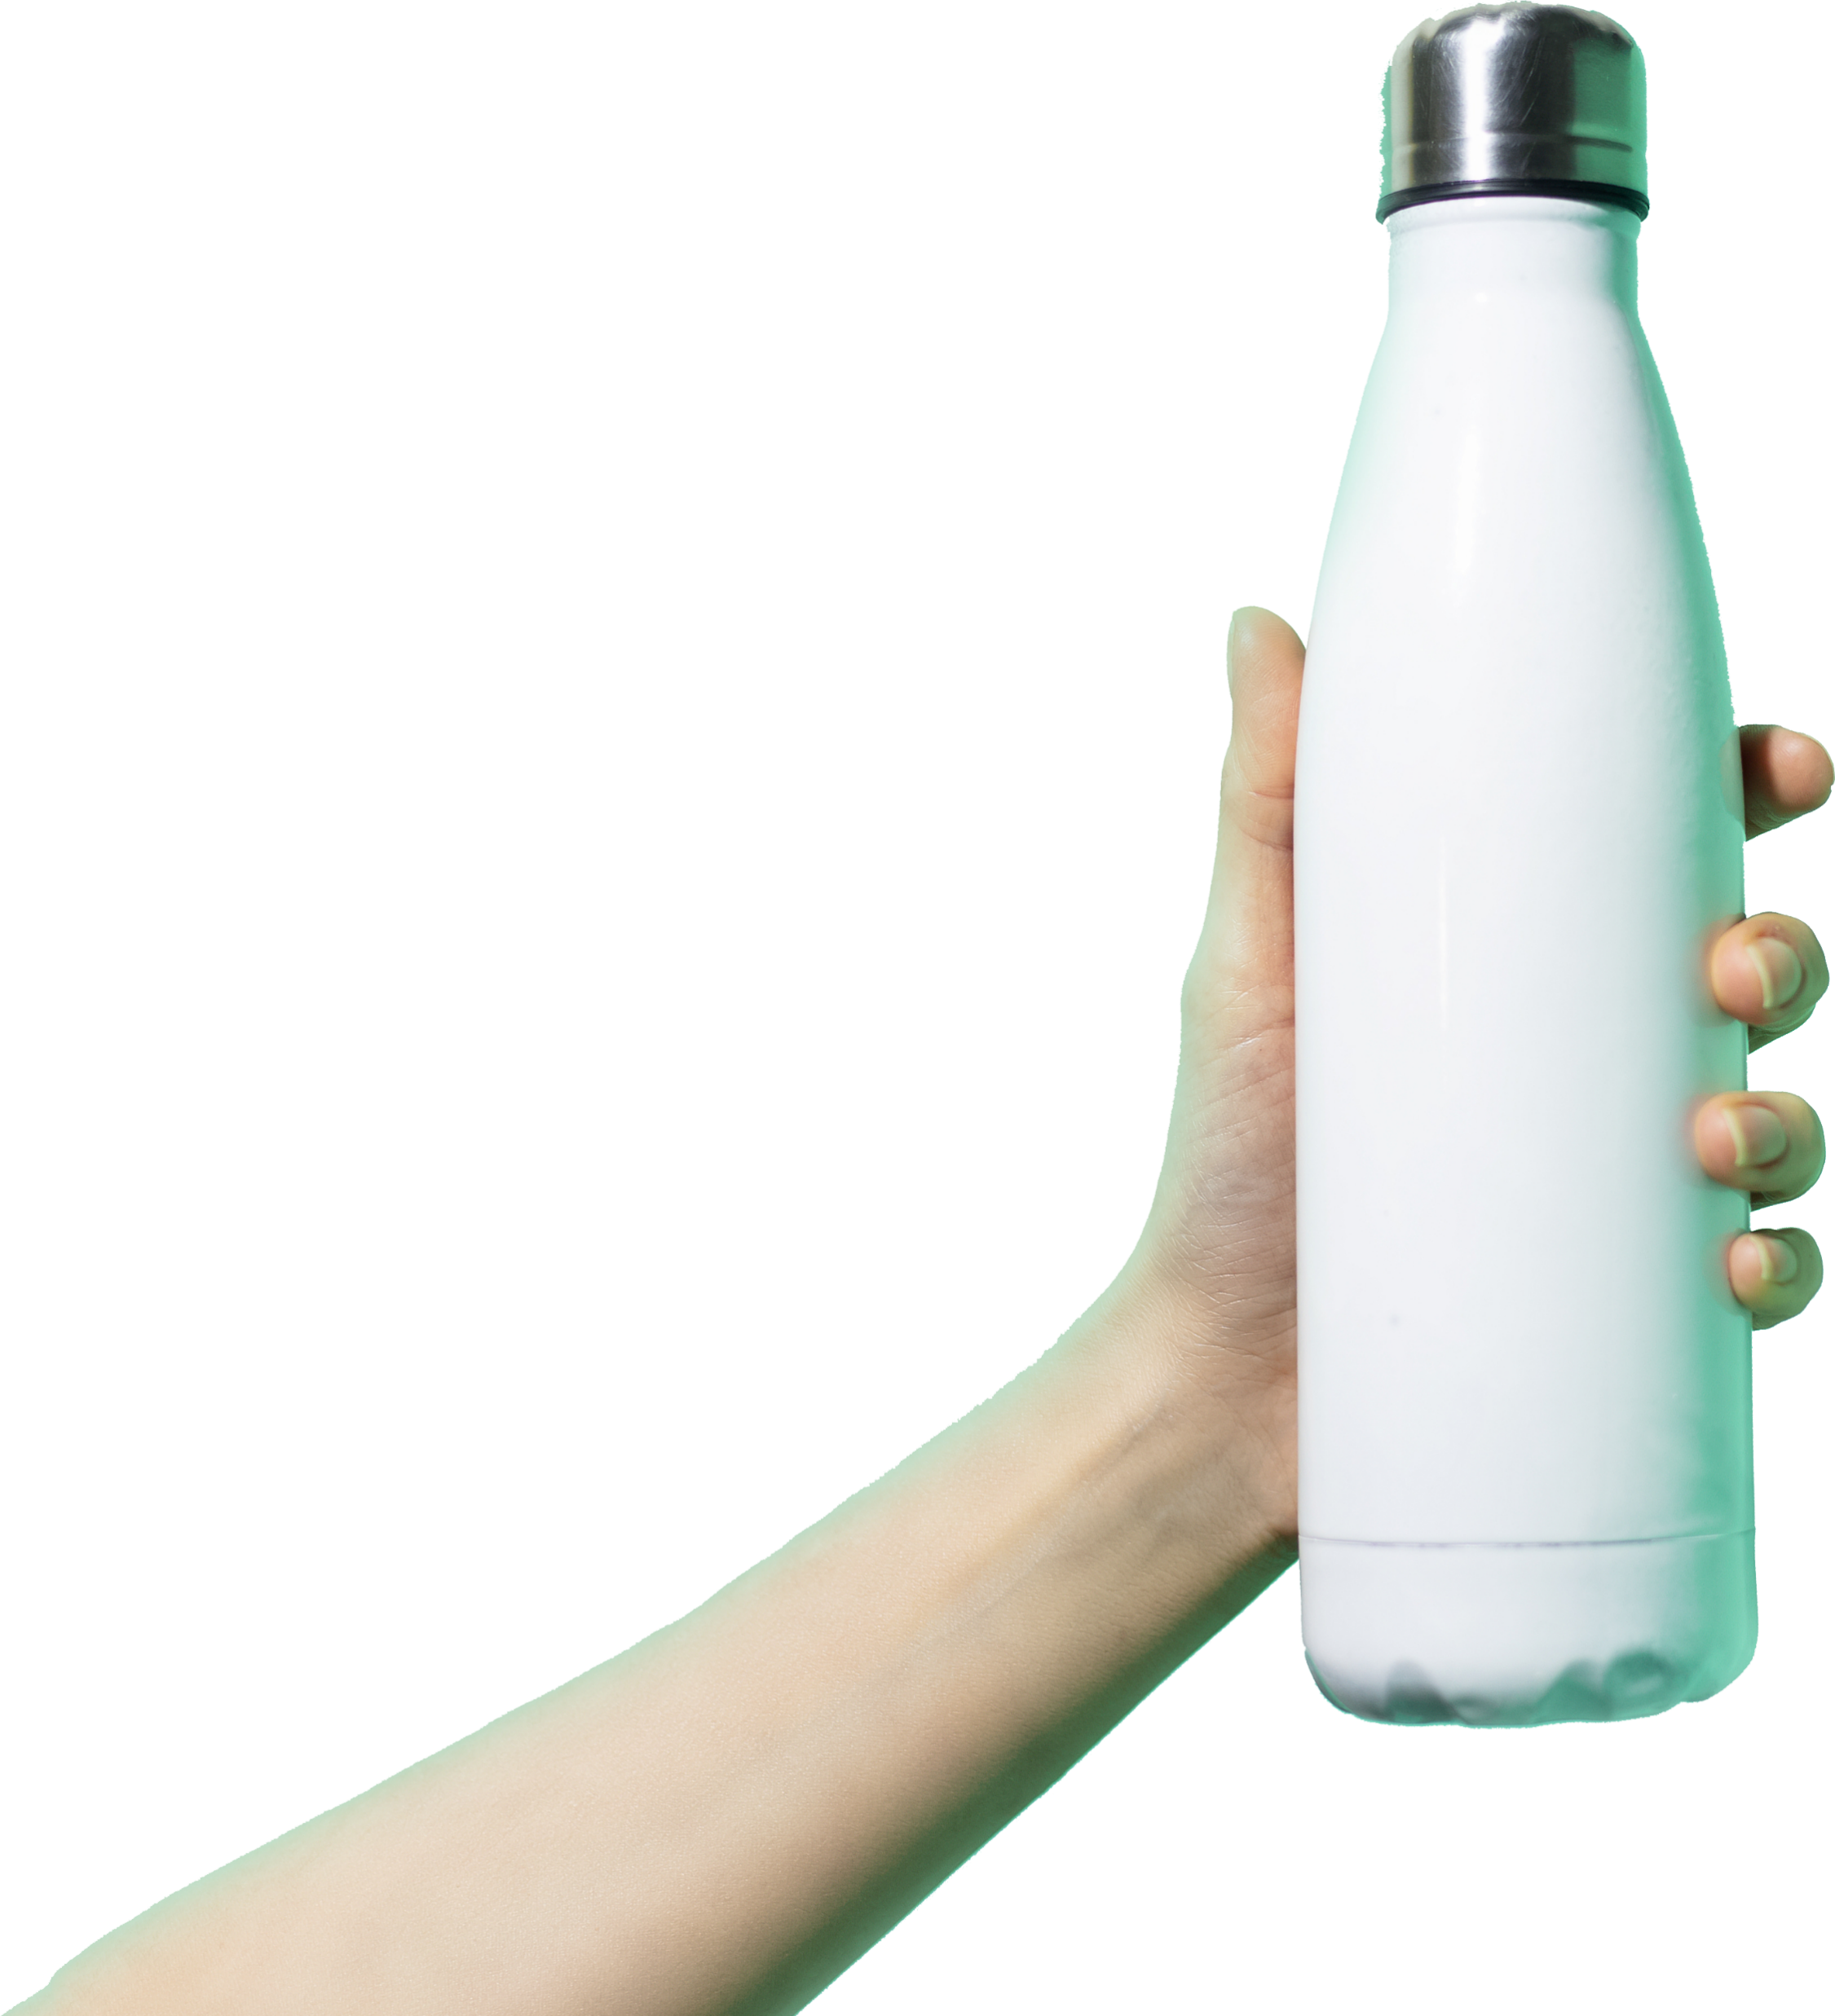
MEETS CONSUMERS’ NEEDS + EXPECTATIONS
FLAVOR + CHOICE
SUSTAINABLE
SOLUTION
Tracks and displays plastic bottles saved by user and facility
17,800-21,400
Choose from 6 unsweetened flavors, premium nano-filtered still and sparkling water
Select custom temperature, flavor intensity, and carbonation level
PROJECTED SINGLE-USE BOTTLES SAVED PER UNIT
9
9

Slide 10





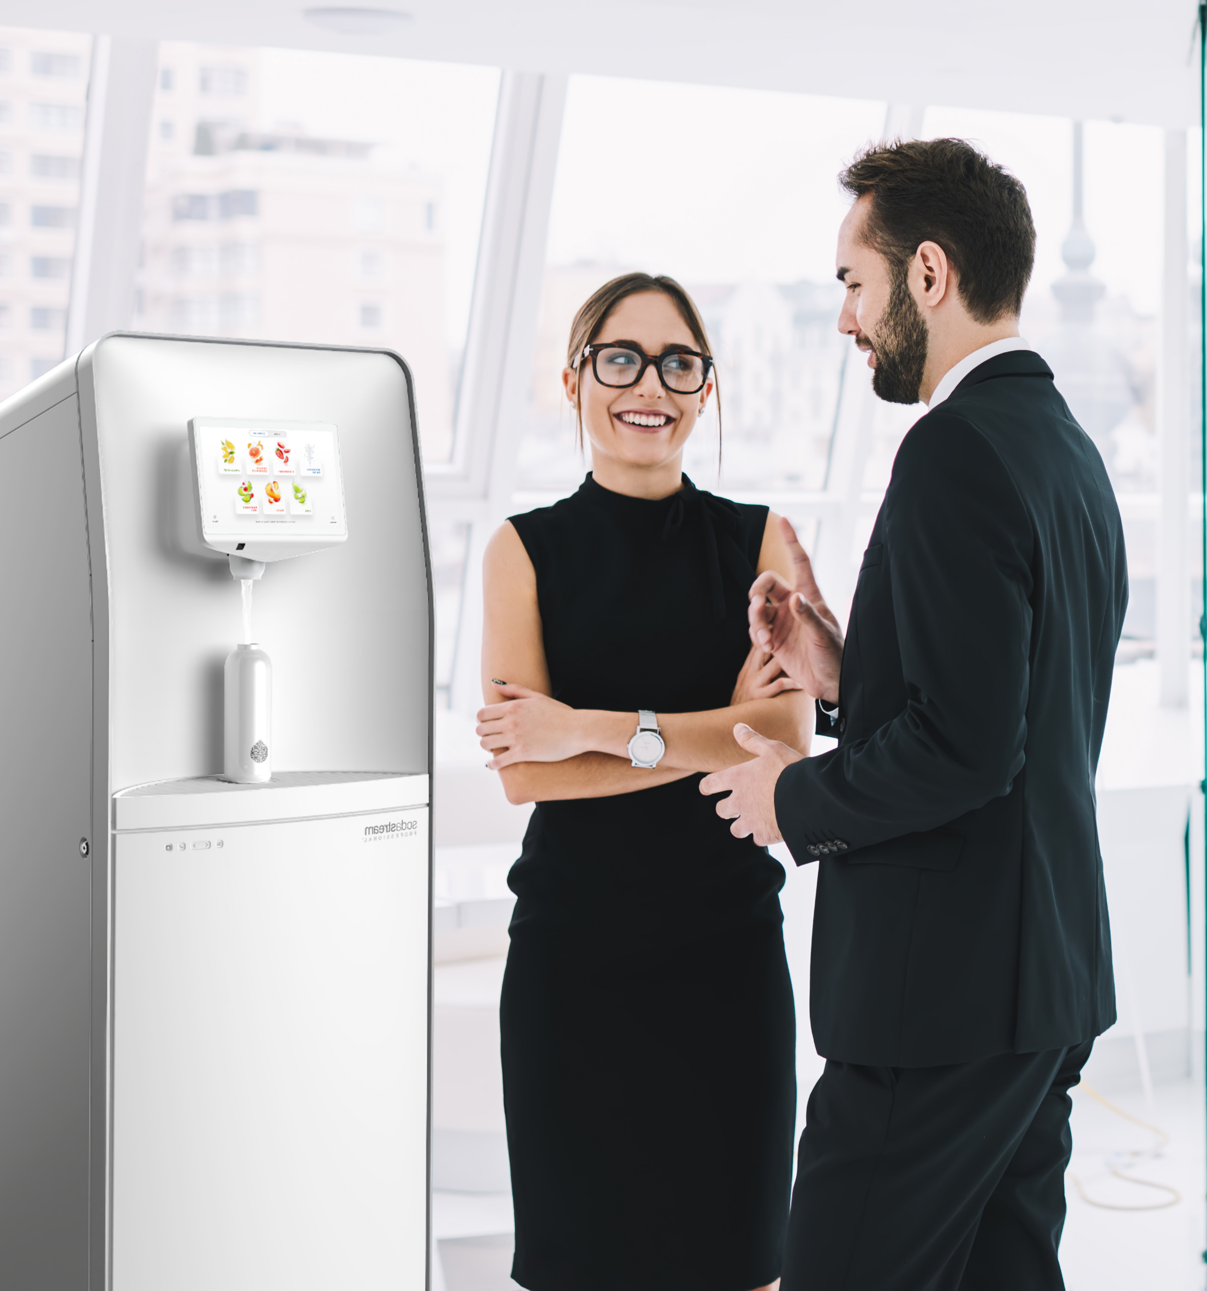
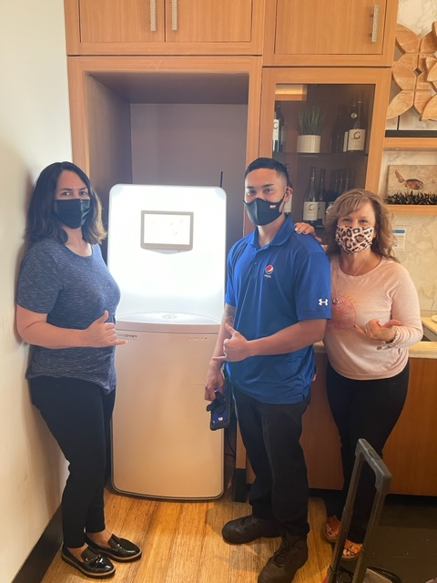


SIGN UP IS EASY:
Sign Agreement
Site Visit
Prep Completion
Go Live
Acct Set Up
Determine *Paid vs Free
Identify Distributor
Identify locations/units #
Confirm Prep
Waterline/Elect/cell
Marketing Discussion
Product Sourced 6 BIBs
Co2 Sourced
Water line/shut off valve
90 Min install
Staff Training
Schedule Portal Train
Schedule Site Visit
Order Equipment
Installation Scheduled
Sustainability Impact!
10

Slide 11
SODASTREAM PROFESSIONAL
For the full SodaStream Professional customer pitch, visit the link below.
FULL CUSTOMER PITCH

Slide 12
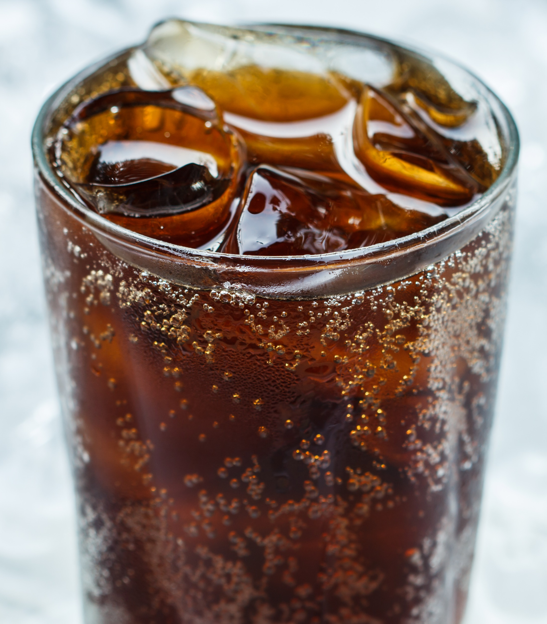
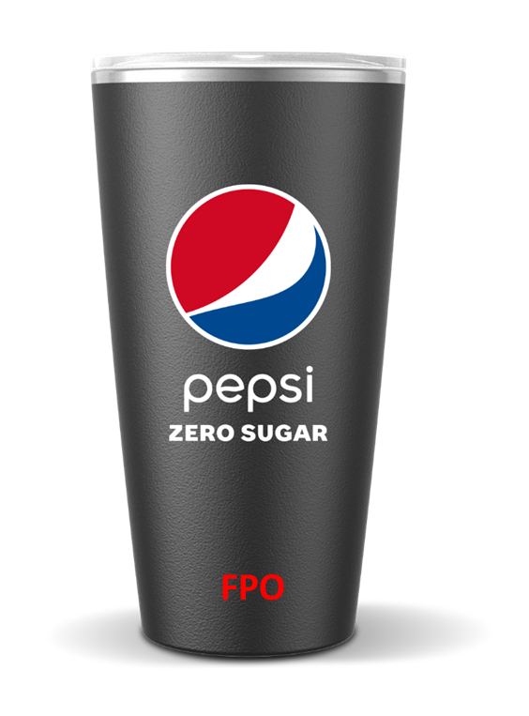
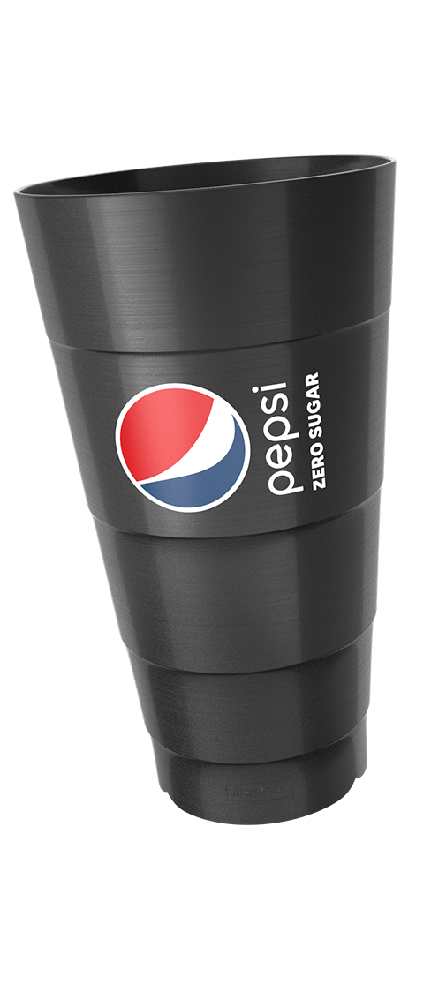
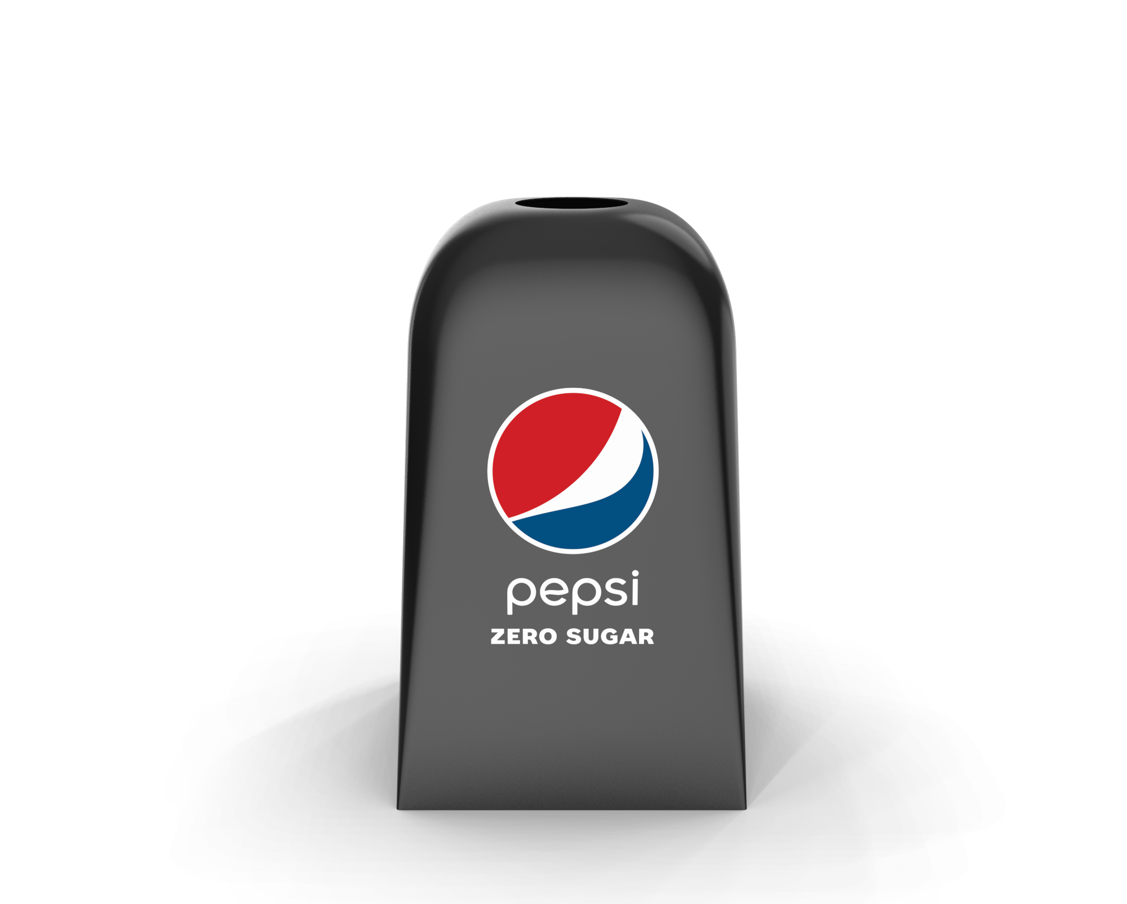
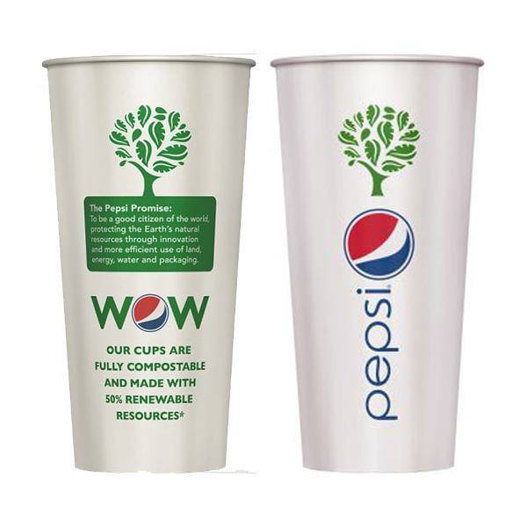
SUSTAINABLE CUPS
PepsiCo is seeking partnerships to jointly build and test any of the following models:
ONSITE REUSABLE
REUSABLE PERSONAL
REUSABLE CUP-SHARE
ECO-FRIENDLIER DISPOSABLE
Durable, dishwasher-safe cups (tumblers or glasses)
Stay onsite
Washed in house or by a third party
Consumers bring their own
OR consumers are given/sold a personal cup to use
Use is incentivized with discounts, rewards or points
Consumers “borrow” a reusable cup and return
Cups are professionally cleaned and re-used
Return is incentivized through deposits, penaltiess or gamification
PepsiCo currently offers an assortment of recyclable and compostable cups
Available on PepsiCo Partners or Pepsi Direct
Notes:
If a customer is interested in partnering, assist them in completing the Sustainable Cups Interest Form: PepsiCo Sustainable Cups Interest Form (office.com)

