Slide 1


Let’s partner today for a more sustainable tomorrow.
Introducing:

Slide 2

What is Partners for Tomorrow?

Slide 3
Partners for Tomorrow:
A robust portfolio of sustainability solutions for our partners designed to help meet shared sustainability goals.
AGRICULTURE
FOR TOMORROW
RECYCLING
FOR TOMORROW
LEARNING
FOR TOMORROW
PACKAGING
FOR TOMORROW
ENERGY
FOR TOMORROW

Slide 4
Partners for Tomorrow:
A robust portfolio of sustainability solutions for our partners designed to help meet shared sustainability goals.
AGRICULTURE
FOR TOMORROW
RECYCLING
FOR TOMORROW
sow+ Agriculture
CIRQU
LEARNING
FOR TOMORROW
PACKAGING
FOR TOMORROW
Recycling Bins
Recycle Rally
Sustainability Summit
SodaStream Professional
Sustainability Action Center
ENERGY
FOR TOMORROW
Sustainable Cups
pep+ REnew

Slide 5
Partners for Tomorrow:
A robust portfolio of sustainability solutions for our partners designed to help meet shared sustainability goals.
AGRICULTURE
FOR TOMORROW
RECYCLING
FOR TOMORROW
LEARNING
FOR TOMORROW
PACKAGING
FOR TOMORROW
ENERGY
FOR TOMORROW

Slide 6
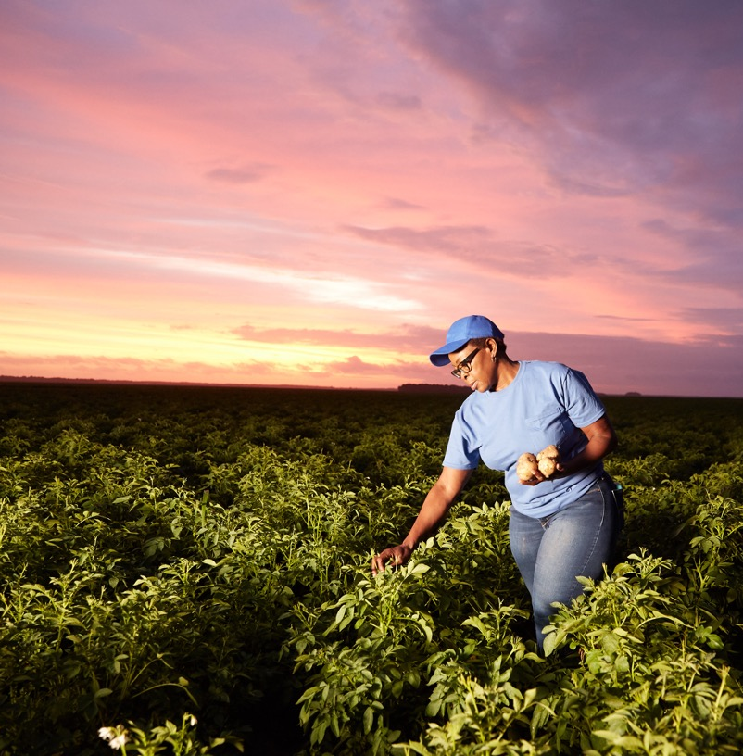
sow+ AGRICULTURE
We’re making investments today
for sustainable
farms tomorrow.
Agriculture typically accounts for a large percentage of greenhouse gas and carbon emissions and is often the #1 opportunity for climate impact.
Let’s sow seeds together.

Slide 7

sow+ AGRICULTURE: BENEFITS
sow+ (Sow Positive) Agriculture converts agricultural land to regenerative practices with direct investments – allowing our partners to easily make joint claims about progress.
Reduces carbon emissions
Participating customers may receive full credit for scope 3 carbon emissions throughout supply chain.
Lifts farming communities
Boosts economic vitality and self sufficiency
of farming communities.
Helps increase farmers’ resilience to climate change
Therefore, increasing our businesses’
resilience to climate change as well.

Slide 8
sow+ AGRICULTURE: REGENERATIVE PRACTICES
Cover Cropping
A cover crop is a close-growing non-commodity crop that provides a surface cover of main crops during fallow periods. It provides seeding protection and soil protection and improvement. After termination, residues from cover crops continue to protect the soil from erosion. Some examples are legumes, grasses, turnips, and radishes.
Through partnerships with local experts in our operating regions, we can incentivize farmers to adopt new, more sustainable practices that not only reduce gradual degradation of the land but actually improve it – hence the term “regenerative.”
Crop Rotation
Crop rotation is a system of growing different kinds of crops on
the same land in which two or more crops are grown one after
the other. This technique can break disease cycles, reduce crop protection agents used and promote soil diversity.
Conservation Tillage
Conservation tillage is a tillage system that potentially conserves soil, water, and energy resources mainly through the reduction in the intensity of tillage, and retention of plant residues. It can include no till, low/reduced tillage, and strip tillage.
Agroforestry
Agroforestry is a collective name for land-use systems and technologies where woody perennials (trees, shrubs, palms, bamboos, etc.) are deliberately used on the same land-management area as agricultural crops and/or animals.

Slide 9
sow+ AGRICULTURE: LET’S SCALE IMPACT TOGETHER
Example Project & Carbon Beneficiaries
PepsiCo has already done much of the legwork and set up multiple regenerative agriculture programs across the United States.
We’ve cultivated relationships with implementors who farmers trust, and we know the programs work. To scale impact, farmers need support.
To claim up to 100% of the carbon benefit, our partners only need to make a financial investment.
PROJECT:
Red River Valley Sugar Beet Pilot
LOCATION:
Red River Valley (Northern MN and ND)
IMPLEMENTER:
Soil and Water Outcome Fund (SWOF)
Buyer*
(PepsiCo)
Claims 50% of carbon benefit
Farmer
Claims 100% of carbon benefit
Supplier
Claims 100% of carbon benefit
Retailer*
Claims 100% of carbon benefit
Buyer*
Claims 50% of carbon benefit
*Buyers and retailers split program costs three ways
Notes:
If customer is interested, connect them with Margaret Henry to discuss specific opportunities and options: Margaret.Henry@pepsico.com

