Slide 1



Slide 2
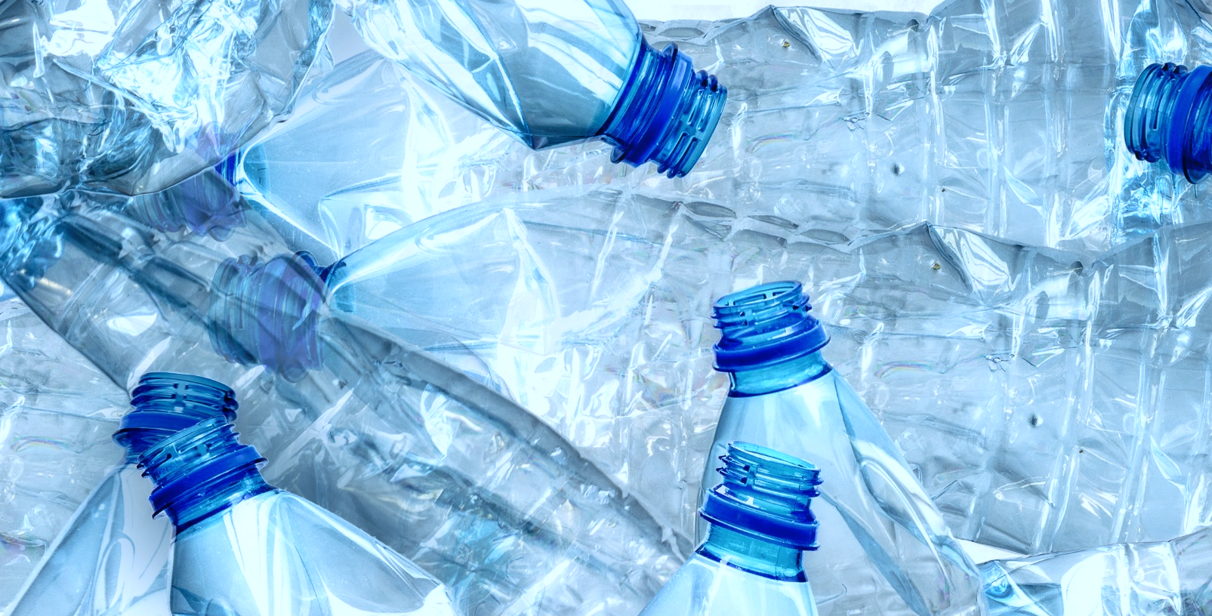
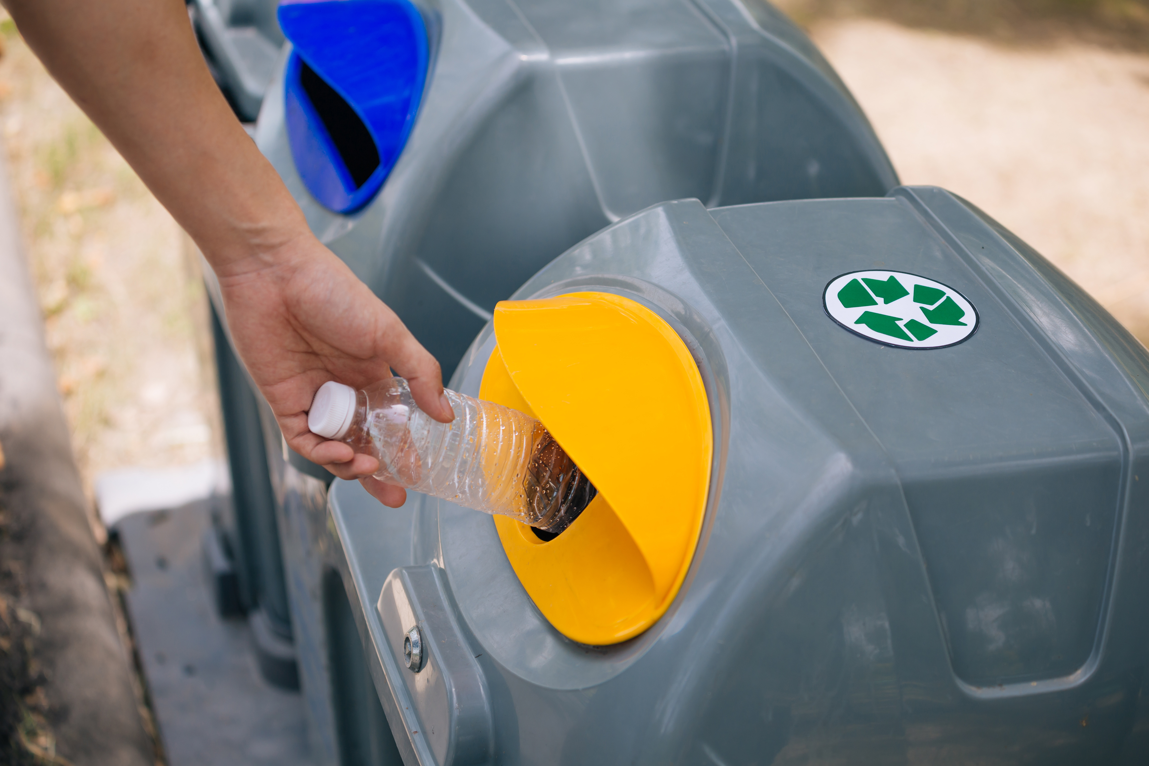



JOIN US IN BUILDING CIRCULARITY FOR OUR PACKAGING
RECYCLING TODAY
RECYCLING GETS SMART
INSERT CUSTOMER LOGO
INSERT CUSTOMER LOGO
BOTTLES BECOME BOTTLES AGAIN… AND AGAIN!
LANDFILL
TRADITIONAL RECYCLING HAULING
+ IT'S FREE TO PARTICIPATE!
Notes:
VO: PepsiCo is committed to building circularity for our packaging. With Replenysh's help, we collect plastic and aluminum from customers like you to work these materials back into our supply chain.

Slide 3
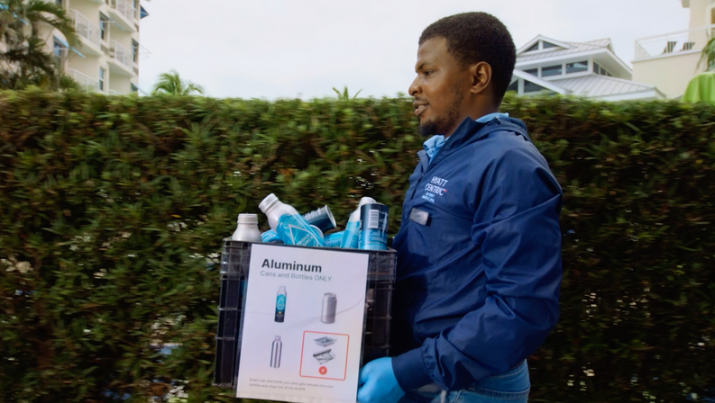
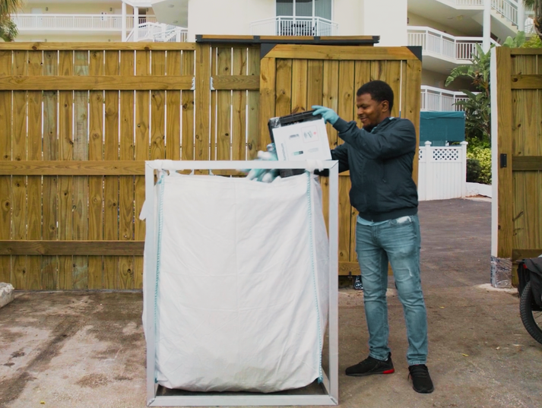
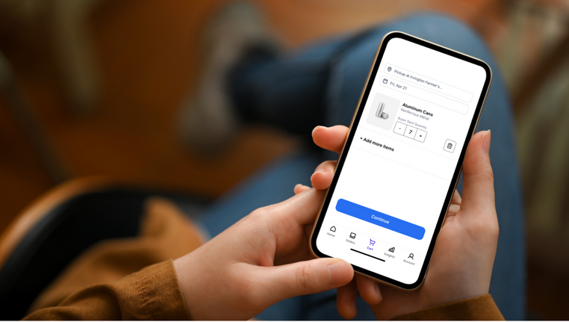

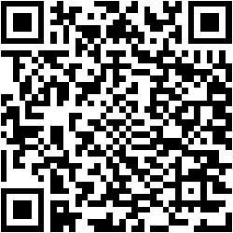

HOW IT WORKS
Collect Material
Sort & Store
Request Pickup
Share Impact
Collect recyclable materials from customers across the property.
We provide super sacks to store your plastic and aluminum.
A local operator will swap your full super sack for an empty one; recurring pickups available.
Your customized impact report is updated in real time and ready to share with the world.
Notes:
We do all the heavy lifting so that you can get started quickly and effortlessly. Best of all, it’s entirely free.

Slide 4




THERE ARE MANY BENEFITS TO PARTICIPATING
1
2
3
4
Showcase your commitment to Sustainability
Traceable Verification
Free and Easy to Join
Financial Advantages
Opportunities to engage employees, partners, and broader community or charitable organizations in your efforts.
Trust that your material is being recycled and get shareable impact reports to publicly demonstrate your commitment to sustainability.
Free supplies, training, and support make it easy to get started and involve your team!
Potentially reduce your waste service fees, and if enough material is collected, you may receive earnings for you to keep or donate!

Slide 5
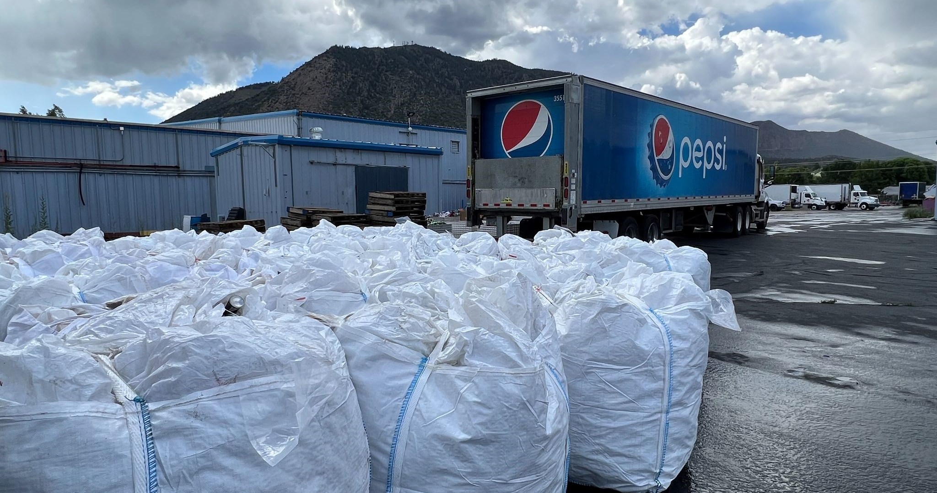
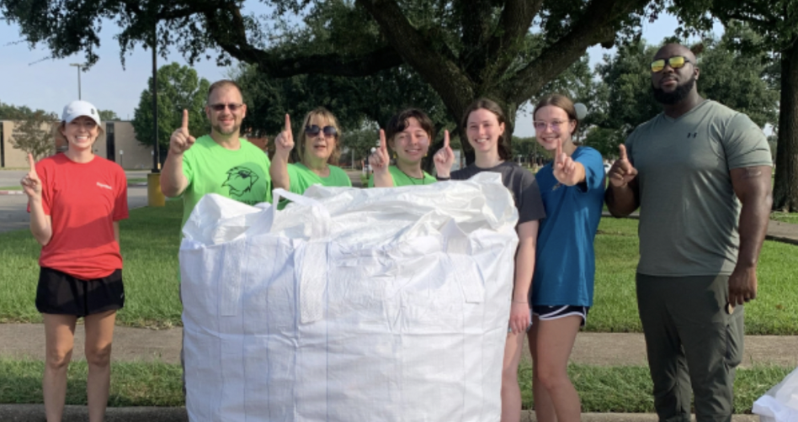
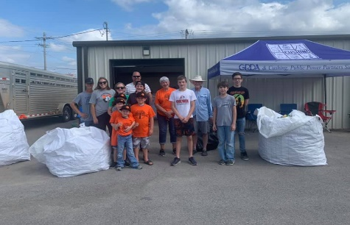
WE’VE ALREADY SEEN GREAT SUCCESS
RESORT
NATIONAL PARK
COLLEGE/UNI
COMMUNITY
Copper Mountain Ski Resort, CO
Grand Canyon National Park, AZ
Lamar University, TX
Bristow, OK
The resort’s sustainability efforts were undermined by the low recycling rate and lack of transparency from its single-stream recycling service.
The park’s remote location made it difficult to offer recycling to guests.
Lamar University desired an easy, cost-effective recycling solution.
All waste in Bristow, OK was landfilled until a few dedicated residents demanded change.
A local Pepsi bottler helped unlock the opportunity by backhauling supersacks for pickup by a CIRQU operator.
The university used CIRQU tools to start recycling and donated their material earnings to local charities.
The implementation of CIRQU became a prime example for other OK cities to follow.
CIRQU not only made closed-loop recycling possible, but also built unprecedented employee engagement.
9,000+ lbs. recycled in just 6 months
$30,000/year savings from waste expense
20,758 lbs. collected and kept out of landfill
350,000 lbs. recycled since May 2022
4,250+ lbs. recycled in the first 4 months of launch

Slide 6
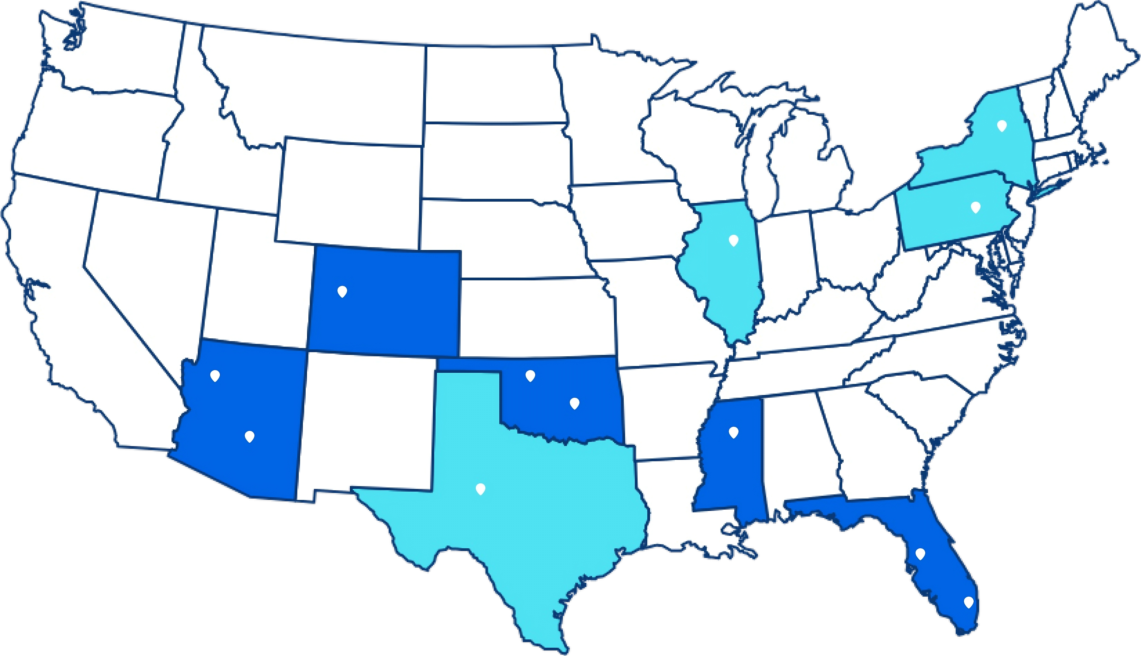
CIRQU IS LIVE IN MULTIPLE MARKETS AND CONTINUES TO GROW
WHERE WE ARE TODAY
Launch in days
Denver, CO
Miami, Tampa, and Orlando, FL
Tulsa and Oklahoma City, OK
Phoenix and Flagstaff, AZ
Jackson, MS
WHERE WE’RE GOING
Dallas and Houston, TX
Jacksonville, FL
St. Louis, MO
Kansas City, MO
Philadelphia, PA
Albany, NY
Chicago, IL
We can activate any eligible location if it meets the minimum volume requirement (see next slide)
VIEW THE LATEST MAP

Slide 7
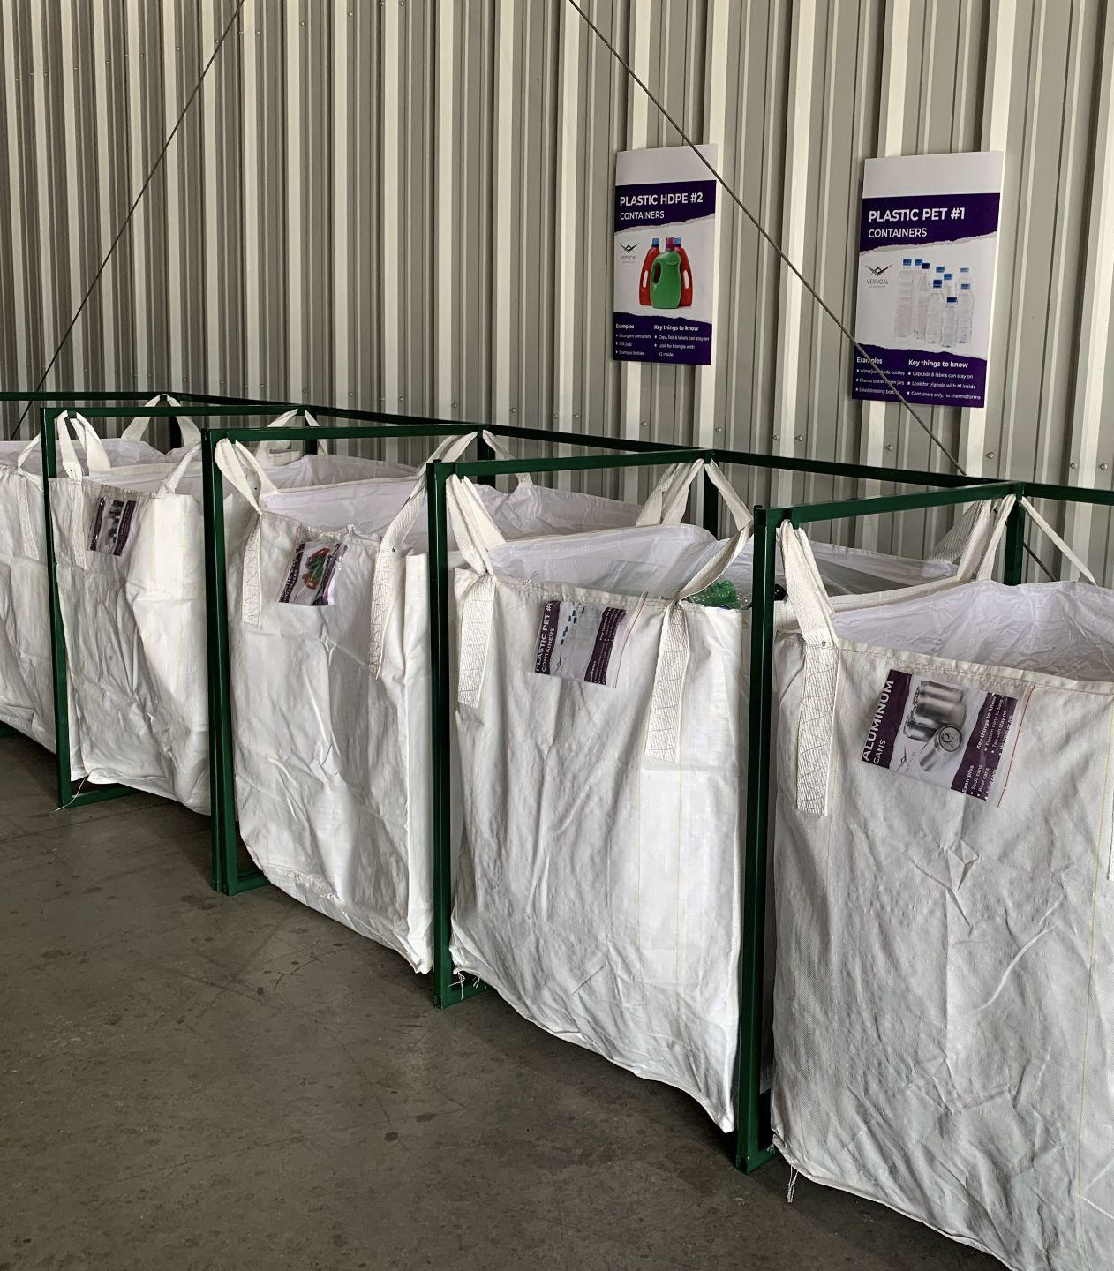
BECOME A CIRQU PARTNER
1
Check your eligibility
Located in existing CIRQU market area OR location(s) within 15-mile radius produce 12,000lbs / month plastic (PET) bottles and/or aluminum cans (360,000 containers / month)
Ensure storage space for material – super sacks measure 3´x3´x5´
Complete an introductory call and on-site activation
Ensure materials can be separated by type and moved to designated super sack(s)
Download app to schedule collections
Collect materials, request your first pickup, and see your impact!
FILL OUT OUR ONLINE QUESTIONNAIRE
2
3
Questions? Contact: support@replenysh.com

Slide 8
APPENDIX

Slide 9
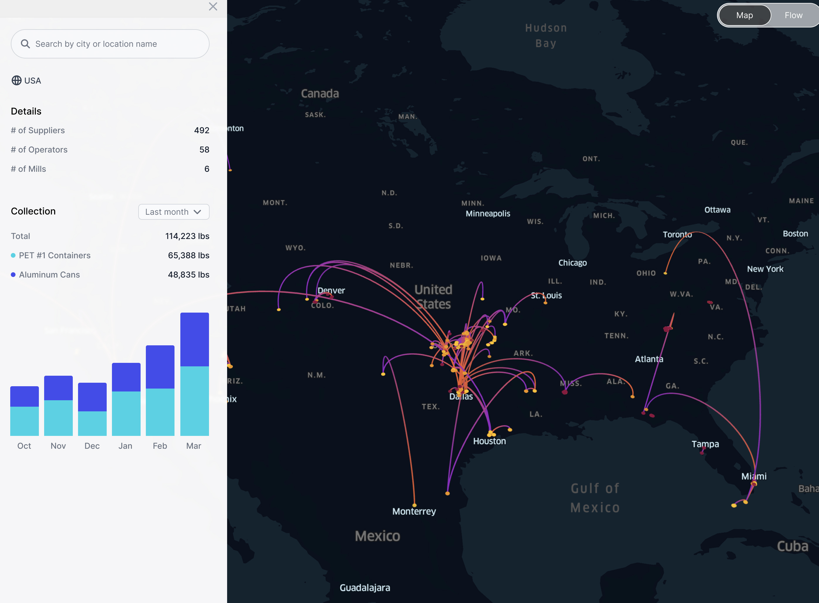
TECHNOLOGY UNLOCKS TRACEABILITY
COMING SOON
Follow your recyclables to our partnering processors and PepsiCo manufacturers.
Notes:
VO: CIRQU is the world’s first and only closed-loop recycling program with end-to-end material traceability.

Slide 10
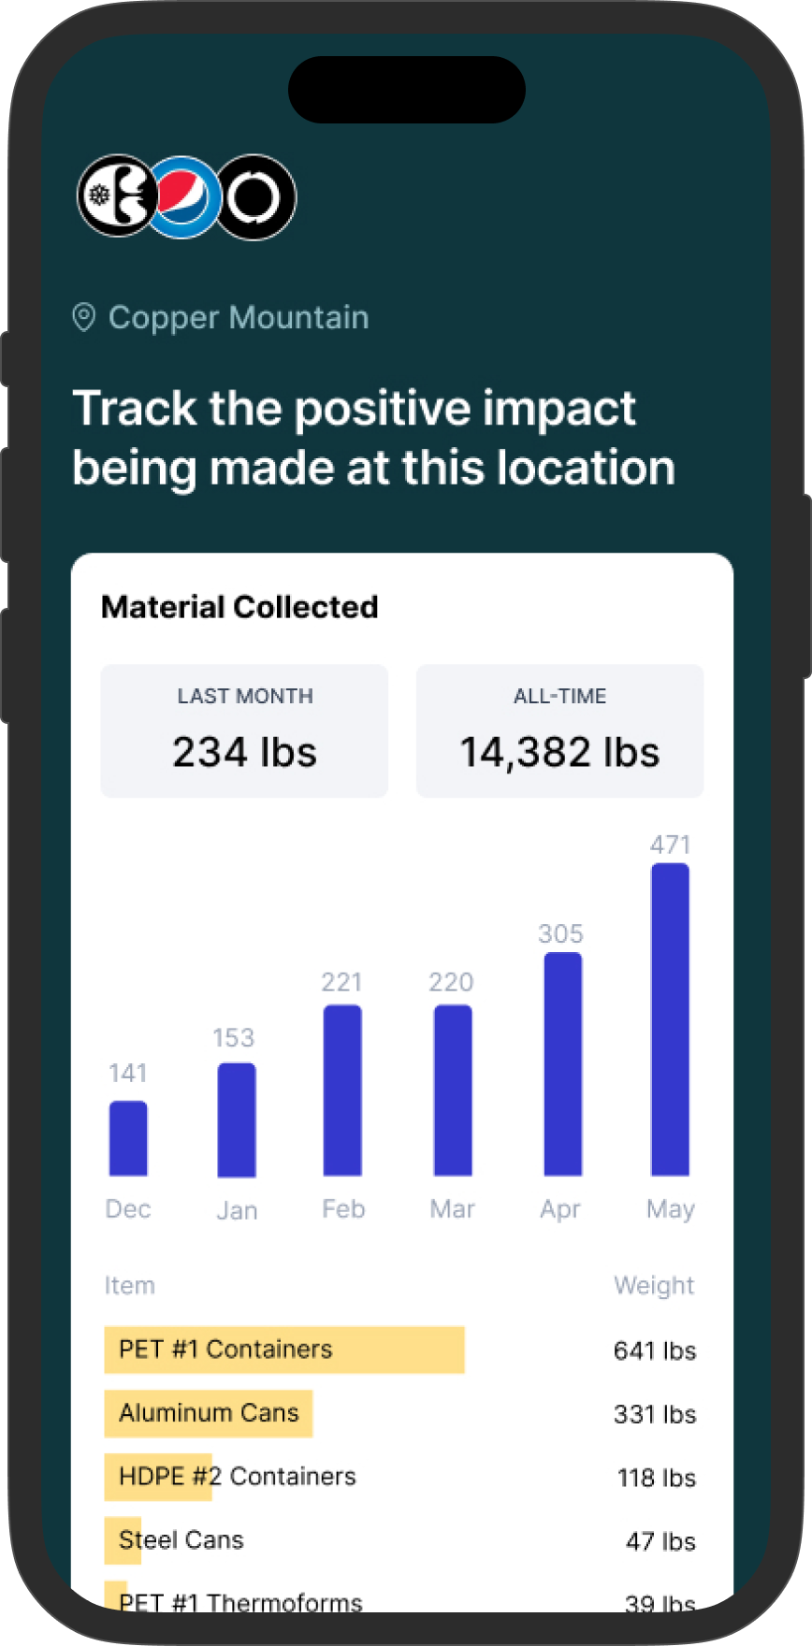
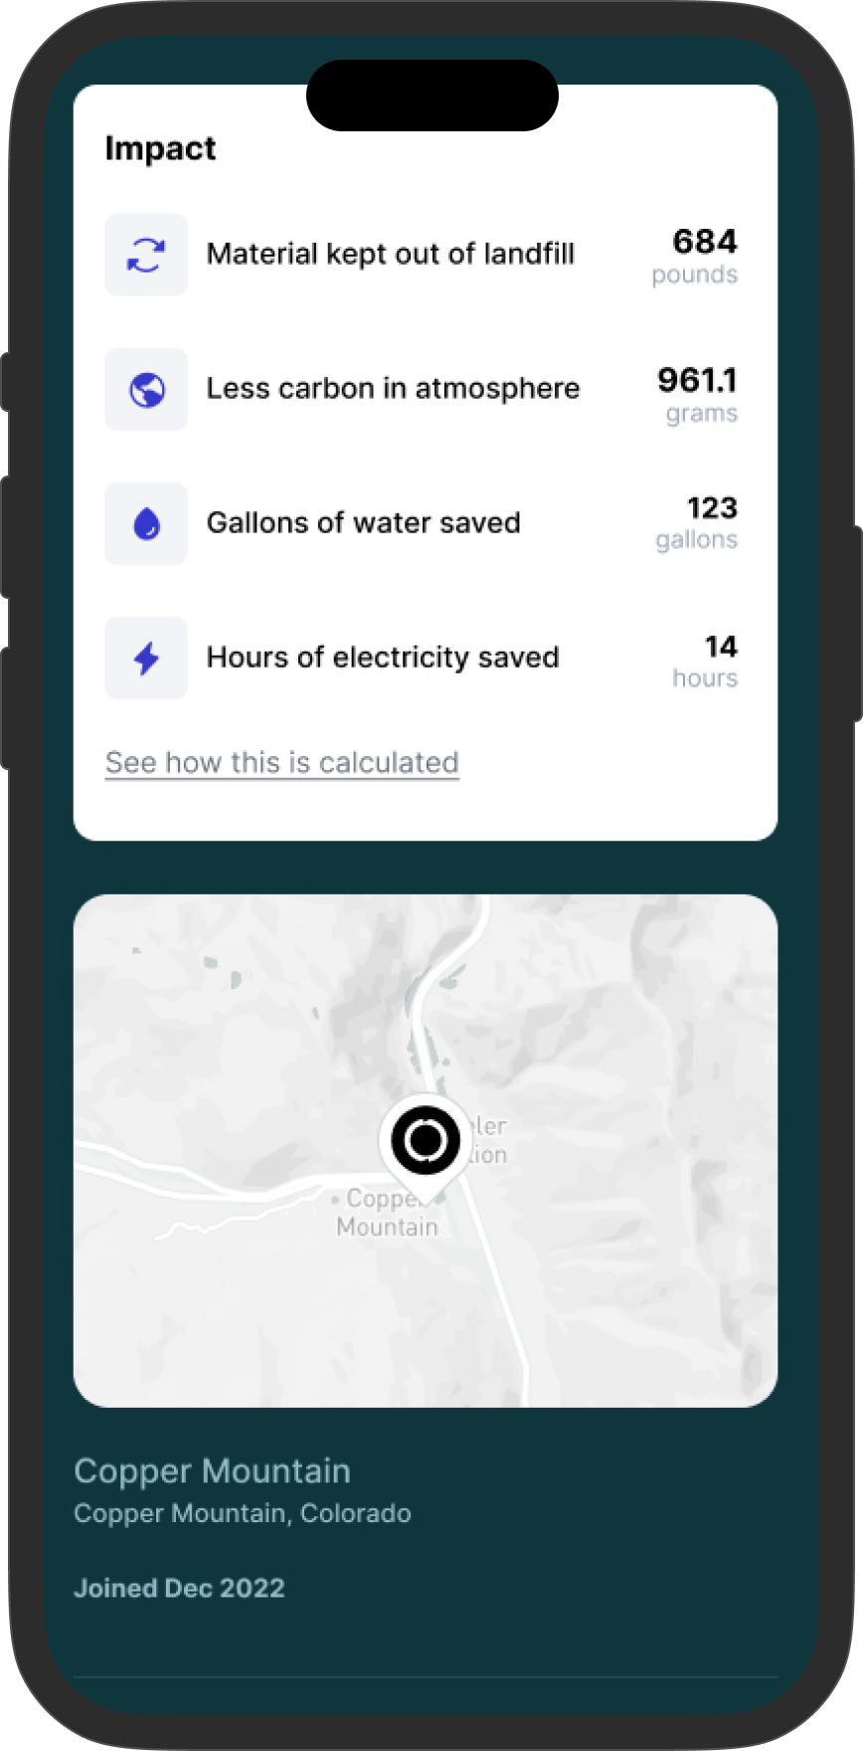
CUSTOM IMPACT REPORT

Slide 11
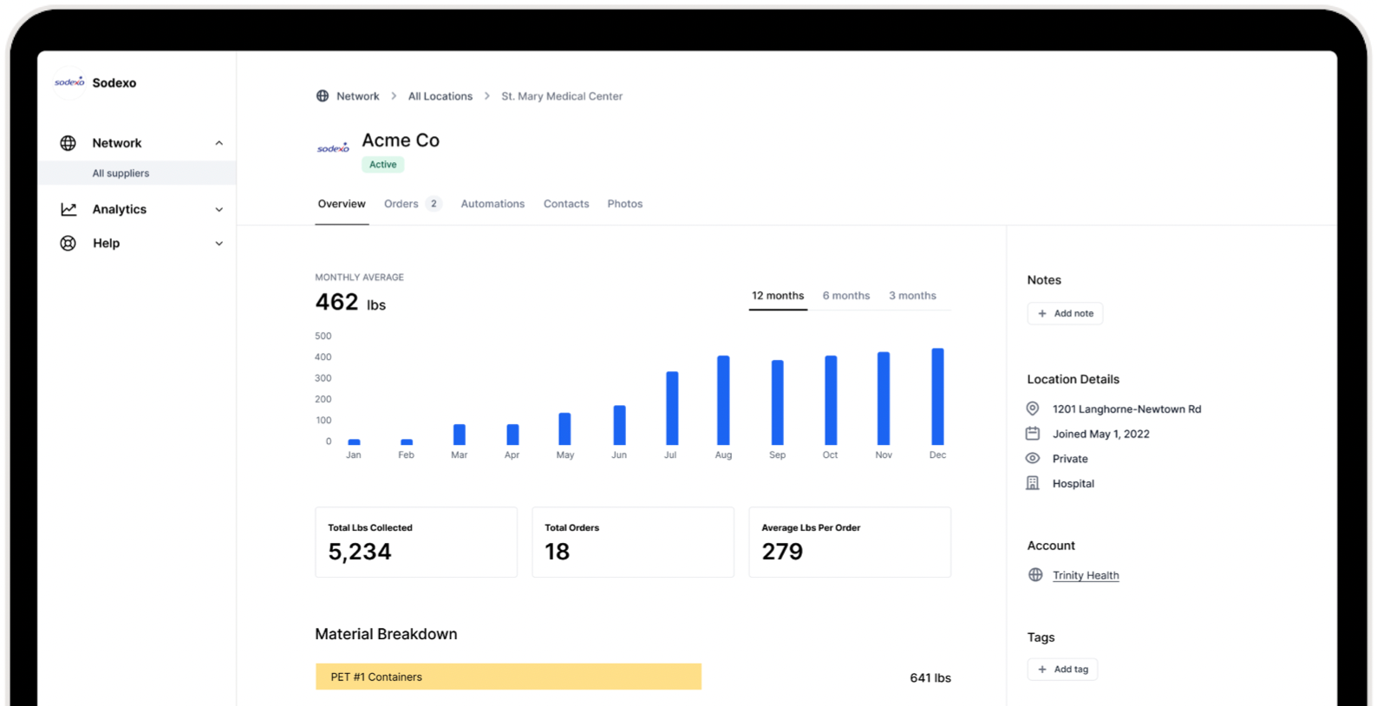
DASHBOARD ACCESS & REPORTS FOR MULTIPLE LOCATIONS

